Slide 1
The Mechanical Engineering & Technology (MET)
Senad Kudumovic
www.europeanspallationsource.se
31 January, 2018

Slide 2
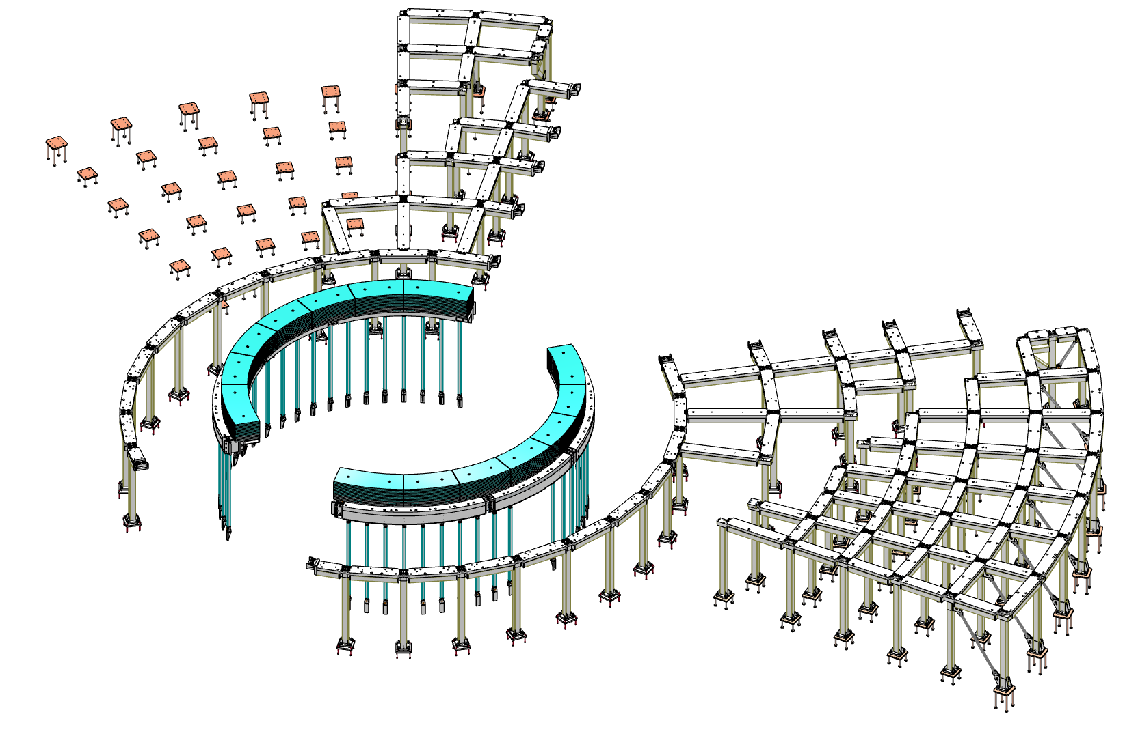
Bunker Frame
Performing conceptual, detail design and drawings
Preparing specifications and reports
Performing FEA and hand calculations
Preparing installation procedure reports
Handling interfaces with CF and Target Division

Slide 3
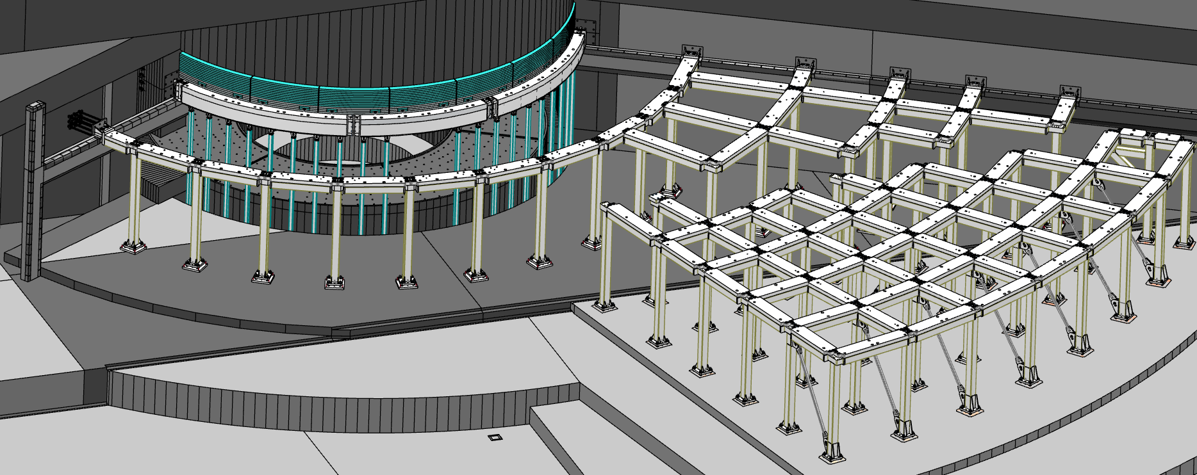
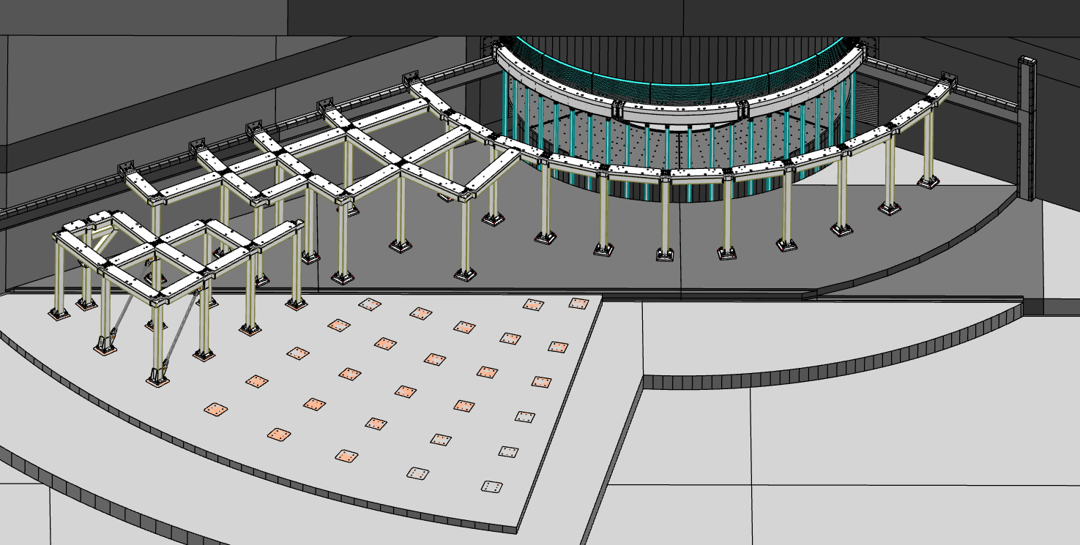
Support Frame
Design considerations:
Support bunker roof load of ~6.6 t/m2
Support additional 3.3 t/m2 for removed roof block placement during maintenance
Prevent roof blocks impacting monolith during
an H4 seismic event
Provide minimal spatial constraints for beamlines & equipment
All elements to be removable as needed during maintenance
R6m Frame
Target building frame
Instrument hall frame
North and West sector
South and East sector

Slide 4
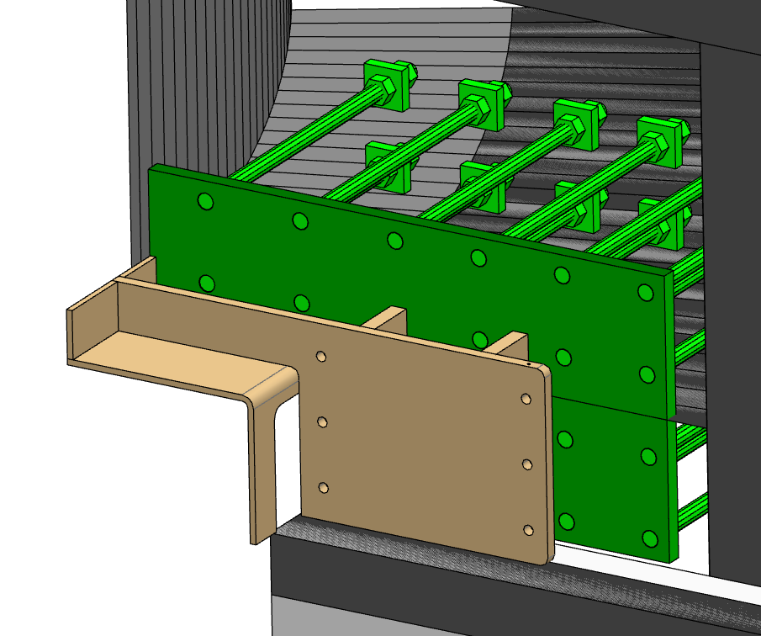
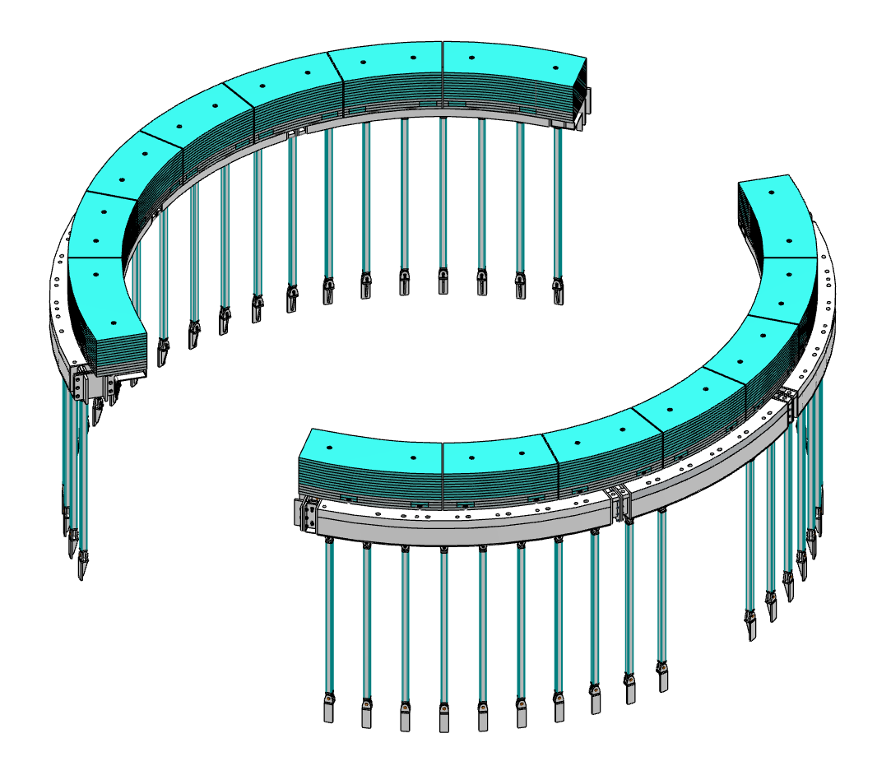
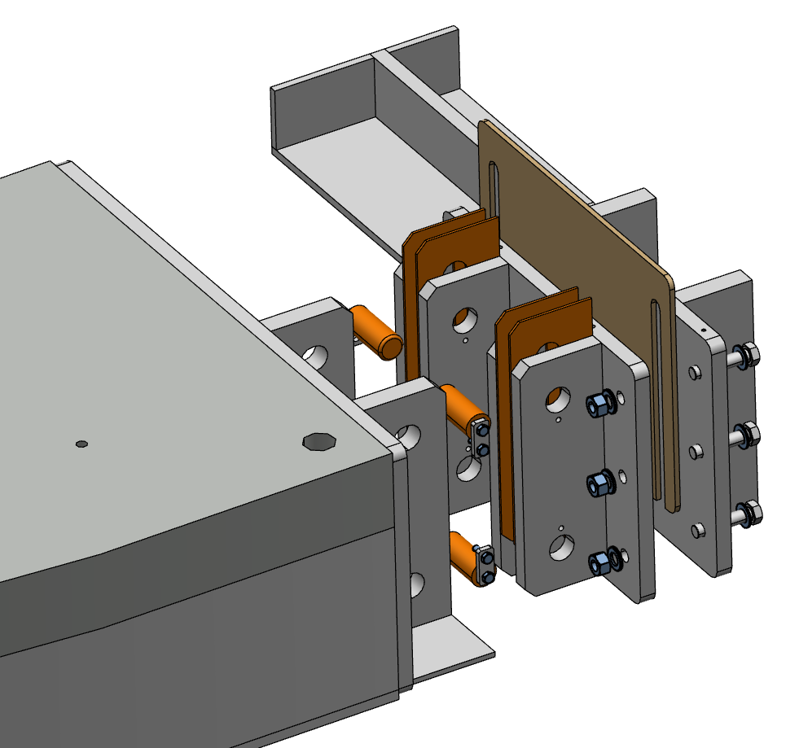
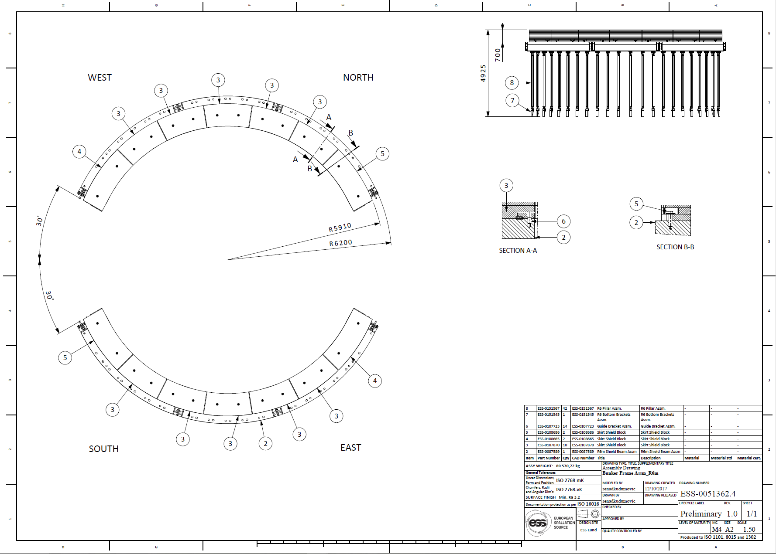
Support Frame-R6m
R6m Frame-Columns attached to large radial box beam.
Wall Brackets
Connection Flanges
R6m Box Beam
Support Pillars and Brackets
Skirt Shield Blocks

Slide 5
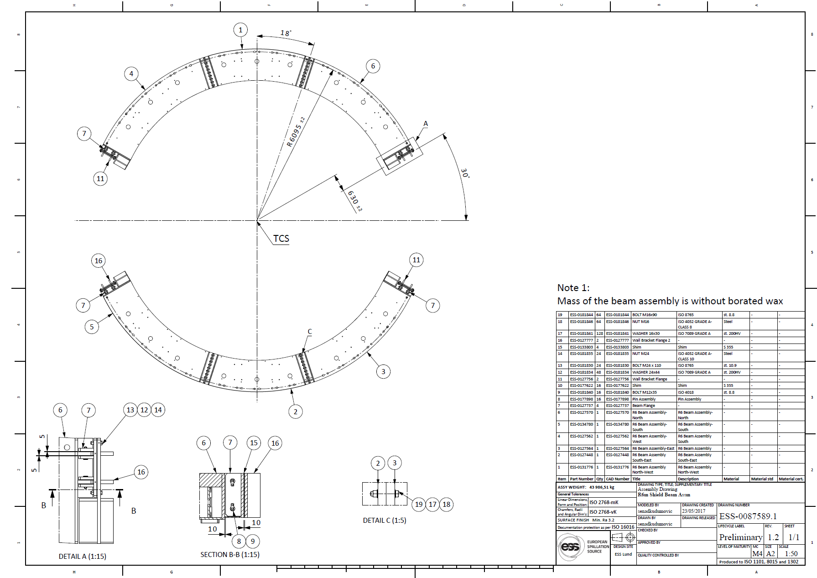
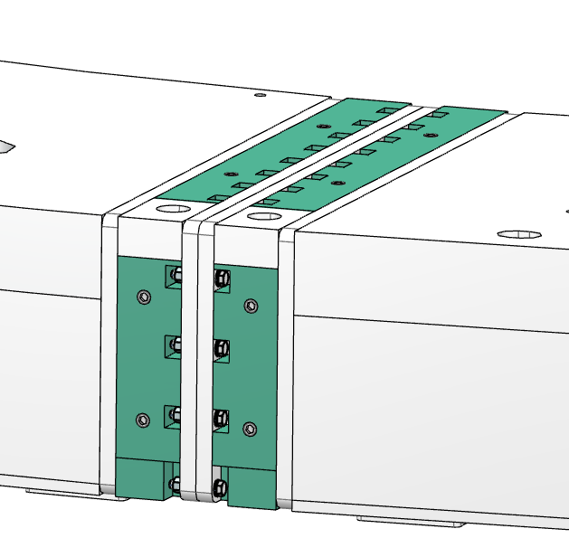
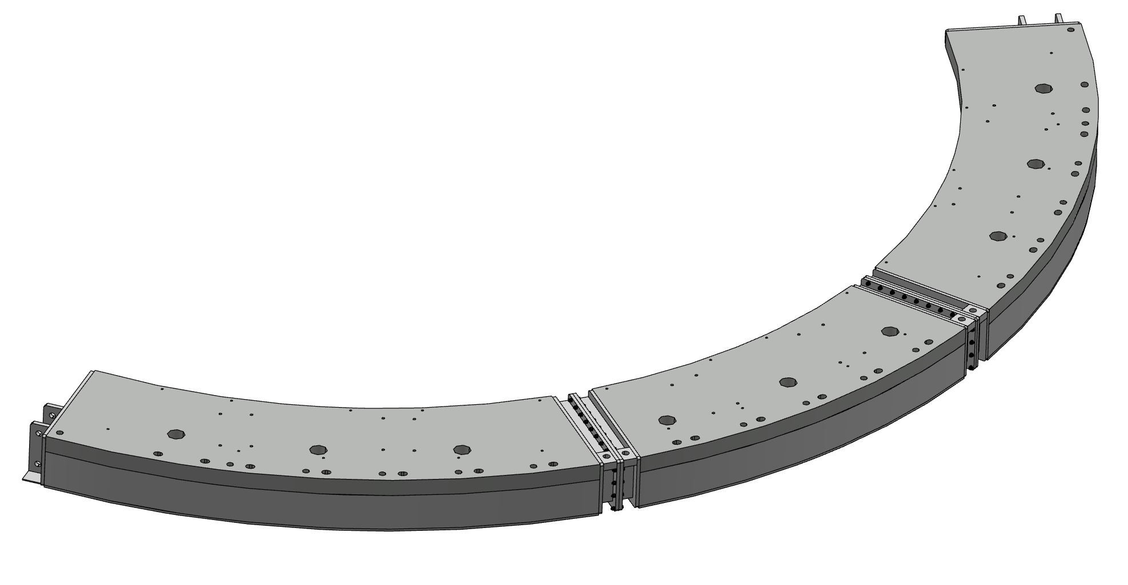
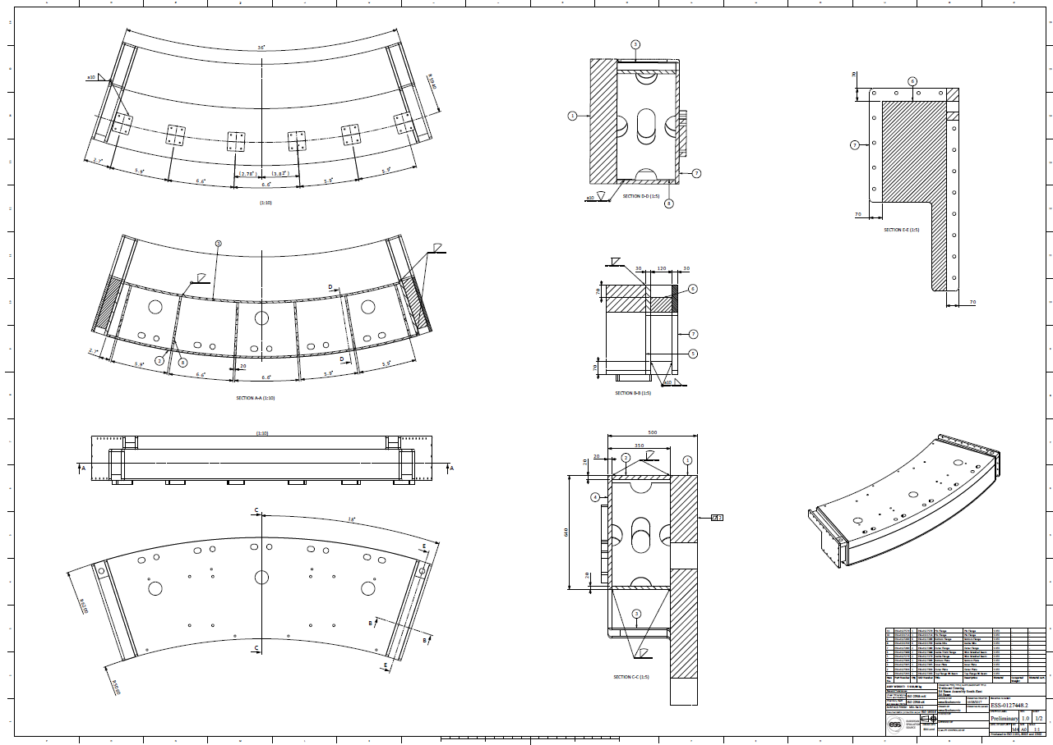
R6 Beam
R6 BEAM:
Made from 3 separate beams for manufacturing and installation reasons.
Filled with grinded HDPE pellets
- Each beam has several different cutouts and threaded holes on top of the thick plate and holes on side flanges.
Ø150 mm holes for filling with grinded HDPE pellets
Ø60 mm holes for pin connection with roof blocks
M24 threaded holes for fixing skirt shield blocks
M30 threaded holes for lifting tool
16 x Ø18 for bolt connections on side flanges
ESS-0087589
ESS-00127448

Slide 6
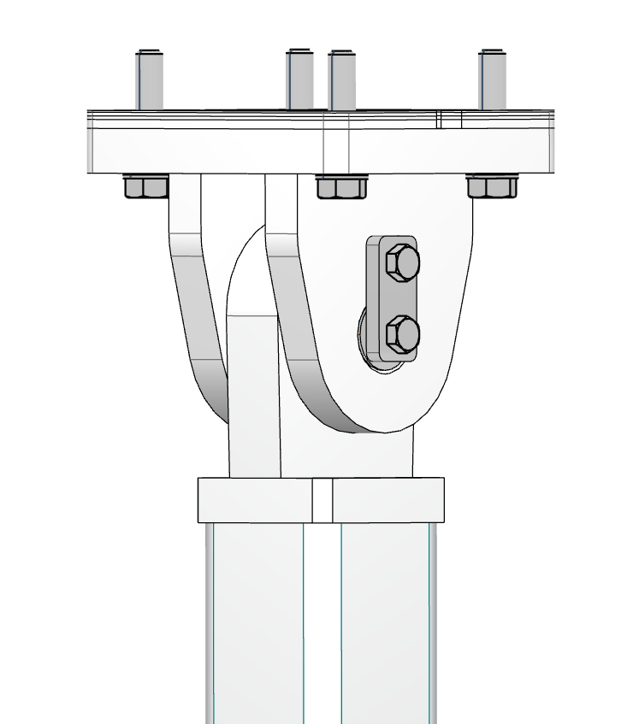
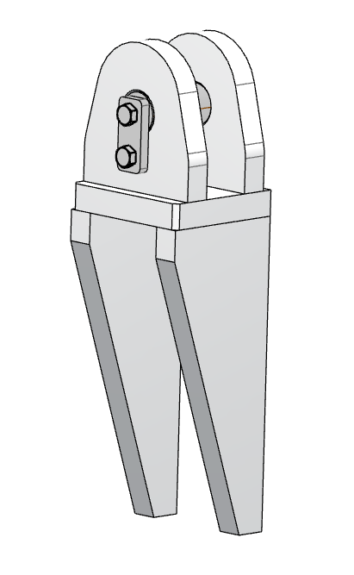
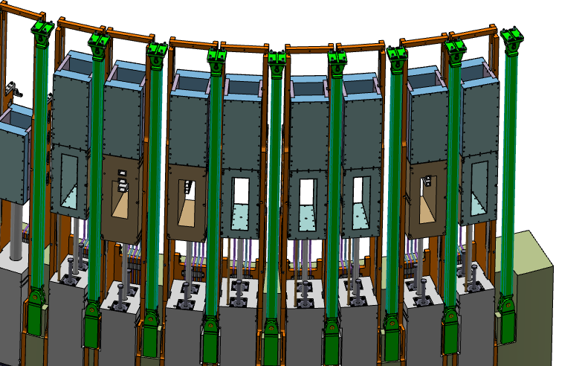
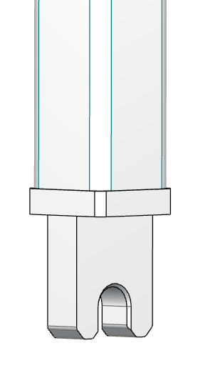
Support Pillars and Top Bracket
The baseline concept is to weld the lower angle brackets to the CF structure during installation. Lower and upper bracket will be hinged. This hinge joint caters for a much larger possible misalignment since pillar position need to be vertical after installation.
Lower hinge connection contain open hole on pillar plate due to lack of space for pin installation, while the upper hinge has standard pin connection
Shims
Top bracket
Pin
Support Pillar

Slide 7
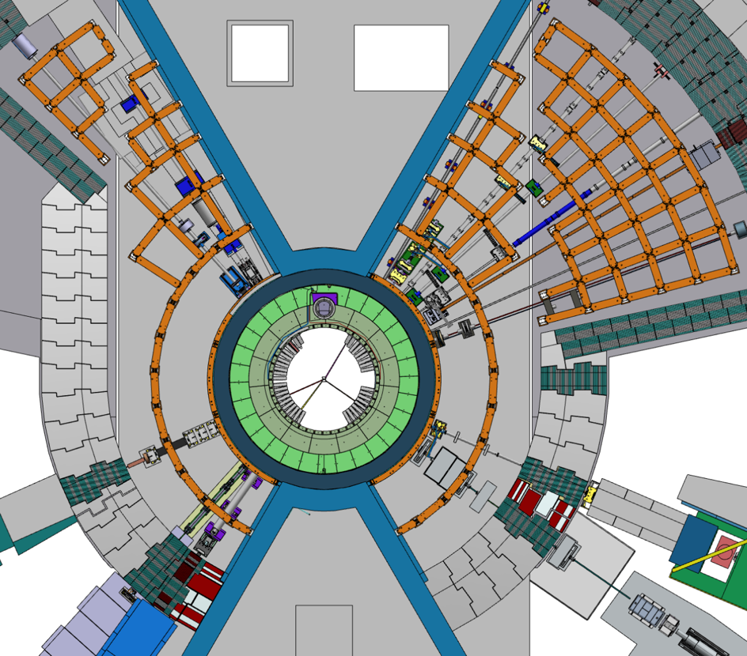
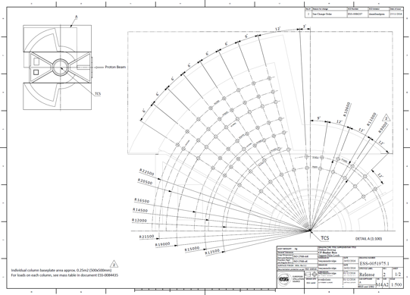
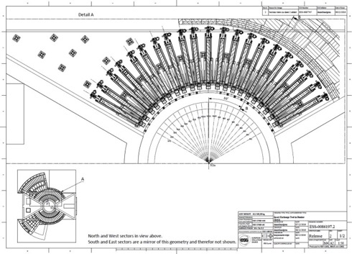
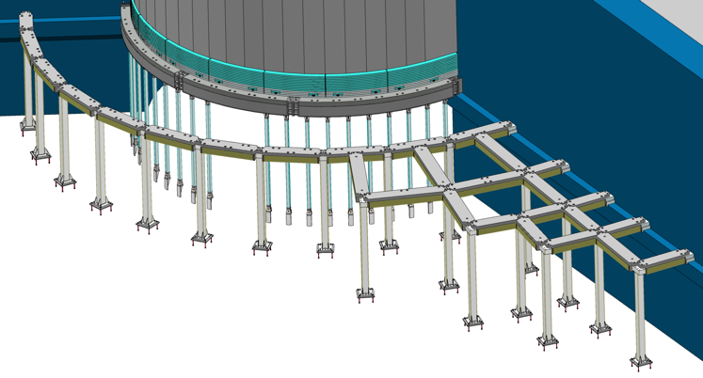
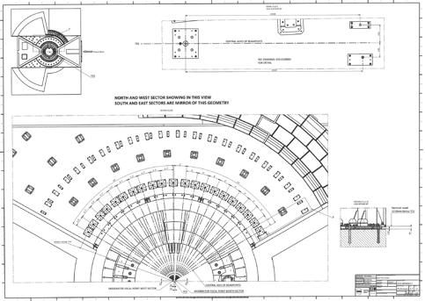
Target Building Frame
Pillar position unchanged from PDR since they provide no clashes and required clearance in R9 with revised IET.
Also placement of pillars radiating outward from R9m selected based on load distribution onto floor.
Pillars positioned in between beamlines
Support pillar positions ESS-0051975
IET – Column interface ESS-0086197
NBX – Floor alignment plates
ESS-0108885

Slide 8
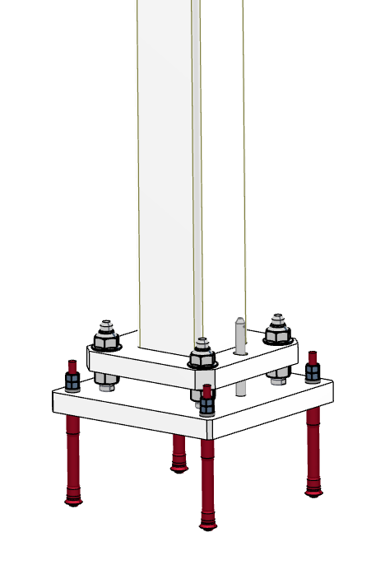
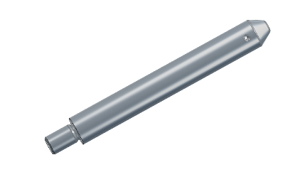
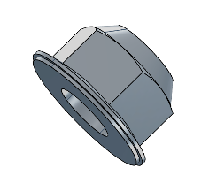
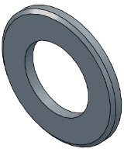
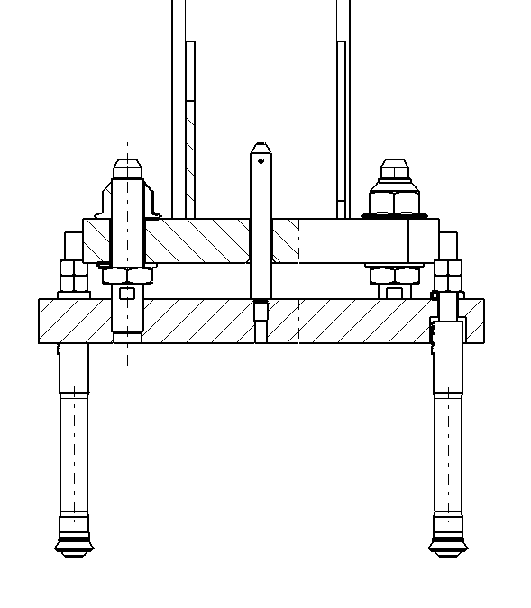
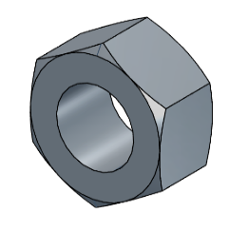
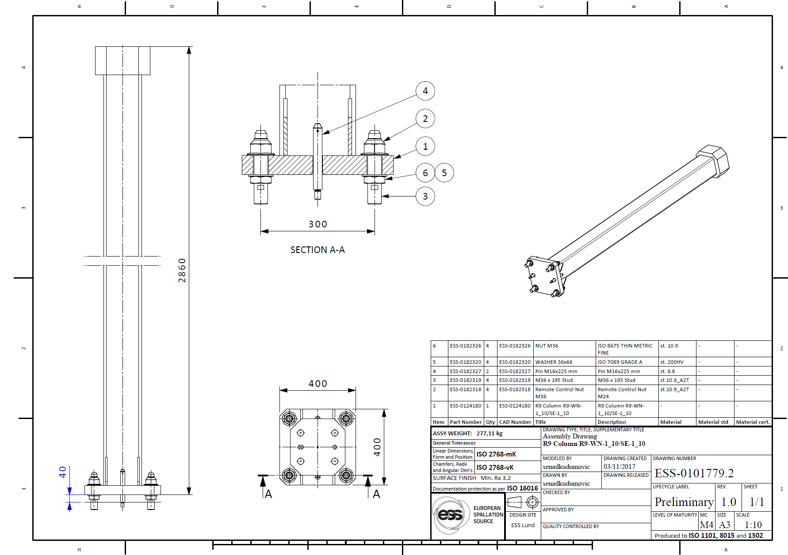
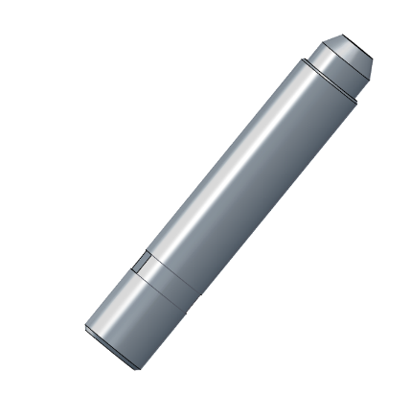
Target Building Frame (D02)
Remote handling connection between pillars and base plates
Guide Pin
M36 Remote Control Nut
M36 Nut and Washer
ESS-0101779
M36 Stud

Slide 9
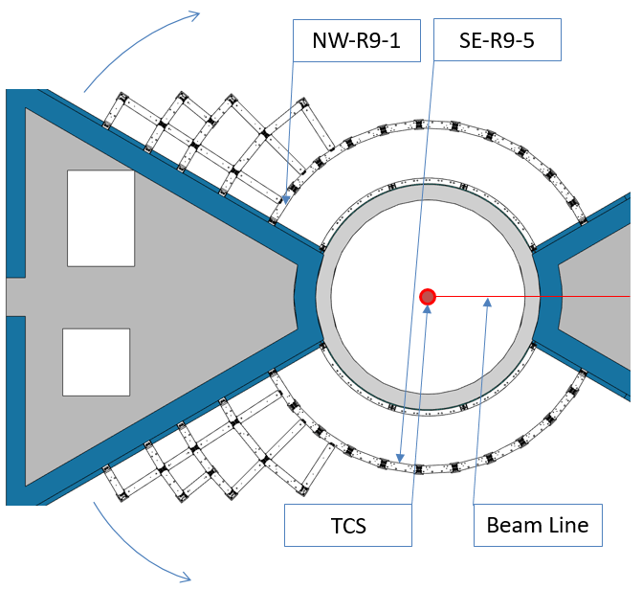
Target Building Frame (D02)
Bunker frame is built of nearly 200 pillars/beams and every pillar/beam has its own, unique destination. In order to avoid errors during an installation, each beam and pillar must be labelled - painted numbers on sides and on top of each beam and painted number on side of each pillar.
Every label gives tree information about a beam/pillar position and it is defined as follows:
[sector]. [row]. [beam#]
[sector] – NW (North-West), or SE (South-East)
[radius] – beam/pillar radius number counted outwards from the TCS
[beam#] – beam/pillar number counted clock wise in the NW sector, and counter clockwise in the SE sector
For the sake of an example, NW-R9-1 label stands for:
North-West Sector
Radial Beam (9 m radius)
First beam in row

Slide 10
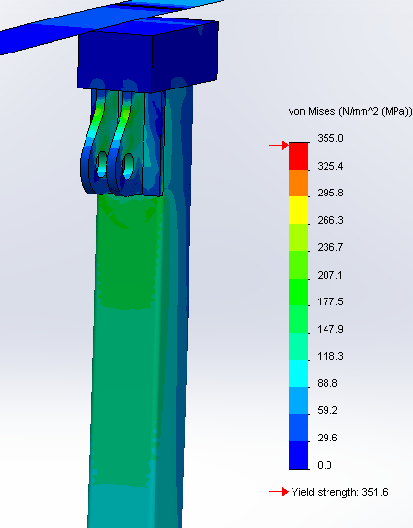
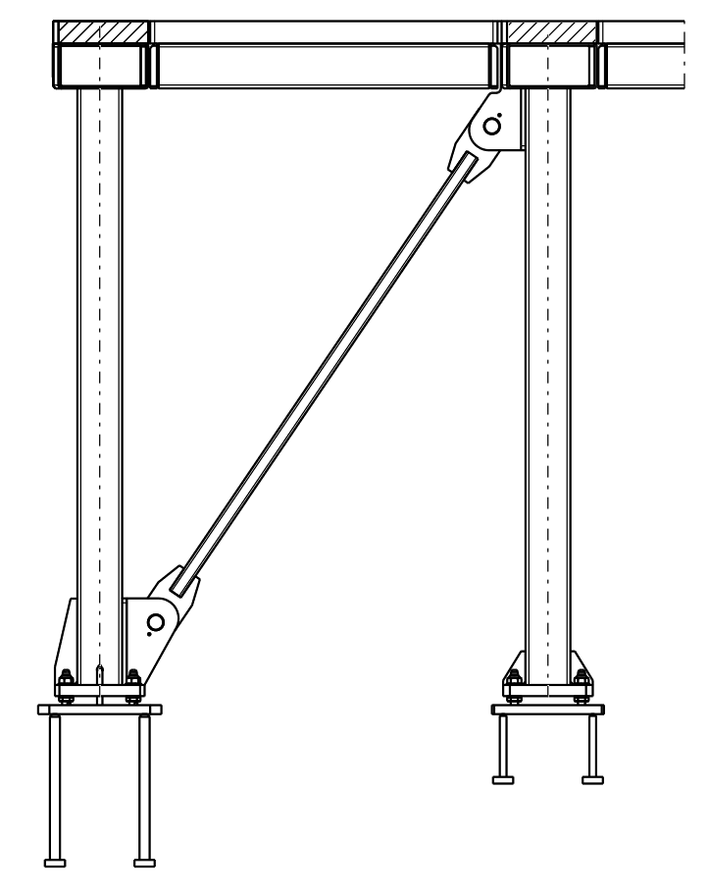
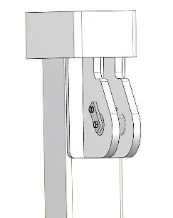
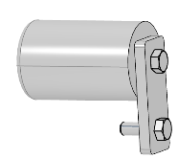
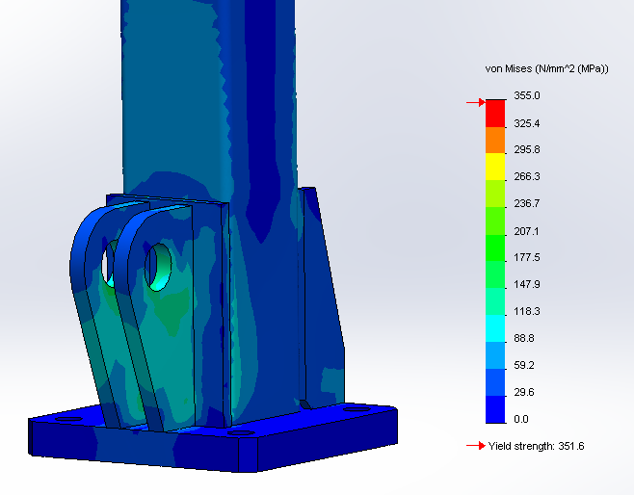
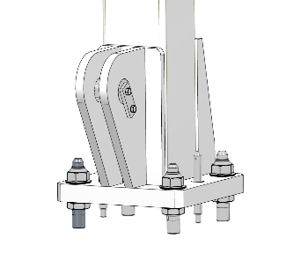
Target Building Frame (D01/D03)
To ensure the bunker do not fall inwards, bracing is arranged that makes the structure much stronger inwards than outwards
Top Connection Point
Connection Pin
ESS-0191430
Bottom Connection Point

Slide 11
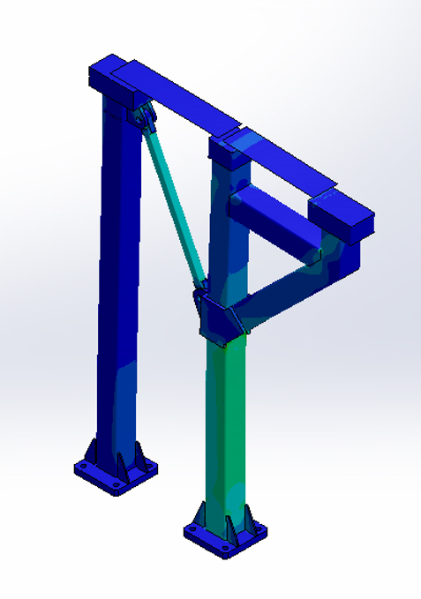
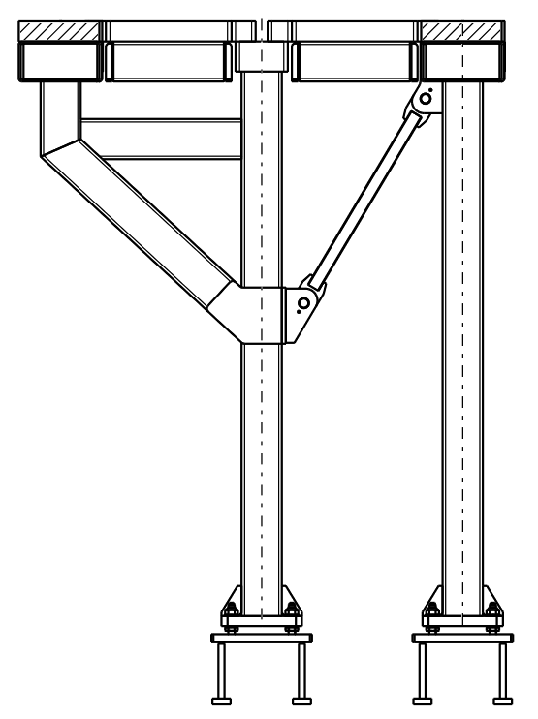
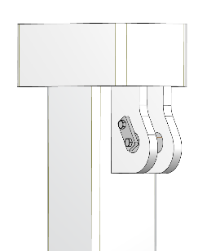
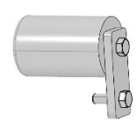
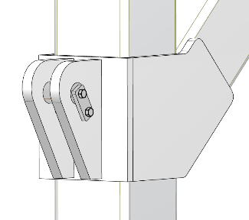
Target Building Frame (D01/D03)
Pillar position in collision with dillatation gap
Top Connection Point
Connection Pin
Dilatation gap
Bottom Connection Point
ESS-0191430

Slide 12
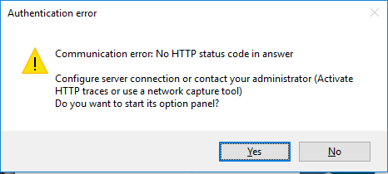
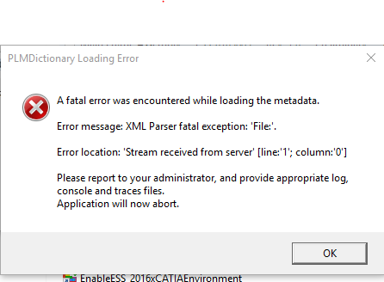
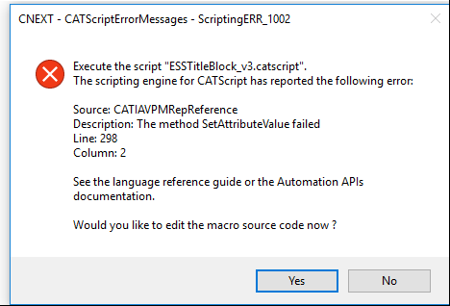
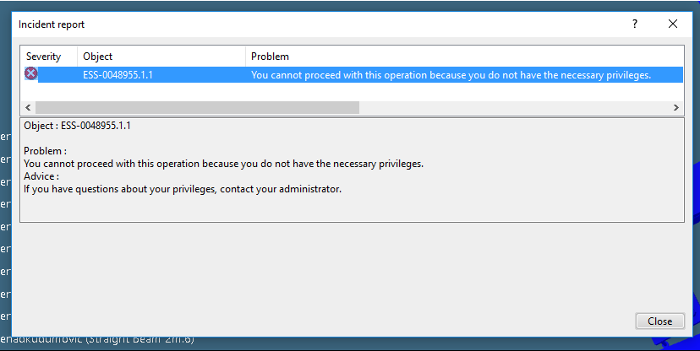
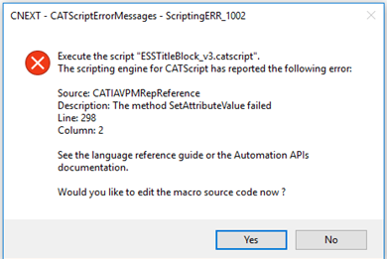
Expectations and needs
CAD Methodology
CAD Standard Parts
CAD Standard Materials
Plan for CATIA improvements
Handy tools (MathCad, Snagit…..)

