Slide 1
MET Session workshop Job description Integration Engineer
Clara Lopez
Senior Mechanical Engineer
www.europeanspallationsource.se
24 January, 2018

Slide 2
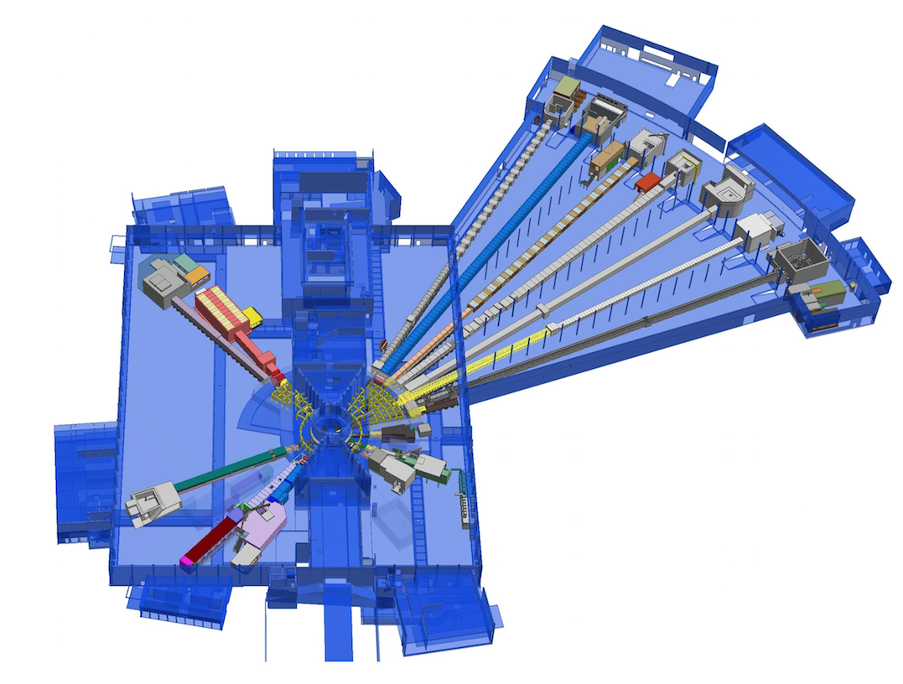
Instruments overview
4. C-SPEC (cold chopper spectrometer) TUM (Munich and LLB Paris)
7. Partial work:
Odin
Magic
6. MIRACLES backscattering spectrometer- ESS Bilbao
3. VESPA -vibrational spectroscopy
(CNR Italy-ISIS UK)
5. Heimdal Hybrid diffractometer-Denmark
Aarhus university
1. LoKI Broad band SANS
(ISIS -UK)
2. FREIA Liquids Reflectometer
(ISIS -UK)
Notes:
Scope of deliverables: 15 instruments and 1 TBL
Distribution in the different halls, North, East, South and West
Different challenges in each of the areas

Slide 3
Interfaces
LoKI
FREIA
VESPA
MIRACLES
Design
C-SPEC
Procurement
HEIMDAL
Installation
MAGIC
Instruments
EU/SE Regulations
Commissioning
ODIN
Tech groups
DREAM
ESS
Operations
BEER
NSS Project Office
T-REX
SKADI
Bunker
ESTIA
BIFROST
NMX
TEST BEAM

Slide 4
Main activities for Integration
Single point of contact for Technical information
Follow logs, agreements, schedule, action plans, risks assessments, design solutions, procurement process, etc.
Monitoring and chasing on going process: CAD models, documents, change request, design progress, development plans, critical constrains, technical reviews, etc.
Highlighting areas of concern between ESS/NSS and instruments partners
Knowledge of the work process in both parties- applied design
Facilitate communication and ensure the proper flow within ESS/IKP/suppliers
Help to identify interface responsible, lead to solutions, etc.
Supporting simultaneous projects with different phases, align gaps
Support NSS Technical activities.
Coordination of installation for ISIS instruments: LoKI, Freia and Vespa (UK-Italy)

Slide 5
Expectations and needs from MET
CAD Translation
P&ID
Piping/cabling for instruments
As built drawings
Installation drawings
Review drawings for procurement and TG3
Specific work design: NSS and Instruments
Integration envelops
CE Support for instruments
Personnel for installation
Identification of suppliers/ materials – special cases
Standards: models in 3D and drawings
Quality
Project understanding
Cost/duration
Quick response

Slide 6
Questions and comments

