Slide 1
Giuseppe Aprigliano Mechanical Engineer NMX Instrument Project Engineer Introduction
www.europeanspallationsource.se
01st February , 2018

Slide 2
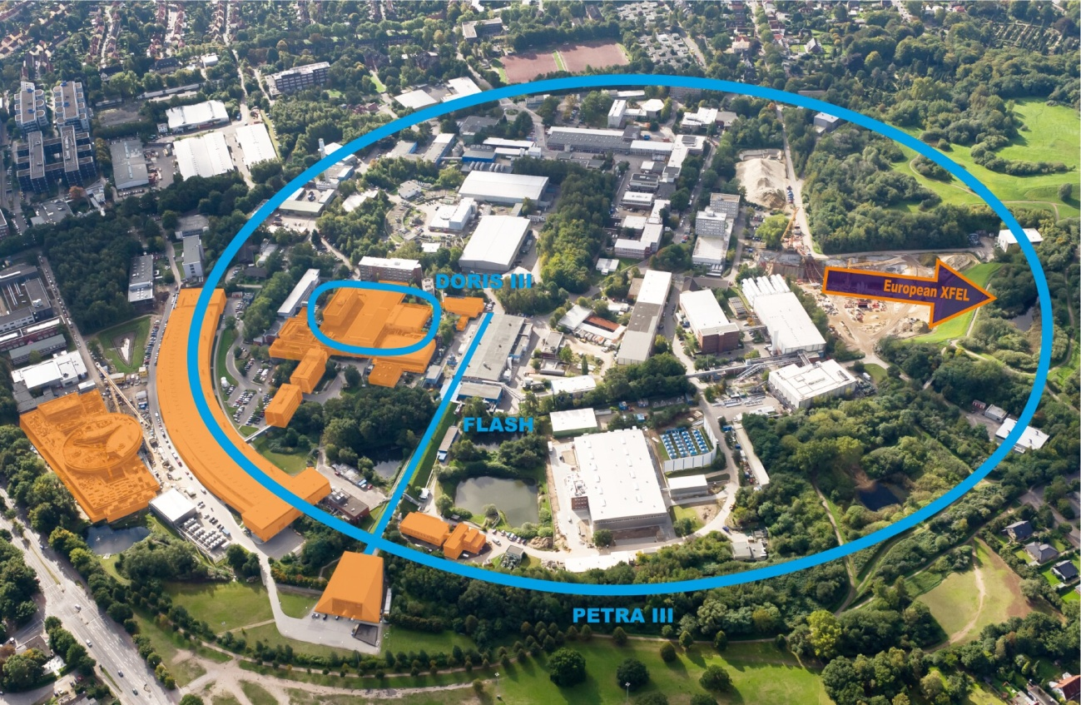
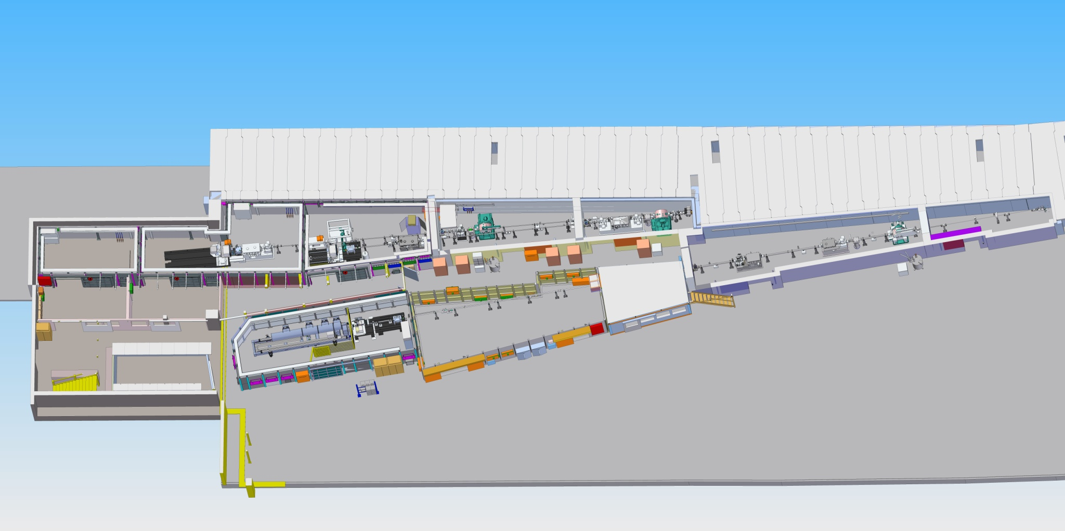
NMX Project structure
Previous Employment
2008 -2013 European Molecular Biology Laboratory-Hamburg outstation, Germany
Mechanical Engineer of the Instrumentation team
Responsible for mechanical integration of X-ray beamlines at the Synchrotron Radiation Source PETRA III (DESY).
P12 BioSAXS
P13 Macromolecular Crystallography
P14 Macromolecular Crystallography
Notes:
NMX is an instrument led by ESS, Esko Oksanen, is the proposer of the instrument and currently is the instrument project leader and I am the Instrument Project Engineer,
Here on the right are the partners that participate to the instrument construction
France
Hungary Wigner research centre
The CERN contribution comes through the detector group for the development of the NMX neutron detectors
On the left is a list of the people that are supporting us in the

Slide 3
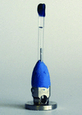
Neutron Macromolecular Crystallography instrument at ESS
Since 2013 at ESS, Lund, (Sweden)
- Since January 2014, Instrument Project Engineer for the neutron instrument NMX, responsible together with the instrument scientist to deliver one of the first instruments of the ESS instrument suite.
-NMX is a Quasi-Laue time of flight diffractometer with Macromolecular Crystallography as primary scientific case.
“Small” crystals : 0.2mm to 5mm
Beam property | min | max
Beam size | 0.2mm x 0.2mm | 5mm x 5mm
Wavelength | 1.8Å | 3.55Å
Max divergence | ±0.2°
Sample-Source distance | 157.6m
Notes:
Quasi-Laue time of flight diffractometer,
Typical samples are small crystals of biological molecules

Slide 4
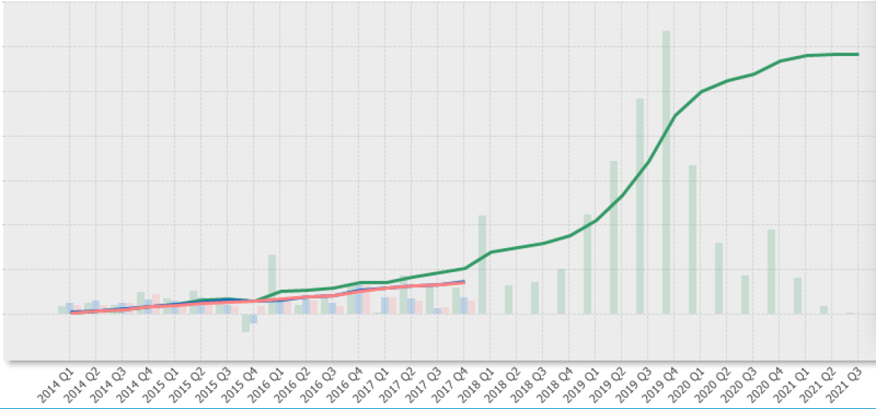
Project structure
Instrument Project Engineer: Giuseppe Aprigliano, ESS
Instrument Project Leader: Esko Oksanen, ESS
Budget: 11 670 140 Euro
End of construction 2021 (under review)
Start of scientific program 2023
Earned value 10%
Zoe Fisher (ESS-SAD)
Anders Pettersson (ESS-SAD)
Richard Hall Wilton (ESS -Detector group)
Dorothea Pfeiffer (ESS- Detector group/CERN)
Phillip Bentley (ESS-NOSG)
Valentina Santoro (ESS-NOSG)
Damian Martin Rodriguez (ESS-NOSG)
Iain Sutton (ESS-NCG)
Markus Olsson (ESS-NCG)
Stuart Birch (ESS-PSS)
Peter Ladd (ESS-Vacuum Group)
Marcelo Juni Ferreira (ESS-Vacuum Group)
Thomas Gahl (ESS-MCA)
Paul Barron (ESS-MCA)
Thomas Holm Rod (ESS-DMSC)
Jonathan Taylor (ESS-DMSC)
Peter Sångberg (ESS-SPD)
Magnus Israelsson (ESS-Programme office)
Jean-Luc Ferrer (IBS – GSY Group, FR)
Márton Markó (Wigner Research Centre, HU)
Szabina Török (Centre for Energy Research,HU)
Petri Kursula (University of Bergen, NO)
University of Bergen

Slide 5
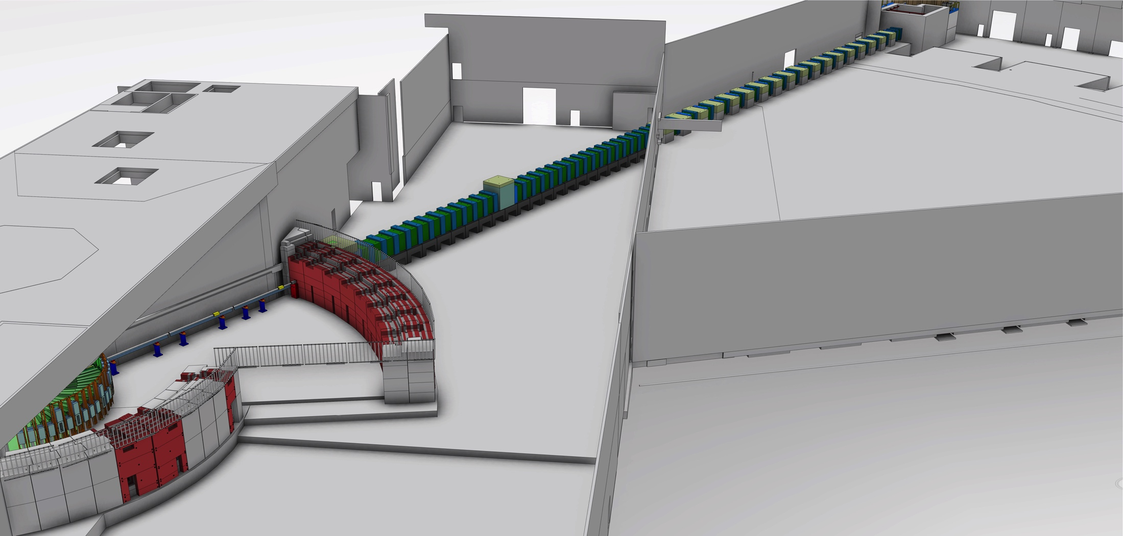
NMX Overview

Slide 6
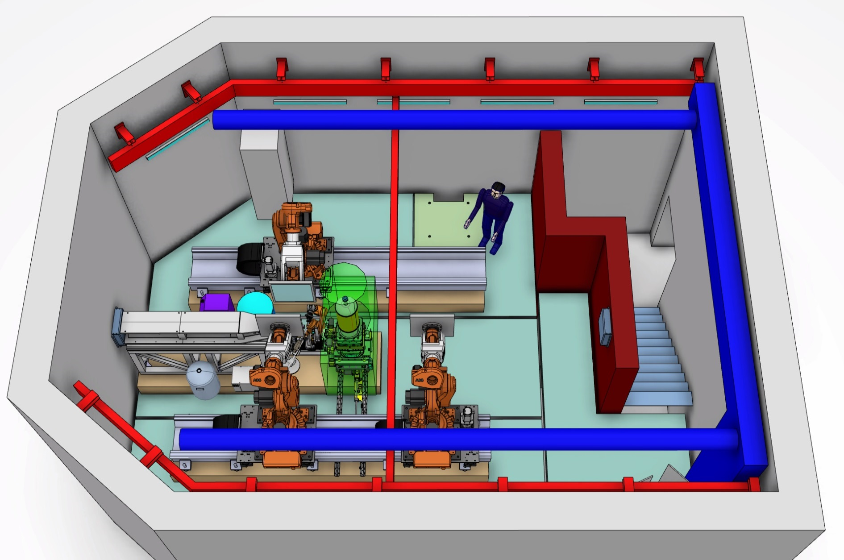
NMX Components: Exp cave
1
2
3
4
1 - Endstation
2 - Safety beamstop
3 - Air conditioning
4 - Crane
Notes:
Missing false floor
Logistics

Slide 7
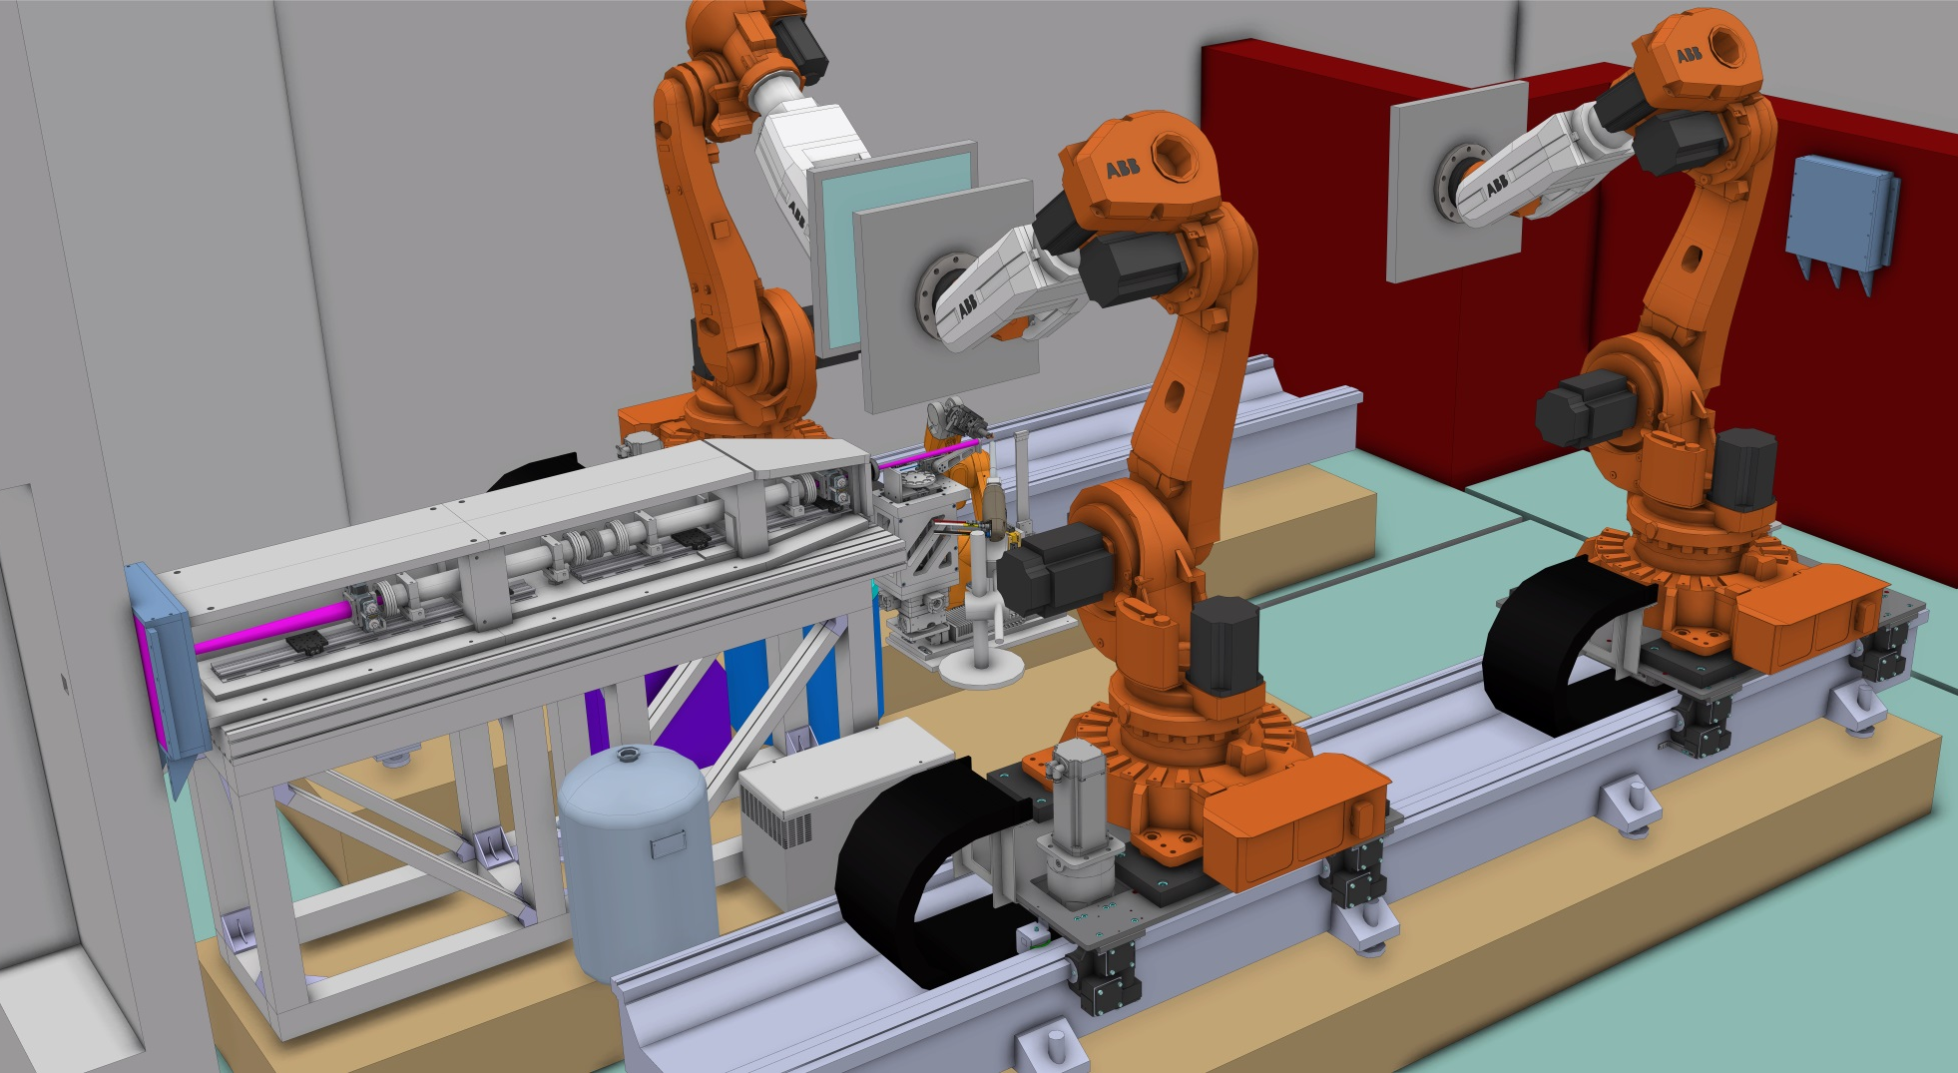
NMX Endstation Components

Slide 8
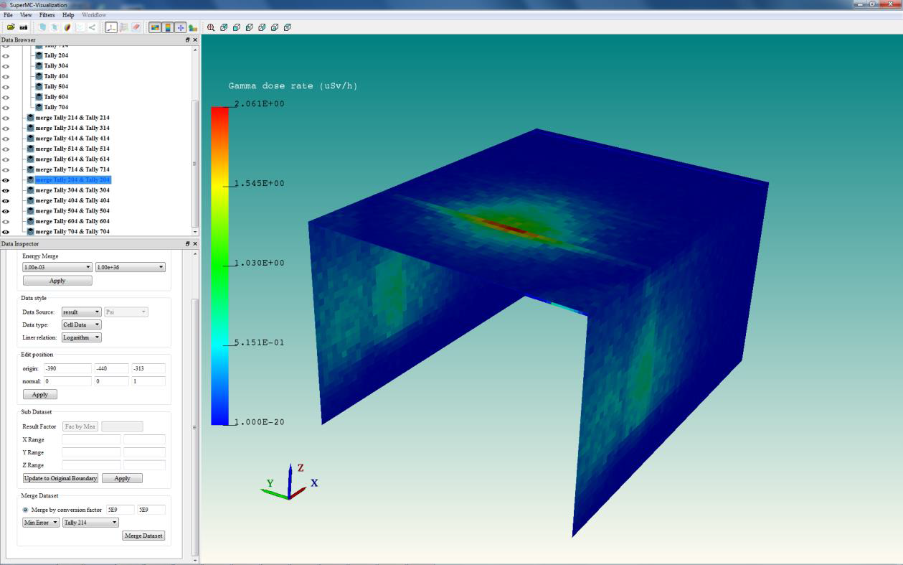
Gamma dose rate from Gd target at the sample position with 90 cm concrete for $5∗{10}^{9}$n/s
Work performed at MTA EK, Hu
Szabina Torok, Peter Zagyvai

Slide 9
Lead Engineer Responsibilities
Reporting to the Neutron Scattering Systems Project Leader: S.Kennedy
WP Management
Planning
Budget management
Documentation and Reporting
WU coordination (IK/In house)
Technical coordination
Instrument Integration (CAD/ P&ID/Conceptual developments)
Interfaces management
Technical and project documentation
In-house components development
NSS Integration activities

Slide 10
Centralized services needs
Definition of standard components and materials (CAD)
Availability of short term design/drafting resources on demand
Availability of draft checking/reviewing capacity
Core experience sharing

Slide 11
Questions?

