Slide 1
Mechanical Engineering & Technology (MET) section workshop
ESS 31 January – 1 February 2018

Slide 2
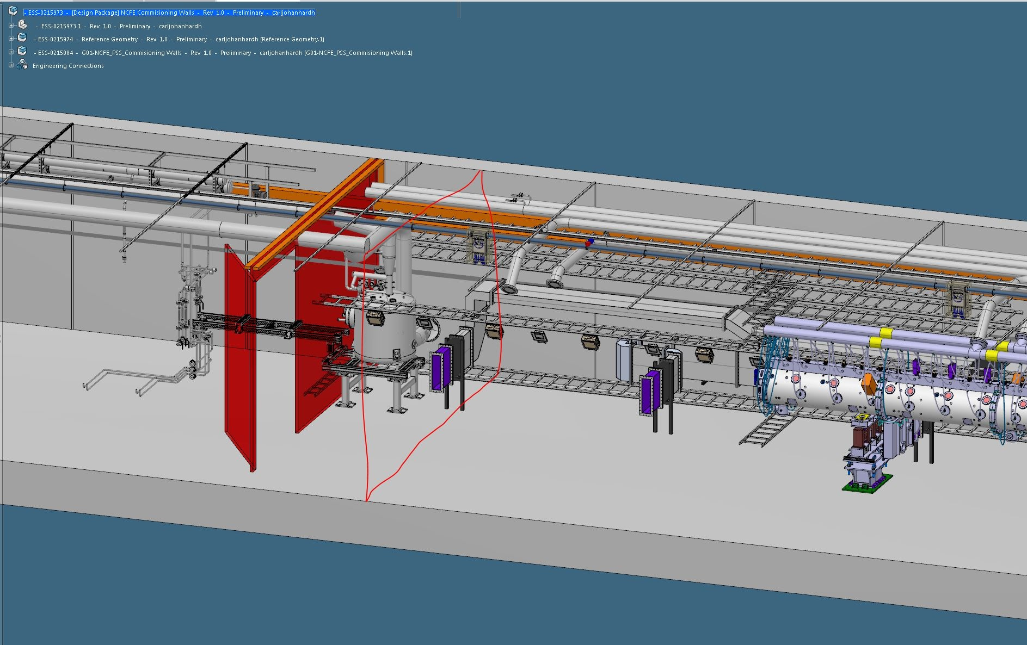
What do I do?

Slide 3
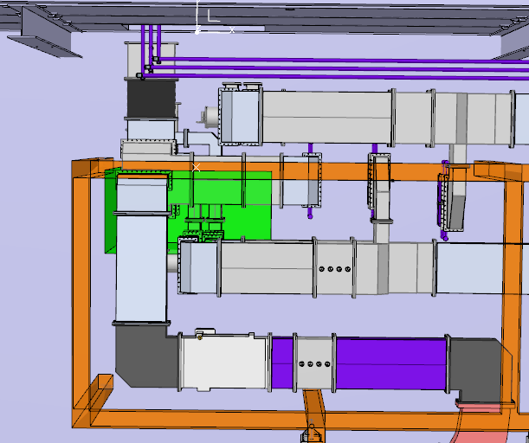
What do I do?

Slide 4
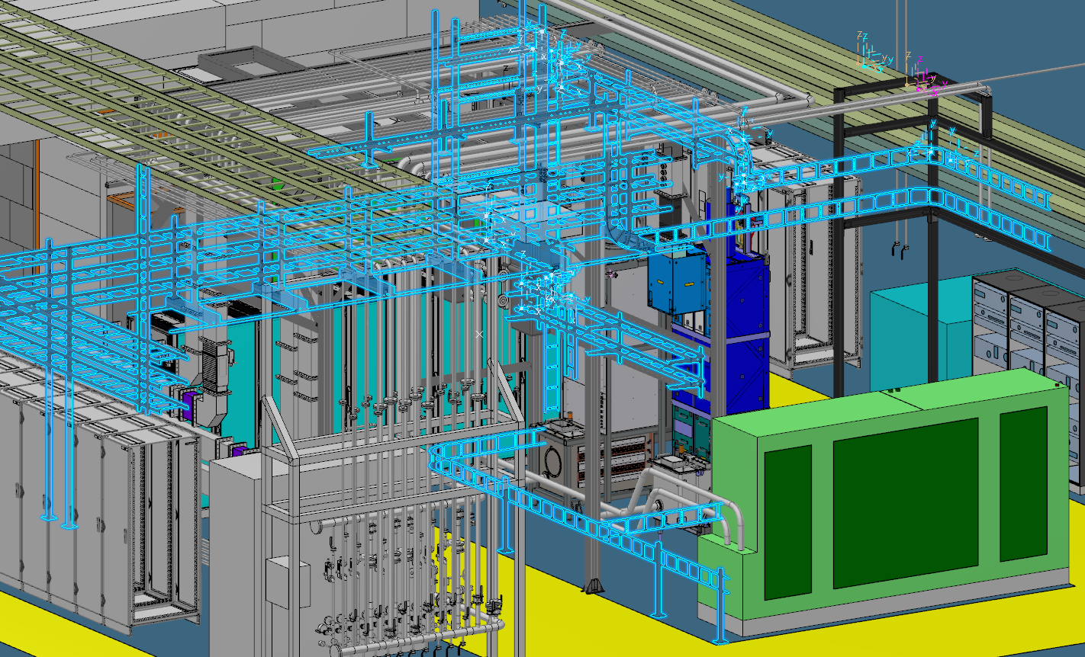
What do I do?

Slide 5
Expectations, requests and needs…
I would like to see a better planning and workflow within the organization. Urgent…waiting…waiting…PANIC!
More stable program Catia/ Enovia (Crash, lose contacts with server etc.)
ESS Standard - STD Materials - STD Parts - Methodology
Design Lesson Learned, share experiences and tips of how to work better and together.
Nice with this workshop, get to know the section, who's responsible for what and meet colleagues! ☺

