Slide 1
Mats Olsson Mechanical Designer Target Division-NBEX
Work tasks and responsibilitys
Conceptual development of the LSS (Light Shutter System) functionality.
Refinement of mechanical structures
DFM in order to create components with high functionality with low manufacturing costs and efforts.
Development of integration and installation procedures
Reviews of manufacturing documents
Drawings
Expectations
Participate in the manufactoring, installation and perhaps commissioning of the LSS and NBEX systems.

Slide 2
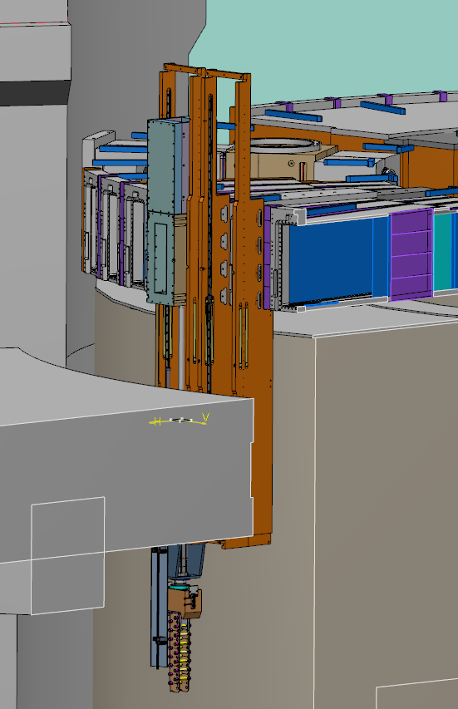
Expectations on the MET section
Further develop and establish mechanical guidelines and processes.
Be a forum for issues within the mechanical development area.
Develop methods and ”best practise” for e.g. CAD modelling and drawings
Strengthen the mechanical development within ESS.
CATIA
After using other market leading CAD systems, Catia is a dissapointment, seems not ready to be used in full scale production. Many bugs and work arounds.
Implemetation not optimal. I need to start a new session every morning. I loose +30 min every day.
Basic sketching and modeling functions are not up to par or simply not there.
However, the drafting module seems to work well.
Desperate need for a STD component library.
Model resoloution. When i work with cylindical features i expect so see smooth edges and arcs. Not polygones. In the end a huge quality risk.

