Slide 1
MET workshop
Srdjan Vareskic
Mechanical Engineer / Work Unit Lead
Fagerström Industrikonsult AB
Active Cells / Casks and Associated Handling Devices / Mock-Up and Test Stands
www.europeanspallationsource.se
30 January, 2018

Slide 2
Srdjan Vareskic Tasks & Responsibilities
Target Group – Remote Handling Systems WP06
Started October 2014
Active Cells equipment specifications
Interface requirements
RCC-MRx, standards and norms applicable for Remote Handling Systems
Design and Construction Rules for Remote Handling Systems Mechanical Components (Safety related SSC: s non-pressure retaining mechanical components )
Inspection Plan (IP) templates for RHS project
Detail design of stainless steel liner and embedded parts of Active Cells facility incl. drawings and preparation of IP for manufacturing and installation
Responsibility as WUL for Mock-Up and Test Stands project – PDR completed Dec 2017
SDD-Req, SDD-Sol and other system engineering documentation for Mock-Up project
Current assignment: Classification of safety and safety-related SSC: s of ACF

Slide 3
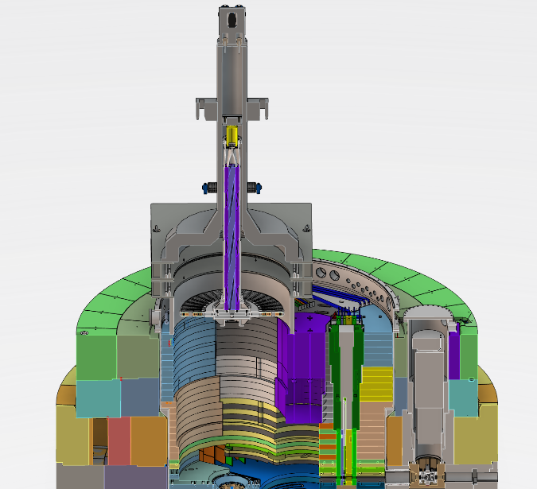
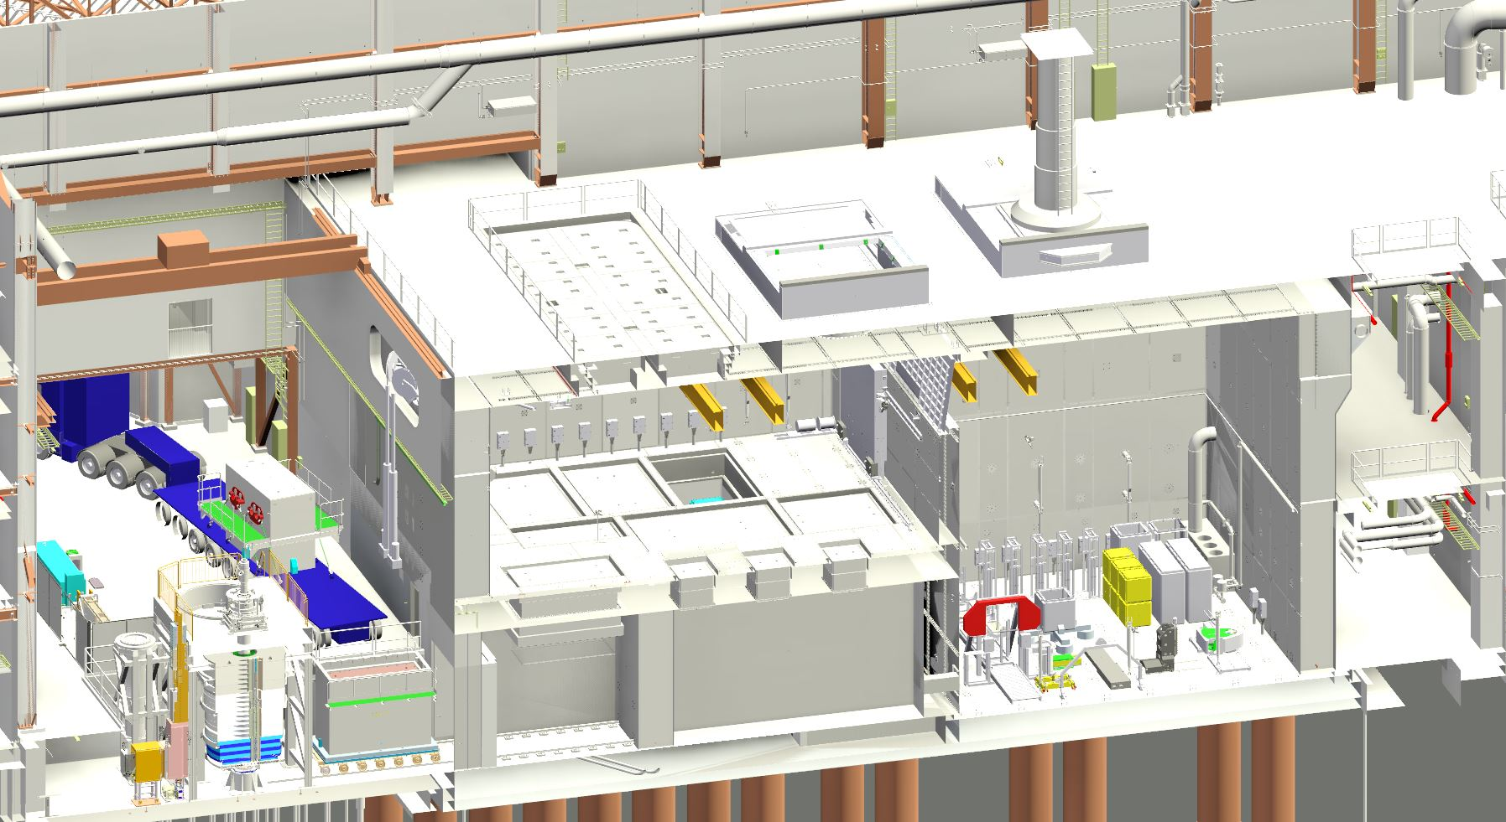
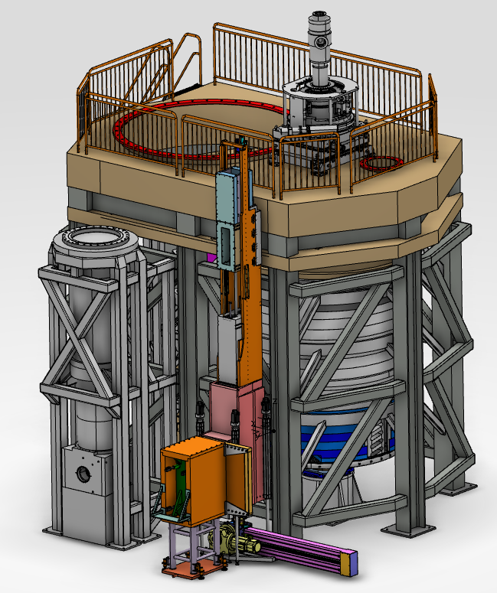
Srdjan Vareskic Tasks & Responsibilities

Slide 4
Srdjan Vareskic Expectations & Needs
Forum for discussion of technical issues
Guideline for classification of Mechanical Components
CAD - Standard Parts
Generalized and clear rules with in-kind partners: templates, responsibilities, review process etc.

