Slide 1
Active Cells Facility MET workshop
Paul Erterius
Mechanical Engineer
www.europeanspallationsource.se
31 February, 2018

Slide 2
Overview
My position Active Cells Facility / Remote Handling Systems, WP6 <- Target Division <- EIS Division <- Fagerström Industrikonsult AB ◦ Conceptual and detail design development ◦ Model and design coordination
Active Cells Facility ◌ General ◦ Hot Cell and man accessed adjacent building ◦ Tasks: Handling, size reduction and interim storage of spent Monolith components (TW, MRP, PBW and others) ◦ Comprises a static and a dynamic barrier (1,3m HD concrete walls and ventilation pressure cascade) ◦ Interior completely covered with 1.4404 sheet metal liner (Mechanical Quality Class: MQC4C/MQC3C) including an embedded steel framework of liner profiles. ◦ Approximately 4000 different embedded steel items. ◌ Project achievement so far: Detail design -> Public procurement -> Manufacturing -> Installation -> embedment completion
Drawing details ◌ Combined Manufacturing Drawings -> machining, welding and assembly consolidated on a single drawing (for each wall, floor, ceiling etc)
◌ Installation reference systems: Elevation annotations (RHS2000) and Gridlines (Sweref) same as can be seen from the construction drawings.
◌ Complementary Revision box for increased traceability of updates.
◌ Design lifecycle through ECOs (~100 ECOs consumed so far)

Slide 3
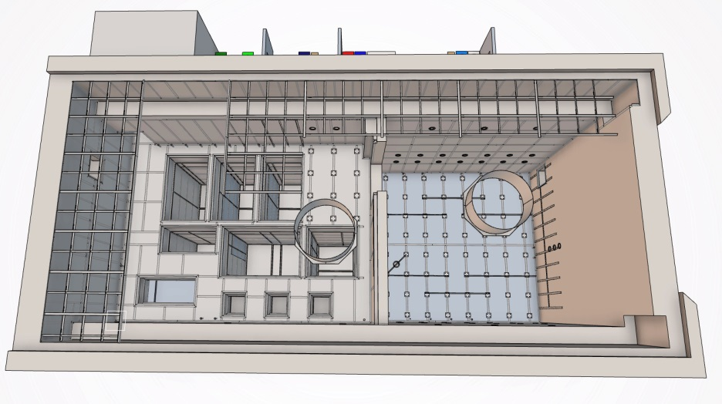
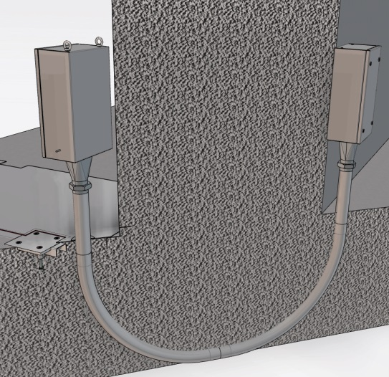
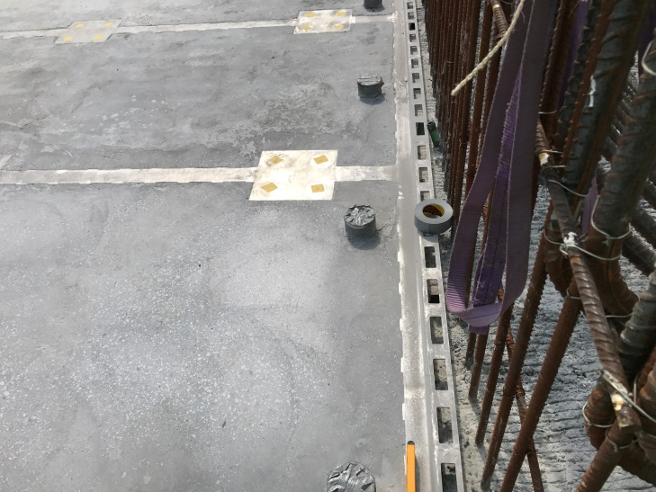
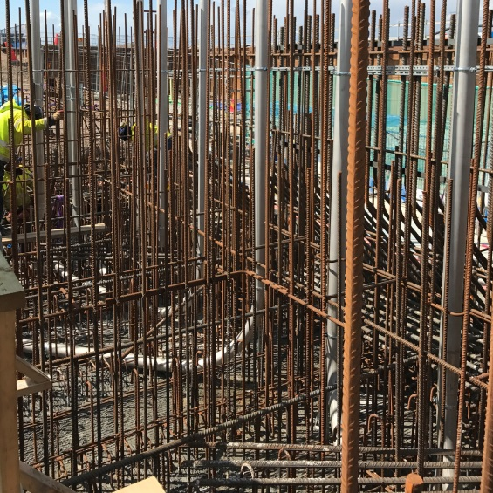
Example drawings
Installation drawings
◌ Liner embedments of floor and interim storage compartments
◌ Liner and anchor plate ceiling embedments
Manufacturing drawings
◌ Anchor plate (high requirements)
◌ Anchor plate (moderate requirements)
◌ Liner Beam framework

