Slide 1
Reinhard Blum
Working for Target Division since Feb 2014
Concept design Target Wheel
Concept design PBIP (Proton Beam Instrumentation Plug)
Concept design Target Monitoring System
Various tasks within Target Division
Now: Generation of Manufacturing Drawings for Outer Shielding
Review of drawings from ESS Bilbao
Tasks connected to Nnbar
Expectations to MET section
Forum for discussion of technical issues

Slide 2
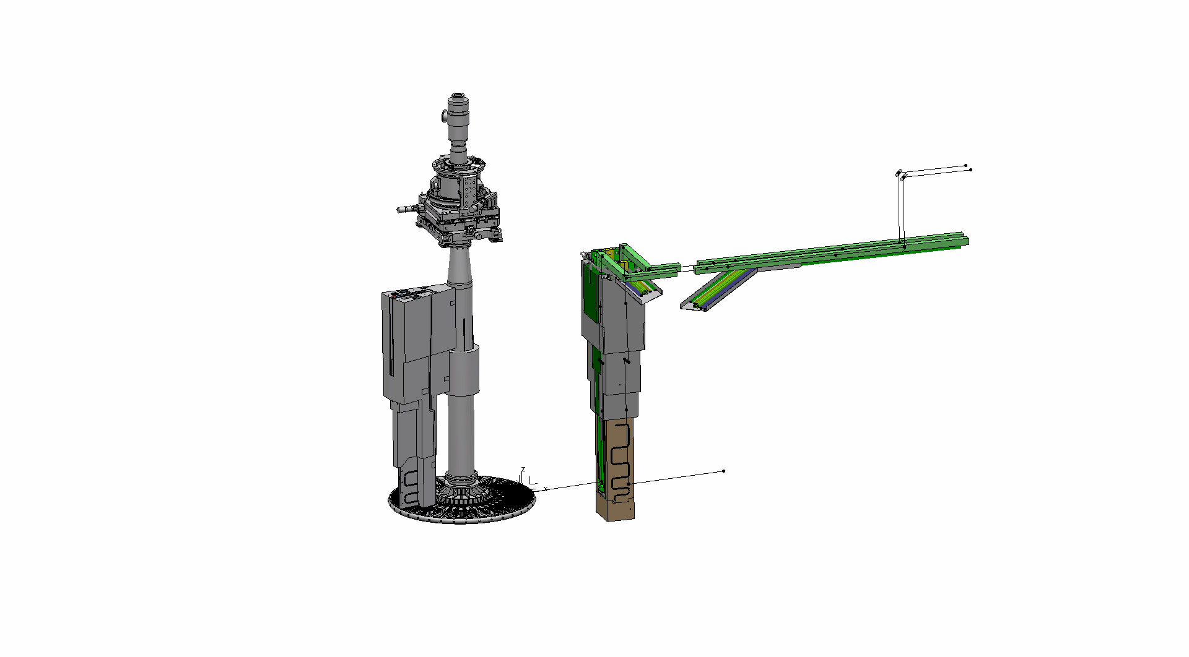
Target Wheel with Target Monitoring System and PBIP

Slide 3
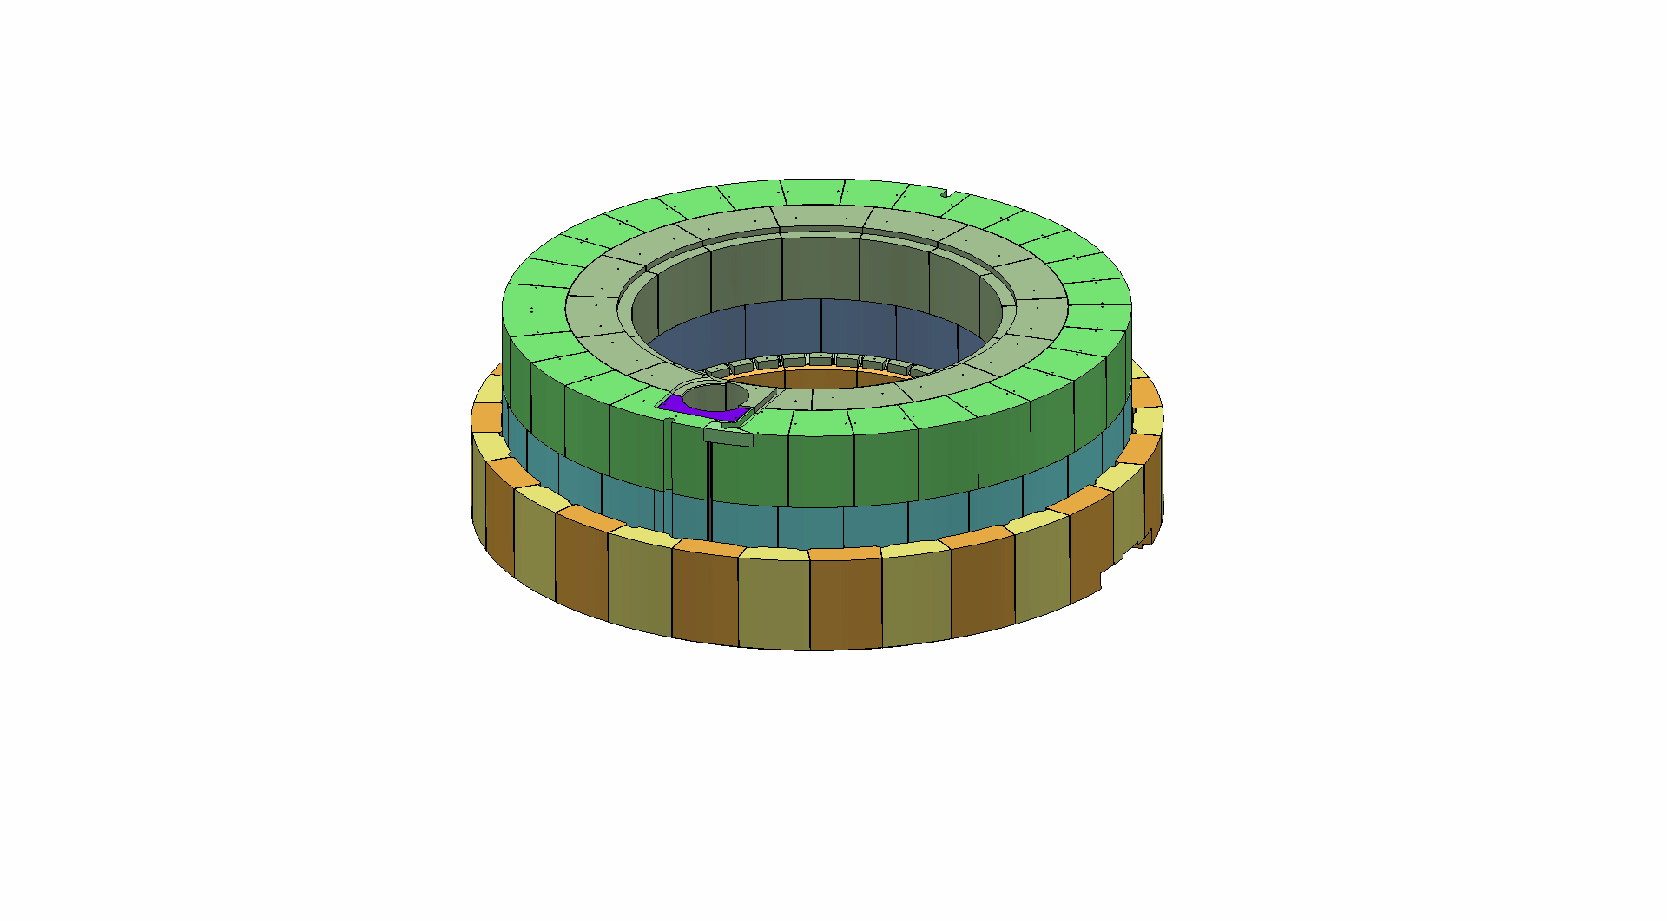
Outer Shielding

