Slide 1
Bunker Project Instruments interface
Sebastian Lyrbo
Design engineer
www.europeanspallationsource.se
26 January, 2018

Slide 2
Wall segment drawing R15
ESS-0062127
Area of responsibility: Interface between bunker wall and instruments.
Interfaces are
Feedthroughs – where instruments are passing through the wall in shape of a guide insert
Shielding – downstream side of bunker walls have an opening/cutout where it interfaces with the instruments shielding
Other tasks include design of:
R15 wall segments
Temporary shielding walls in East Sector
Showing some examples in the next slides.

Slide 3
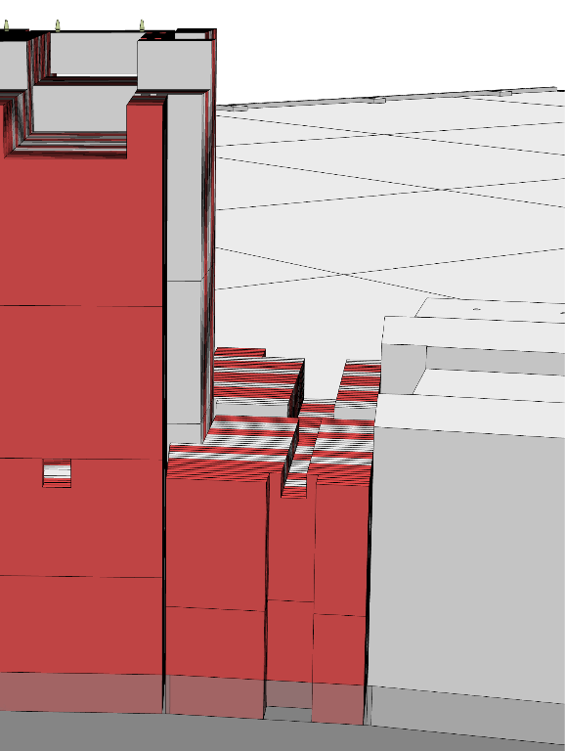
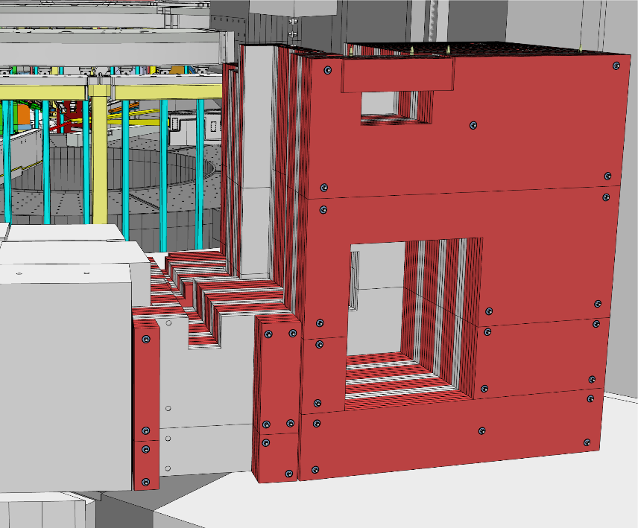
Insert installation
Example of installation of an instrument insert in R15 wall
First two layers in place
U-shaped feedthroughs
Upstream side - 200mm deep cutout in the first HDPE layer to make space for vertical support
Downstream side - 300mm deep cutout in the outer HDPE layer for interface with instrument shielding
Laser scanning of feedthrough surface
Machining of shims on-site

Slide 4
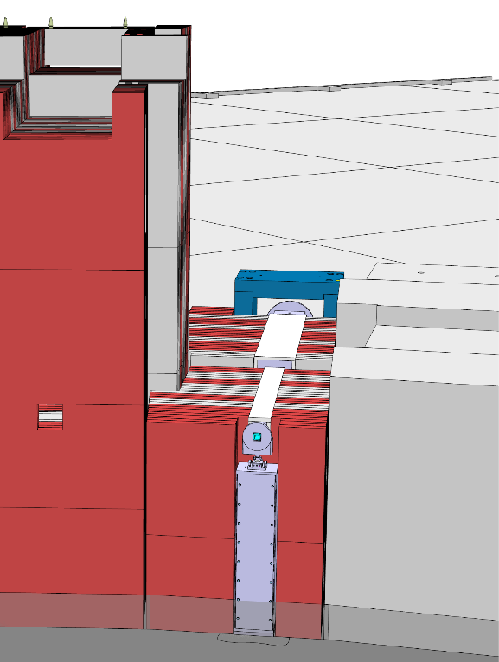
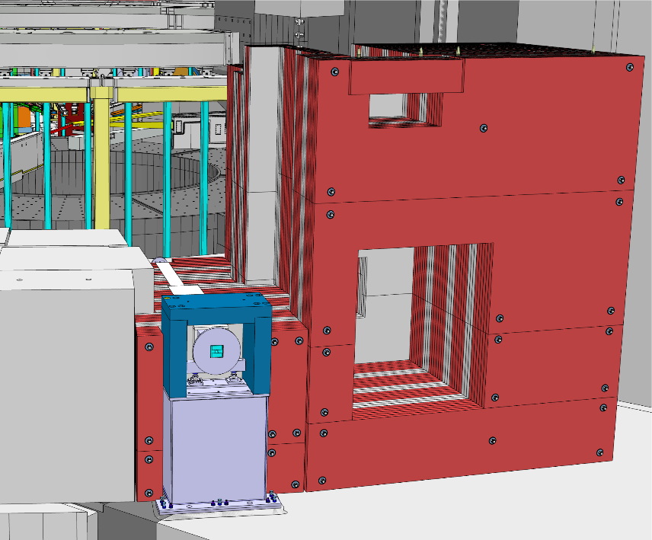
Insert installation
Example of installation of an instrument insert in R15 wall
Vertical support are mounted and bolted to the concrete floor as standard. Supports for inserts which are in dilatation joint areas (FREIA, LOKI, VESPA, E5) are bolted into the steel skid plate.
Shims are put in place
Guide insert lifted in from the top

Slide 5
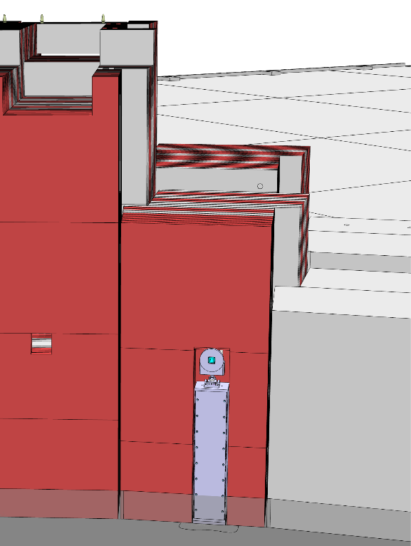
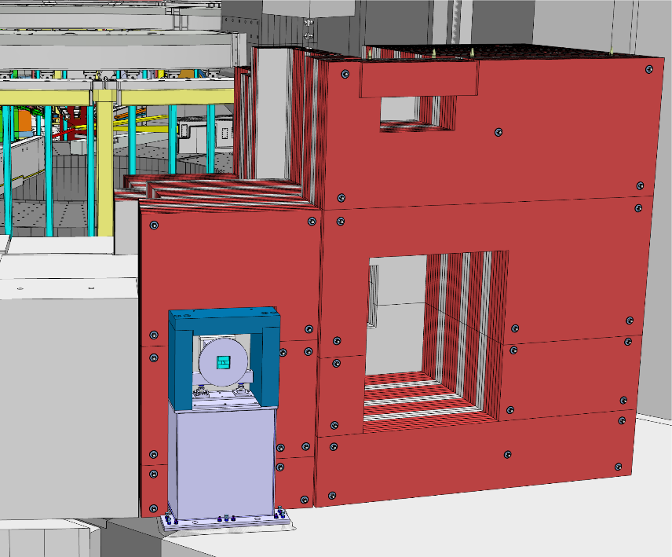
Insert installation
Example of installation of an instrument insert in R15 wall
2nd Instrument block layer mounted

Slide 6
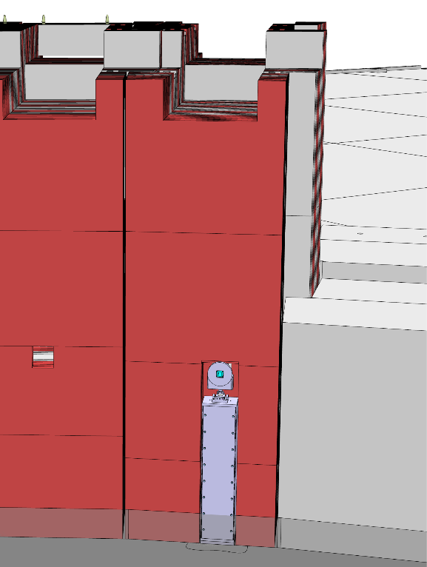
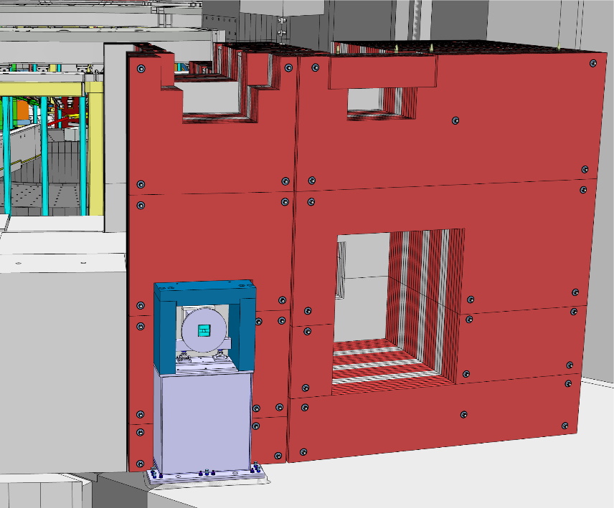
Insert installation
Example of installation of an instrument insert in R15 wall
Top block layer mounted
Instrument utilities to be installed along the utility feedthrough

Slide 7
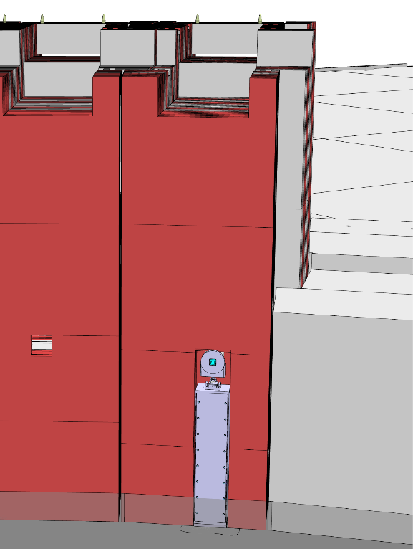
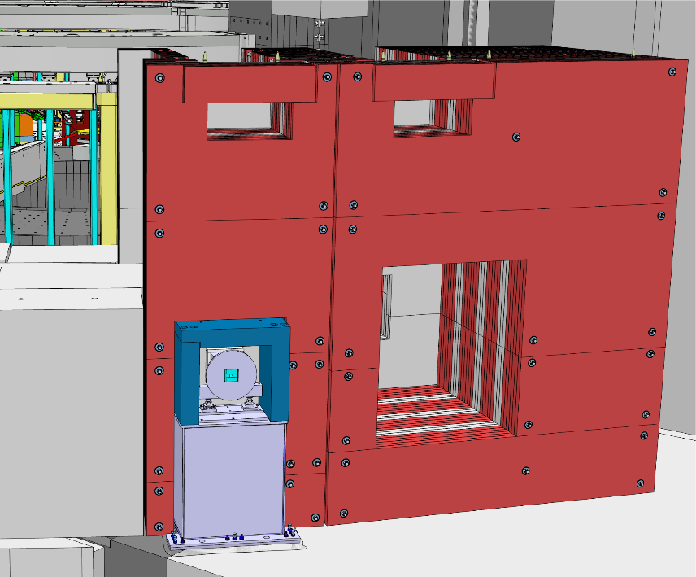
Insert installation
Example of installation of an instrument insert in R15 wall
Utility block put in place

Slide 8
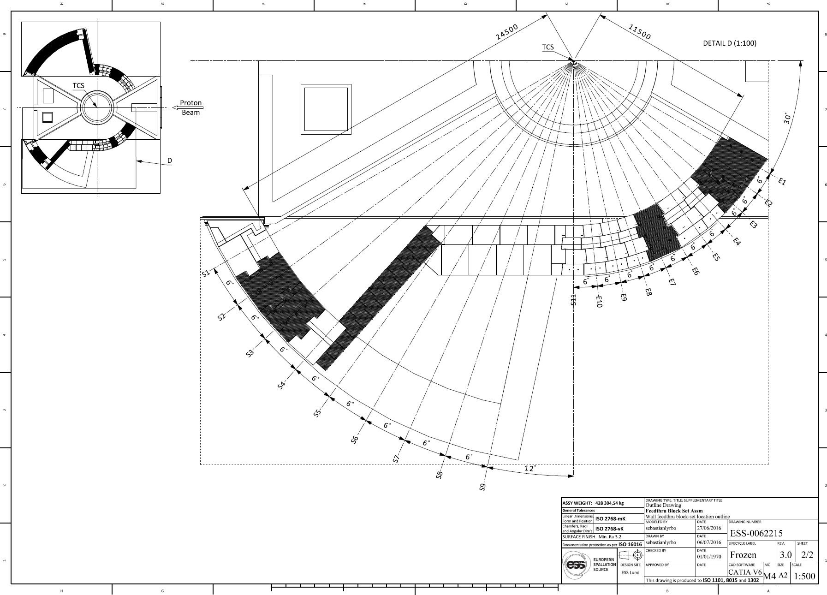
E3 SKADI Wall segment
Showing position of wall. E3 shown as an example.

Slide 9
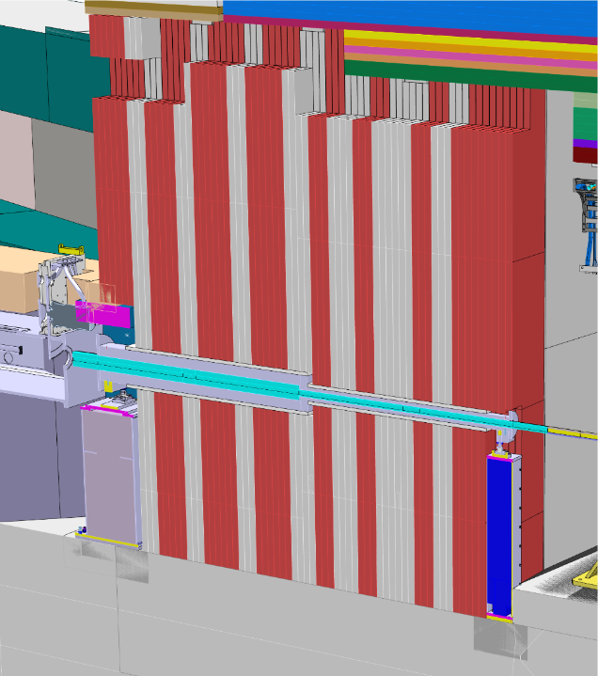
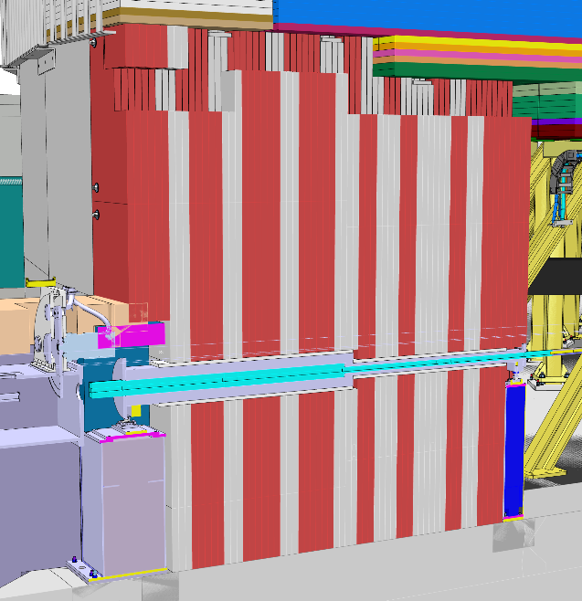
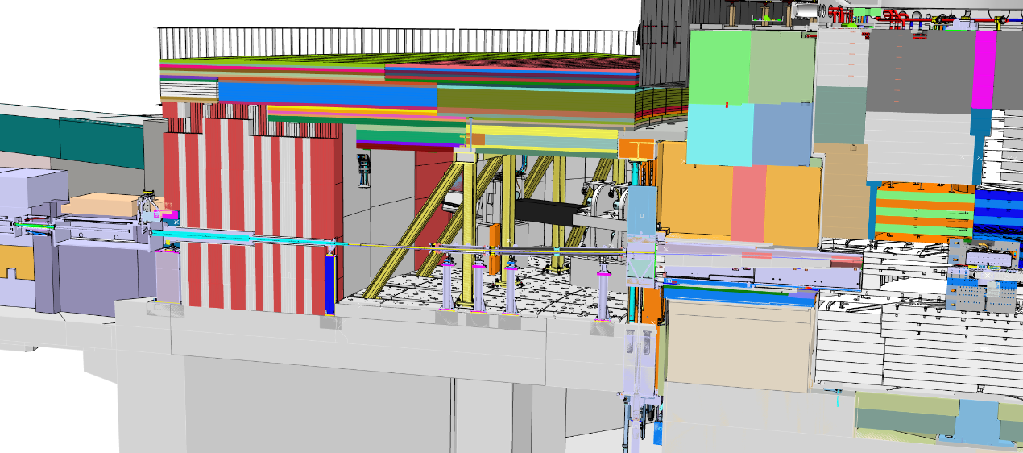
E3 SKADI interface
Assembly incl. dwg: ESS-0092766
Section cut of E3 wall and Instrument installed
Upstream side – support pillar mounted to the concrete floor in the in-wall cutout space.
Downstream side – support pillar mounted to the conrete floor and instrument shielding interfaces with wall cutout.
1
2

Slide 10
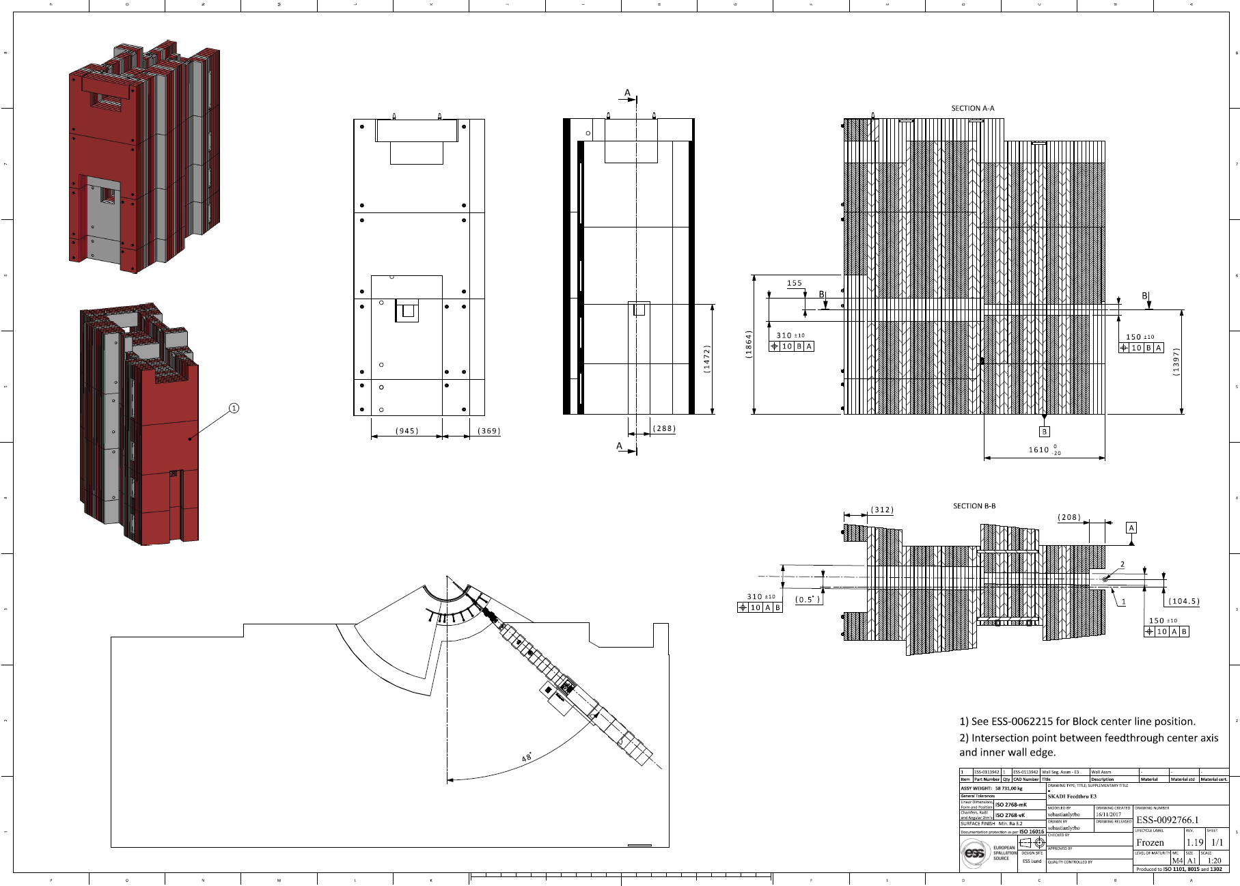
E3 SKADI feedthrough drawing
For each instrument there’s an assembly including wall and instrument with a drawing showing the feedthrough geometry.
All these assys can be found in ESS-0085974.

Slide 11
However…
…it was decided that we are changing from HDPE and steel in the walls to Heavy Concrete.
This means we need to re-design the complete bunker wall.
We have already started with the re-design and expect to have a concept ready within the next two weeks.
If the sun shines upon us, with the help of God and with the wind in our backs we might even have a fairly detailed design in the end of February.

