Slide 1
Insert Installation Tool
Johan Ohlsson
Design engineer
www.europeanspallationsource.se
23 January, 2018

Slide 2
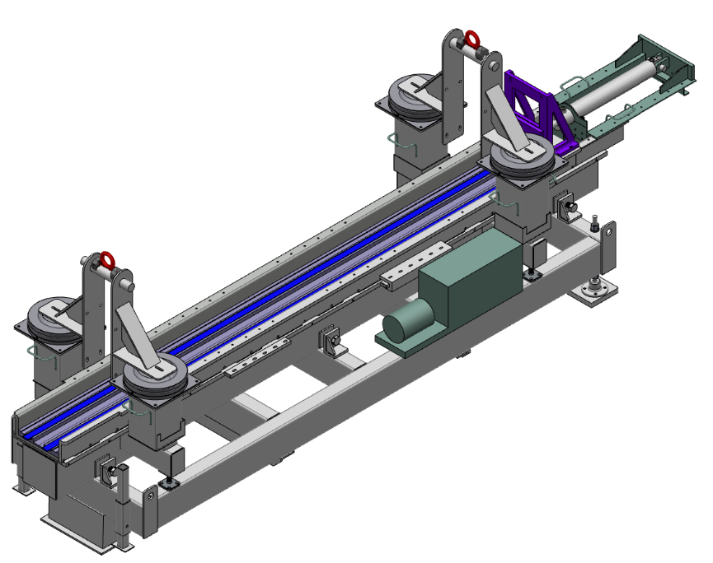
Insert Installation Tool
TASKS:
Current task:
To develop the insert installation tool.
Needs
Knowledge exchange
Technical exchange
Forum to brainstorm design ideas with.
Expectation of MET
Whom to contact in specific topics.
Give or Get support
Technical adviser/Specifier

Slide 3
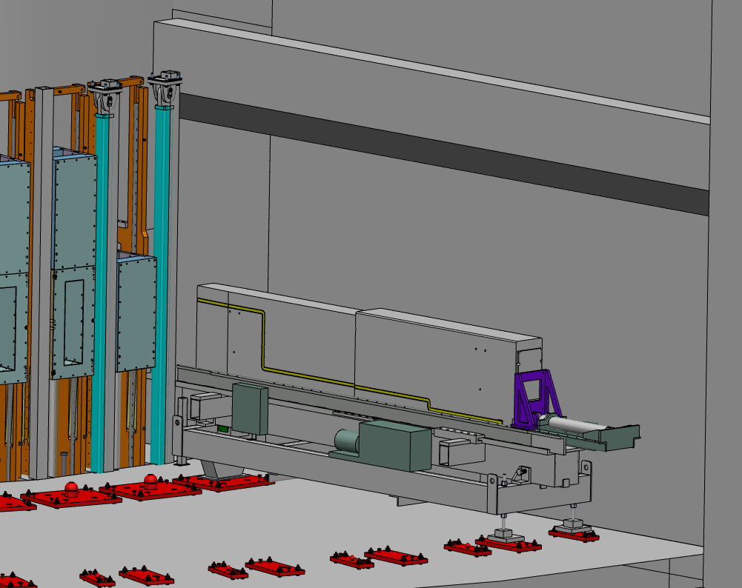
Insert Installation Tool (IIT)
Responsibility for the IIT within NBEX system.
Responsibility regarding other interfaces which IIT is dependent by.
Insert installation tool is a cold handling tool. IIT install the Neutron Beam Port Inserts and Plugs, before beam on target. In total 42 pieces.

Slide 4
5 Questions
Where can I find:
MET contact chart to MET members? / area of expertise?
An easy way to find or get MET news, updates of: Standardize of norms and ways of work?
A technical adviser/specifier?
What can I do?

