Slide 1
MET Section Workshop
Mattias Wilborgsson
Work Unit Lead
Target Division
www.europeanspallationsource.se
30 January, 2018

Slide 2
ESS
Started at ESS in August 2015 as Design Support to the Active Cell Facility
Design of Stainless steel liner
  Drawings
  Inspection plans
April 2016, Work Unit Lead
Proton Beam Window
Proton Beam Instrumentation Plug
Tuning Beam Dump
ESS-Bilbao, Spanish In-Kind contribution
Responsibility as WUL
  Ensure fulfilment of ESS requirements
  Coordinate interfaces
  Guide and support ESS-Bilbao (ESS procedures, Chess, expertise)
  Review design documentation

Slide 3
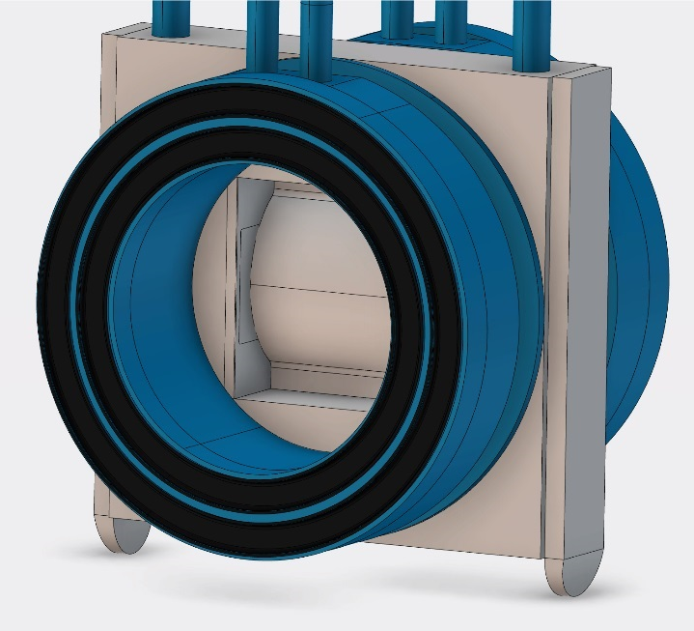
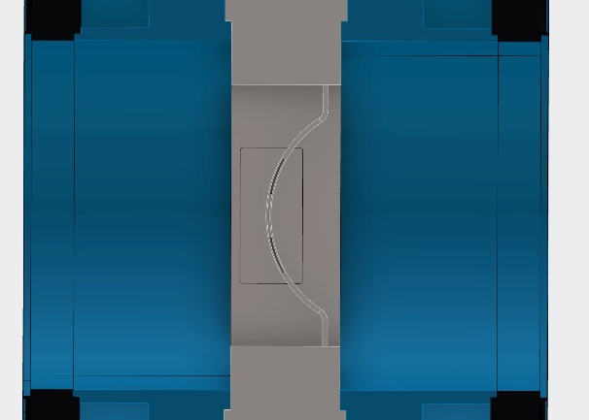
Proton Beam Window (PBW)
Function
  Separating the monolith atmosphere from the ultra high vacuum of the accelerator beam pipe
Position
  Located approximately 1.5 m into the monolith steel shielding
Expected lifetime
  A half up to one year at full power operation (5 MW)
Window
Al6061-T6
Space claim
APTM
Luminescent
coating

Slide 4
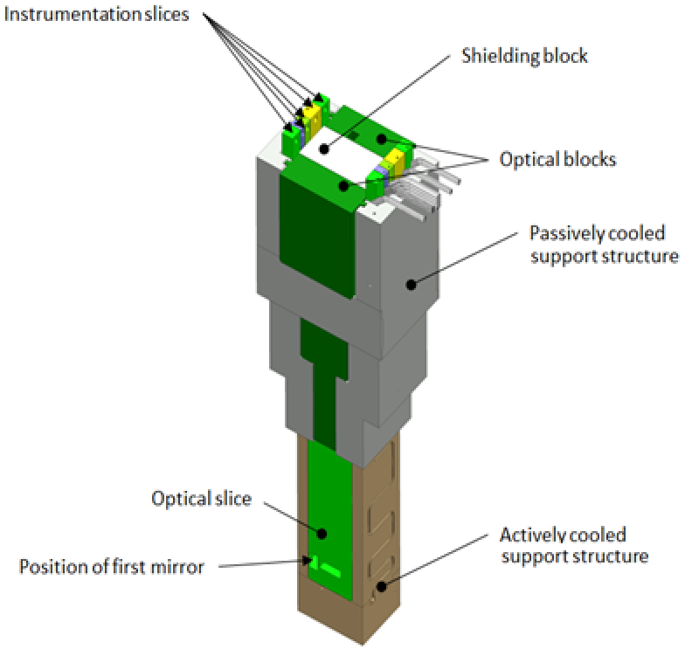
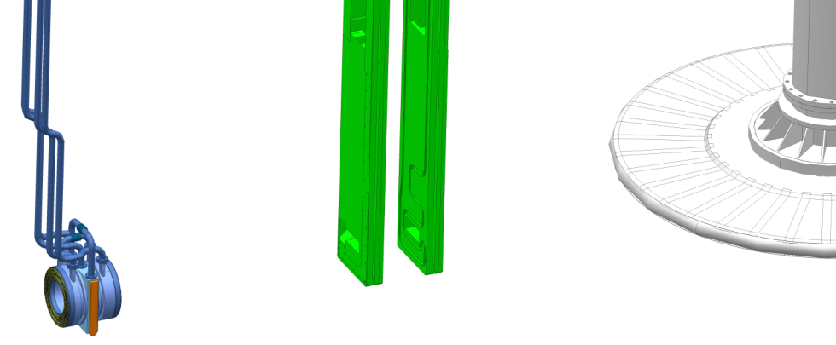
Proton Beam Instrumentation Plug (PBIP)
Function
  Support, cool and align the PBI
  Allow an optical view of the proton beam window and the beam entrance window
Position
  Located between PBW and TW
Minimum lifetime of PBI part
  Two years at full power operation (5 MW)
PBW
TW/ BEW

Slide 5
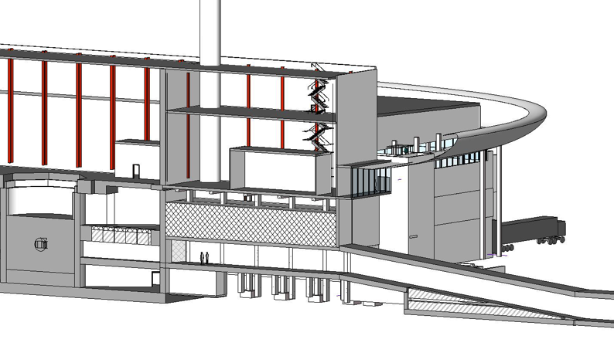
Tuning Beam Dump
Function
  Receive and stop beam during beam study (12.5 kW)
Position
  In beam dump cave at the end of the ESS linac in A2T area
Expected lifetime
  lifetime 40 years
Position of the Tuning Beam Dump

Slide 6
MET
ESS need a guideline for review of drawings
What expertise do we have in MET/ EIS and how to find it?
High workload and tight deliveries within well advanced projects makes it difficult to embrace new procedures and guidelines.

