Slide 1
MET workshop
Markus Andersson
Work Unit Leader
Monolith Vessel (In-kind)
Monolith Port Block Package (Self perform)
www.europeanspallationsource.se
26 January, 2018

Slide 2
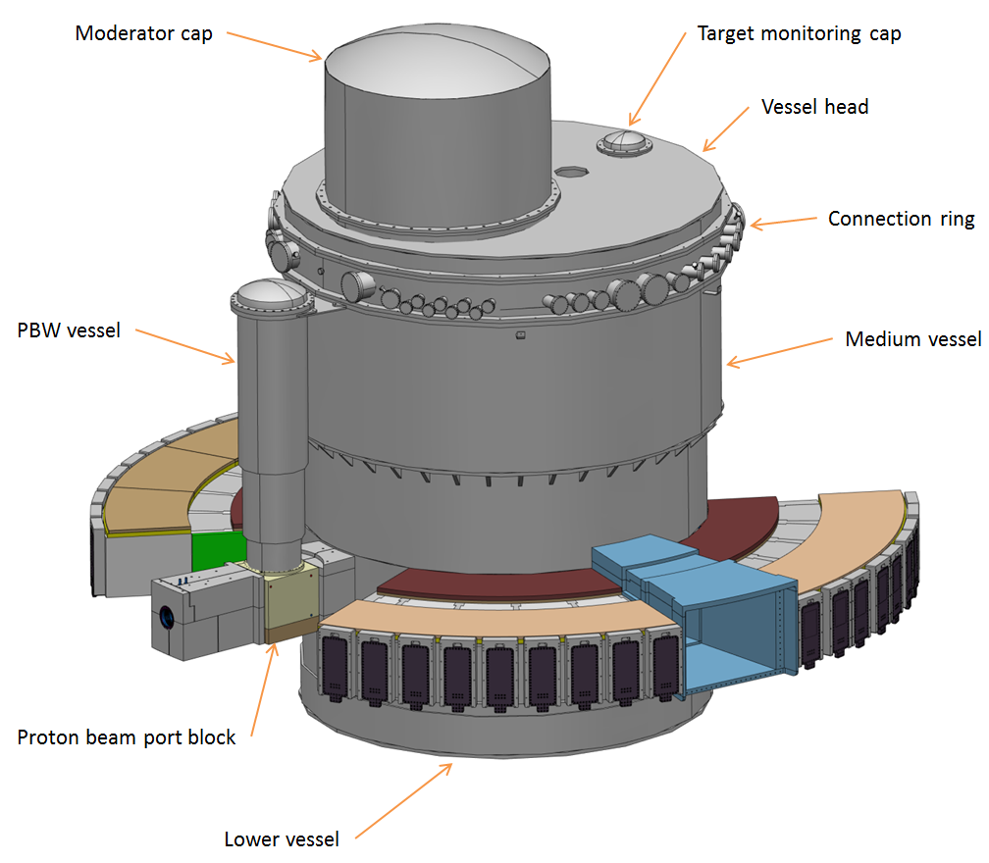
Monolith Vessel (system 1067)
Classification of Monolith confinement
In-kind coordination
Material and handling analyses
Timeplan follow-up
Interfaces management
Quality coordination ESS-Q and ESS-BQ
Vacuum issues
Designed for ESS life-time

Slide 3
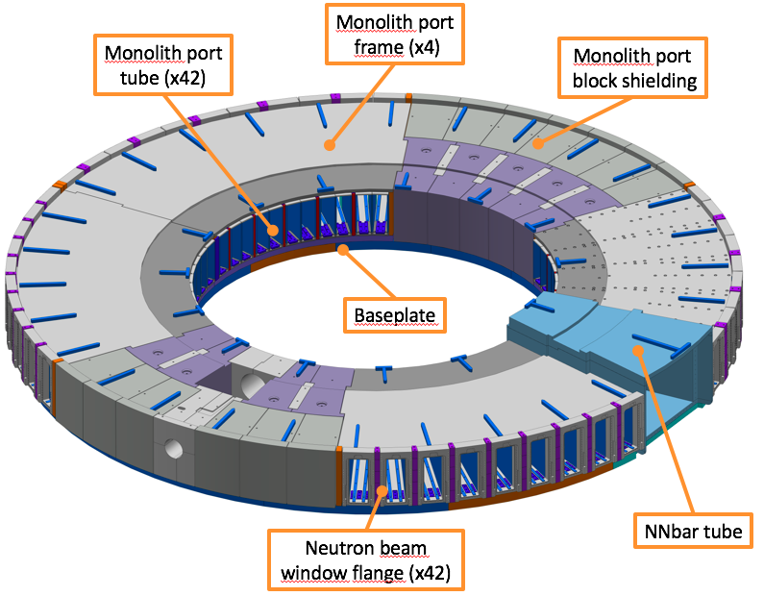
Monolith Port Block Package (system 1098)
Complex assembly
Material and handling analyses
Designed for ESS life-time
To be re-worked
Heavy components
Timeplan follow-up
Interfaces management
Quality coordination ESS-Q and ESS-BQ
Vacuum issues
Structural analyses coordination Earthquake requirements

