Slide 1
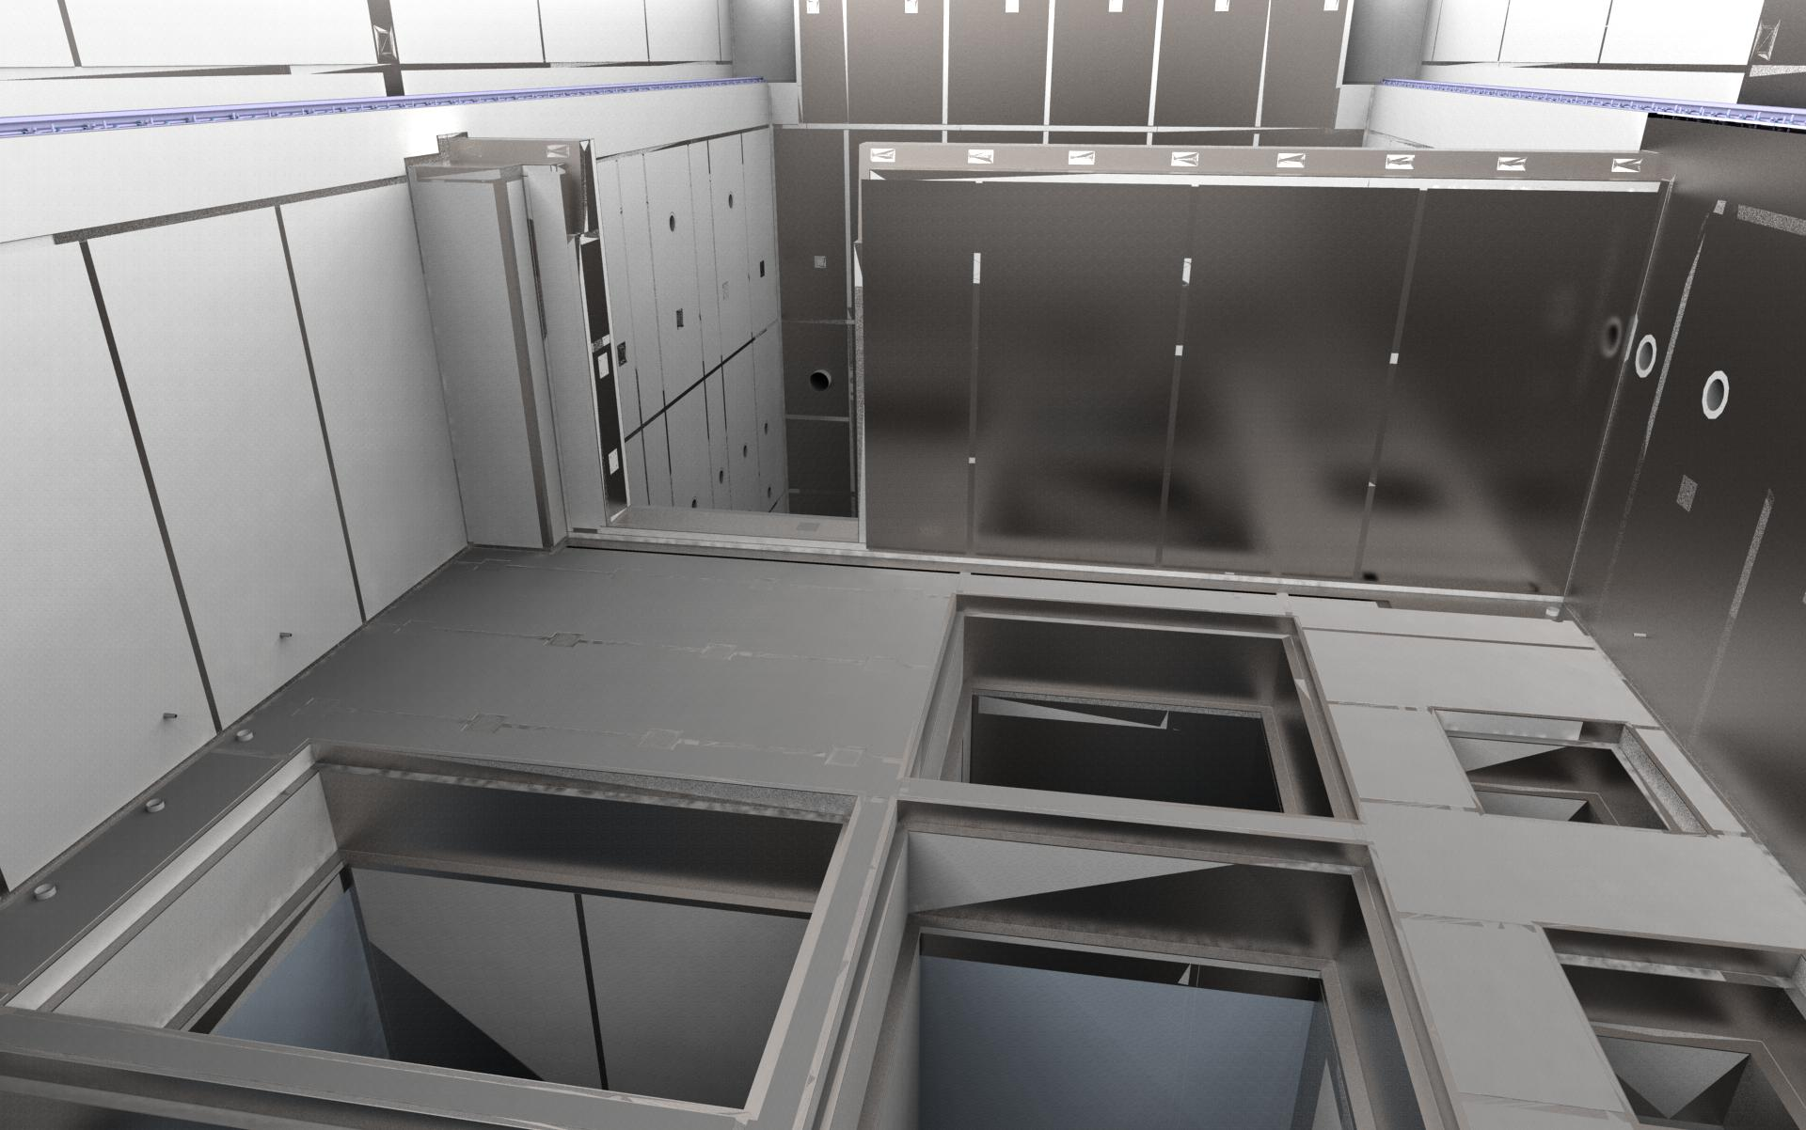
Active cells facility

Slide 2
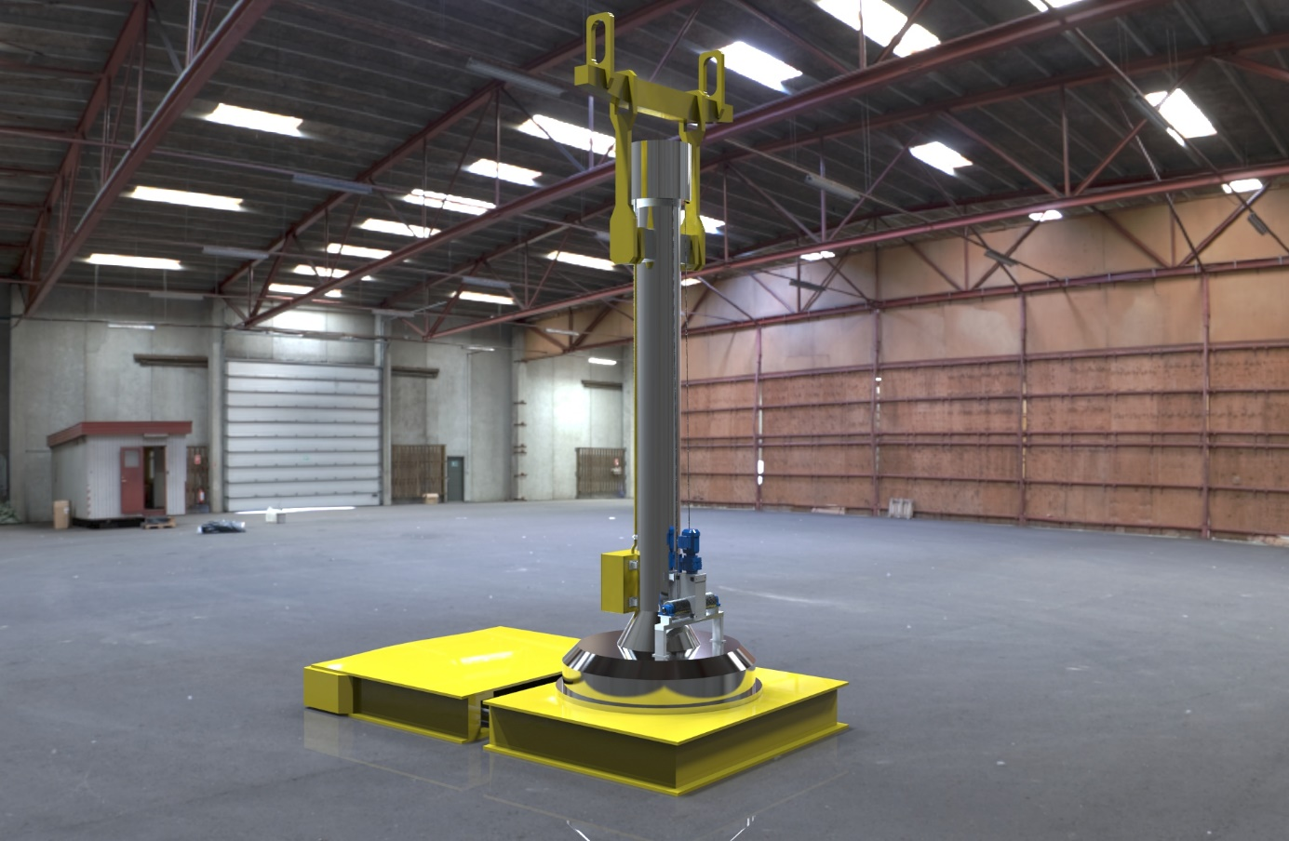
Target wheel and shaft CASK

Slide 3
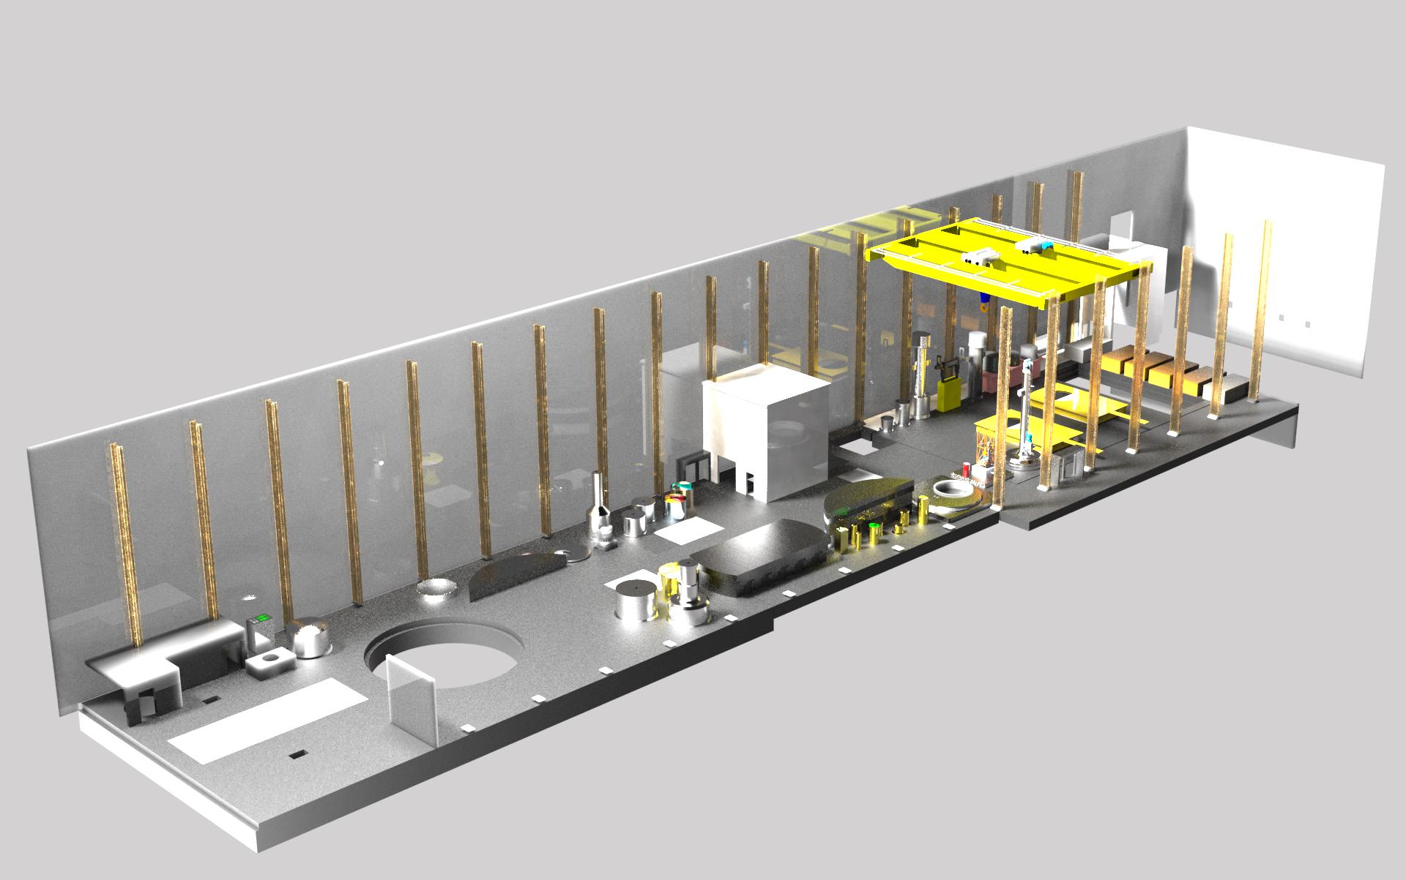
Remote handling High bay

Slide 4
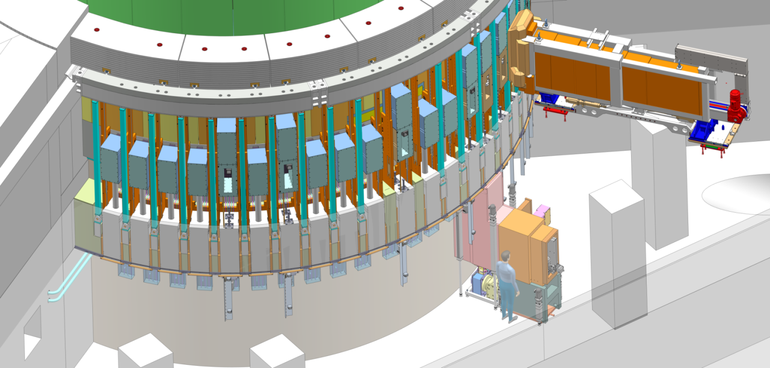
NBEX Neutron Beam Extraction System
Outside of Monolith and Monolith Basement, location of Light Shutter System comprising the `Vertical Actuators’
In Monolith, location of Neutron Beam Port Insert

Slide 5
Possible path forward?
Common
visions
Personal knowledge and skills
Systemic thinking
Team learning
Thought models
Systemic thinking, or slightly shorter, system-thinking, refers to the importance of being able to see the entire system of the organization and how the elements form a coherent whole.
Systematic work has more to do with endurance in combination with consistent work.

