Slide 1
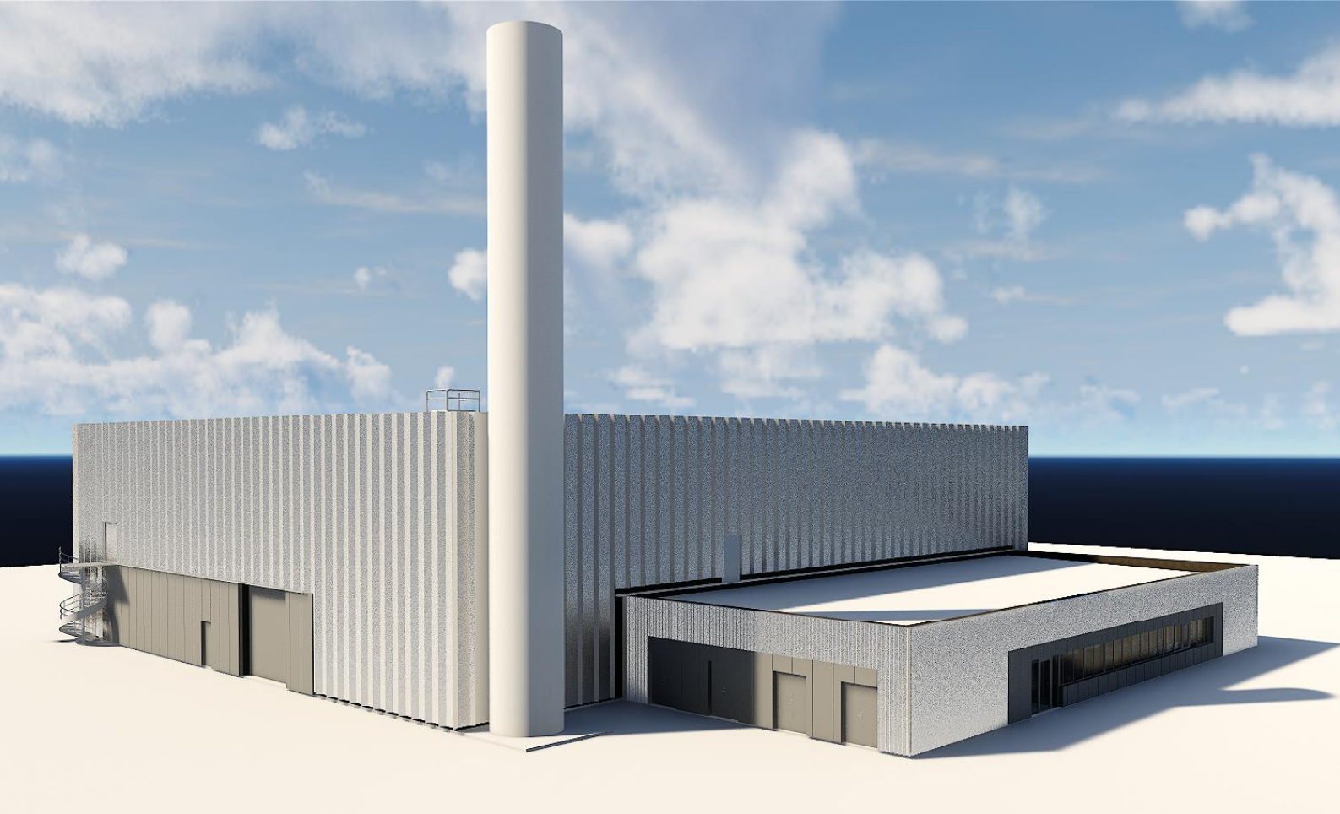
H09 Electrical
Ralph Ahlcrona
Designer Electrical
www.europeanspallationsource.se
18-02-05
Notes:
My name is Ralph Ahlcrona.
Electrical designer in DD for CF.
Presenting the electrical systems in H09.

Slide 2
Content electrical systems
Low voltage power
Lighting
Communication
Fire alarm
Security systems
Grounding
Notes:
The following electrical systems is present in H09

Slide 3
Interfaces
H09
Electrical
D05 Substation
H09 Transport
H09 Process
H09 HVAC
H09 C&M
Notes:
Interface from D05 Substation (electrical power).
To other external systems (blue).

Slide 4
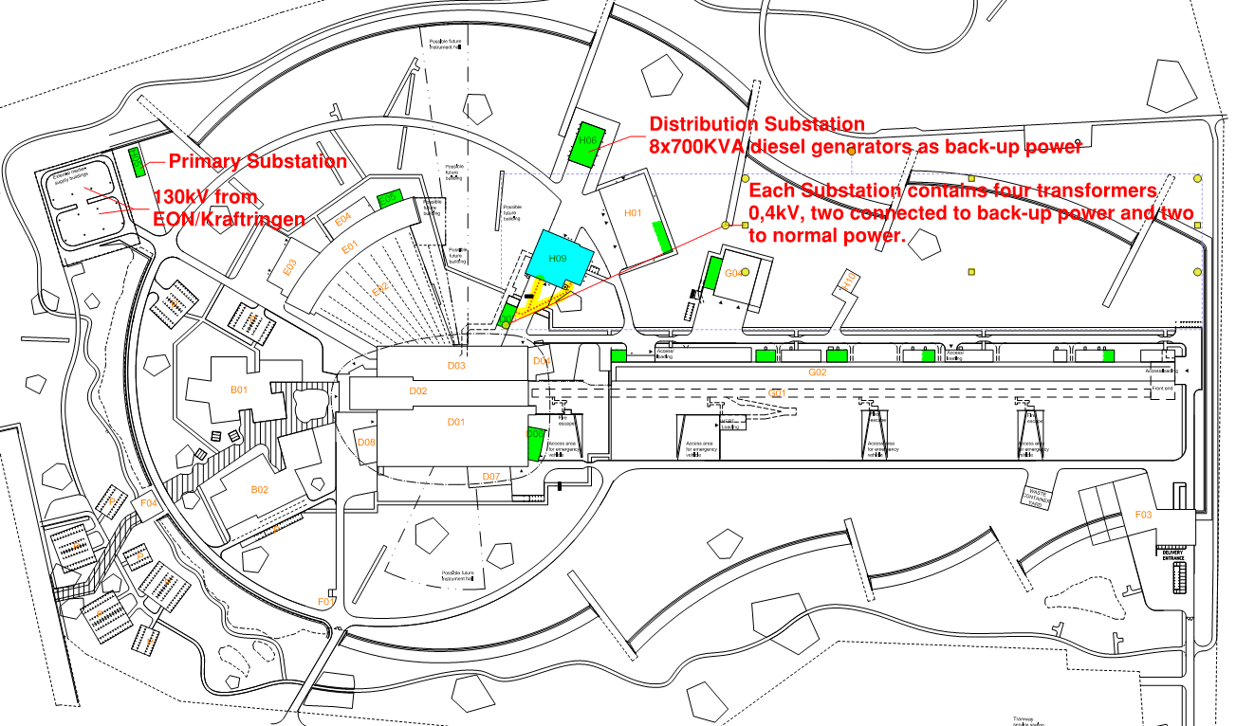
Power supply Site Wide
Notes:
130kV from EON/Kraftringen to H05 Primary Substation
Transformed down to 20kV and divided in two separate grids
20kV grids is in ”parallell” and feeding substations around the facility
Each Substation contains four transformers to 400V low voltage, two of them connected to back-up power and two to normal power.
The H06 Distribution Substation contains eight 700KVA diesel genarators as back-up power. The back-up power is transformed up to 20kV and distrubuted in one of the 20kV grids.

Slide 5
Power supply H09 Waste building
From EON/Kraftringen 130kV
Primary Substation H05 130kV/20kV
Distribution Substation H06 8 pcs diesel generators 0,4kV/20kV
Startup time approx. 30 sec
Secondary Substation D05 GP 2 pcs transformers - 20kV/0,4kV
BP 2 pcs transformers - 20kV/0,4kV
Notes:
H09 will be power supplied from Substation D05 with Low Voltage.
Four separate feeds; three (400A) normal power and one (160A) Back-up power
Two (400A) normal power and the (160A) back-up power ends up in distribution bords in low voltage room in H09. The other (400A) normal power ends up in electrical cabinet for Process.
Back Up power feeds: emergency lighting, fire alarm, intrusion alarm and access control, and critical loads in process specified in C&M scope.

Slide 6
Distribution boards H09 Waste building
Notes:
From distribution boards around the facility low voltage will be distributed to cabinets for process, cranes, lighting, outlets and other.

Slide 7
Distribution boards H09 Waste building
Notes:
From distribution boards Low Voltage will be distributed to cabinets for process, HVAC.

Slide 8
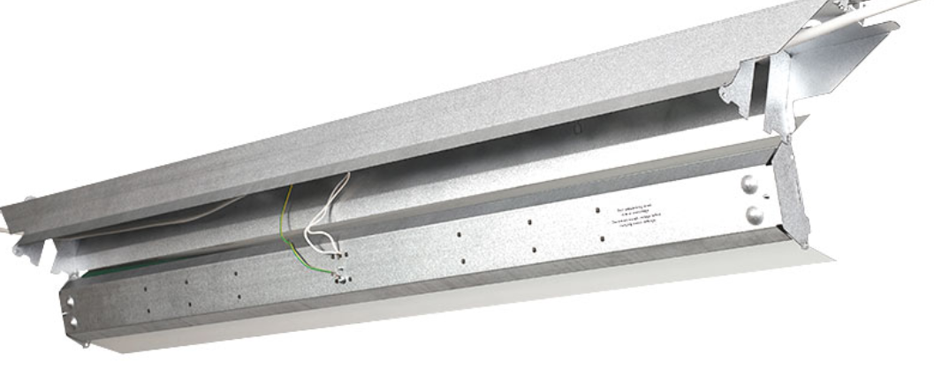
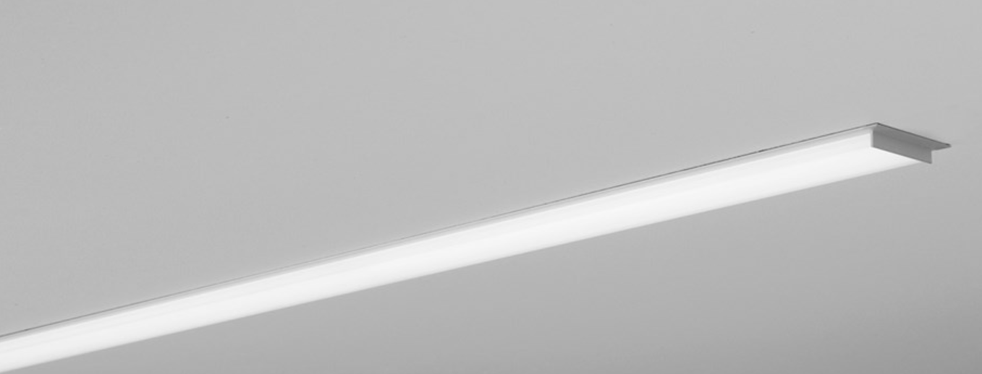
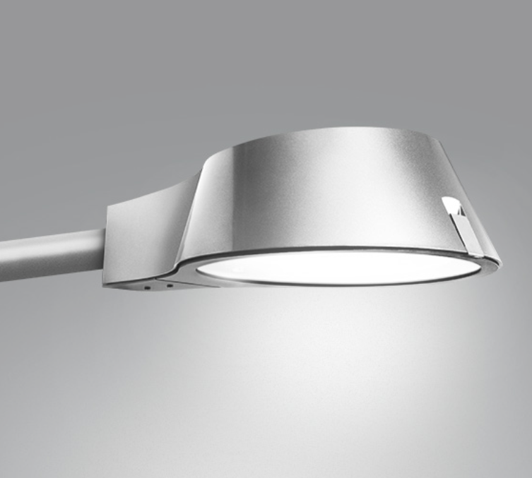
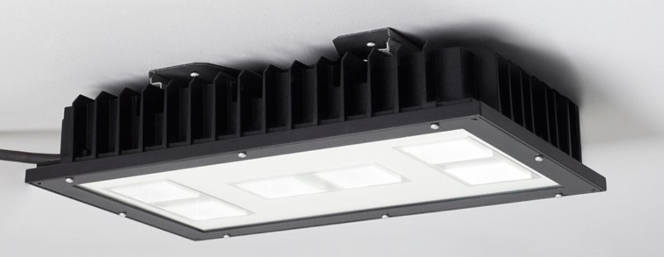
Lighting system H09 Waste building
Lighting in H09 will be adapted to work environment and environment
Notes:
Lighting is design to meet the demands which is based on the european standard (SS-EN 12464-1).

Slide 9
Emergency lighting system H09 Waste building
Notes:
Emergency lighting is designed to meet the demands in Fire Safety Strategy Report.
Emergency lighting will be connected to back-up power (diesel generators) and is designed to secure evacuation if power failure occur.
Exit signs with built in battery back-up

Slide 10
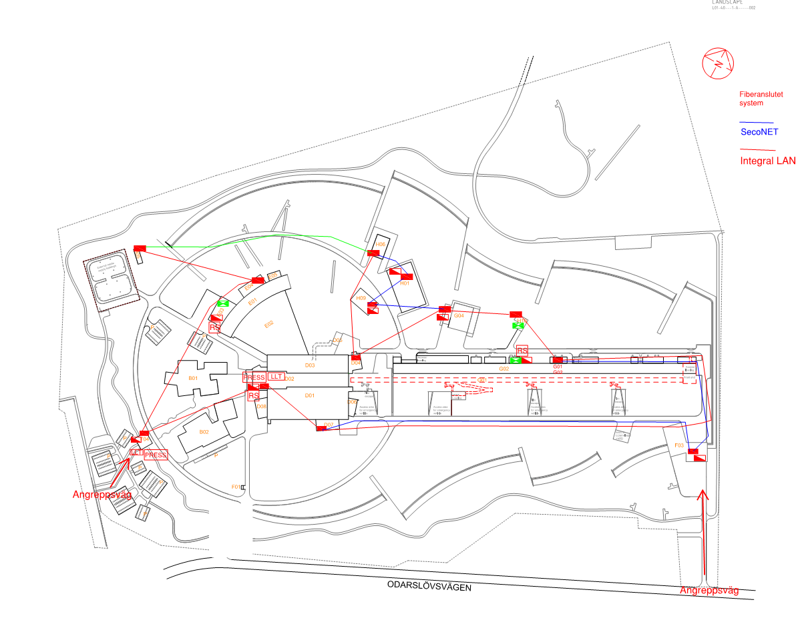
Fire alarm system Site Wide
Notes:
The fire alarm is a site wide system interconnected with a redundant fiber network.

Slide 11
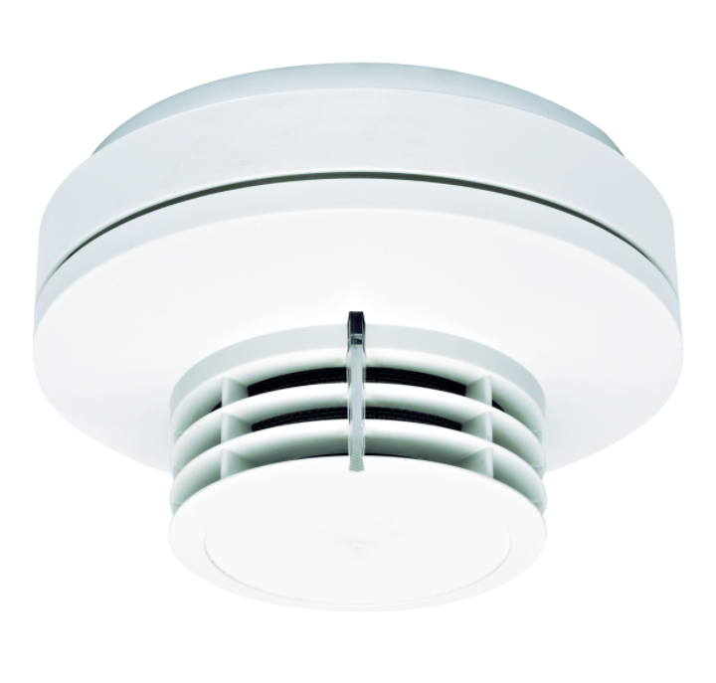
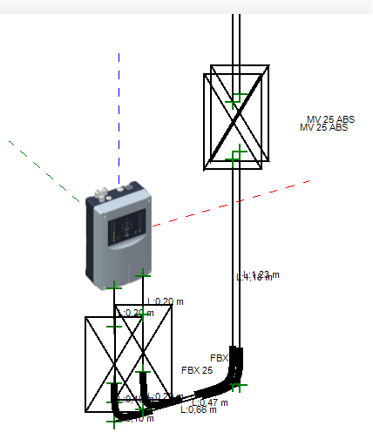
Fire alarm sytem H09 Waste building
Notes:
Fire alarm will be designed according to Swedish regulations.
Fire alarm system will be designed to detect fire, alert fire brigade and site personal and start evacuation alarm.
Type of detection method adapted to environment in the specific spaces.
Limited manual override in detection when specific operations occur. Precise instructions and organization are required.

Slide 12
Security system H09 Waste building
Site wide basically the same as fire alarm system
An integrated intrusion alarm and access control system will be installed to prevent unauthorized to access the building.
The systems consists of card readers, magnets and detectors.
Activated alarm will alert site security personal
Notes:
Security System

Slide 13
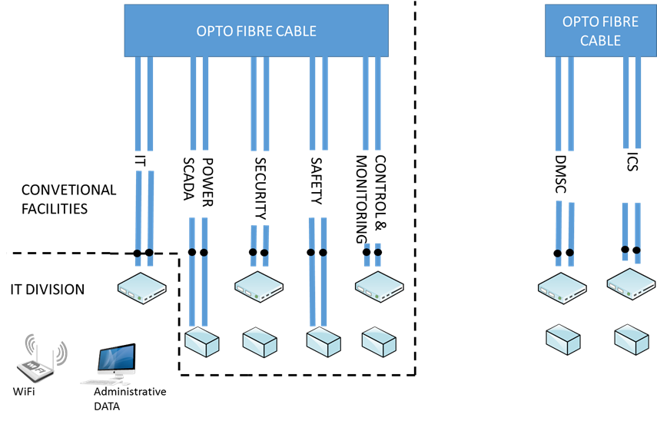
Communication system H09 Waste Building
Network outlets will be installed around the building.
Communication system will be connected to the site fibre backbone.
Notes:
Conventional Facilities division (CF) – designing and constructing the building
Integrated Control System division (ICS) – operating servers in the server room
Environmental, Safety & Health (ES&H) – interpreting regulatory requirements and expectations
Data Management Centre (DMSC) – operating servers in the server room
Information Technology division (IT) – future user of the server room
Third party operator CPS – designing, constructing, and operating the Central Process Systems

Slide 14
Grounding system H09 Waste building
Notes:
Lightning protection system will meet european standard.

