Slide 1
H09 HVAC for waste building Preliminary design
Patrik Persson
Owner of HVAC
www.europeanspallationsource.se
2 February, 2018

Slide 2
HVAC are responsible for following systems in the building:
Domestic Water system
Conventional Waste Water System
Radiological Waste Water System
Cooling Water System
Heating Water System
Conventional Ventilation System
Radiological Ventilation System
Fire extinguishing system

Slide 3
Drains, thresholds and handling of internal flooding level 115

Slide 4
Drains, thresholds and handling of internal flooding level 110

Slide 5
Drains, thresholds and handling of internal flooding level 100

Slide 6
Drains, thresholds and handling of internal flooding level 090

Slide 7
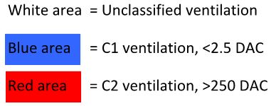
Zoning of radiological ventilation level 115

Slide 8
Zoning of radiological ventilation level 110

Slide 9
Zoning of radiological ventilation level 100

Slide 10
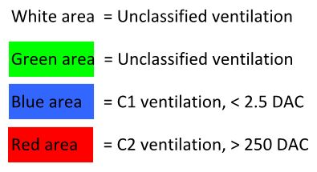
Zoning of radiological ventilation level 090

Slide 11
Flowchart Domestic Water

Slide 12
Flowchart Conventional Waste Water System

Slide 13
Flowchart Radiological Waste Water System

Slide 14
Flowchart Cooling Water System

Slide 15
Flowchart Heating Water System

Slide 16
Flowchart Conventional Ventilation System

Slide 17
Flowchart Radiological Ventilation System

Slide 18
Flowchart Sprinkler system

Slide 19
View over fan rooms

