Slide 1
Introduction to the Swedish waste management system and its application at ESS
PDR 2018-02-05
Per Persson
Radioactive Waste Manager
www.europeanspallationsource.se

Slide 2
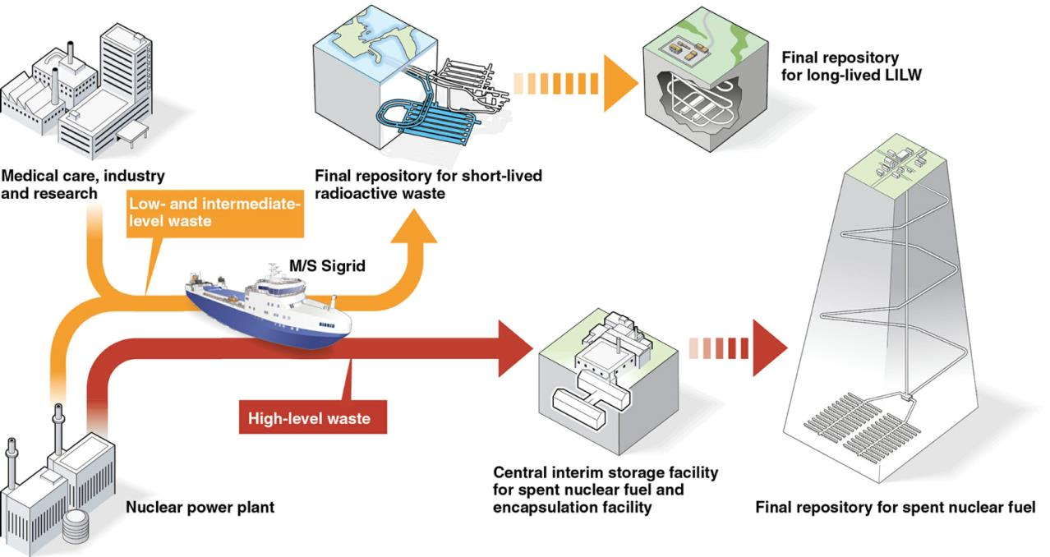
Radioactive Waste Management
General approach
ESS will adopt to the existing Swedish system.

Slide 3
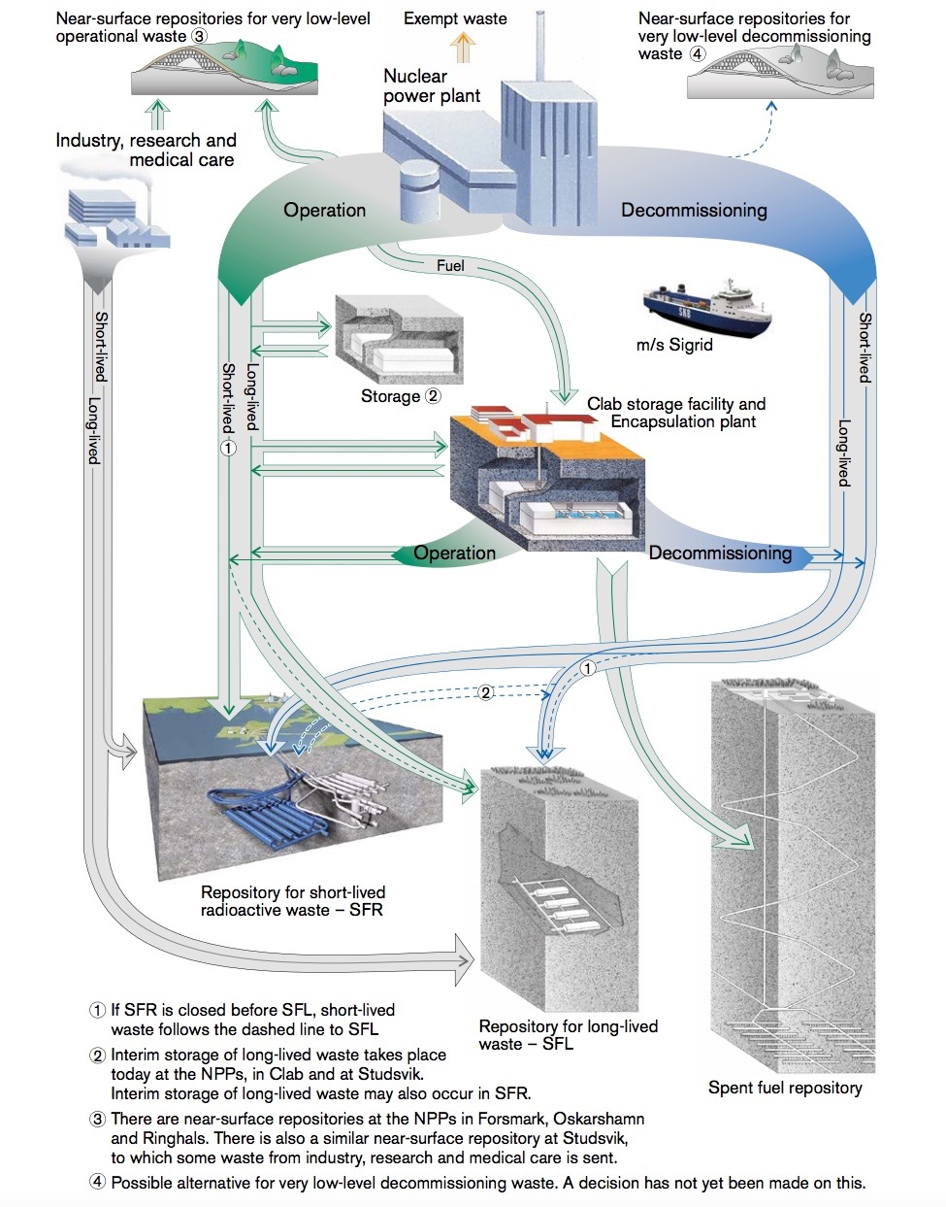
Radioactive Waste Management

Slide 4
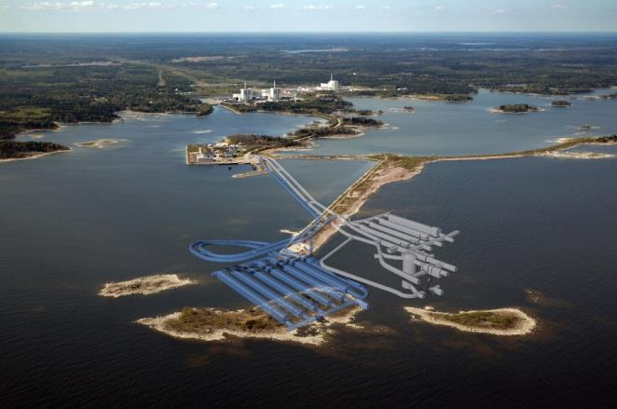
Radioactive Waste Management

Slide 5
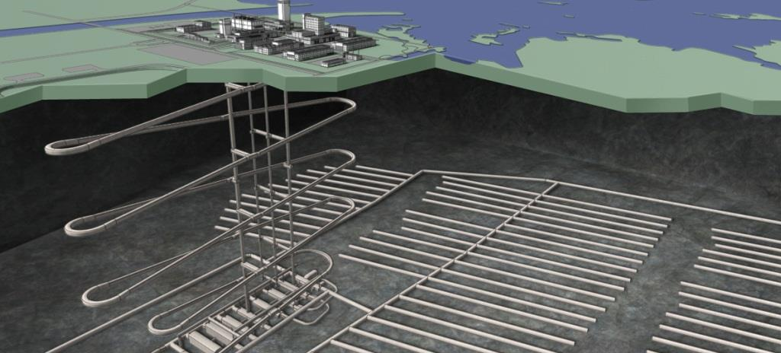
Radioactive Waste Management

Slide 6
Radioactive Waste Management
Handling of Operational Radioactive Waste
Basically solidification of waste using steel/concrete moulds and other containers.

Slide 7
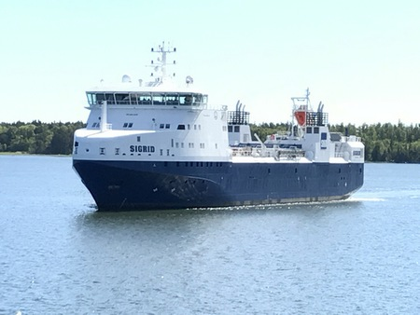
Radioactive Waste Management
Transportations of Radioactive Waste
Road transport with trailer to a harbor in the Malmö area.
Transport by ship between Malmö and the local harbor at Studsvik.
Short transport with a terminal vehicle from the Studsvik harbor to the treatment and interim storage facilities.

