Slide 1
Radioactive Waste Management in the Waste building H09
PDR 2018-02-05
Per Persson
Radioactive Waste Manager
www.europeanspallationsource.se

Slide 2
Radioactive Waste Management
Strategy
Prevent the generation of radioactive waste
Generation of waste and radioactive emissions are to be maintained at the lowest level possible
Use best available technology (BAT)
Manage radioactive waste safely (ALARA)
Use existing disposal routes for radioactive waste
Re-use materials and water when possible

Slide 3
Radioactive Waste Management
Two facilities for treatment of radioactive waste
Active Cells:
for solid waste with more than 10 mSv/h at the surface.

Slide 4
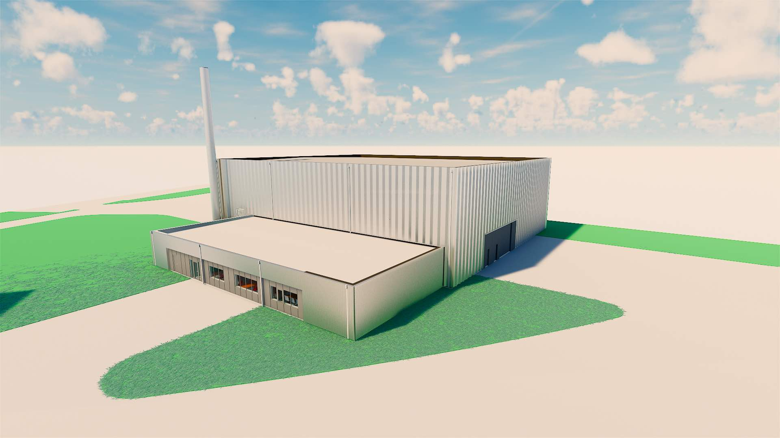
Radioactive Waste Management
Waste Building:
for all liquid waste, all resins and solid waste with less than 10 mSv/h at the surface.

Slide 5
Location of the Waste Building (H09)

Slide 6
Radioactive Waste Management
Schematic illustration of the steel tank for neutron-irradiated components.
The steel tank has external dimensions 3.3*1.3*2.3 m3

Slide 7
Radioactive Waste Management
Requirements from Swedish Radiation Safety Authority (SSM)
Special conditions
Regulations:
SSMFS 2008:27 Regulations on accelerators and sealed radiation sources
SSMFS 2008:29 General recommendations on the competence of radiation protection experts
SSMFS 2008:51 Basic provisions for the protection of workers and the general public
SSMFS 2008:52 External workers in operations that involve ionising radiation
SSMFS 2011:2 Clearance of materials, rooms, buildings and land

Slide 8
Radioactive Waste Management
Requirements from external stakeholders
Environmental court:
Maximum of 550 tones of radioactive waste at site at the same time.
Only sewage water that has been approved in advance by the municipal water and sewage company (VA SYD) and the Supervisory Authorities according to the Environmental Code shall be diverted to the municipal sewage system.
SKB
Contract with SKB regarding the repository for long lived waste (SFL). SFL in operation ≈ 2045.
final conditioning of the waste containers not possible.
need for an off site interim storage.

Slide 9
Radioactive Waste Management
Off-site services
processes metallic waste, i.e. blasting of metallic waste, size-reduction, melting operations and clearance.
incinerate combustible, solid and liquid waste.
pyrolysis, in which material is treated by dry thermal decomposition in a controlled environment.

Slide 10
Radioactive Waste Management
Waste estimates
 | Waste Water [m³/year] | Ion-Exchange Resin [l/year] | Solid Waste [kg/year]
Accelerator | 10 | 100 | 11 500
NSS | 6 000 | 100 | 23 500
Target | 100 | 850 | 1 000
Waste treatment facility | 100 | 100 | 100
∑ | 6210 | 1 150 | 36 100

Slide 11
Draft layout of the Waste Building (H09)

Slide 12
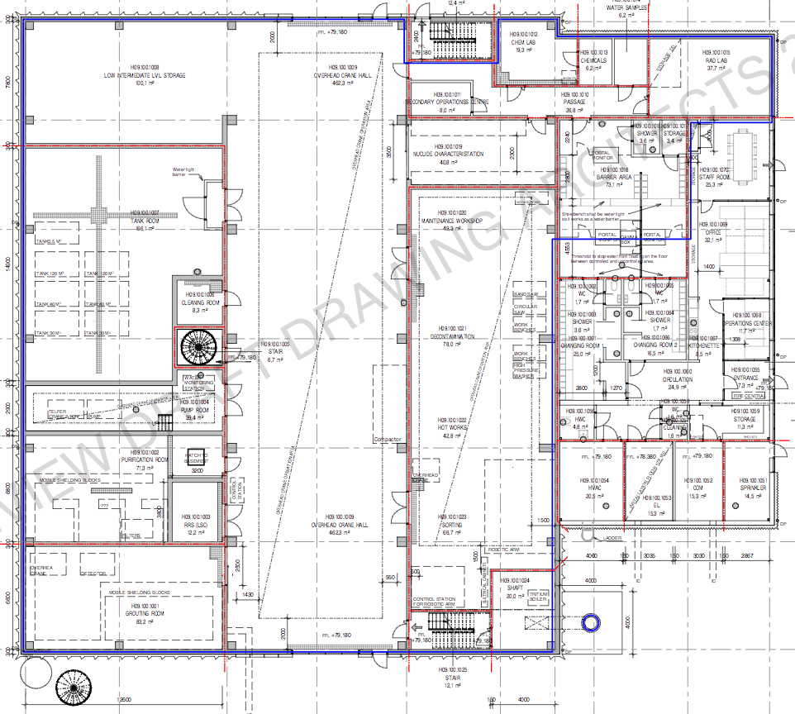

Slide 13
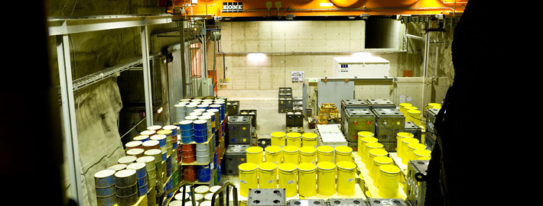
Radioactive Waste Management
Interim Storage of Operational Radioactive Waste
Working on an agreement with SVAFO for Interim Storage.

Slide 14
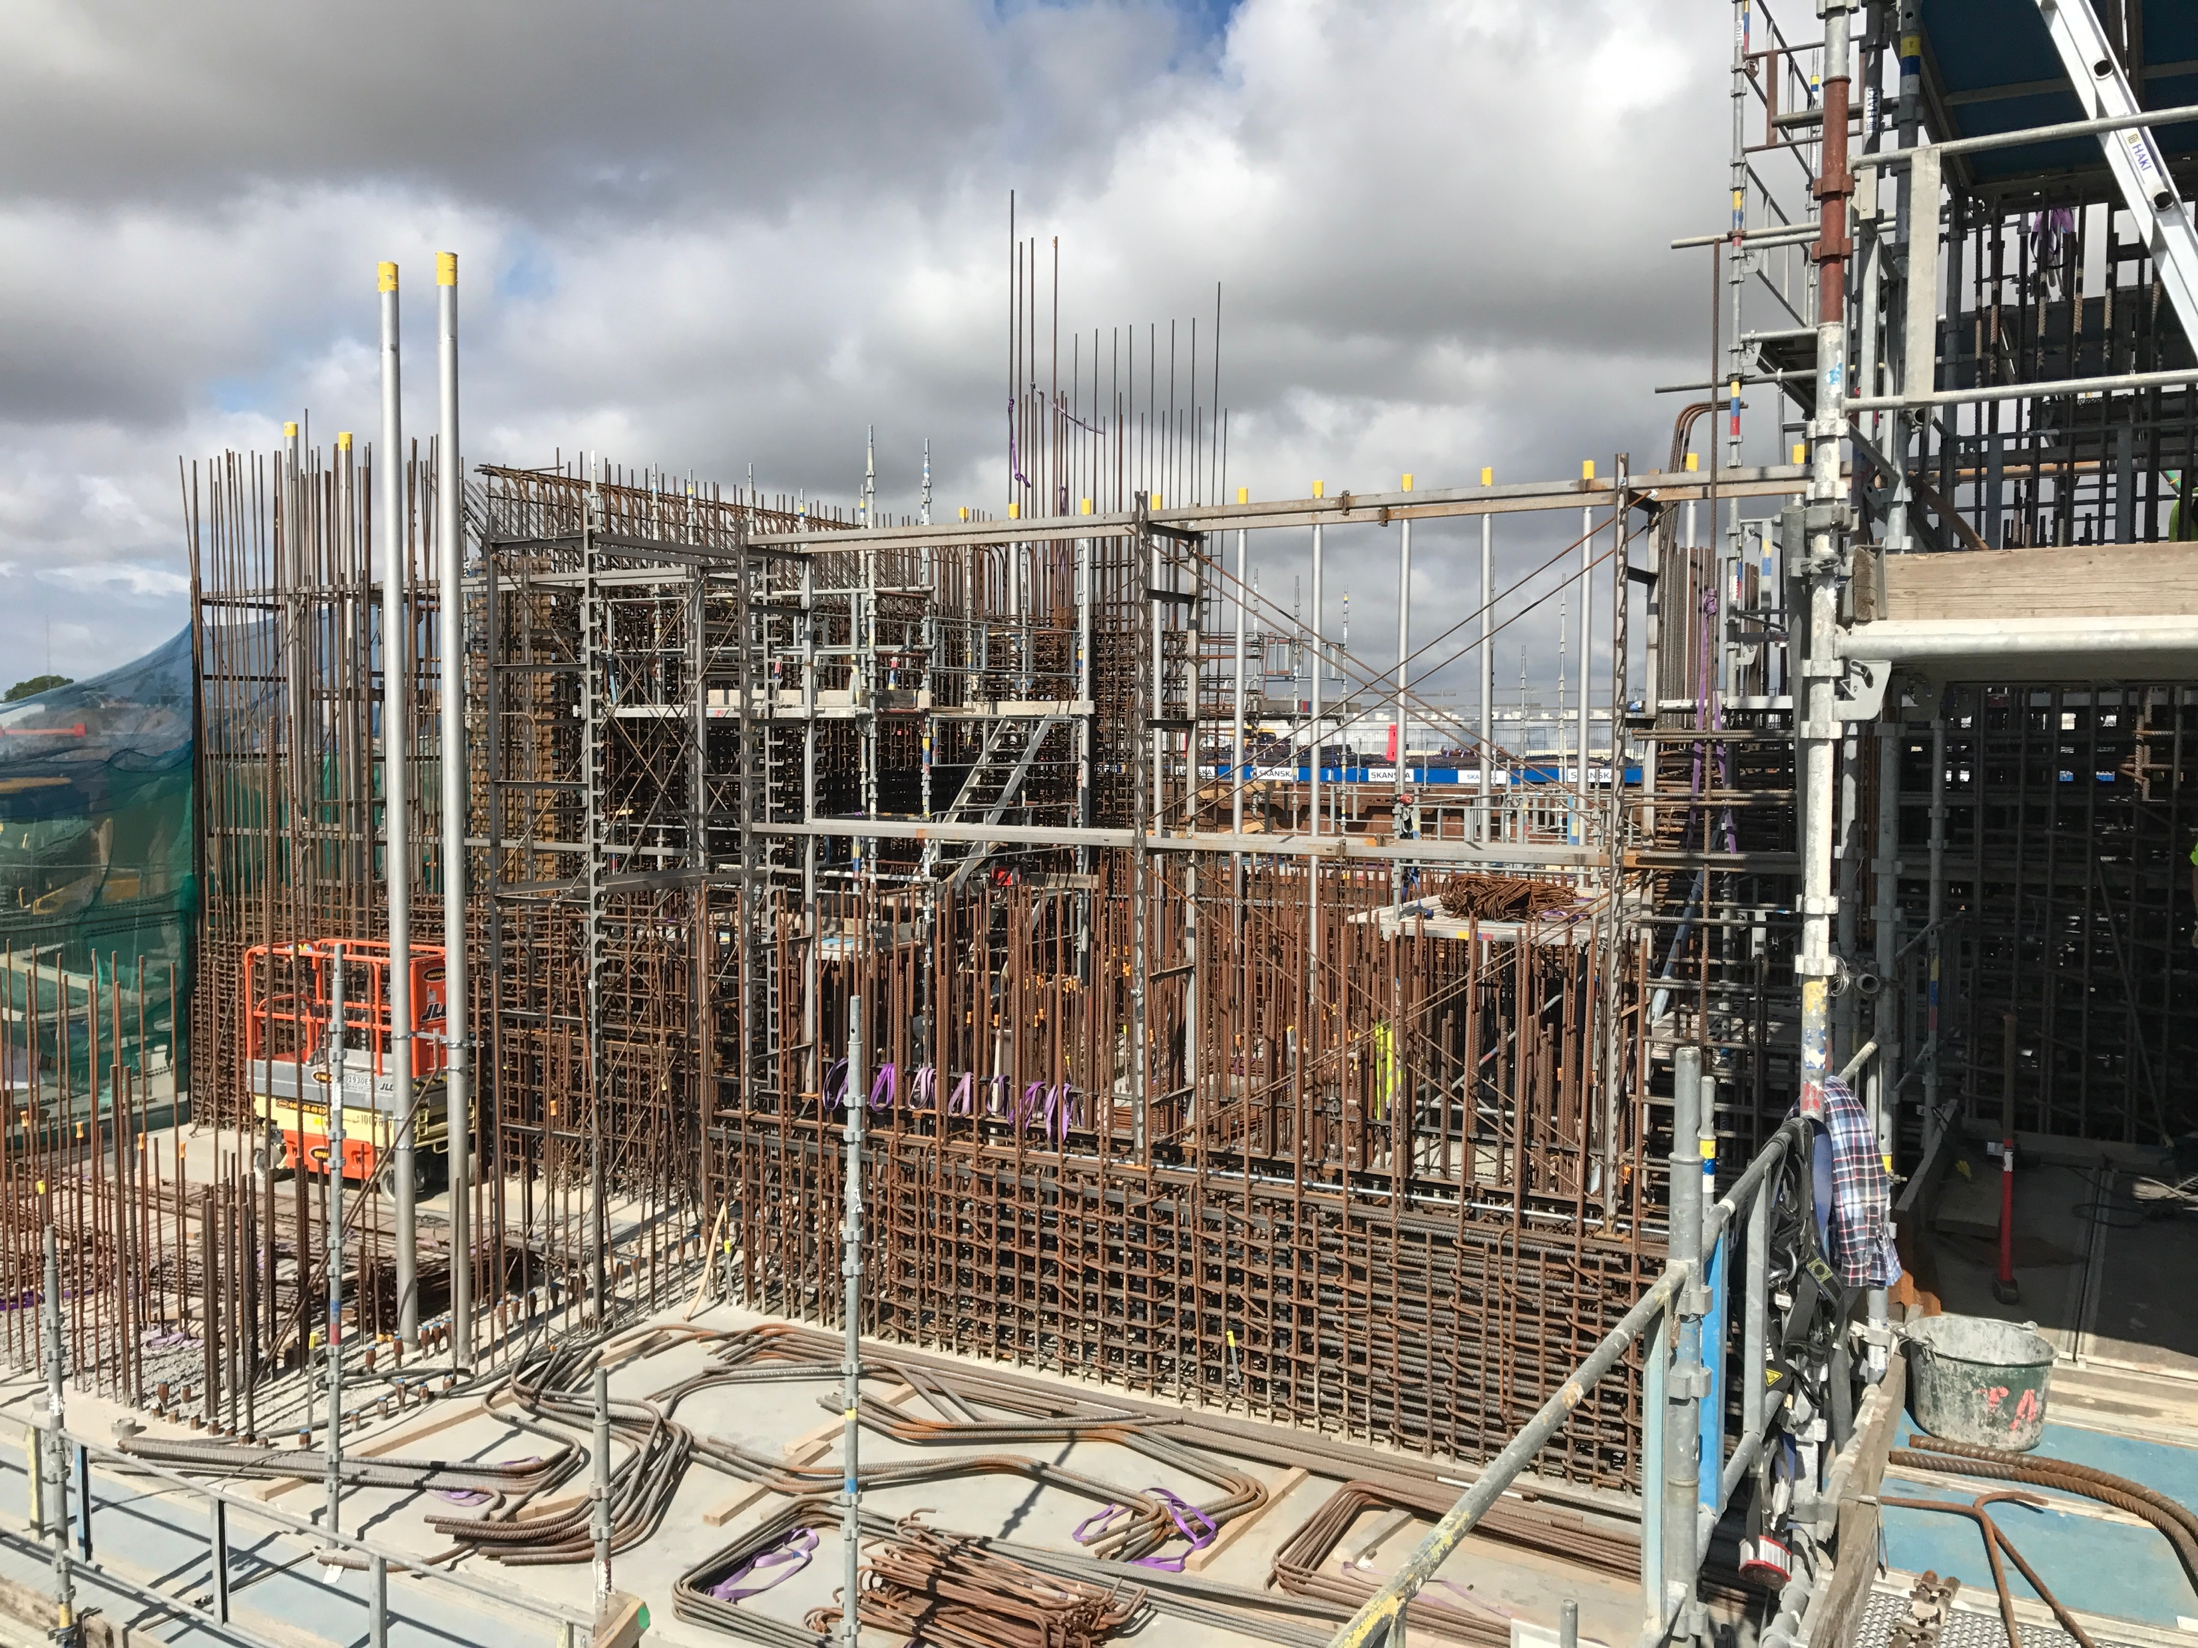
Radioactive Waste Management
Status:
Waste Building:
The preliminary design for the Waste Building (H09) is to be finished within a month. In operation 2021.
Active Cells:
Under construction.
In operation 2021.

Slide 15
Radioactive Waste Management
Thanks!
Questions?

