Slide 1
H09 Architectural & Structural Preliminary Design
Frank Kezerle
H09 Waste treatment facility - Baseline Agreement
www.europeanspallationsource.se
5 February, 2018

Slide 2
INTERFACING DISCIPLINES & STAKEHOLDERS
FIRE
ACOUSTICS
ACCESS & SECURITY
SAFTEY
LOGISTICS INTERFACE WITH CIVIL
HVAC INT. functional space
ELECTRICITY INT. functional space
PROCESS INT. functional space

Slide 3
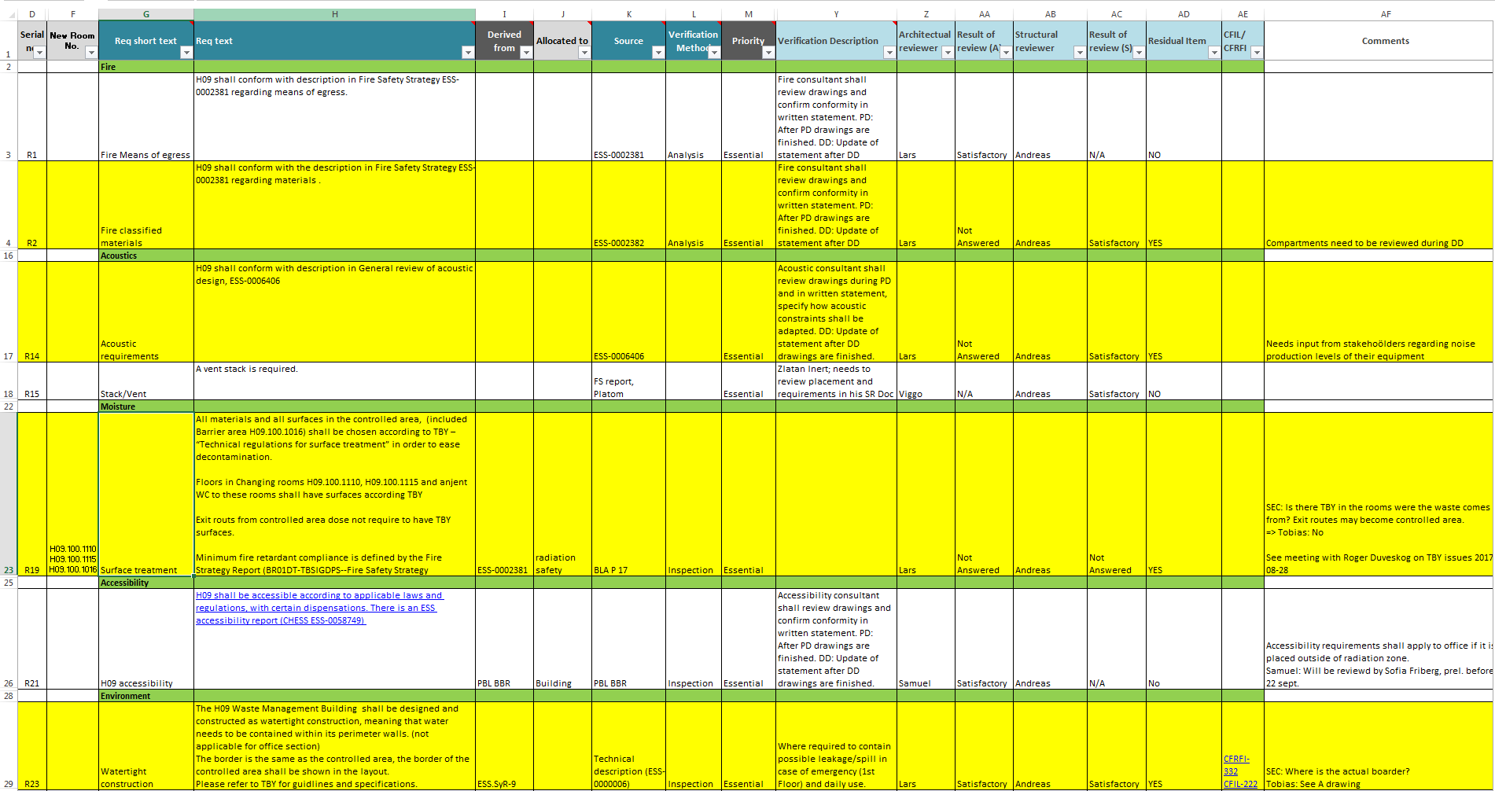
REQUIREMENTS: Cf and Stakeholder
Architectural and Structural requirements are listed in ESS-0082503 DM--SR-TBSIDDH09-System Requirements H09 Structure.

Slide 4
System Descriptions Architectural H09
System Description H09 structure is a description and rationale of the expected operations of the H09 structure from an architecturally functional point of view.
It is a platform for stakeholder consensus to ensure that the system that is built is operationally feasible.
This is a sub document of the System Description H09 Waste treatment facility
[1]. All system requirements and conditions on H09 Structure are listed in the requirement document
[2]. It is part of the technical baseline for the detailed design.

Slide 5
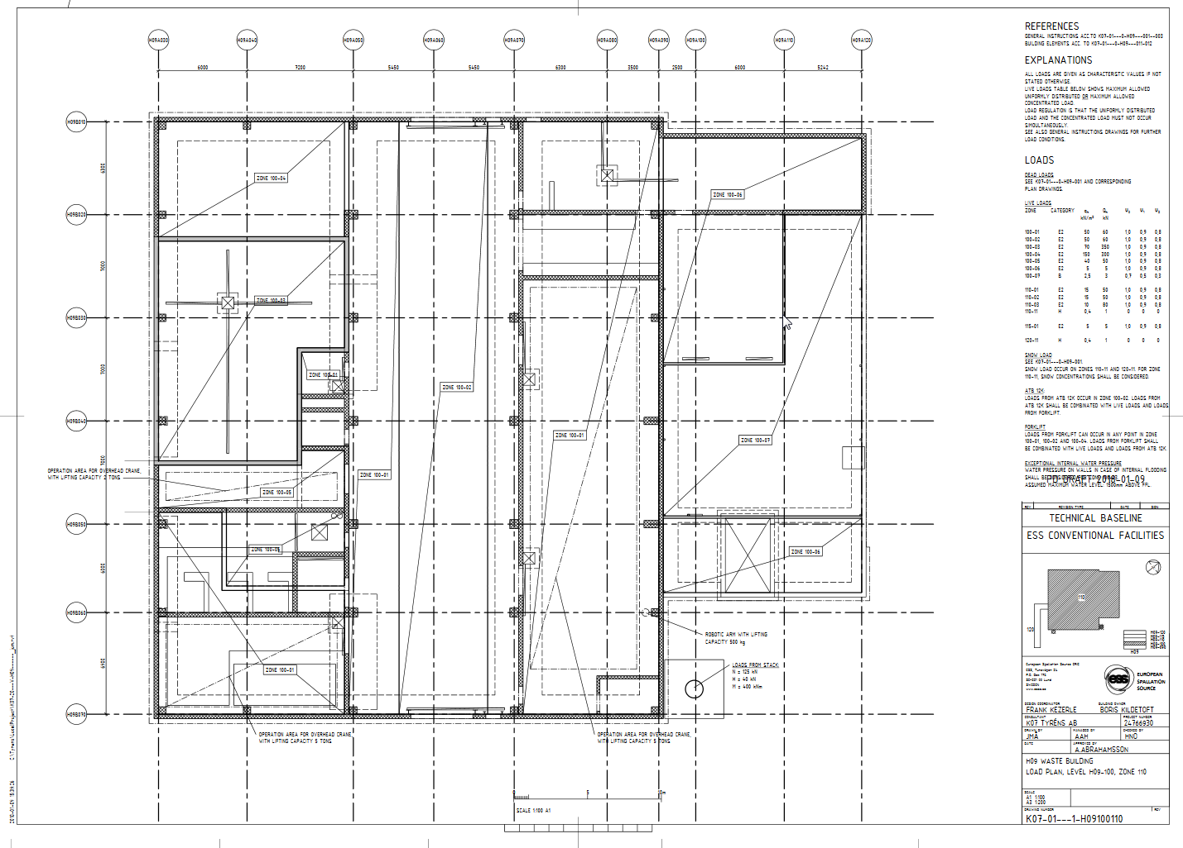
TECHNICAL BASELINE STRUCTURAL H09
Compilation of structural preliminary drawings based on all known requirements

Slide 6
Basis of Structural Design H09
Presents the basis of design for the structure of the H09 Waste Building as part of the larger ESS project,
Present the applicable loads acting on the structures,
Load case combinations, analysis methodology,
Requirements for the structure and design principles,
This document should be read together with both Architectural and Structural drawings of the building.

Slide 7
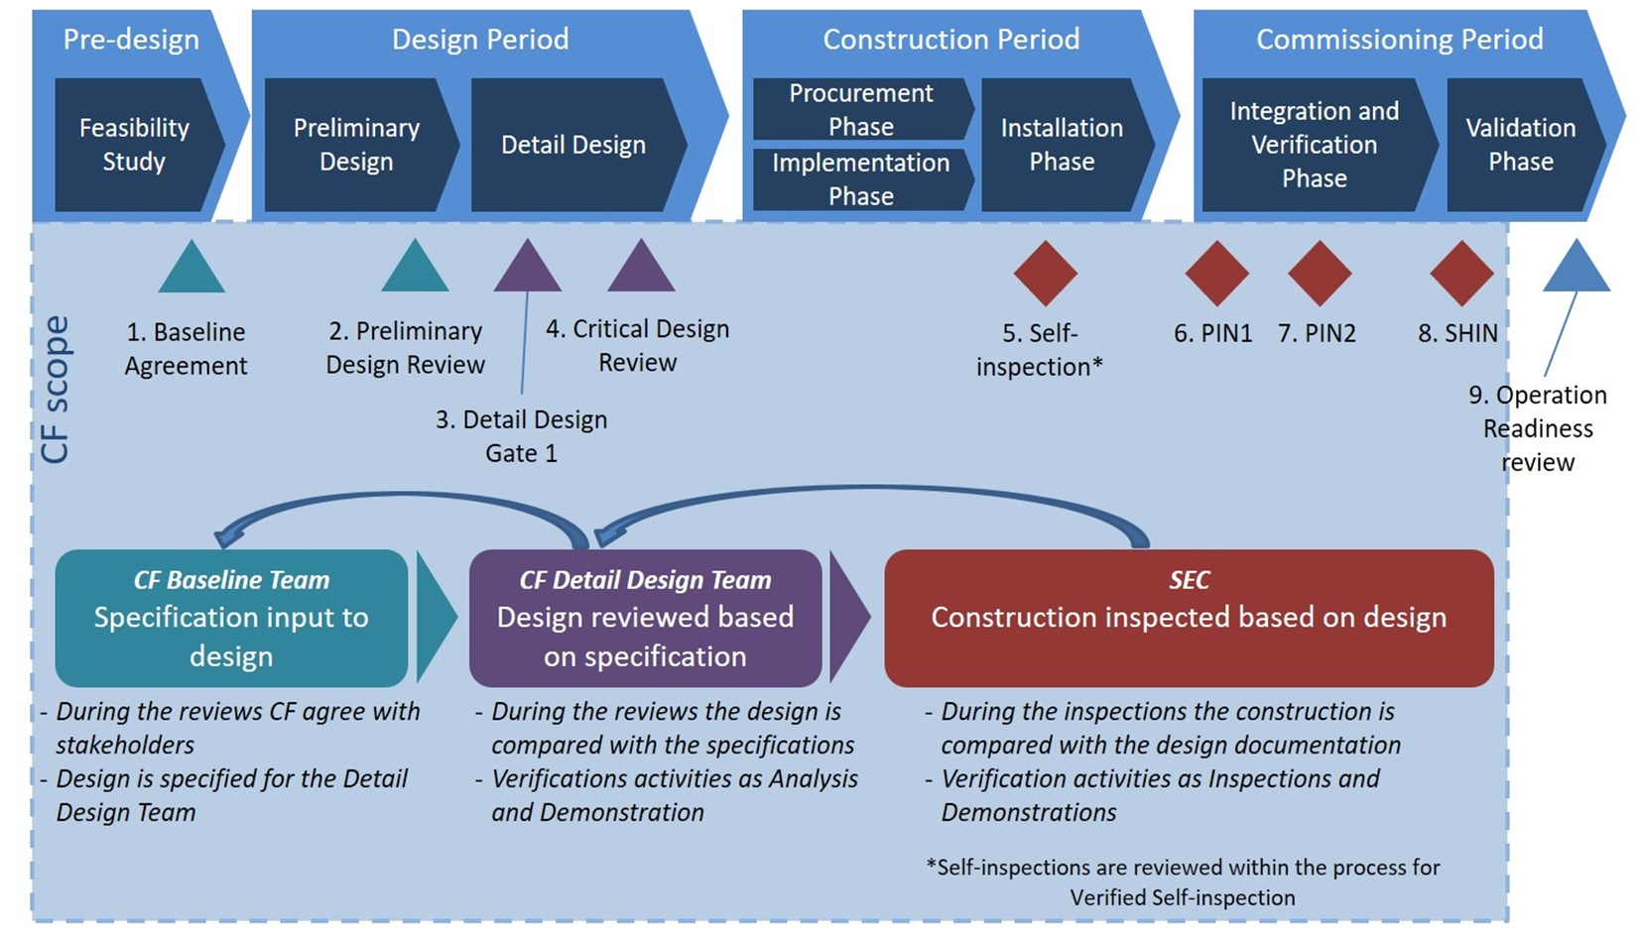
Procedure of CF quality and review

Slide 8
LINKING REQUIREMENTS TO RESULTS
The Verification & Validation Protocol shall provide the link between All Stakeholder Requirements - BLT (PD) - CF Design (DD) - SEC (Construction) & Approval (Final Inspection/ Fulfilment of requirements).
This document shall be part of the design verification process (review protocols) and the construction documents providing input into the ITP (inspection test plan) and MS (method statement).

Slide 9
H09 TECHNICAL BASELINE ARCHITECTURAL
Compilation of Architectural preliminary drawings based on all known requirements

Slide 10
H09 Architectural Preliminary Design
Samuel Martin, Viggo Frost
H09 Waste treatment facility - Baseline Agreement
www.europeanspallationsource.se
5 February, 2018

Slide 11
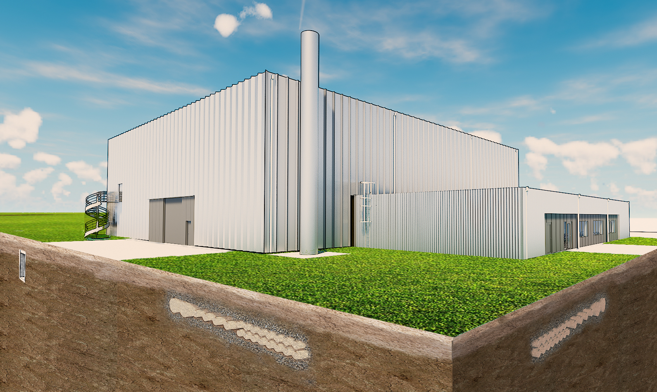
ARCHITECTURAL DESIGN
MEASSUREMENTS:
HIGH VOLUME: 1435m² LOW VOLUME: 448m²
WIDTH: 35m WIDTH: 14m
LENGTH: 41m LENGTH: 32m
HEIGHT: 12m HEIGHT: 4m
CONSTRAINTS:
- ARCHITECTURAL DESIGN MANUAL, REF G04
- H01 GROUND PIPES DISTANCE, >3,5m
- MINIMAL DISTANCE TO ROAD, >3m
- CONNECTION TO D BUILDING CULVERT
- REMAINING OUTSIDE E THE EXPANSIONAREA
OF THE E BUILDINGS
D BUILDING CULVERT
GROUND PIPES
GROUND PIPES

Slide 12
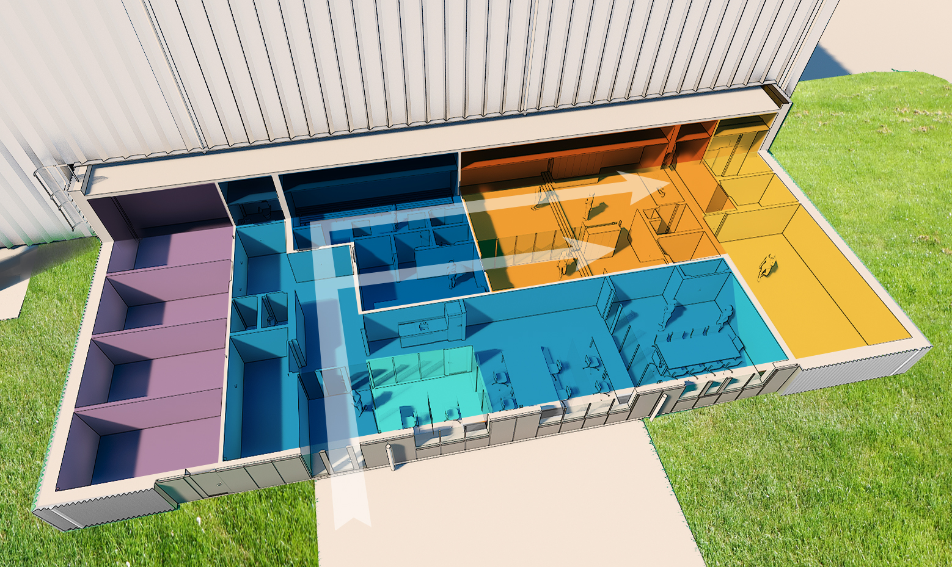
UNCONTROLLED AREA
BARRIER AREA
(CONTROLLED AREA)
CHANGING
ROOMS
LAB
(CONTROLLED AREA)
OFFICE
TECHNICAL
AREA
OPERATION
CENTRE
ENTRANCE

Slide 13
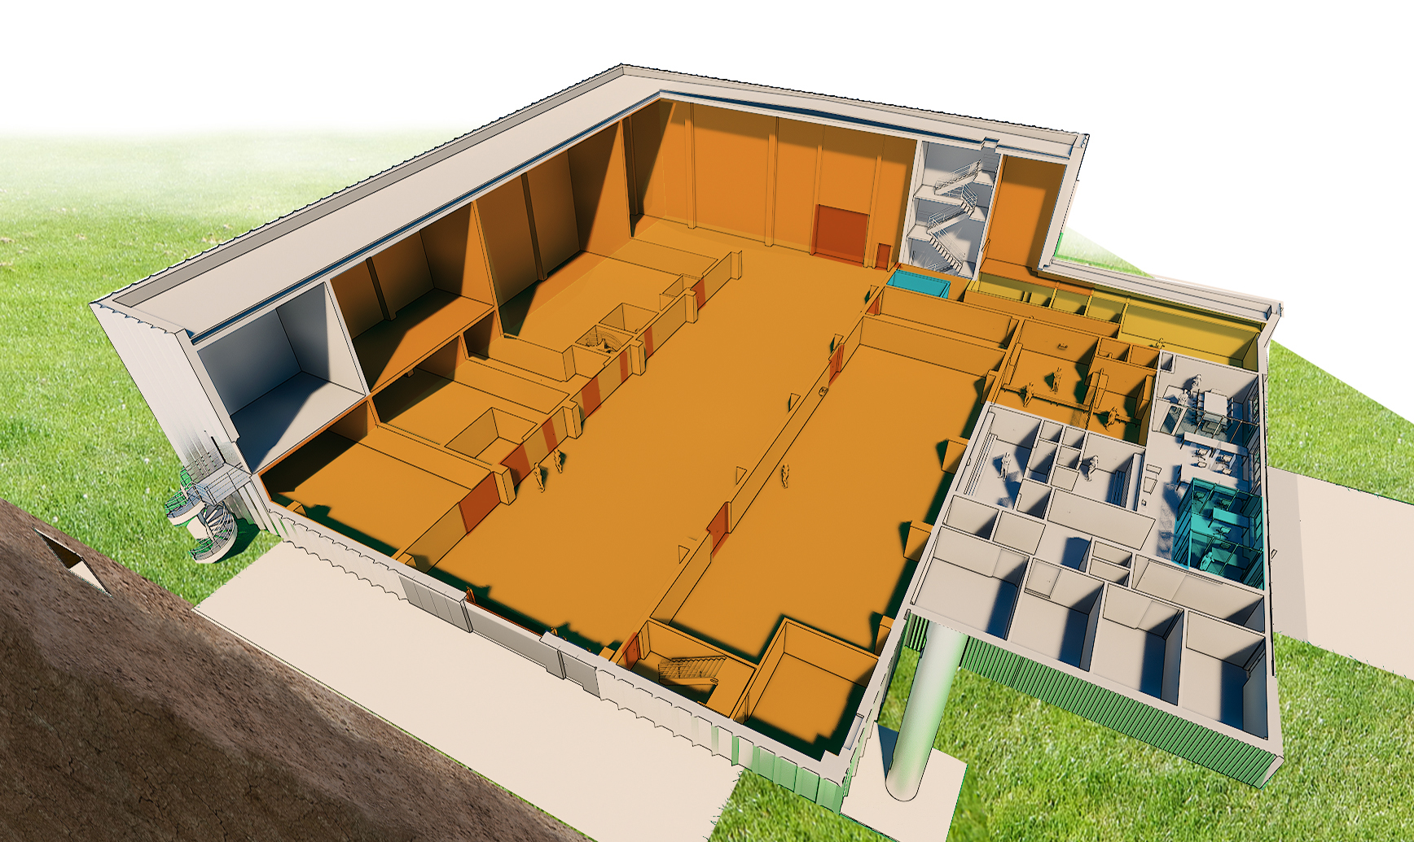
LEVEL 100 - CONTROLLED AREA
ALL OPERATIVE LOGISTICS ARE CHANNELLED
TROUGH THE OVERHEAD CRANE HALL
STAIRS TO HVAC
CEMENTATION
OPERATION CENTRE
(CONTROLLED AREA)
GATE
LIQUID WASTE TREATMENT AREA
(CONTROLLED AREA)
OVERHEAD
CRANE HALL
(CONTROLLED AREA)
SOLID WASTE TREATMENT AREA
(CONTROLLED AREA)
OPERATION
CENTRE
GATE
ENTRANCE
D BUILDING CULVERT

Slide 14
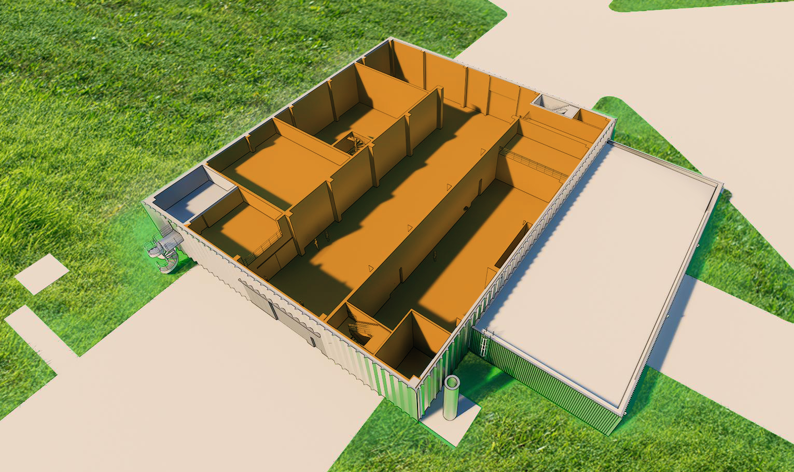
LEVEL 110 - CONTROLLED AREA
STORAGE
OVERHEAD
CRANE HALL
(CONTROLLED AREA)
STORAGE

Slide 15
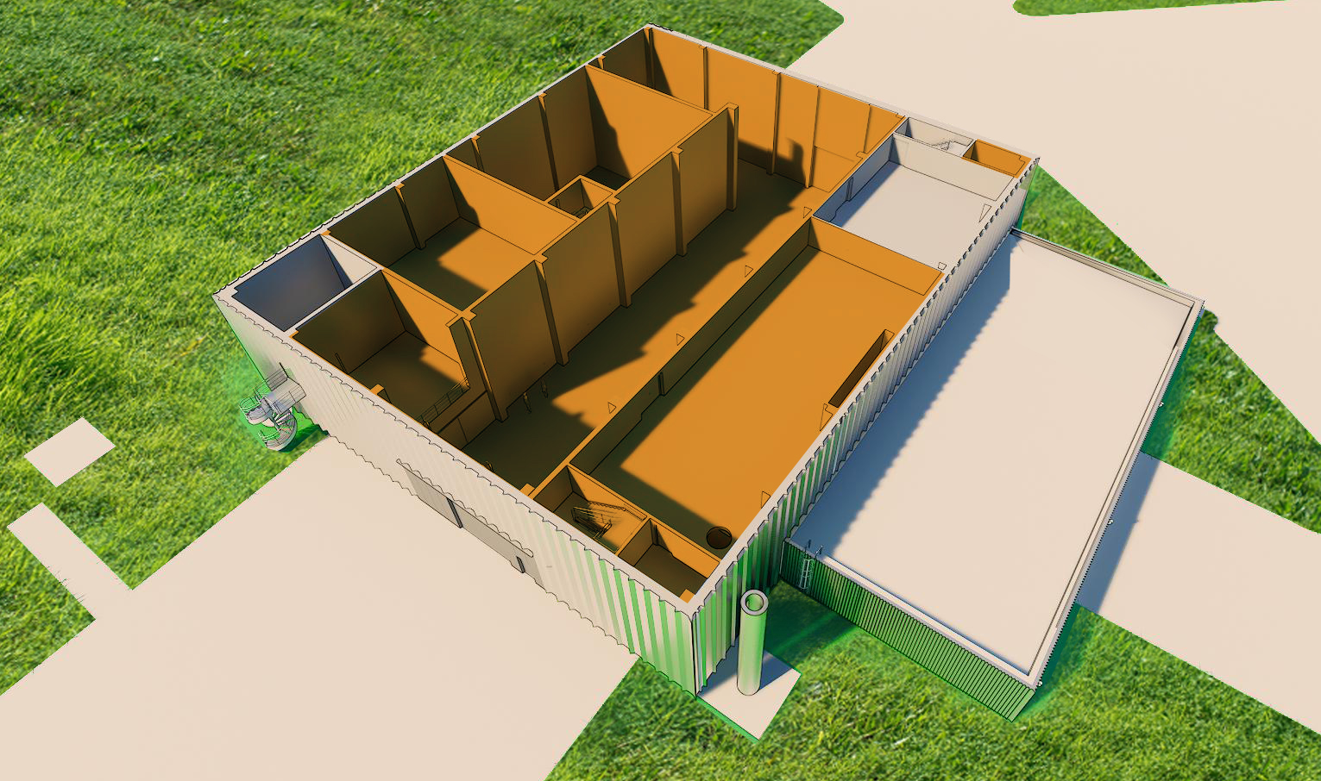
LEVEL 115 - CONTROLLED AREA
CEMENTATION
HVAC
OVERHEAD
CRANE HALL
(CONTROLLED AREA)
HVAC
(CONTROLLED AREA)

Slide 16
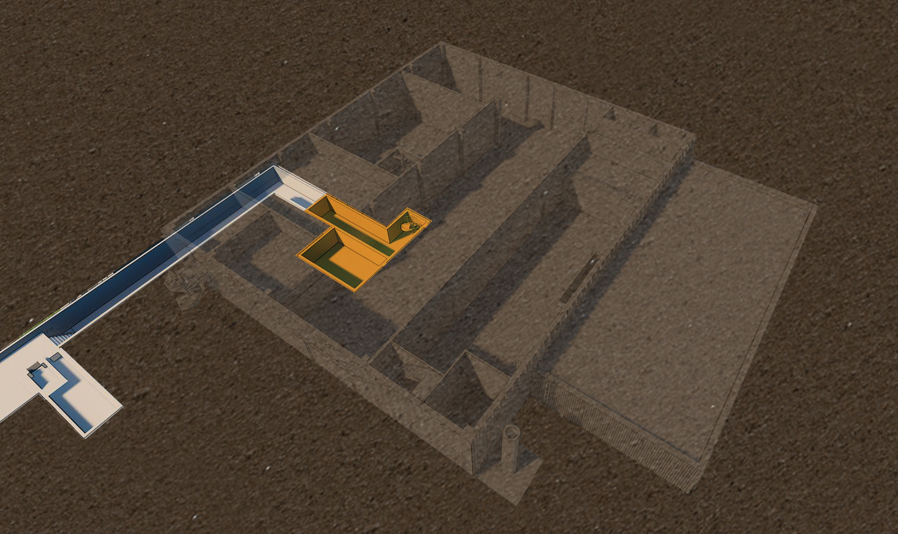
LEVEL 090 - CONTROLLED AREA
E BUILDINGS EXPANSIONAREA
D BUILDING CULVERT
STAIR & BASEMENT
(CONTROLLED AREA)

Slide 17
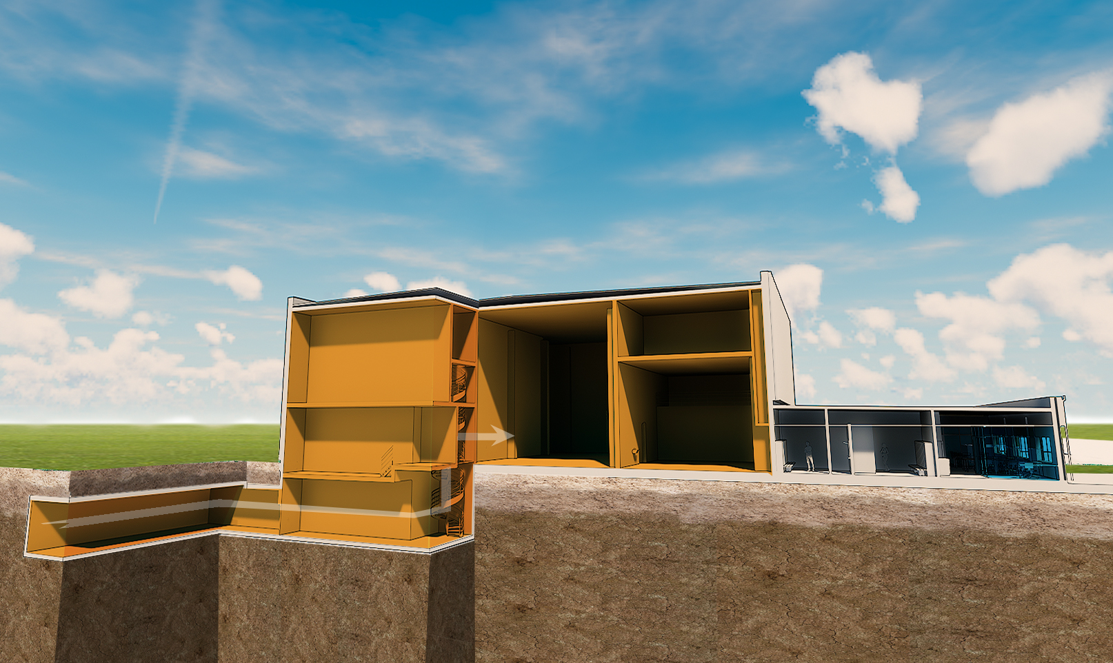
LEVEL 090-115 - SECTION
E BUILDINGS EXPANSIONAREA
LIQUID WASTE TREATMENT AREA
(CONTROLLED AREA)
SOLID WASTE TREATMENT AREA
(CONTROLLED AREA)
CULVERT FROM D BUILDING
ESCAPE ROUTE ONLY TO H09
(CONTROLLED AREA)
OVERHEAD
CRANE HALL
(CONTROLLED AREA)
CHANGING
ROOMS
OPERATION
CENTRE AND OFFICE

Slide 18
H09 Structural Preliminary Design
Andreas Abrahamsson
H09 Waste treatment facility - Baseline Agreement
www.europeanspallationsource.se
5 February, 2018

Slide 19
OVERVIEW
PRECAST CONCRETE STRUCTURE
CULVERT
STEEL STRUCTURE
STACK FOUNDATION

Slide 20
SUBSTRUCTURE
GENERAL: UPSTANDS FOR WALLS
BASEMENT
BASE SLAB/STRIP FOOTINGS
CULVERT
STACK FOUNDATION

Slide 21
SUPERSTRUCTURE
PRECAST HOLLOWCORE SLABS
(FLOORS AND ROOF)
PRECAST COLUMNS/BEAMS
STEEL COLUMNS/TRUSSES

Slide 22
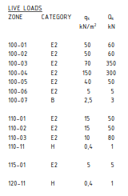
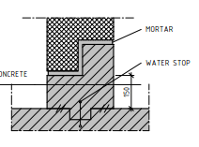
CHALLENGES
SPECIAL LOADS
ATB12K CARRIER
OVERHEAD CRANES
HEAVY EQUIPMENT
ETC.
CRITICAL DETAILS
”LINE OF SIGHT” IN JOINTS
LEAKAGE OF CONTAMINATED WATER
MATERIALS
COMPATIBLE WITH SURFACE TREATMENT

