Slide 1
H09 waste building project presentation
Boris Kildetoft Architect SAR/MSA
Building owner
www.europeanspallationsource.se
5 February 2018

Slide 2
H09 Project status

Slide 3
H09 Management

Slide 4
H09 Documentation
Phases | Documentation | Support
Feasibility study | Baseline Agreement Baseline Agreement Appendix 1 | Confluence Jira Chess Overall valid design documents for ESS
Preliminary design | Documented meeting decisions System description System requirements Common Systems ICD for coordination Additional system specific deliverables

Slide 5
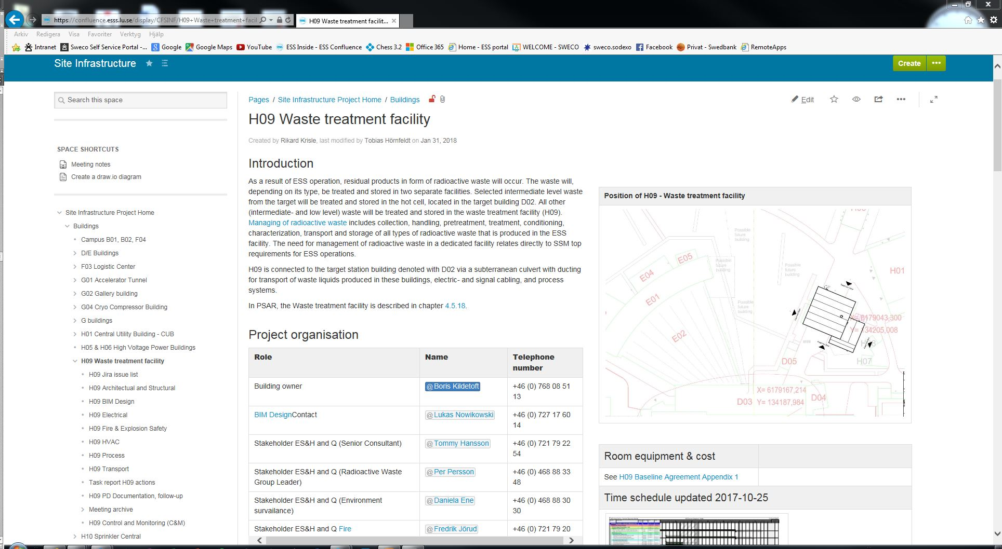
H09 Documentation, Confluence

Slide 6
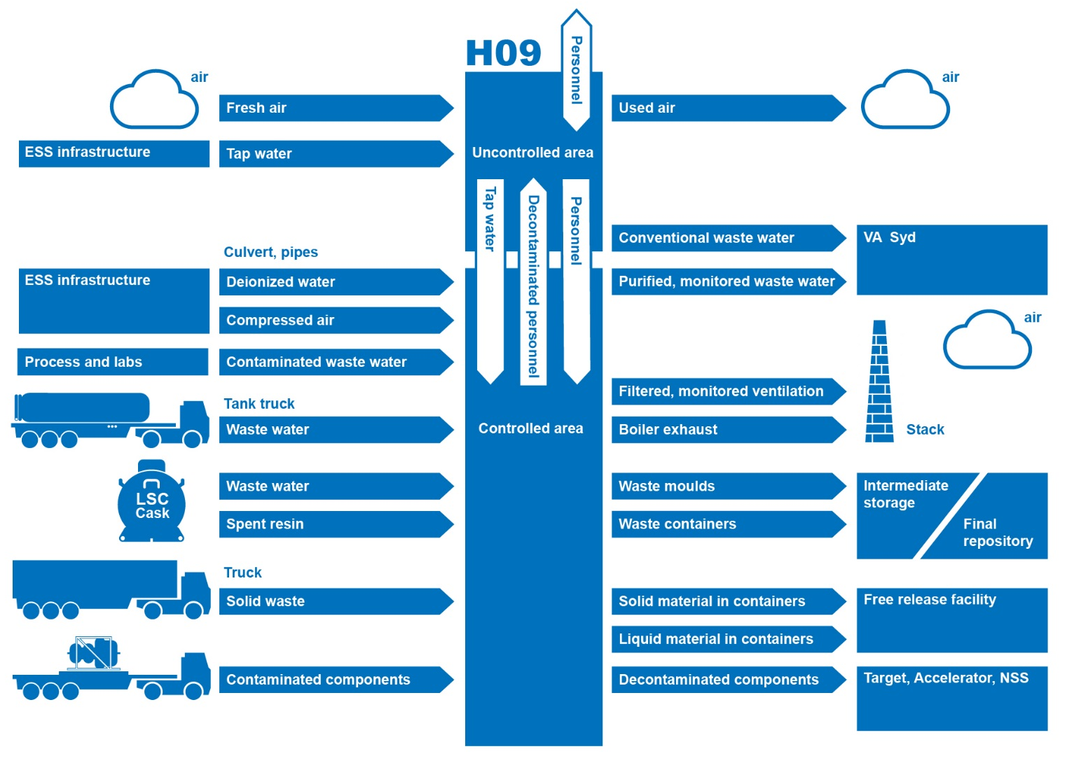
H09 in the ESS context

Slide 7
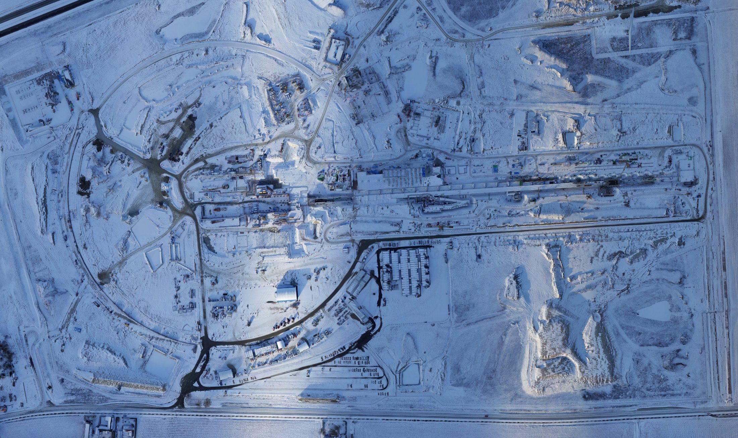
The ESS site

Slide 8
The ESS site and H09

Slide 9
H09 Transport routes site

Slide 10
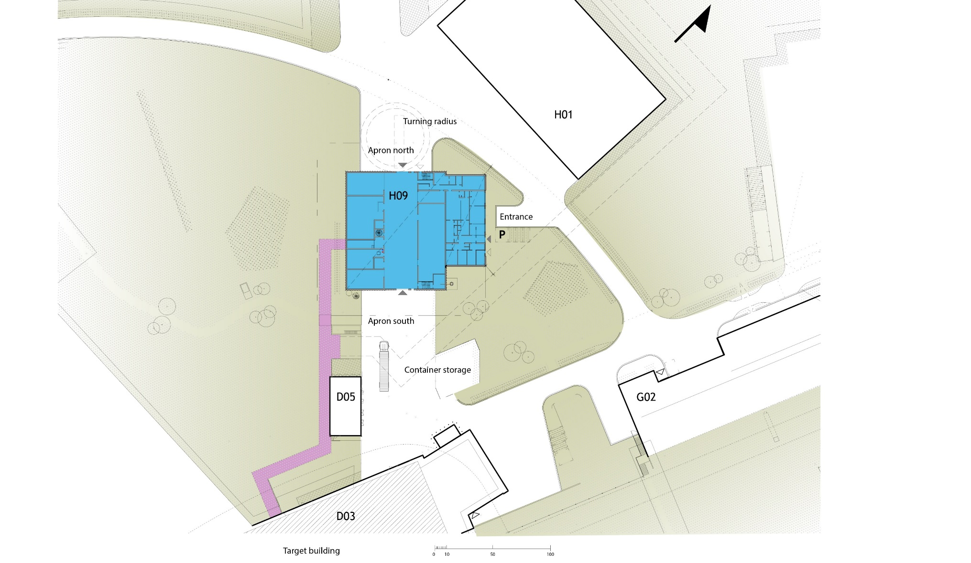
Detailed location of H09

Slide 11
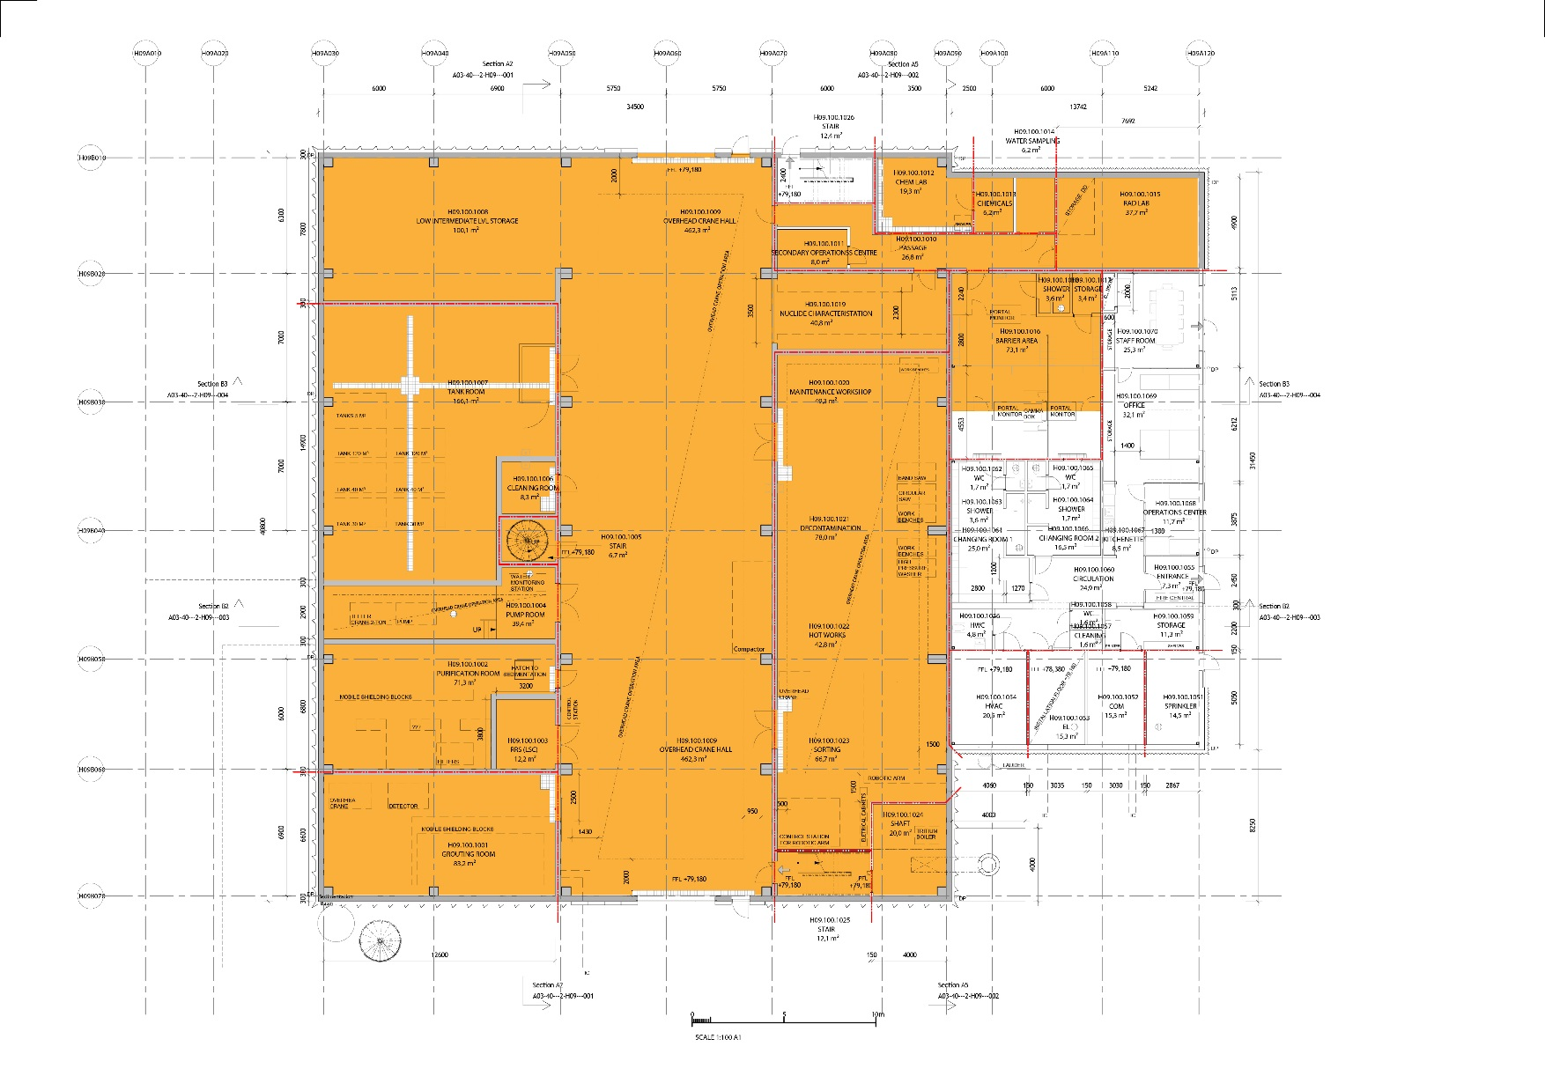
H09 Controlled area

Slide 12
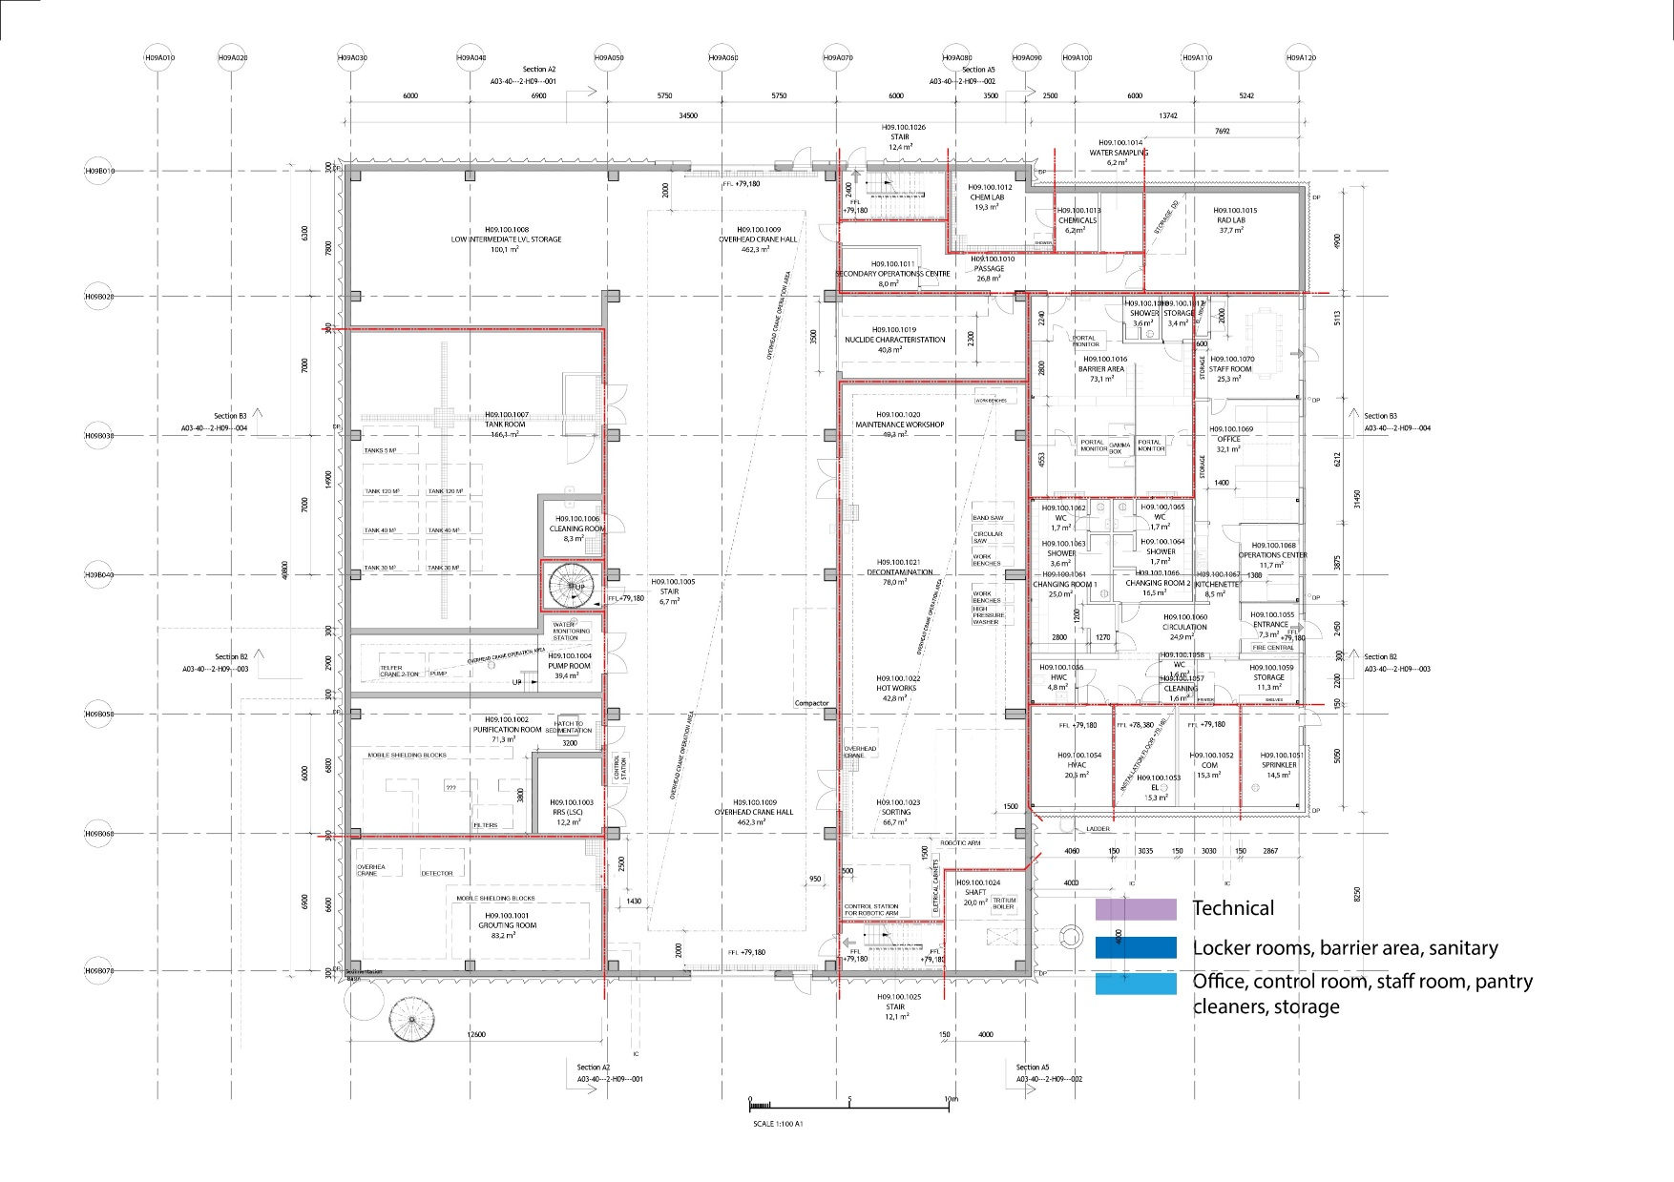
H09 Functional layout, uncontrolled

Slide 13
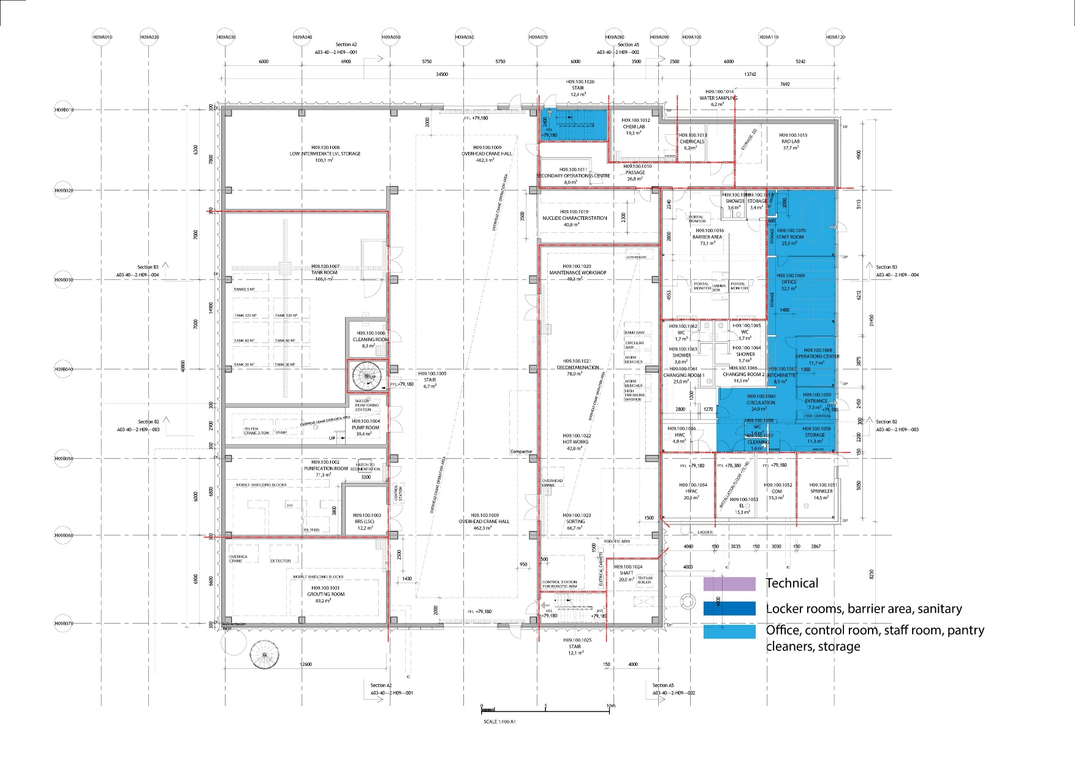
H09 Functional layout, uncontrolled

Slide 14
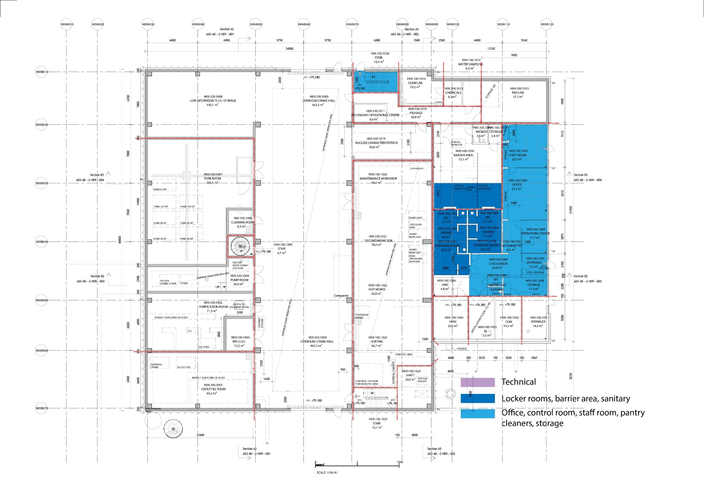
H09 Functional layout, uncontrolled

Slide 15
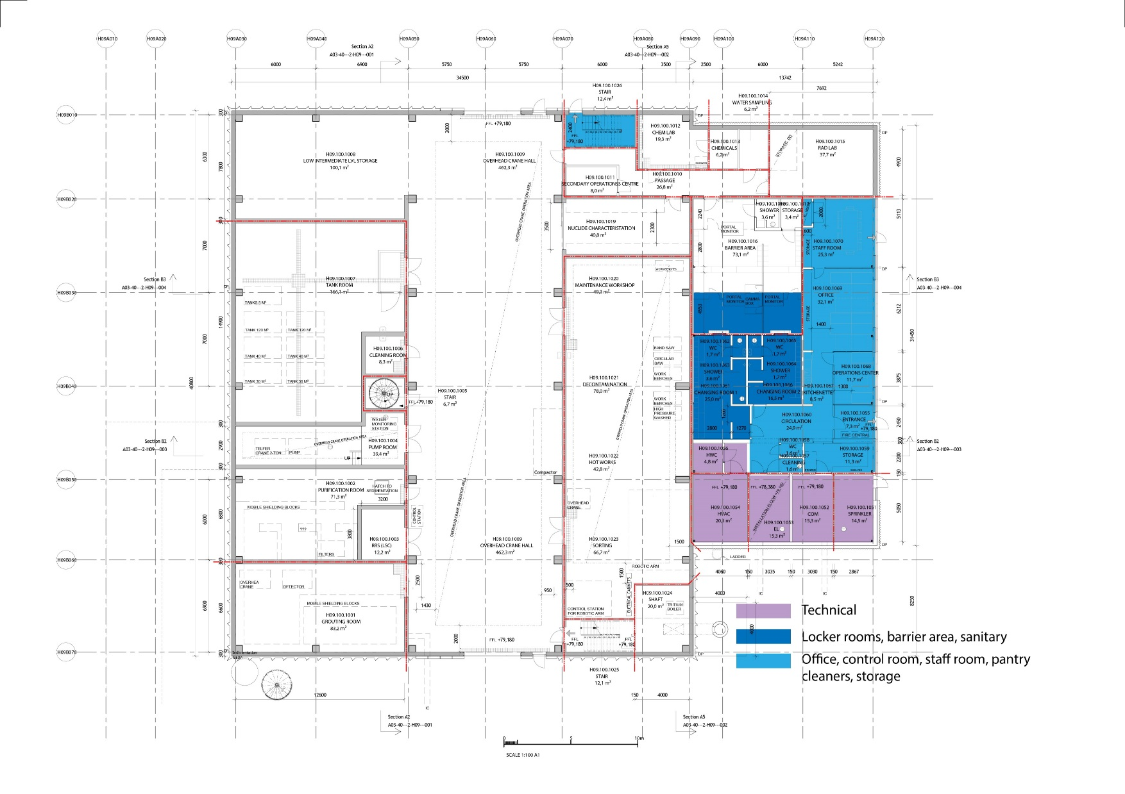
H09 Functional layout, uncontrolled

Slide 16
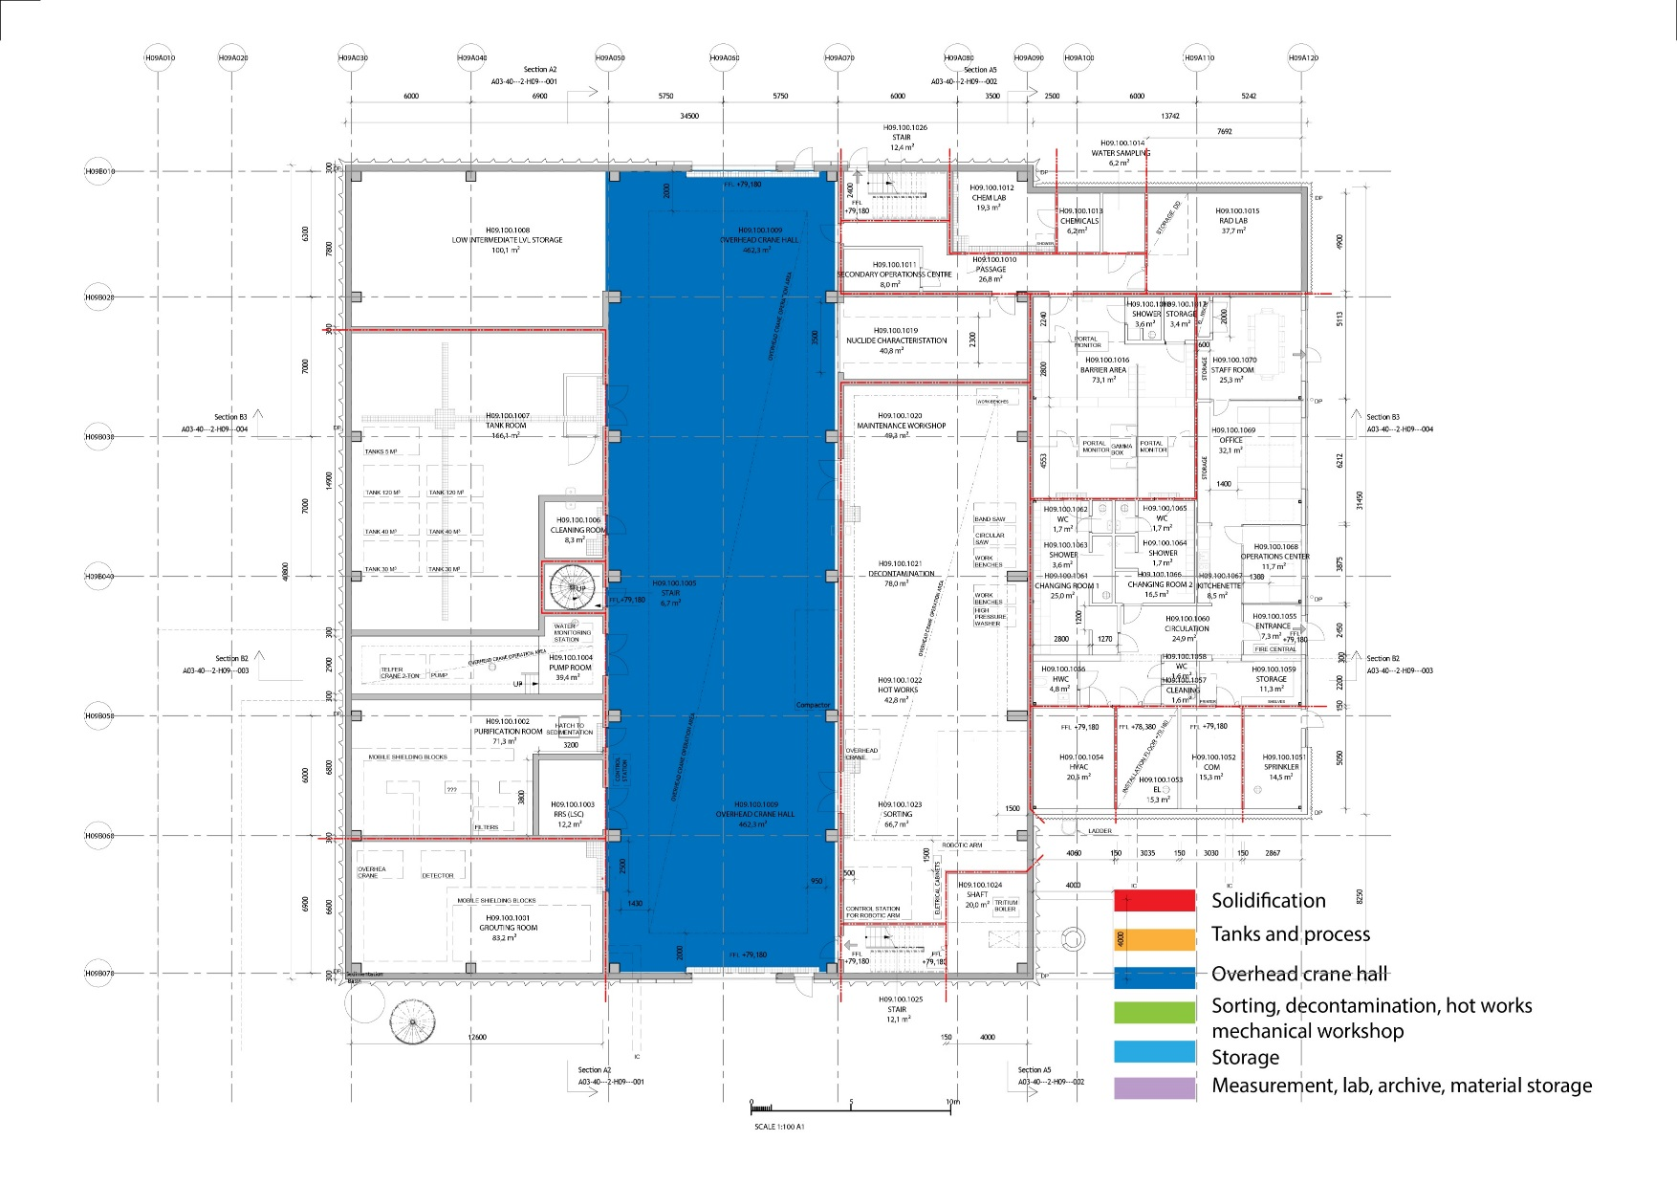
H09 Functional layout, controlled

Slide 17
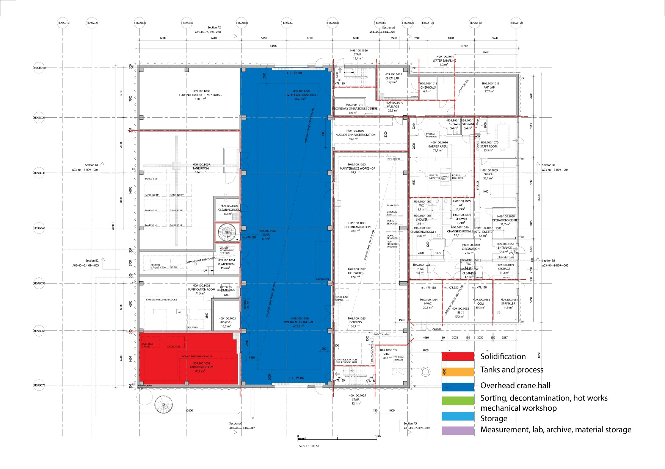
H09 Functional layout, controlled

Slide 18
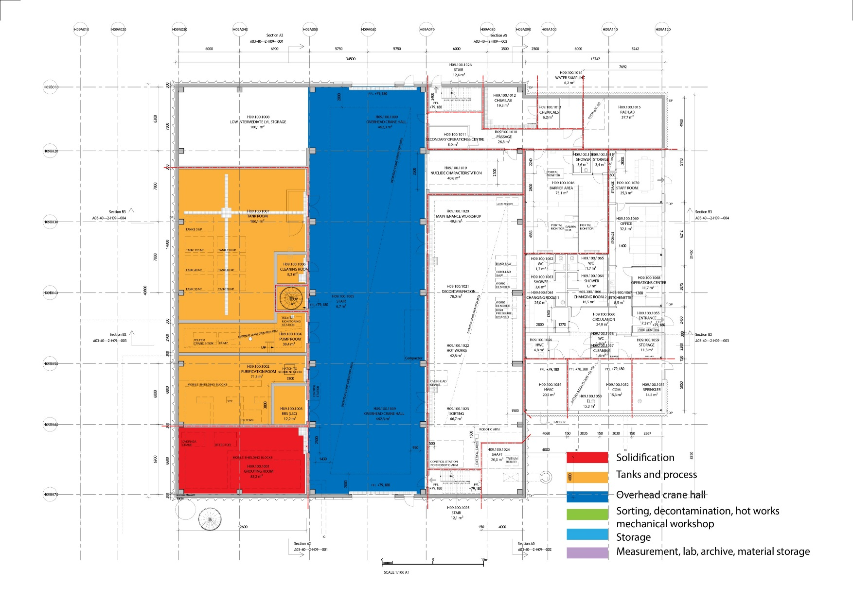
H09 Functional layout, controlled

Slide 19
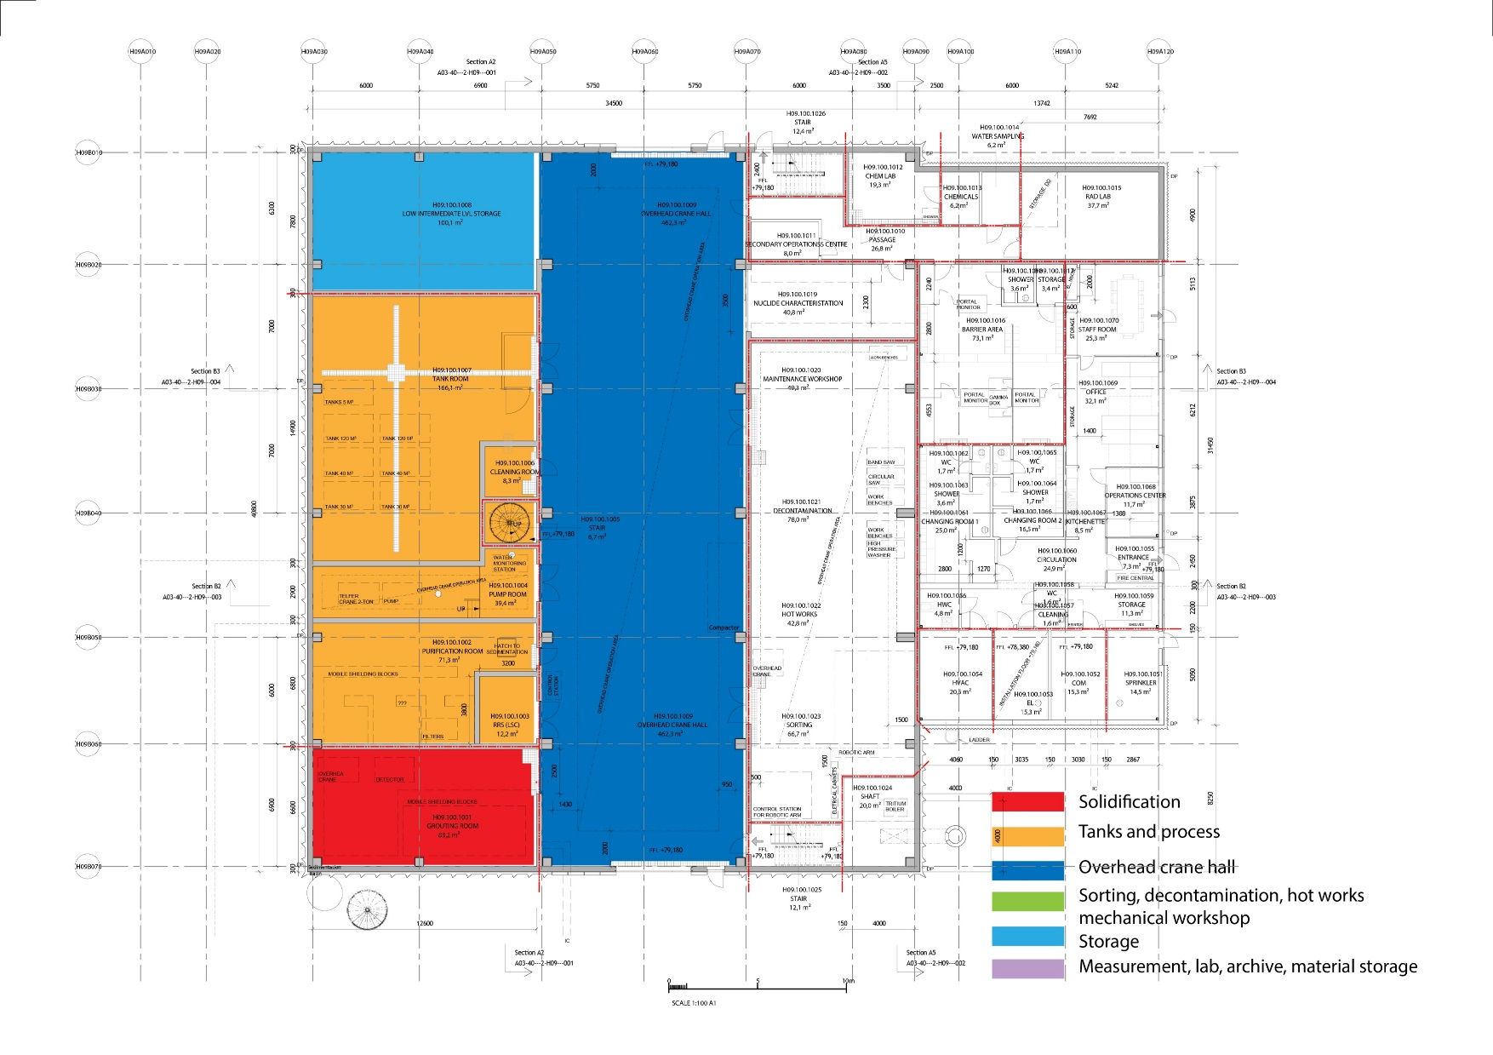
H09 Functional layout, controlled

Slide 20
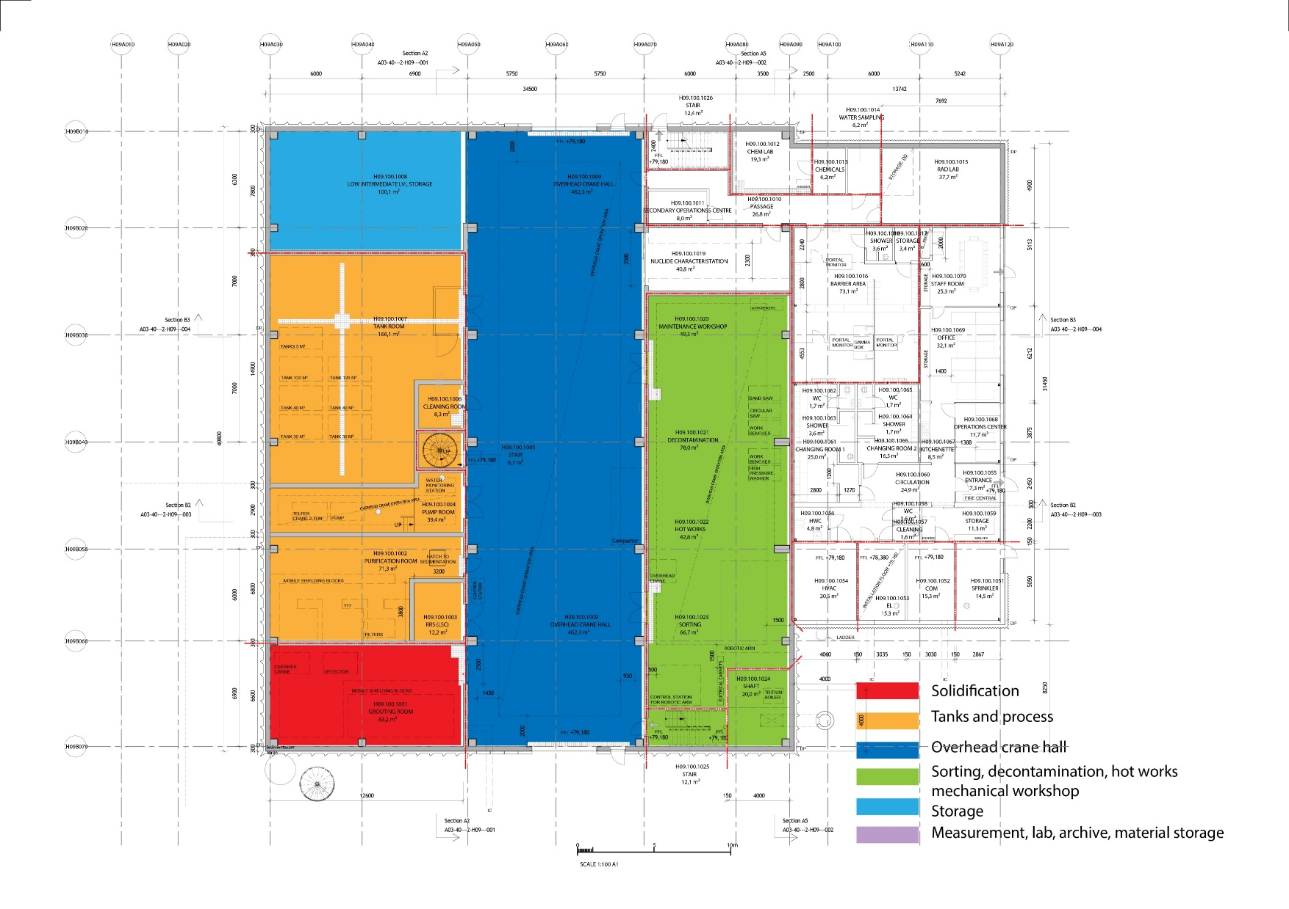
H09 Functional layout, controlled

Slide 21
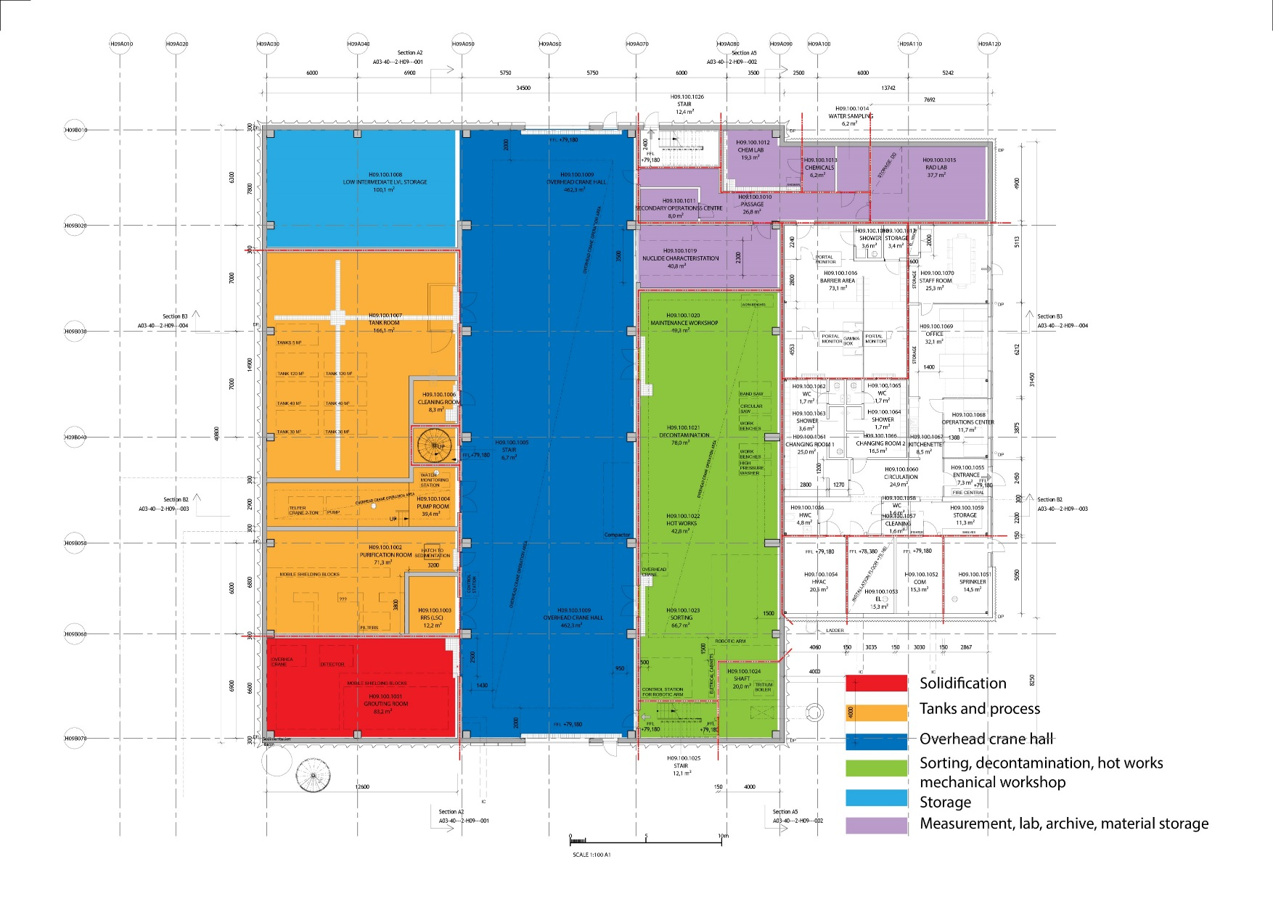
H09 Functional layout, controlled

Slide 22
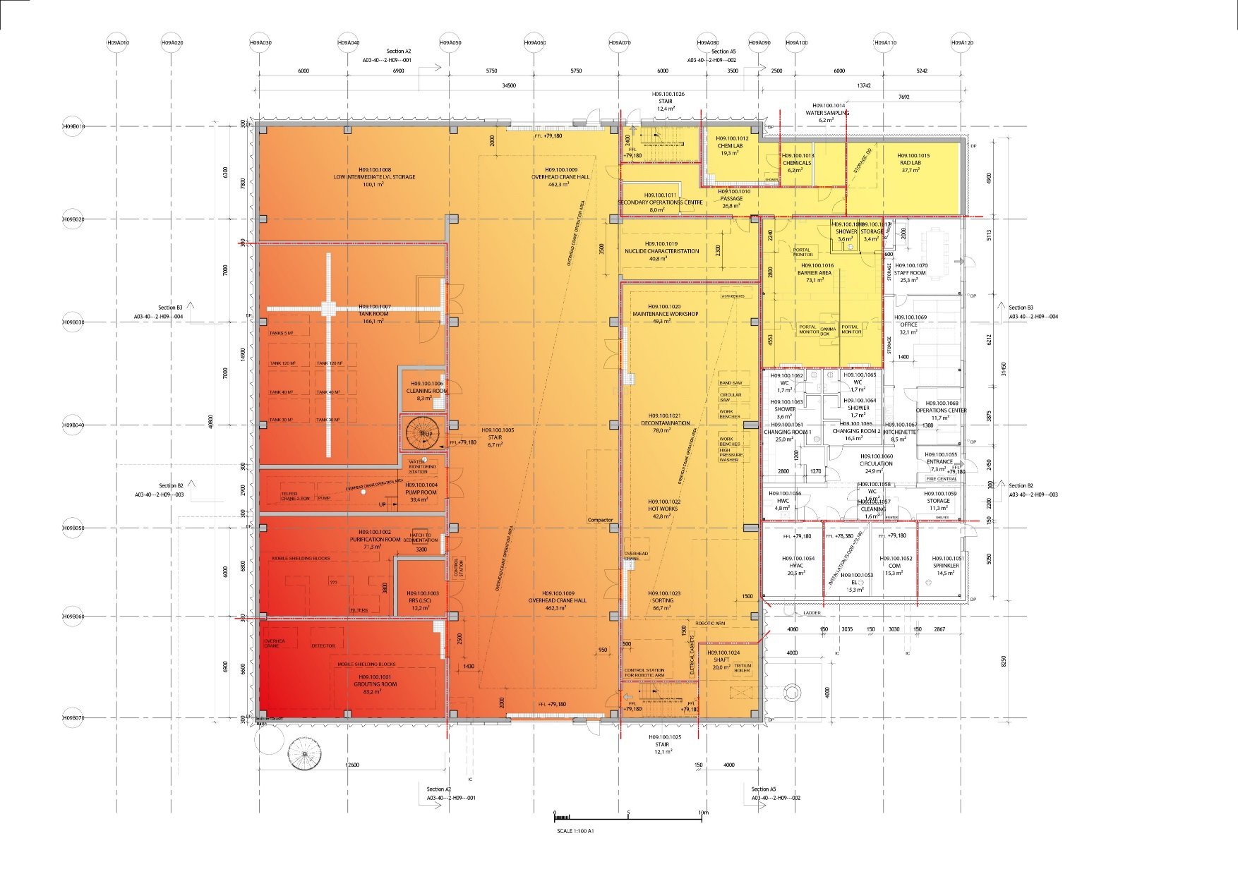
H09 Radiation

Slide 23
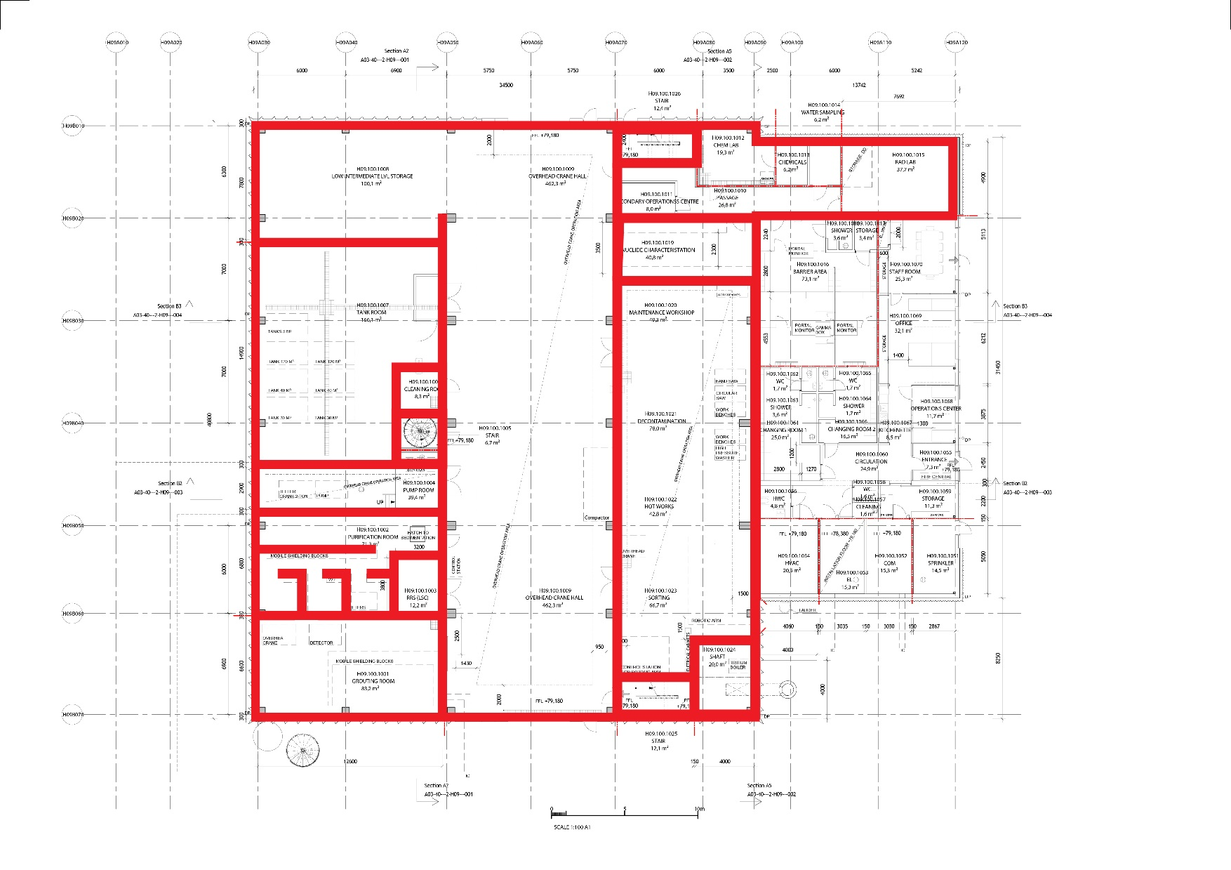
H09 Radiation

Slide 24
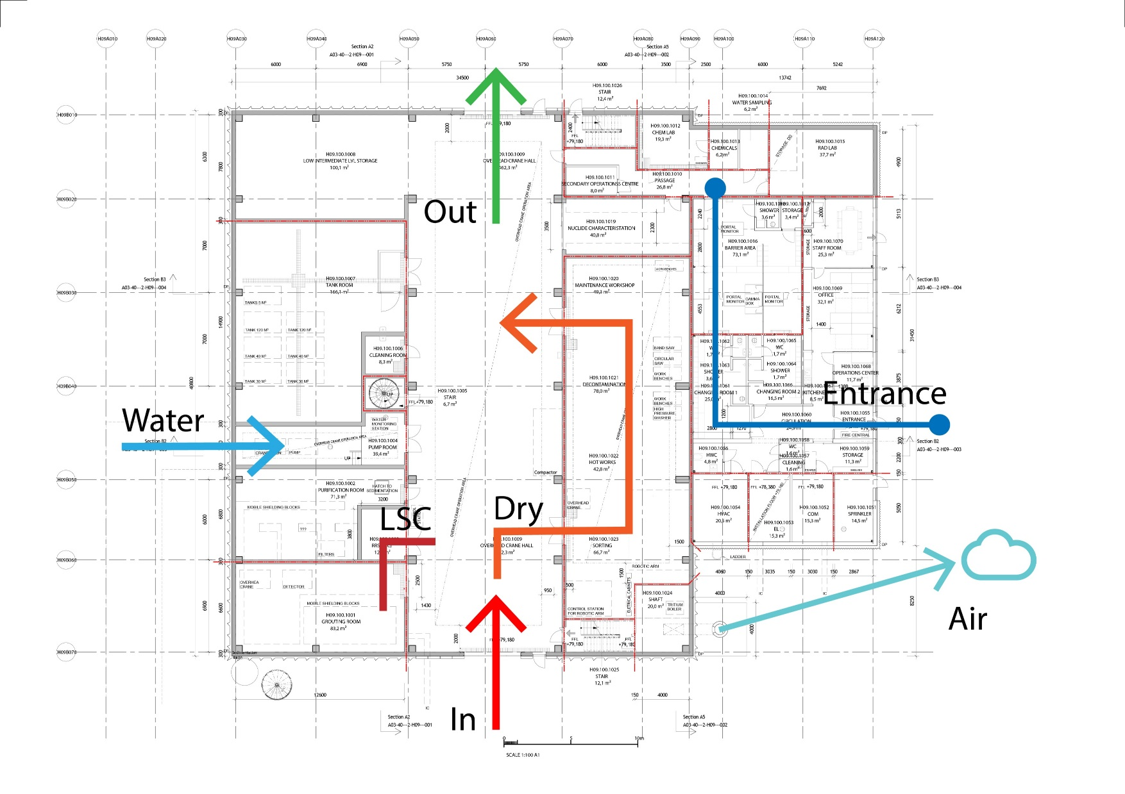
H09 Logistics

