Slide 1
H09 Process
Martin Hansson
CF System Owner Process
www.europeanspallationsource.se
3 February, 2018

Slide 2
H09 Process Basis of Design
Stakeholder estimates, Scope of Process Design only Liquid Waste
 | Waste Water [m³/year] | Ion-Exchange Resin [l/year] | Solid Waste [kg/year] | Reference
Accelerator | 10 | 100 | 11 500 | ESS-0092262
NSS | 6 000 | 100 | 23 500 | ESS-0020758
Target | 100 | 850 | 1 000 | ESS-0048270
Waste treatment facility | 100 | 100 | 100 | -
∑ | 6210 | 1 150 | 36 100 | -

Slide 3
H09 Process Basis of Design
Design considerations
Safety
Operability
Flexibility
Stakeholder input on Radioactive Waste Handling
Platom feasibility study report
Platom as specialist advisors

Slide 4
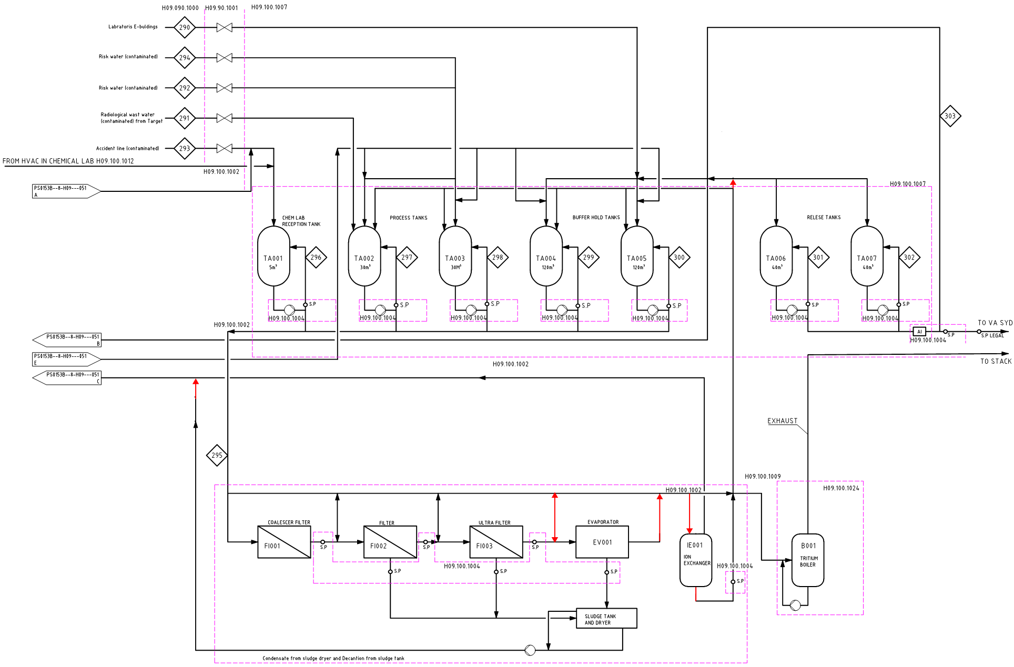
Process Flow Diagram

Slide 5
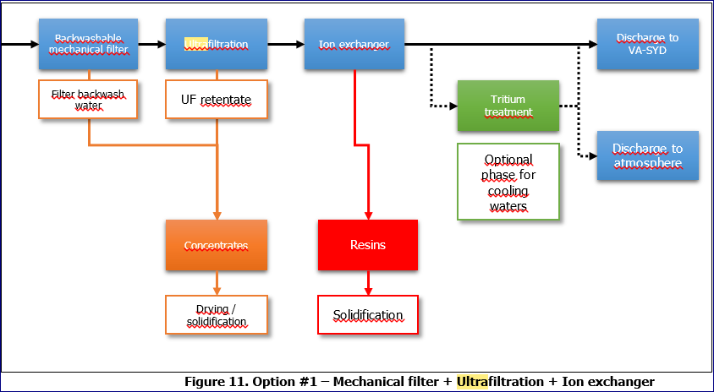

Slide 6
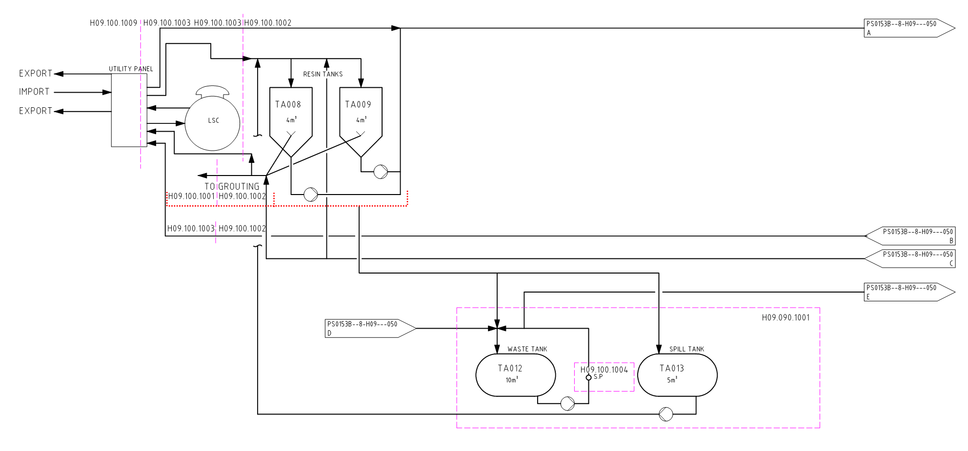
Process Flow Diagram (2)

Slide 7
Process Flow Diagram (2)
Comments:
Flow “D” to tank TA0012 includes
Internal controlled sewers
Fire Water including sprinkler
H09.090.1001 is utilized for containment of Fire Water
Process tanks are vented via tensile break

Slide 8
Process Flow Diagram (example 1 - NSS)

Slide 9
Process Flow Diagram (example 2 - RWW)

Slide 10
Process Flow Diagram (example 3 – ³H)

Slide 11
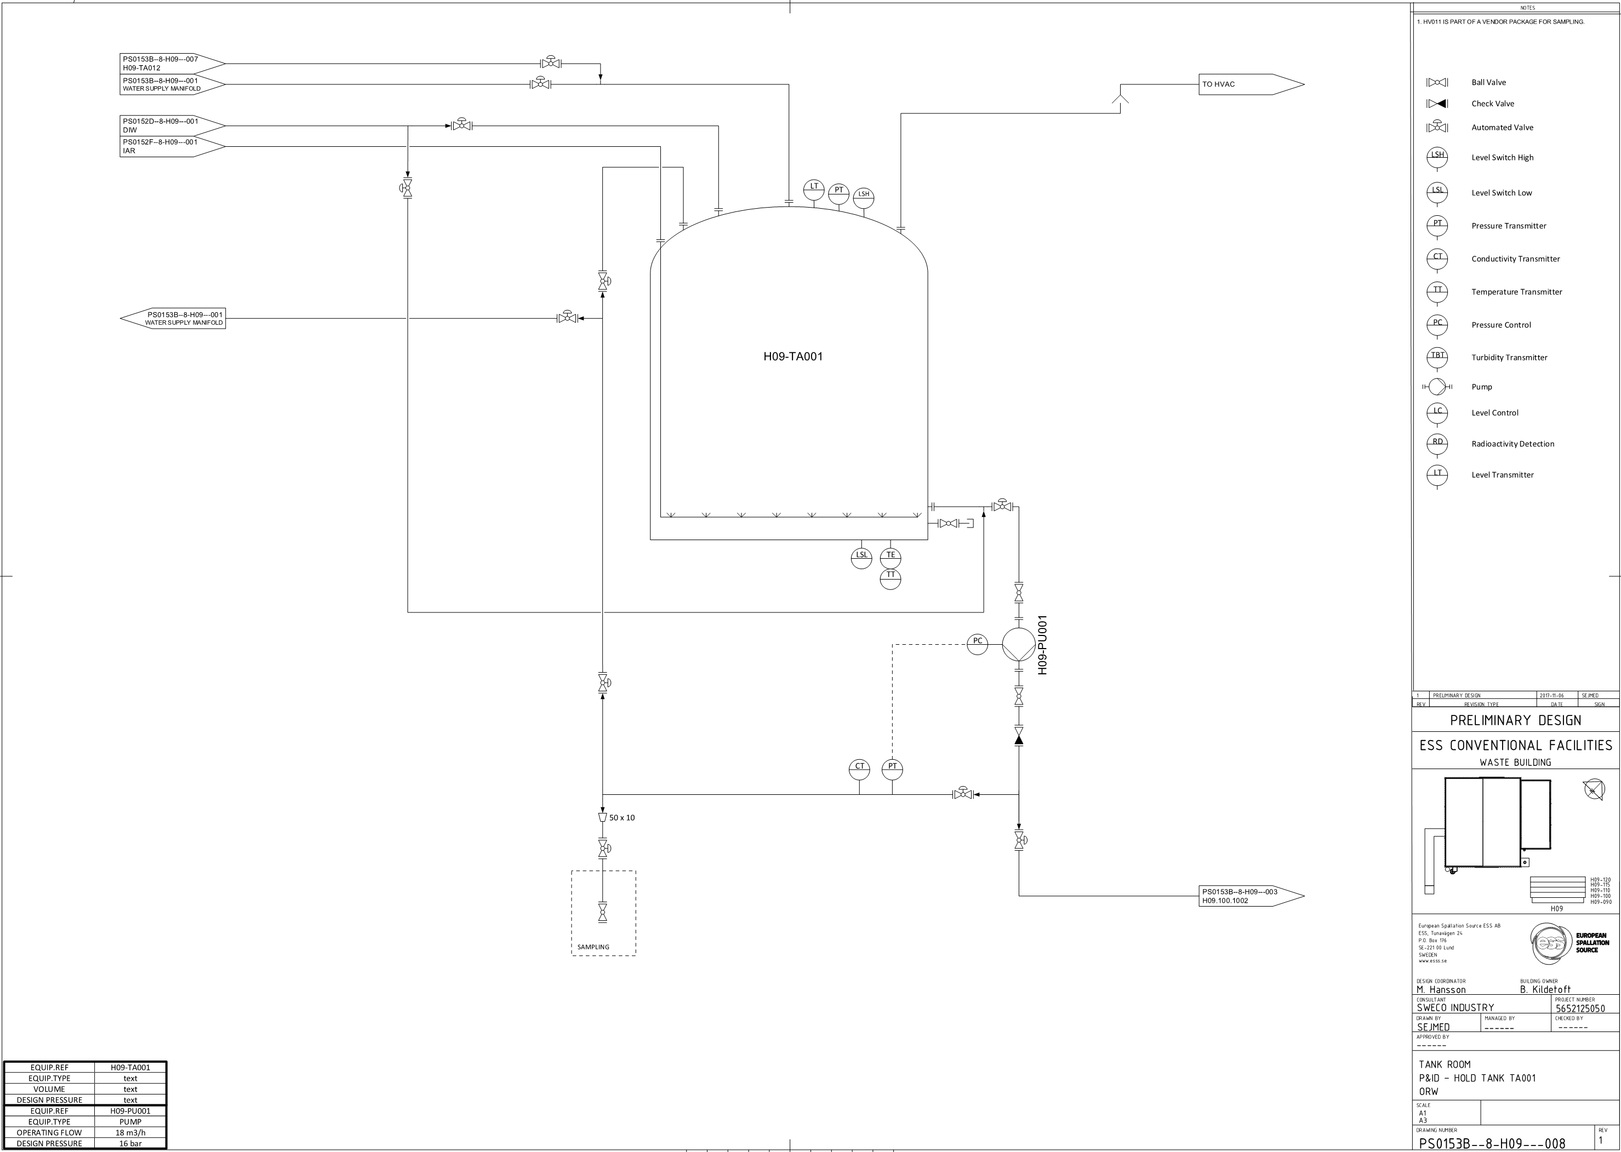
Process & Instrumentation Diagram Tank TA001 - typical

Slide 12
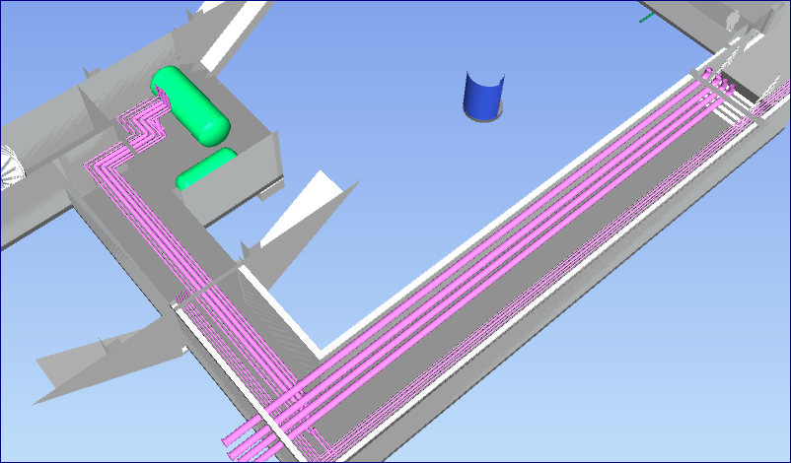
H09 Process Waste Buildning Interface – level 090
LEVEL 090
From Target
Waste Tank TA012
Spill Tank TA013
INCOMING MEDIA:
Cooling Water Low (CWL)
District Heating Low (DHL)
Instrument Air (IAR)
De Ionized Water (DIW)
Ordinary Risk Waste Water (ORW)
Radiological Waste Water (RWWS)
Accident Risk Waste Water (ARW)

Slide 13
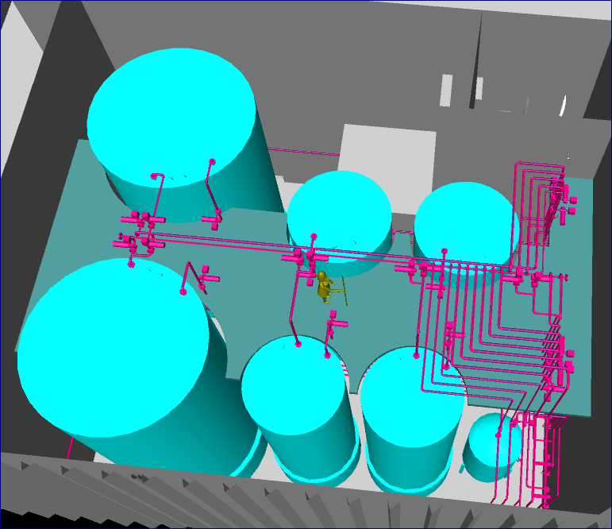
H09 Process Tank Room Top View
TANK ROOM LEVEL 100
RELEASE TANKS:
- 2 x 40 m3
HOLD TANKS:
2 x 120 m3
2 x 30 m3
1 x 5 m3

Slide 14
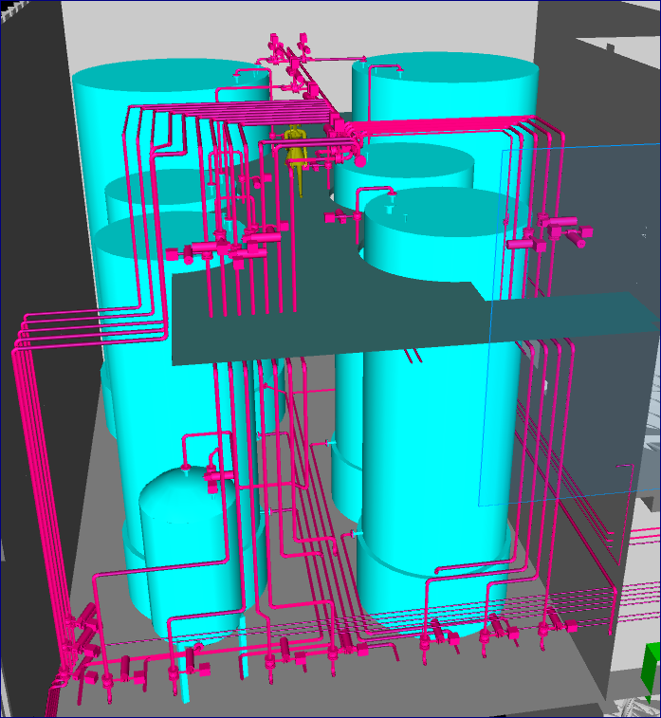
H09 Process Tank Room Side View
TANK ROOM WITH WASTE WATER MANIFOLDS
LEVEL 100-120

Slide 15
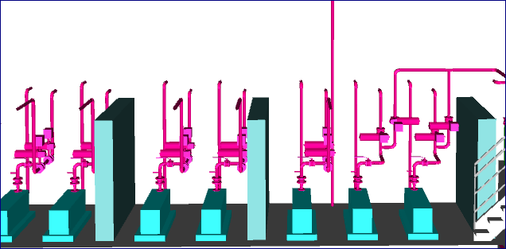
H09 Process Pump room
PUMP ROOM LEVEL 100

Slide 16
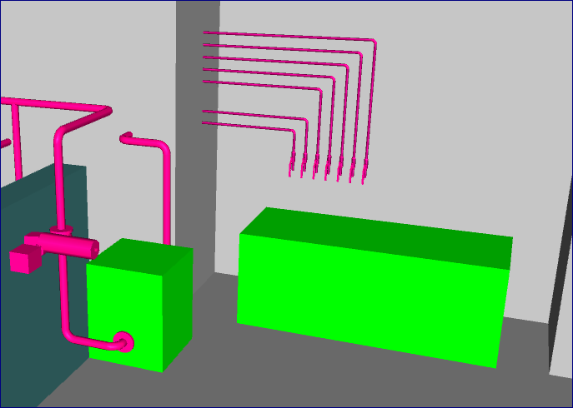
H09 Process Sampling
SAMPLING POSITION LEVEL 100
Sampling from:
Hold Tanks
Release Tanks
Waste Water Tank

Slide 17
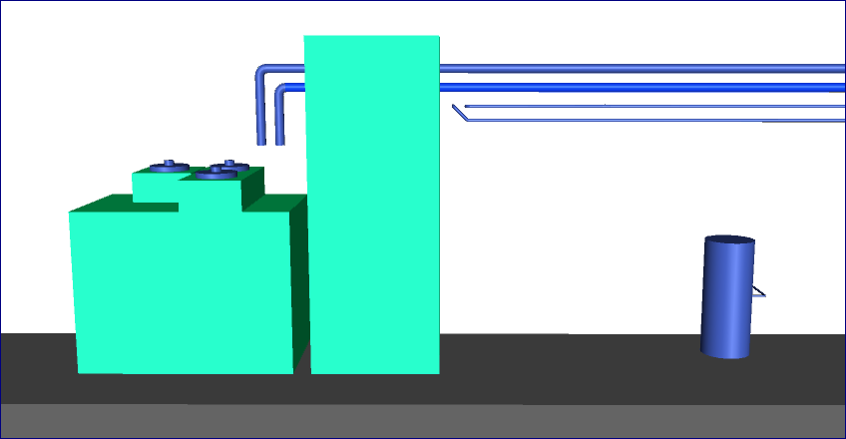
H09 Process Purification room – Evaporator and Hot DIW generatoor
PURIFICATION ROOM L 2 LEVEL 110
Evaporator
Hot DIW generator

Slide 18
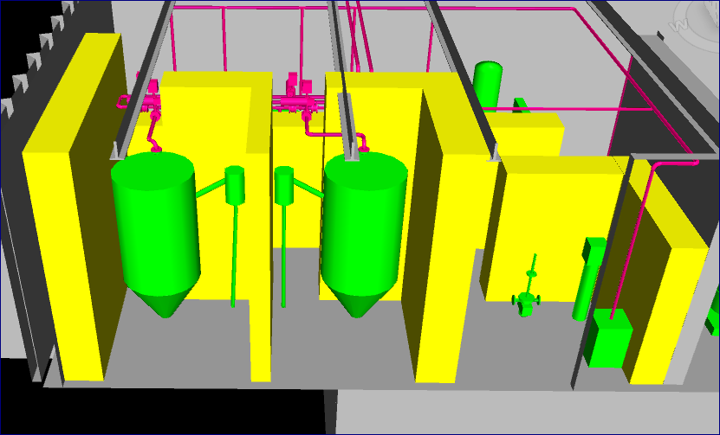
H09 Process Purification room – Filtration and Ion Exchanger
PURIFICATION ROOM LEVEL 100
Resin Tanks
Coalescer filter
Particle filter
Ultrafilter

Slide 19
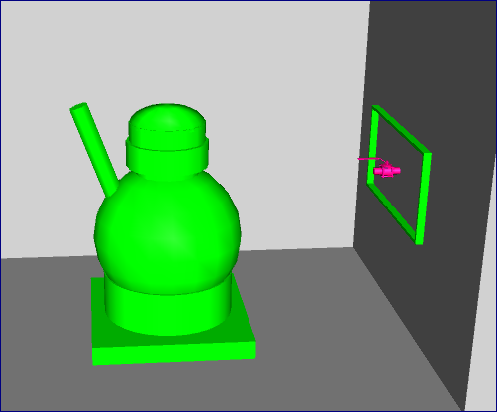
H09 Process Purification room – Liquid Waste Receiving Station
LSC ROOM LEVEL 100
LSC
Utility Panel

Slide 20
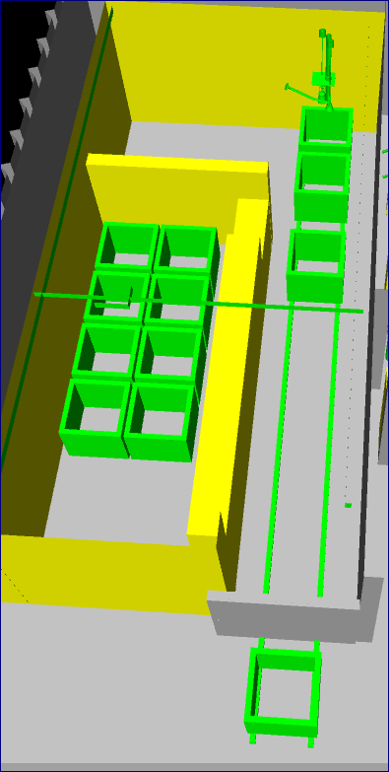
H09 Process Grouting Room
GROUTING ROOM LEVEL 100

