Slide 1




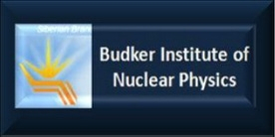

PERLE Facility:
Status and Further Steps
8th Open Collaboration Meeting on Superconducting Linacs for High Power Proton Beams (SLHiPP-8)
On behalf of PERLE Collaboration
Walid Kaabi-LAL/CNRS

Slide 2
Introduction:
PERLE is a high current, multi-turn ERL facility (900 MeV), designed to study and validate main principles of the Large Hadron Electron Collider (LHeC: 60 GeV).
The Orsay realization of PERLE (Called PERLE@Orsay) is a smaller version (500 MeV) with the same design challenges and the same beam parameters:
Target Parameter | Unit | Value
Injection energy | MeV | 7
Electron beam energy | MeV | 500
Normalised Emittance γε_{x,y} | mm mrad | 6
Average beam current | mA | 20
Bunch charge | pC | 500
Bunch length | mm | 3
Bunch spacing | ns | 25
RF frequency | MHz | 801.58
Duty factor |  | CW

Slide 3
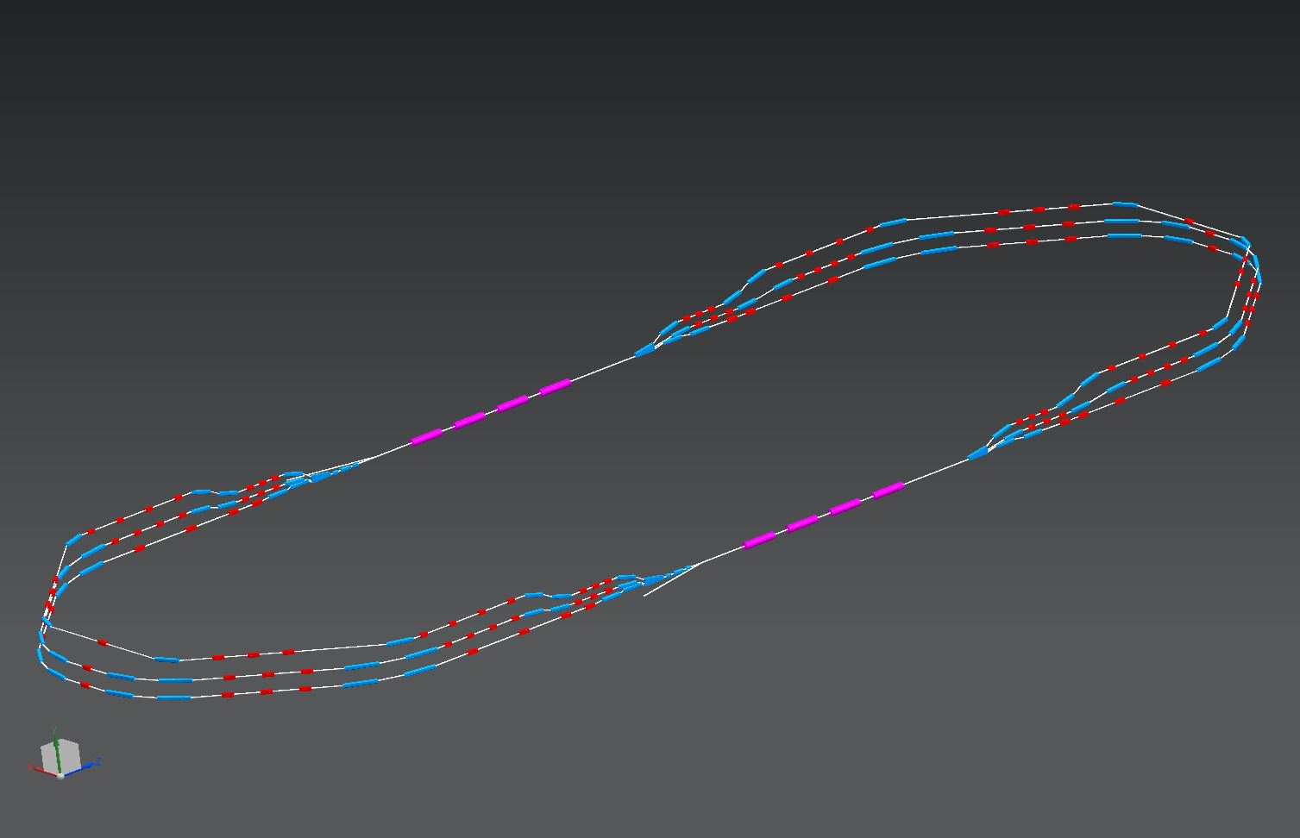
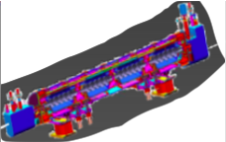
PERLE@Orsay configuration:
2 Linacs (Four 5-Cell 801.58 MHz SC cavities)
3 turns (160 MeV/turn)
Max. beam energy 500 MeV
1 : 3 : 5
DE = 80 MeV
injector
7 MeV
DE = 80 MeV
2 : 4 : 6
7 MeV
dump
DC = l_{RF}/2

Slide 4
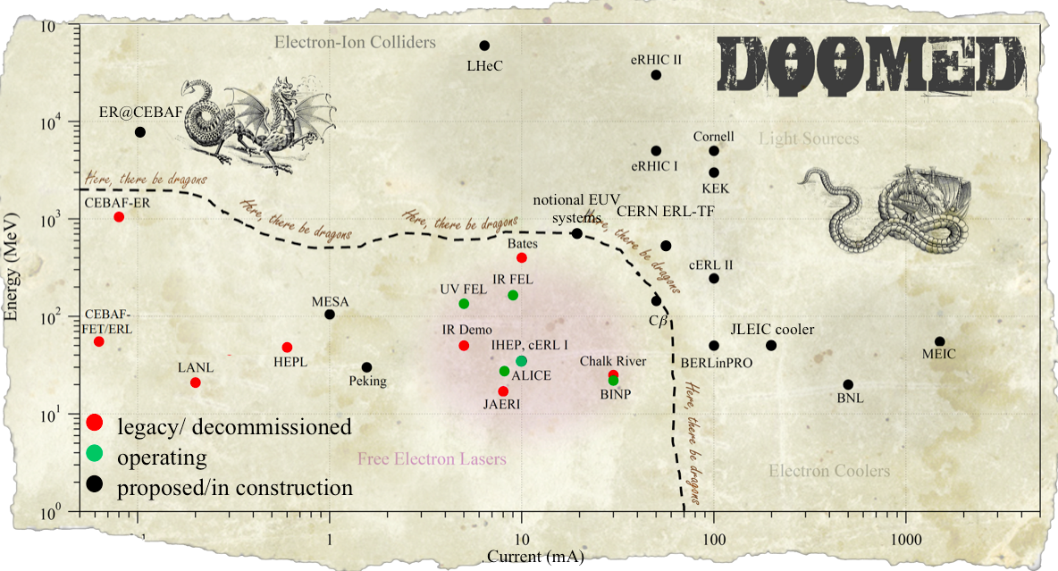
PERLE@Orsay in the global landscape:
1 GW
PERLE@Orsay
100 MW
10 MW
1 kW
10 kW
100 kW
1 MW

Slide 5
PERLE collaboration:
The PERLE@Orsay collaboration includes today CERN, JLAB, ASTeC Daresbury, University of Liverpool, BINP, LAL and IPN Orsay.
We are open to new collaborators.
The collaboration signed the PERLE Conceptual Design Report (CDR) published in J. Phys. G
LAL organized the 1st PERLE@Orsay workshop in February 23-24th 2017.
PERLE@Orsay was presented at ERL 2017 conference and meet a high interest of the community, supportive to see PERLE becoming a real project, with proposals of synergetic work with other ERLs in construction worldwide.
First PERLE collaboration meeting was held at Daresbury, January 15-16th 2018. Next one is foreseen at Orsay, on June 27-29th 2018 during the LHeC/FCC-eh and PERLE Workshop (Electrons for LHC).
Next step will be the redaction of PERLE Technical Design Report.

Slide 6
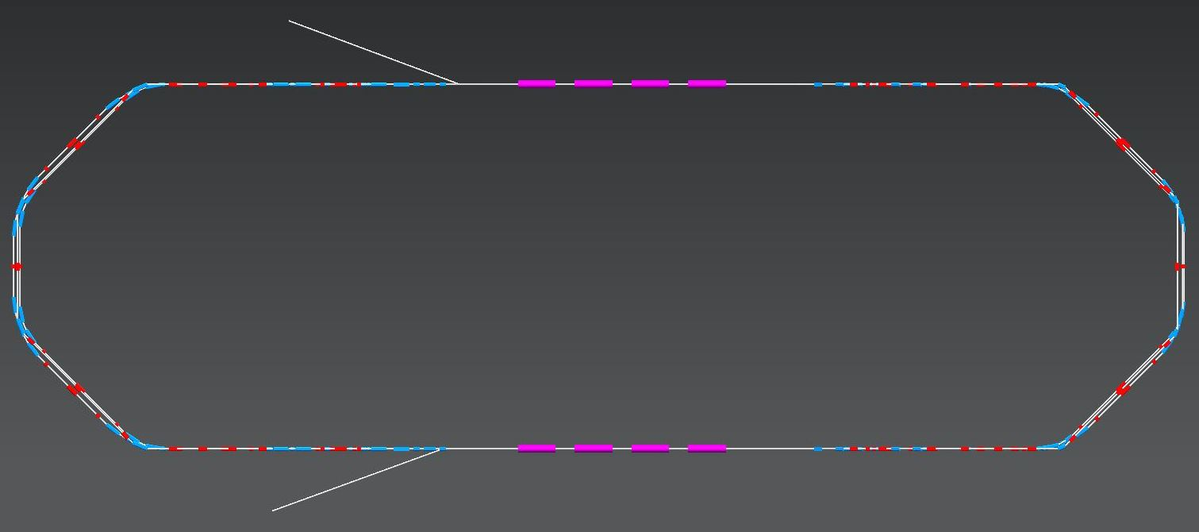
PERLE Layout:
Alex Bogacz- JLAB
Top view
5.5 m
24 m
4 m
10 m
2 : 4 : 6
Side view
1 : 3 : 5
0.4 m + 0.4 m
Footprint: 24 x 5.5 x 0.8 m³

Slide 7
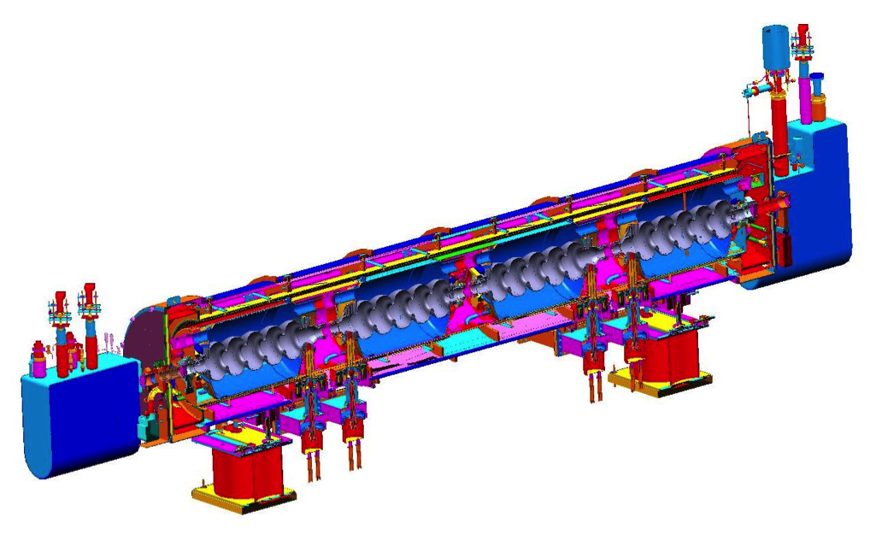
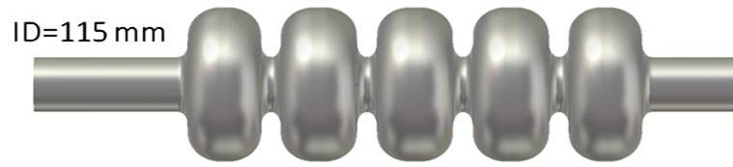



Linac, Cryomodule Layout:
Alex Bogacz- JLAB
SNS-like cryomodule
801.58 MHz RF, 5-cell cavity:
λ = 37.40 cm
L_{c} = 5λ/2 = 93.50 cm
Grad = 21.4 MeV/m (20 MeV per cavity)
ΔE= 80 MeV per Cryo-module
8.491 m
93.5 cm
10
Linac length: 26 × λ_{RF}
BETA_X&Y[m]
0
0
BETA_X
BETA_Y
9.72
Re-injection chicane
Cryo-module (8.491 m)

Slide 8
Multi-pass Energy Recovery optics:
E_{inj}
Linac 1
E₁
E₂
E₁
E₂
Arc 2,4,6
Arc 1,3,5
Linac 2
Linac 1
12
BETA_X&Y[m]
Acceleration/Deceleration
0
0
BETA_X
BETA_Y
DISP_X
DISP_Y
59.2518
E_{inj}
E₁
E₂
E₃
E₄
E₅
E₆
×3

Slide 9
Multi-pass Energy Recovery optics:
Linac 1
Arc 2,4,6
Arc 1,3,5
E₂
Linac 2
E₁
E_{inj}
E₁
Linac 2
12
BETA_X&Y[m]
Acceleration/Deceleration
0
0
BETA_X
BETA_Y
DISP_X
DISP_Y
59.2518
E₆
E₅
E₄
E₃
E₂
E₁
E_{inj}
×3

Slide 10
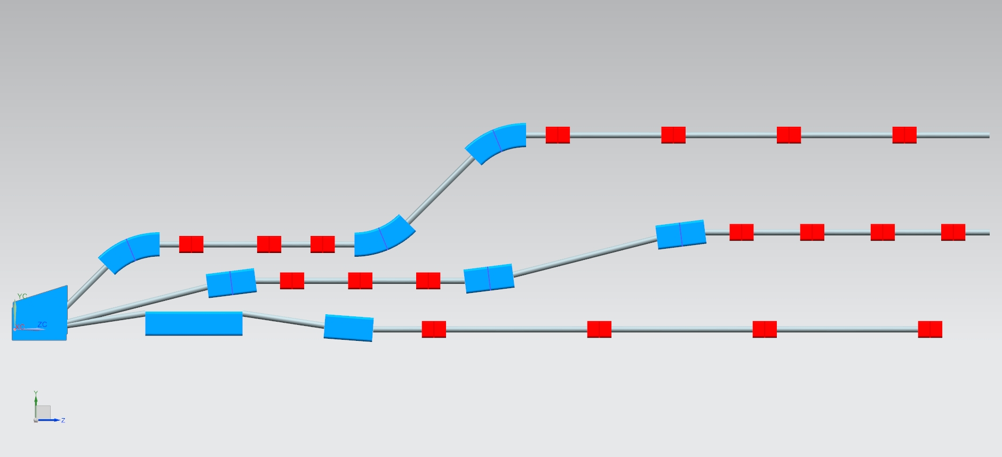
Switchyard- Vertical Separation of Arcs (1, 3, 5):
Energies1 : 3 : 5
87 MeV
40 cm
247 MeV
35 cm
20 cm
40 cm
407 MeV
Dipoles: (20 and 40 cm long), B = 0.8 Tesla

Slide 11
Arc optics, Arc 1 (71 MeV) as example:
20
Isochronous Arc
2
BETA_X&Y[m]
pathlength: 42 × λ_{RF}
DISP_X&Y[m]
0
-3
0
BETA_X
BETA_Y
DISP_X
DISP_Y
15.71
2-step vert. Spreader
180⁰ Arc
2-step vert. Recombiner
Spr. dipoles:
4× 45⁰ bends
L = 20 cm
B = 9.5 kGauss
Arc dipoles :
4×45⁰ bends
L = 45.6 cm
B = 4.5 kGauss
Rec. dipoles:
4× 45⁰ bends
L = 20 cm
B = 9.5 kGauss
quads: L = 10 cm G ≤ 1 kGauss/cm
14

Slide 12
1 pass up + 1 pass down optics:
Pass-1 ‘up’
20
2
BETA_X&Y[m]
DISP_X&Y[m]
0
-2
0
BETA_X
BETA_Y
DISP_X
DISP_Y
50.8316
7 MeV
87 MeV
167 MeV
Pass-1 ‘down’
20
2
BETA_X&Y[m]
DISP_X&Y[m]
0
-2
0
BETA_X
BETA_Y
DISP_X
DISP_Y
50.8316
167 MeV
87 MeV
7 MeV

Slide 13
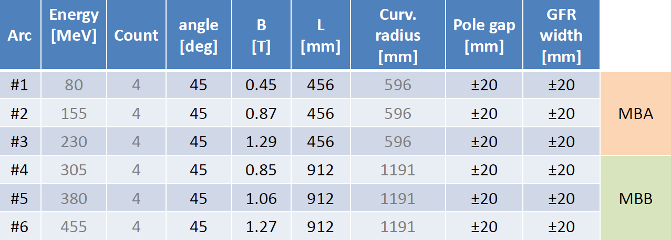
Cost-effective magnet solution:
Cynthia Vallerand (LAL) & Pierre Thonet (CERN)
Iron-dominated resistive magnets preferred for improving tunability
Magnet aperture of +/- 20 mm
Current density of 7-8 A/mm2
H design to reduce the magnet height for stacking
Homogeneous field as low as possible due to the use of one power supply by arc
Cost minimization with a design of the arc magnets coupled to studies of the power converters, the vacuum system and cooling as well as only one magnet per bend with a 45° deflection

Slide 14
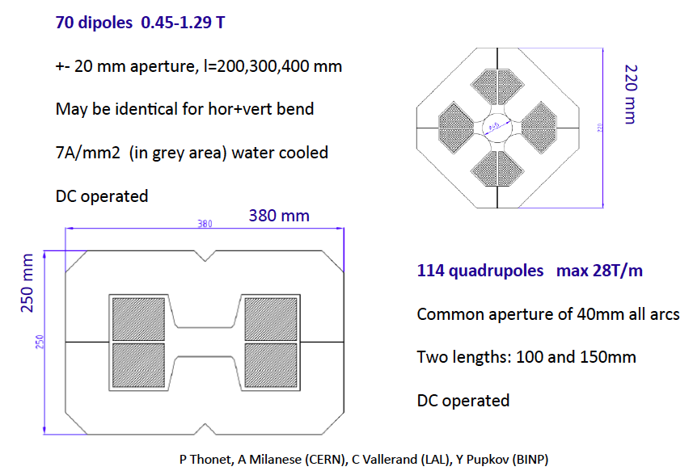
PERLE magnet design (dipoles and quadrupoles):

Slide 15
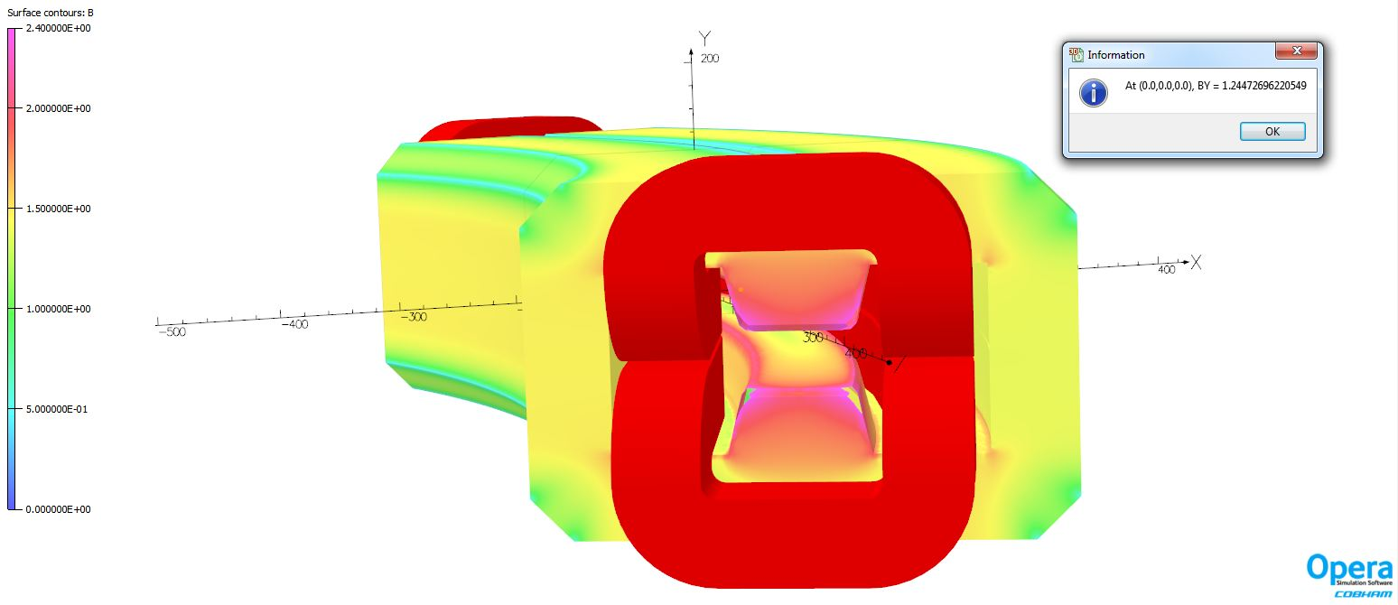
PERLE magnet design:
3D Simulation results from 2D design with bedstead coils
Value of vertical field at the center fulfill the requirements. We obtained with the same number of turns the same value but with a current density much lower than model with racetrack coil : 5.5A/mm2 instead of 7.8 A/mm.
The field homogeneity with the optimized shim is 8.8 10⁻⁵ at ± 20 mm (GFR), better than expected (5 10⁻⁴).

Slide 16
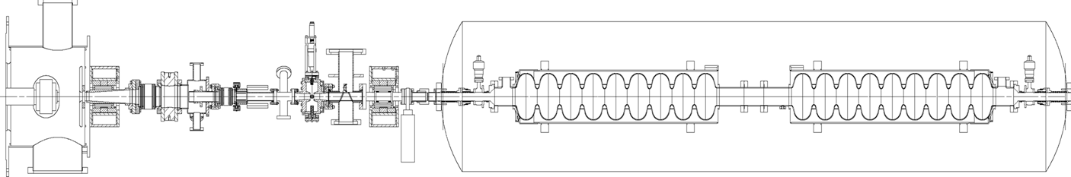
Electron source and injector:
Boris Militsyn & Benjamin Hounsell- Daresbury
Preferred concept: Photocathodes, DC Gun, NC single cell buncher and SRF accelerator (booster),
Laser allows flexible bunching sequence,
Nominal repetition rate 40.1 MHz (20th sub-harmonic of 801.56 MHz),
Nominal bunch charge: 3.12 10⁹ e- = 500 pC → 500 pC x 40 MHz = 20 mA.
Photocathode gun
Buncher
SRF booster
Light box
350 kV for Sb-based photocathodes (unpolarized)
220kV for GaAs photocathodes (polarized) to reduce dark current
Focusing solenoids

Slide 17
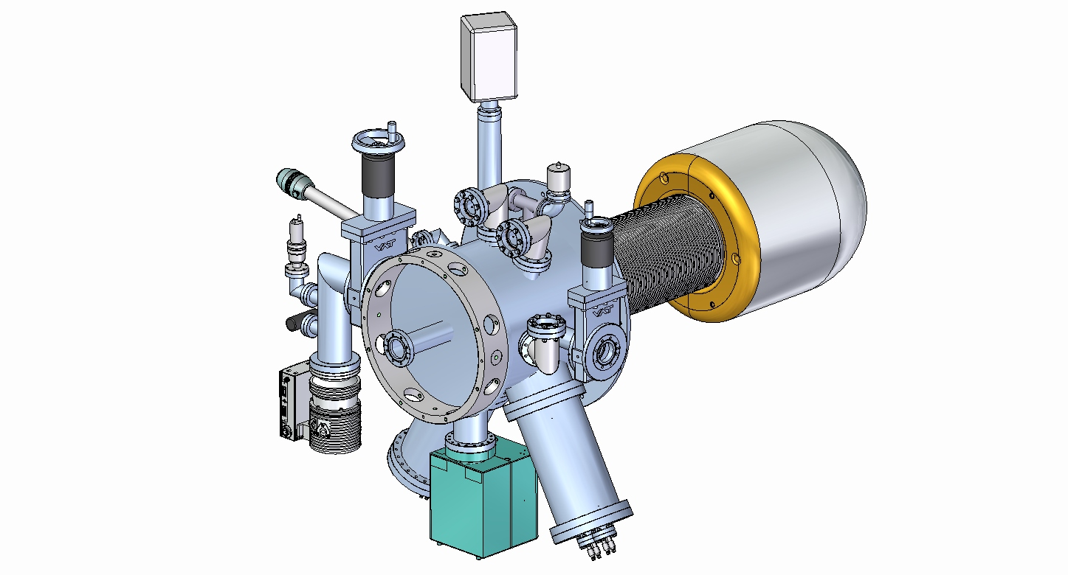
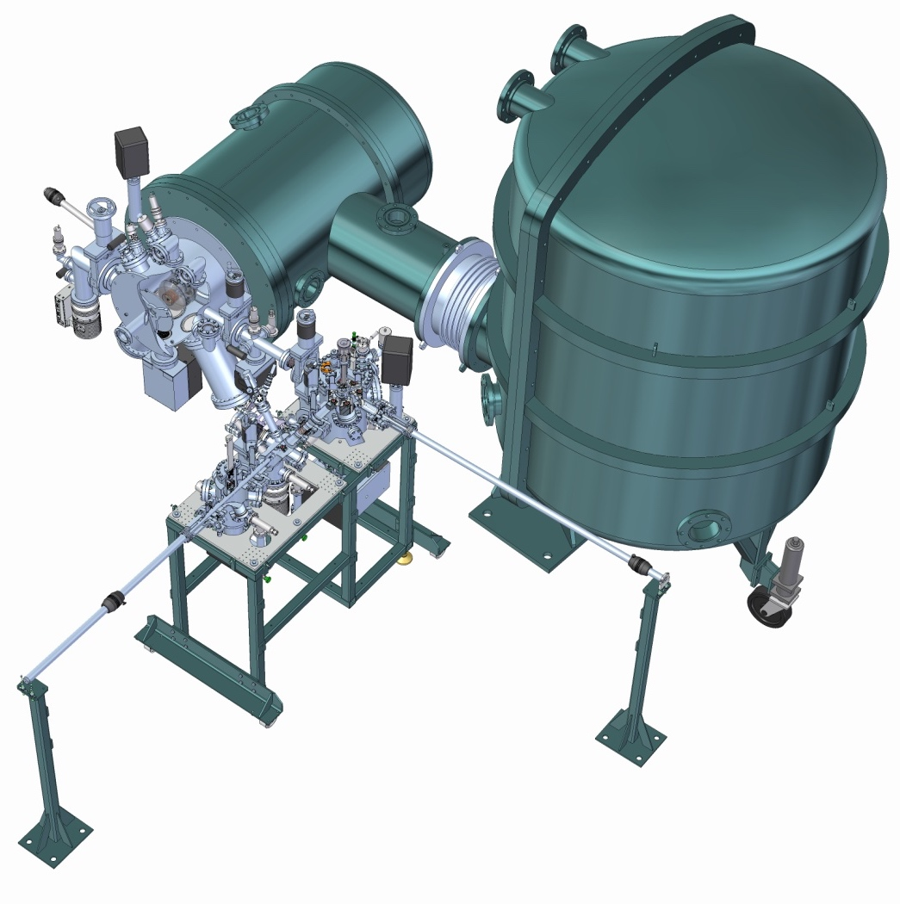
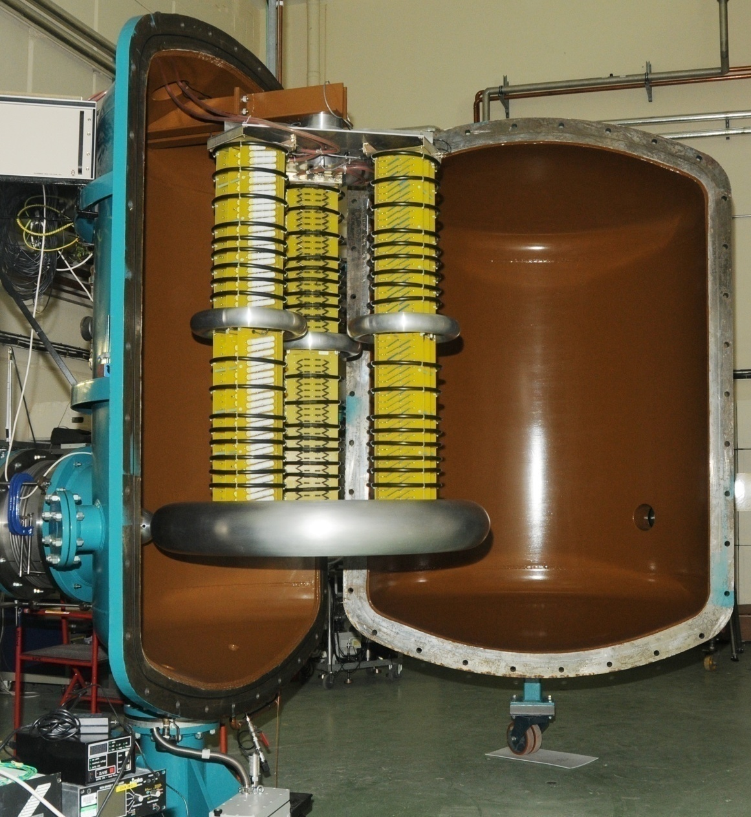
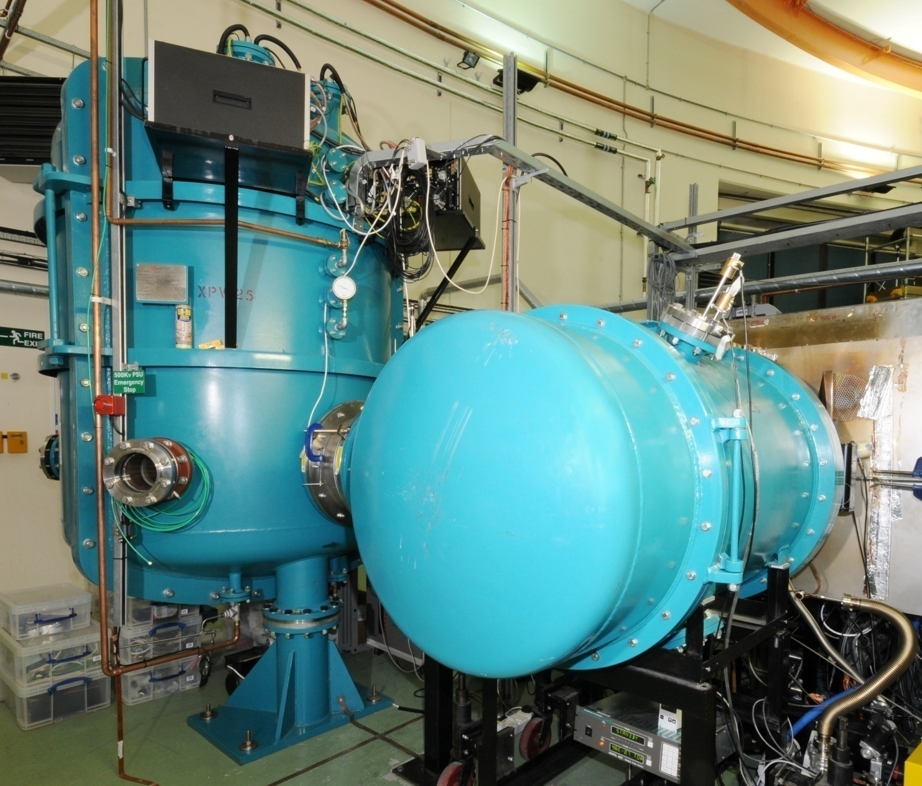
Electron source and injector:
RGA
Transfer arm for
winding cathode forward
Viewing ports
Photocathode gun
Dedicated pumping
port for bakeout
Ceramic
insulator
Electrons
NEG pumping
Photocathode
preparation facility
500kV power
supply

Slide 18
ASTeC/Cockcroft Institute:
Investigation operation of ALICE gun upgrade at up to 500 pc- Beam dynamic simulation
Electron source and injector:
The goals of the simulations are:
Optimisation of the laser pulse size (transverse and longitudinal) to minimise emittance of 500 pC beam delivered by the gun
Choice of buncher frequency in order to minimize emittance growth
Optimise beam transport from the gun to entrance of the booster to minimize transverse beam size and compensate emittance
Current results:
Beam dynamic simulation have been done at a bunch length of 28 ps delivered by existing ALICE laser with a pulse diameter of 8 mm
800 MHz normal conducting low-beta buncher cavity does not provide significant emittance growth
Uncompensated beam emittance at the entrance of the booster is about 5.8 π∙mm∙mrad
Maximum RMS beam diameter in the second solenoid is 8 mm. It may require adjustment of the gun optics to minimize it.

Slide 19
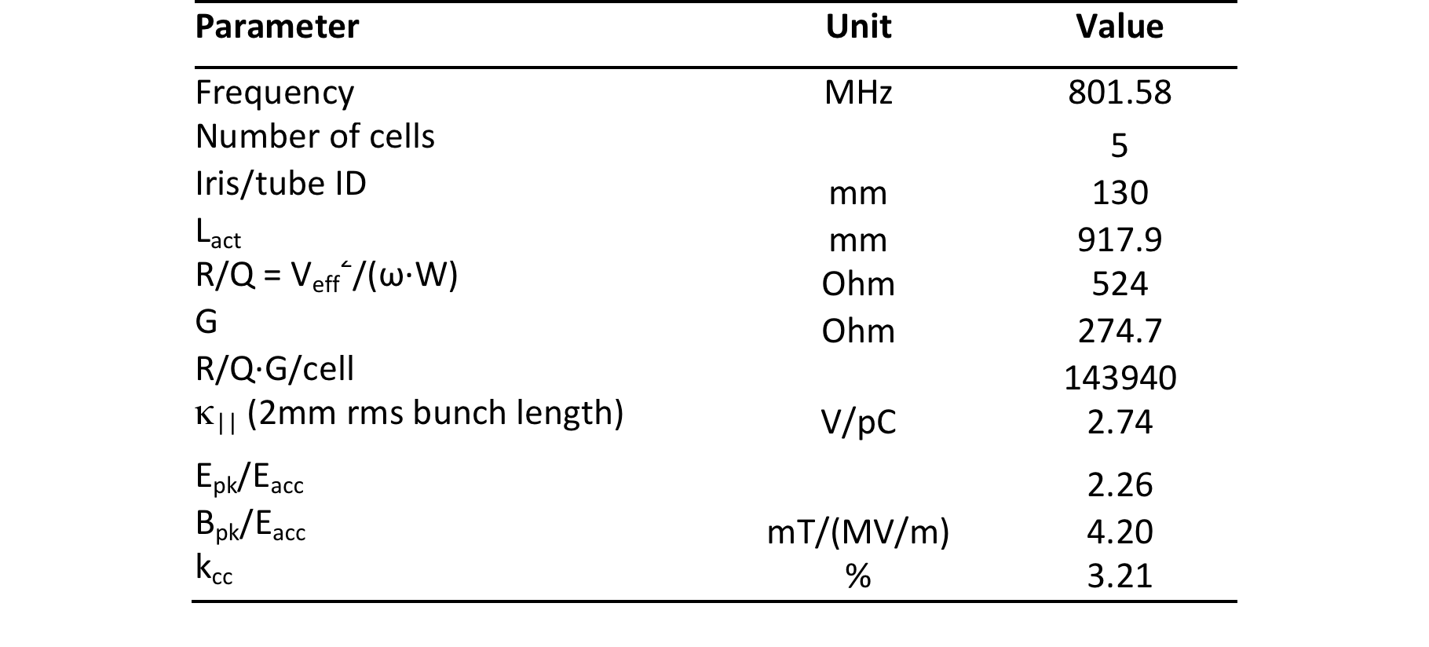
Main cavity parameters:
Frank Marhauser-JLAB

Slide 20
Cavity fabrication and test:
The first Nb 802 MHz 5-Cell cavity fabricated mid-October at JLAB

Slide 21
Cavity fabrication and test:
5-cell cavity successfully electropolished with new flange adapters

Slide 22
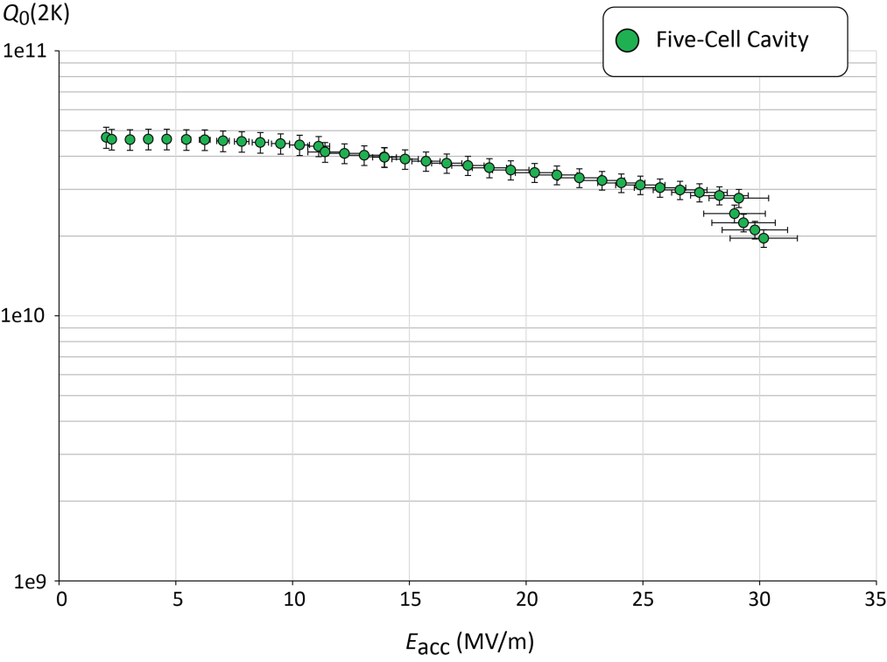
Cavity fabrication and test:
Q₀ (2k) = 3 e10 @ ~27 MV/m
Quench @ E_{acc} ~ 30 MV/m
Regime of E_{acc} requirements in PERLE

Slide 23
Cavity fabrication and test:
Single Cell:
802 MHz Niobium single cell cavity has been completed in August’ 17

Slide 24
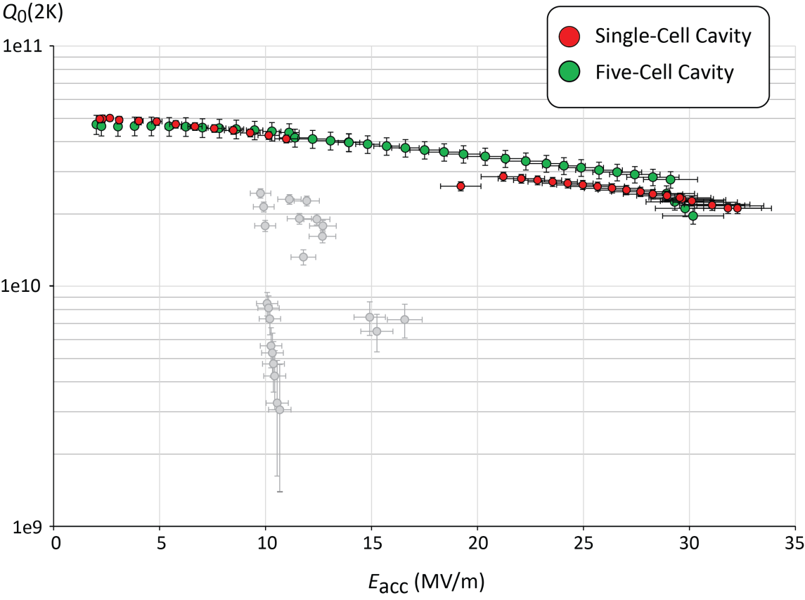
Single cavity fabrication and test:
30 min processing
Quench @ E_{acc} = 32.3 MV/m (Q₀ = 1.7 10¹⁰)
Multipactor barrier and radiation @ 10MV/m

Slide 25
Cryomodule design study:
IPN-Orsay & CERN, started the study of the SPL cryomodule adaptation for PERLE.
SPL cryomodule: designed to integrate 4 elliptical 5-cells 704 MHz cavities

Slide 26
Cryomodule design study:
First results:
Thermal and magnetic shielding are well sized for PERLE operation parameters,
Input coupler designed for SPL cavity could be easily adapted to meet PERLE requirement,
Space liberated due to cavity frequency difference give a margin for auxiliaries integration,
Pending issues:
Find alternative solution to the beam line vacuum valve system,
HOM study will define the design and the number of HOM couplers to be used → Will define the final decision to adapt the SPL cryomodule for PERLE or not.

Slide 27
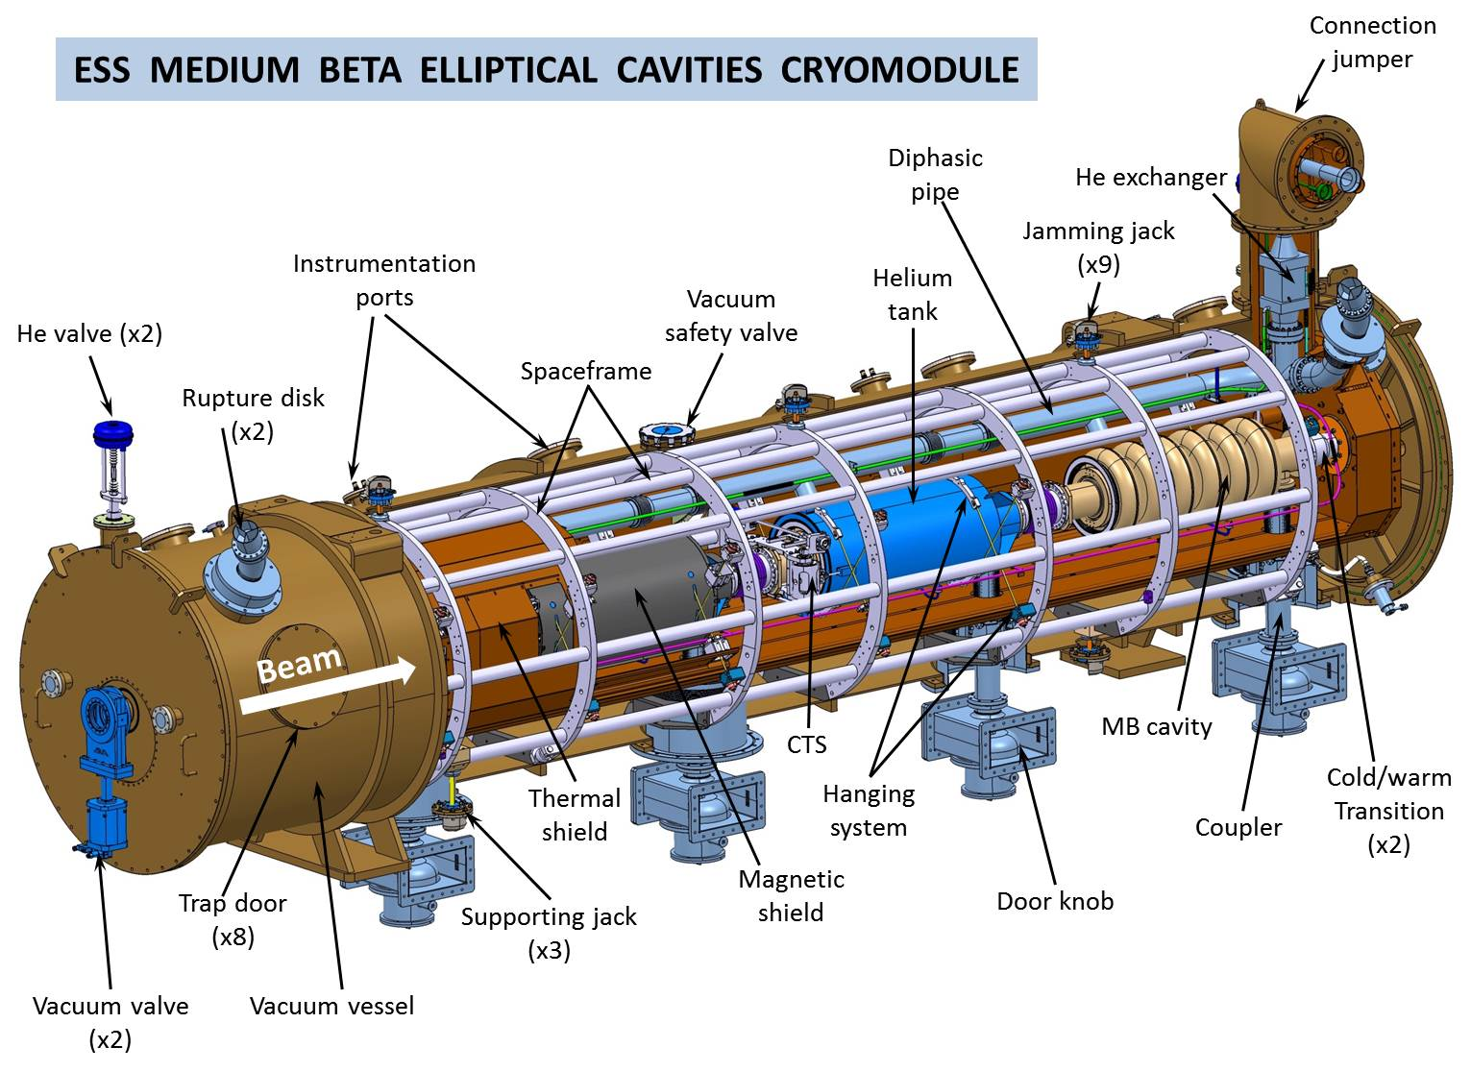
Cryomodule design study:
ESS cryomodule adaptation remain a possible solution for PERLE.
ESS elliptical cryomodule general assembly view

Slide 28
Next steps
Main goal:
to have a complete cryomodule assembled and ready for test in 3 years (Jan2018 – Dec2020)
How ? → 2 stages:
P1: Prototype phase:
Cavity: ongoing work on “naked” 5-cells (HOM study & BBU studies) + produce and test a complete cavity (cav#1)
Couplers: design, produce and test 2 couplers (RF conditioning)
Cryomodule: analyze the possibility to adapt SPL cryomodule to the 802 MHz PERLE cavity
HOM design
→ In this first phase, all the design studies and test results of several components will be included in the TDR.
P2: series phase:
3 more cavities produced and tested
Detailed design and fabrication of cryomodule
2 additional power coupler fabricated and tested
All remaining HOM couplers produced
3 additional cold tuning system produced
→ Staging will allow to maintain the current dynamic within the collaboration and give time to think about a funding strategy.

Slide 29
ASTeC/Cockcroft Institute:
Investigation possibility of using ALICE photo-injector as electron source for PERLE
Next steps
350 kV photocathode gun: Needs upgrade to operate with interchangeable Sb-based photocathodes. The upgrade was designed and many mechanical components have been delivered.
Prototype of the photocathode preparation system for Sb-based photocathode has been designed.
500 kV 8 mA gun power supply: Could be used as it is with operational current of up to 5 mA. Operation with 20 mA requires upgrade.
Injector laser system: Delivers 2.5 W 81.25 MHz 7 ps pulses in 532 nm. Laser may be used as such with high (more than 4%) QE photocathodes. Other laser components need upgrade as specified for low power train pulse operation.
Buncher and booster: To be designed
Use of the gun solenoids is under discussion as increase of the aperture may be required

Slide 30
Next steps
Important R&D effort still to be done in several fields:
  Linear lattice optimization and Initial magnet specifications
  Correction of nonlinear aberrations (geometric & chromatic) with multipole magnets
  Beam Dynamics (start to end simulation with synchrotron radiation, CSR and micro-bunching, Multi-particle tracking studies of halo formation
  Injection line/chicane design
  Space-charge studies at injection
  Final magnets and power supplies specifications
  Beam dumps optimization
  RF power source specification
  Cryogenics optimization
  Beam instrumentations
  LLRF
  Control software system
  Shielding and safety system

Slide 32
Thank you for your attention!
La jeune fille à la perle- J. Vermeer (1665)

