Slide 1

The MYRRHA 100 MeV Accelerator
Dr. Carmen Angulo
MINERVA in MYRRHA Phase 1 – Project Manager
SCK•CEN, Mol, Belgium
SHLIPP’8, Uppsala, May 12th 2018

Slide 2
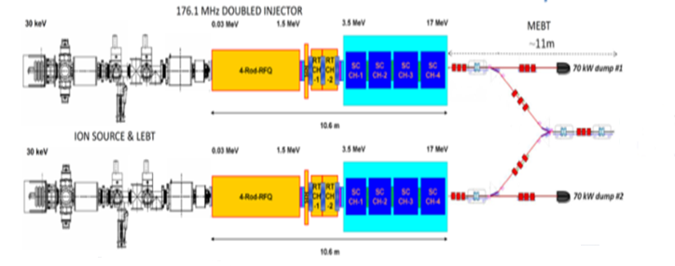

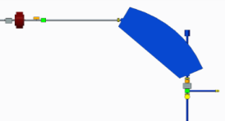
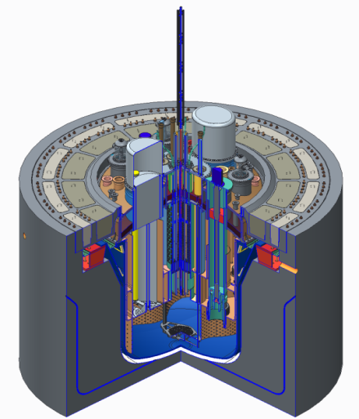
Key technical objective of the MYRRHA-Project:
an Accelerator Driven System
Construction of an Accelerator Driven System for:
ADS concept demonstration
Transmutation of nuclear High-Level-Waste (HLW) demonstration
multipurpose and flexible fast irradiation facility
Target
main reaction | spallation
output | 2·10¹⁷ n/s
material | LBE (coolant)
Reactor
power | 65 to 100 MW_{th}
k_{eff} | 0,95
spectrum | fast
coolant | LBE
Accelerator
particles | protons
beam energy | 600 MeV
beam current | 2.4 to 4 mA

Slide 3
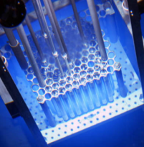






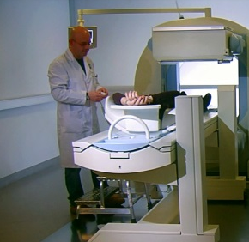
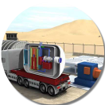
MYRRHA broad application portfolio
Multipurpose
hYbrid
Research
Reactor for
High-tech
Applications
Fission GEN IV
Fusion
SNF*/ Waste
Fundamental research
Radio-isotopes
SMR LFR
*SNF = Spent Nuclear Fuel
Source: SCK•CEN MYRRHA Project Team, MYRRHA Business Plan

Slide 4
MYRRHA Accelerator - Specific requirements
High power proton beam (up to 2.4 MW)
Proton energy | 600 MeV
Beam current | 0.1 to 4.0 mA
Repetition rate | CW, 10 to 250 Hz
Beam duty cycle | 10⁻⁴ to 1
Beam power stability | < ± 2% on a time scale of 100ms
Beam footprint on reactor window | Circular ∅85mm
Beam footprint stability | < ± 10% on a time scale of 1s
# of allowed beam trips on reactor longer than 3 sec | 10 maximum per 3-month operation period
# of allowed beam trips on reactor longer than 0.1 sec | 100 maximum per day
# of allowed beam trips on reactor shorter than 0.1 sec | unlimited
Extreme reliability level: MTBF > 250 hrs

Slide 5
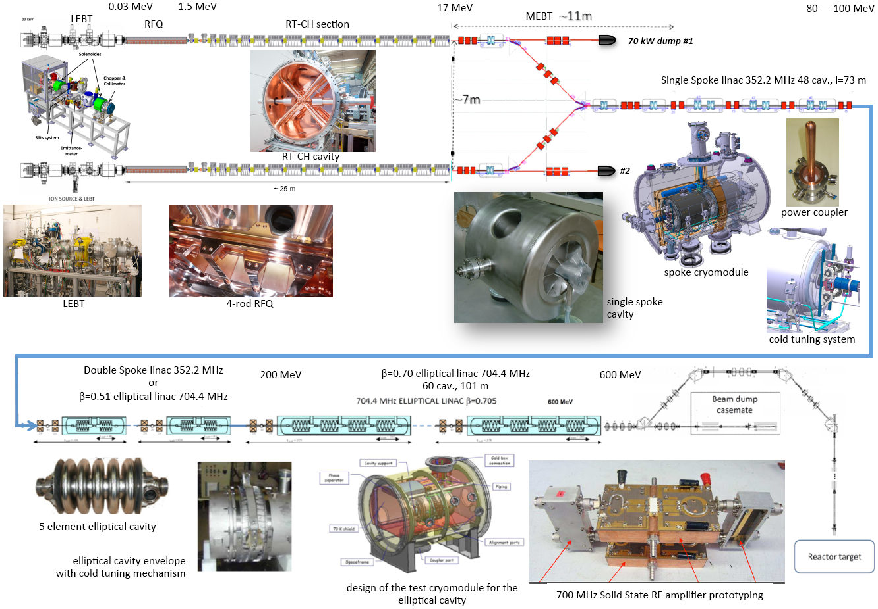
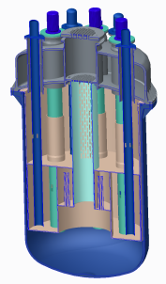
MYRRHA Accelerator – Overview
100 MeV
60 cavities

Slide 6
MYRRHA Phased Implementation Strategy
Benefits of phased approach:
Reducing technical risk
Spreading investment cost
First R&D facility available in Mol end of 2024
100 MeV
60 cavities
Phase 1 – 100 MeV
Phase 2 – 600 MeV
Phase 3 – Reactor

Slide 7
100 MeV Accelerator Objectives
MYRRHA linac design focus on:
  Reliability and reparability of individual components
  Efficient implementation of redundancy (fault tolerance)
100 MeV linac objectives:
  Representative unit of the full MYRRHA linac (600 MeV)
  Implementation of fault tolerant schemes
  Validation of the technological choices (for the injector)
  Evaluation of the reliability goal for the full MYRRHA linac
  Applications

Slide 8
MYRRHA Phase 1 (2018 - 2024) – Objectives
Build a 100 MeV proton linac + ISOL target + Fusion Target
Conduct R&D in support of the accelerator up to 600 MeV (Phase 2)
Conduct the further Design, Licensing, R&D support of the reactor (Phase 3)
MINERVA
MYRRHA Isotopes productioN coupling the linEar acceleRator to the Versatile proton target fAcility
100 MeV linac coupled to a Proton Target Facility (PTF)
Applications
  Production of medical radioisotopes for targeted cancer therapy
  Fundamental physics: high-precision, high-statistics experiments (nuclear, atomic & solid state physics, condensed matter, biology…)
  Material irradiation for Fusion

Slide 9
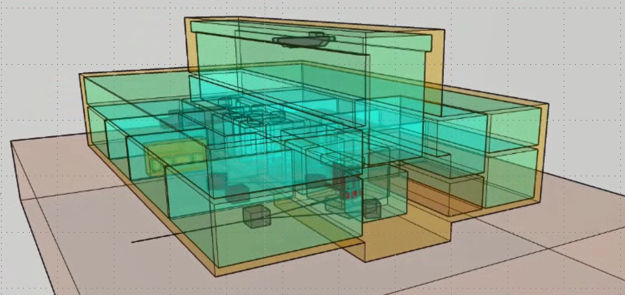
MINERVA in MYRRHA Phase 1 – Schematic View
100 MeV proton linac
17 MeV
(16 cavities)
~11 m
70 kW dump
100 MeV
2 m
4 m
25 m
(60 cavities)
During design and construction of buildings and auxiliary systems at SCK•CEN in Mol, the injector up to RT-CH7 (5.9 MeV) is commissioned (all aspects) in the SCK•CEN vault at CRC/UCL
400 kW dump
~75 m
A fraction of the beam redirected to the target facility

Slide 10

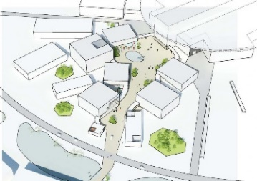

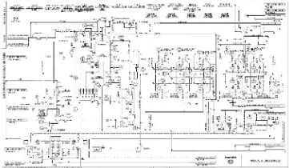
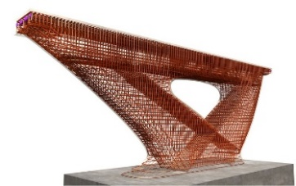
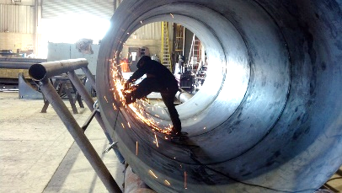
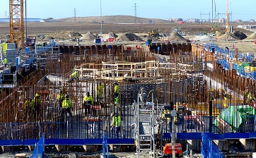
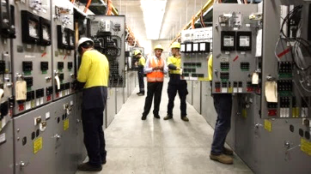
MINERVA in MYRRHA Phase 1 –
Project Phases
Feasibility
Conceptual design
Basic design, including input for license requests
Detailed design, including lots descriptions
Manufacturing
→ License to Construct
Construction
→ License to Operate
Commissioning
Operation
Decommissioning

Slide 11
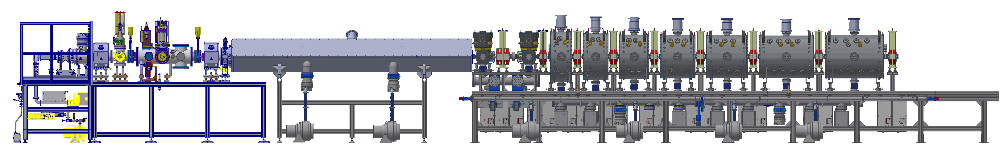
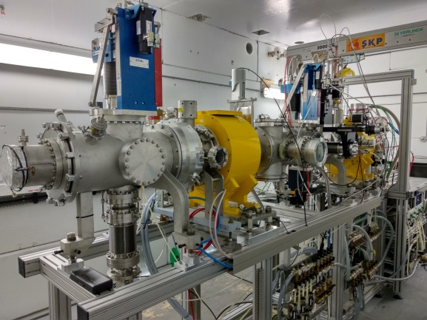
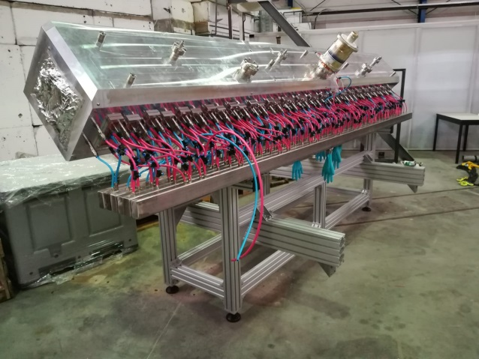
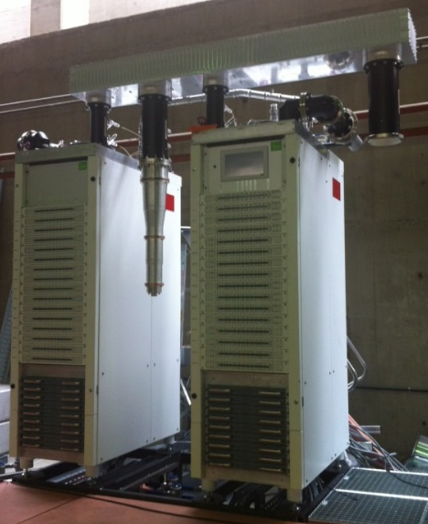
MYRRHA Injector
Shown in Figure up to 5.9 MeV
Ion Source LEBT RFQ MEBT-1 CH-Section 1
~2 m
~4 m
~12 m
ECR source: Pantechnik
LEBT: coll. LPSC Grenoble, IPHC Strasbourg (MARISA, MYRTE), installed at SCK•CEN vault at CRC/UCL for commissioning
Designed by IAP Frankfurt, constructed by NTG (coll. MYRTE project), now at SCK•CEN vault at CRC/UCL for commissioning
RFQ SS amplifier manufactured by IBA (coll. In MYRTE project), installed
18

Slide 12
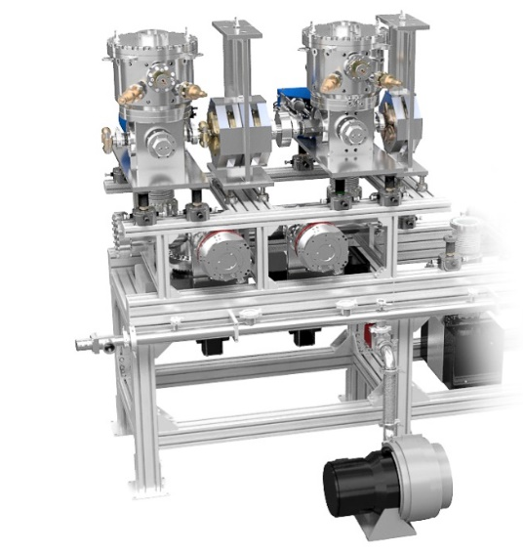
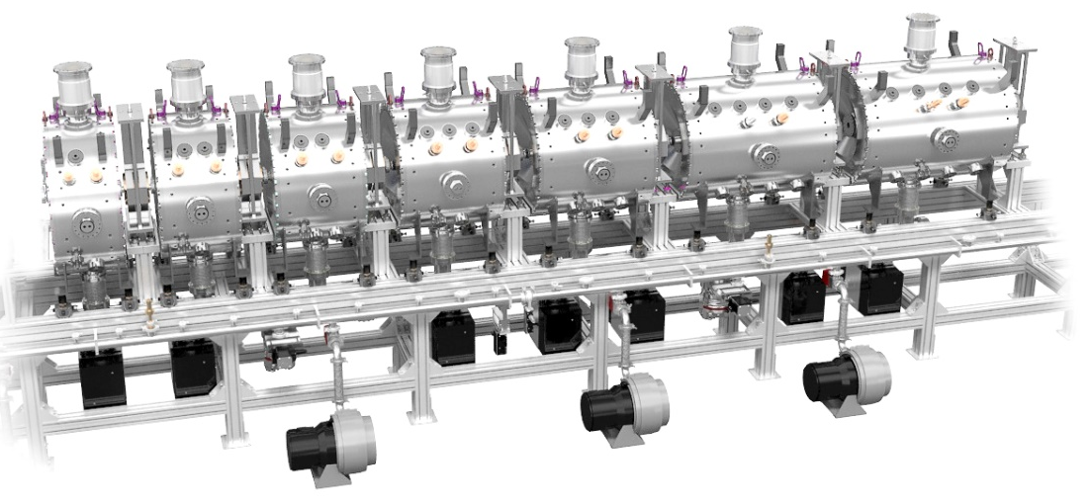
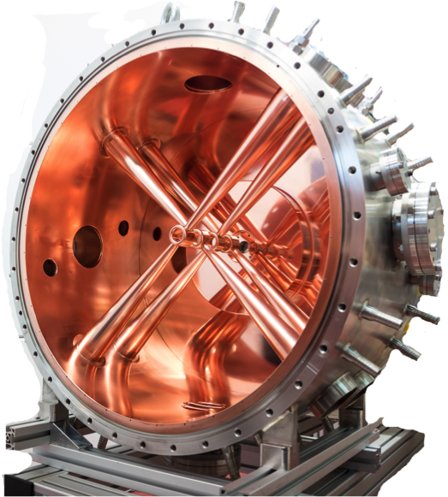
MYRRHA Injector
Shown in Figure up to 5.9 MeV
Ion Source LEBT RFQ MEBT-1 CH-Section 1
Ion Source LEBT RFQ MEBT-1 CH-Section 1
Ion Source LEBT RFQ MEBT-1 CH-Section 1
~2 m
~4 m
~12 m
CH-Section 1
MEBT-1
Designed by Bevatech GmbH (contract), MBET1 under construction, CH1 and CH2 manufactured & under test, CH3 to CH7: call launch this week
19

Slide 13
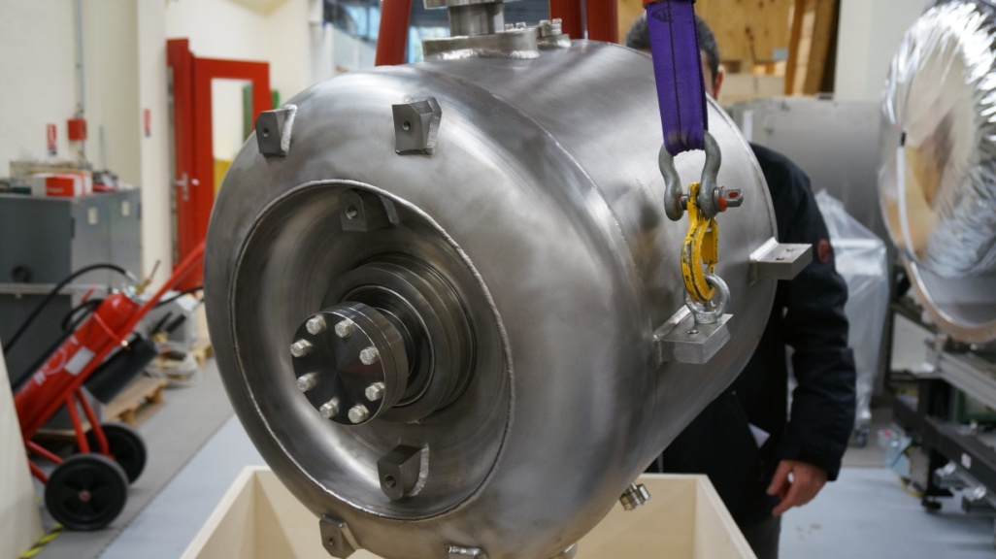
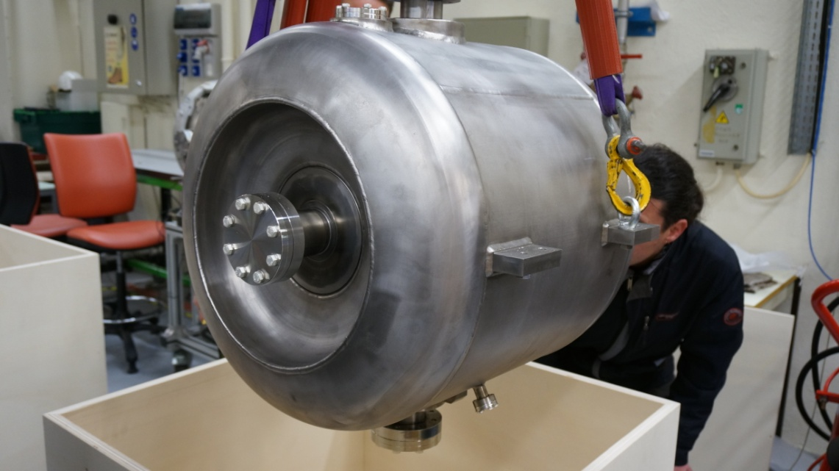
MYRRHA Accelerator - Single spoke cavity
AMELIA (ZA01)
VIRGINIA
(ZA02)
Surface preparation process tested at IPN Orsay with these 2 cavities
Two new final cavities will be constructed and tested (collaboration agreement with French CNRS/IN2P3).
- Call for tender launched, supplier selected.

Slide 14
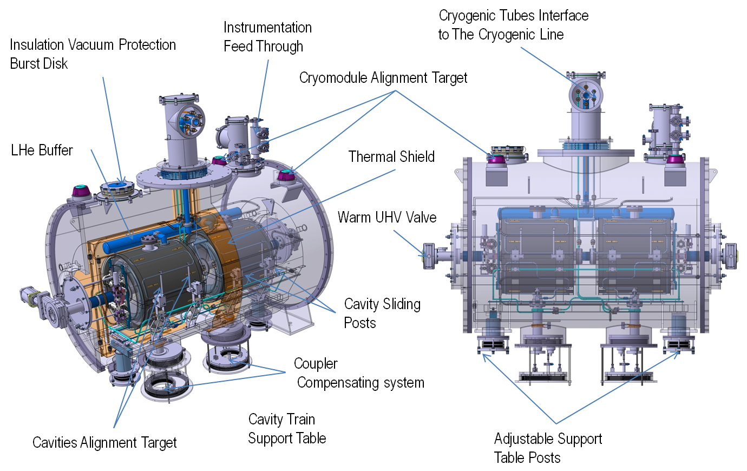
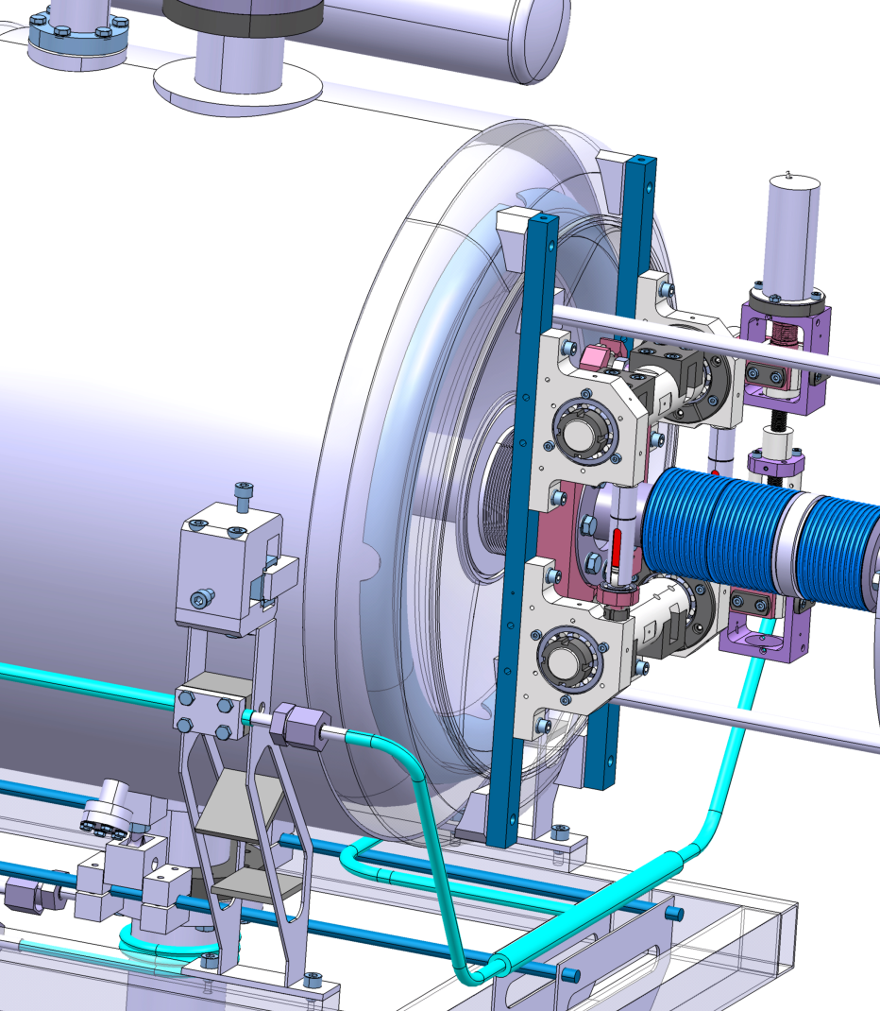
MYRRHA Accelerator - Single spoke cavity cryomodules
- Series of 30 cryomodules → prototype for: SC cavity preparation, cold valve box, RF power coupler, cold tuning mechanisms, instrumentation, assembly and long term operation
- Preparing phase of industrialisation / series production

Slide 15
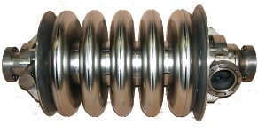
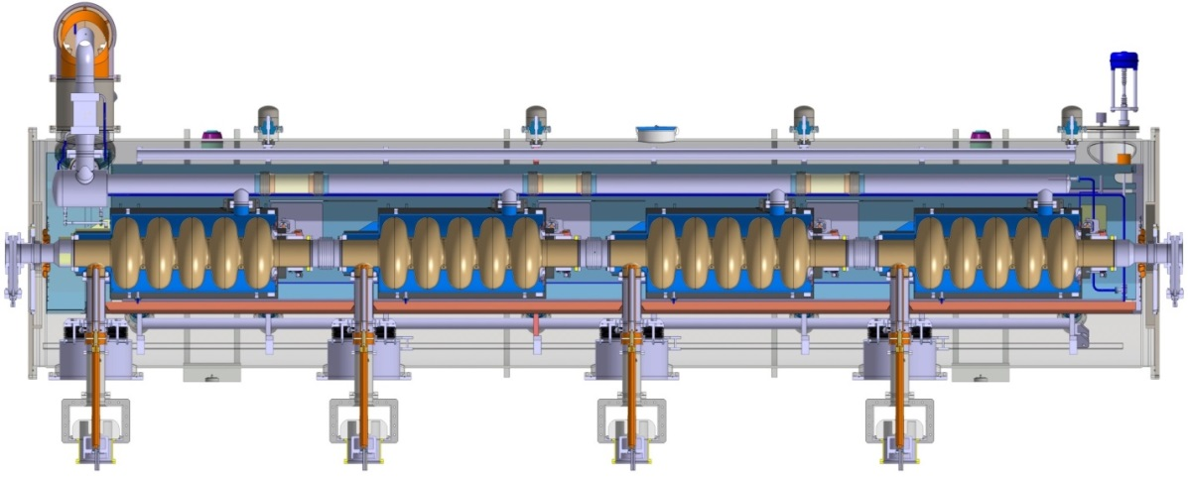
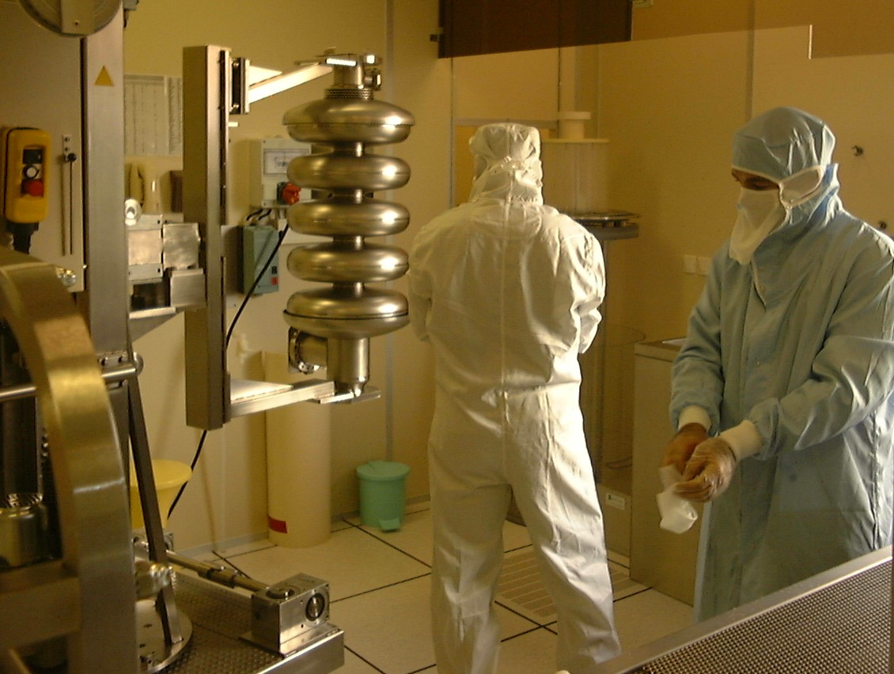
MYRRHA Accelerator - Fourth and fifth accelerating sections (HEBT)
Section 100 MeV to 600 MeV
Superconducting RF structures
  100 – 200 MeV: double spoke (ESS design experience) or elliptical cavities (352.2 or 704.4MHz) or…
  200 – 600 MeV: elliptical cavities (704.4MHz)

Slide 16
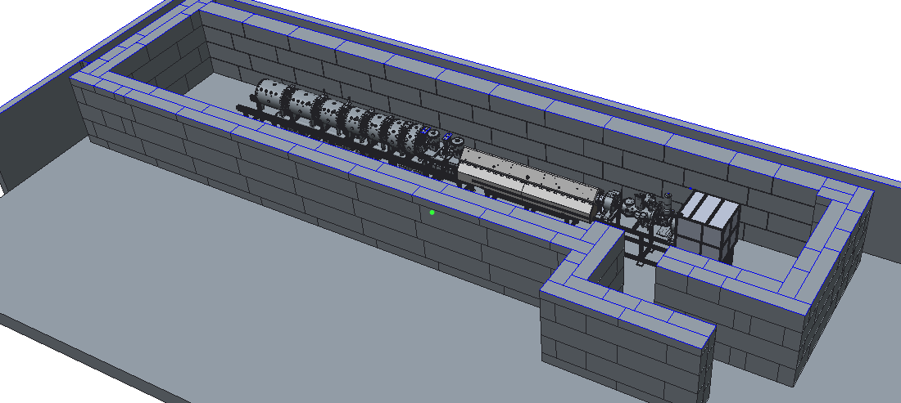
MYRRHA Injector @ 5.9 MeV at SCK•CEN vault CRC/UCL
Current status (June 2018):
ECR source and LEBT installed and getting ready for re-commissioning
RFQ amplifier installed, integrated with its test-bench and ready for stand-alone commissioning (on dummy load and mismatched load)
RFQ cavity delivered and stored in the bunker
The two rebuncher cavities, magnets and couplers under manufacturing
Two first CH cavities currently under low power tests
Cavities CH3 to CH7: call for tender this week
RFQ cavity
ECR source and LEBT
CH1 to CH7 cavities
Rebuncher cavities (MEBT1)

Slide 17
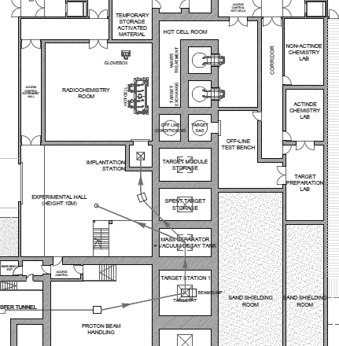
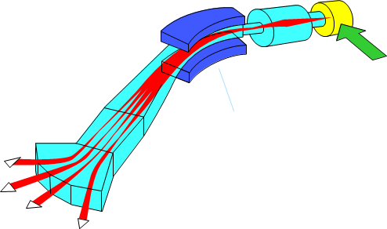
Proton Target facility
ISOL System implementation
PTF Conceptual design on-going
Preparing technical specifications and requirements for buildings and auxiliary systems:
  Cooling, high-voltage, vacuum, handling systems (e.g. target module),…
  Various “facilities”
    target pit (including shielding),
    spent-targets storage,
    isotopes collector station,
    off-line conditioning station
    laser laboratory,
    …
MINERVA team, current collaborations with TRIUMF & CERN

Slide 18
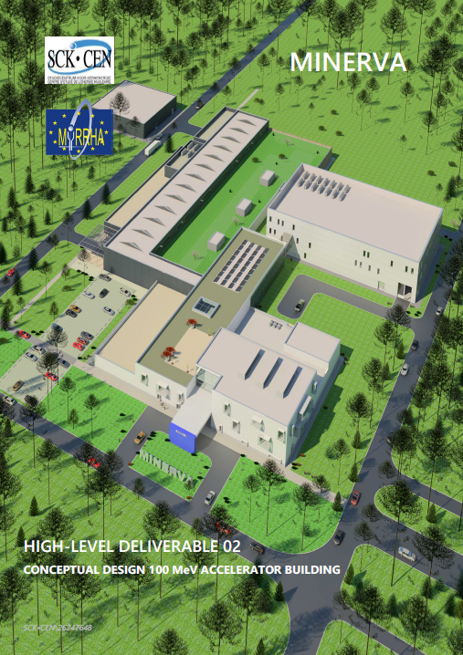
MINERVA in MYRRHA Phase 1 –
100 MeV accelerator buildings & auxiliary systems
Conceptual design
  Masterplan
  Process systems
  HVAC & dynamic confinement
  Building architecture
  Civil & Structural engineering
  Electrical systems and I&C
  Integration, 3D model
  Safety and security in design
Basic design
Detailed design, incl. lots descriptions
Follow-up of construction
MINERVA team
SCK•CEN
Design Engineer call launched, companies selected,
Granting phase in preparation

Slide 19
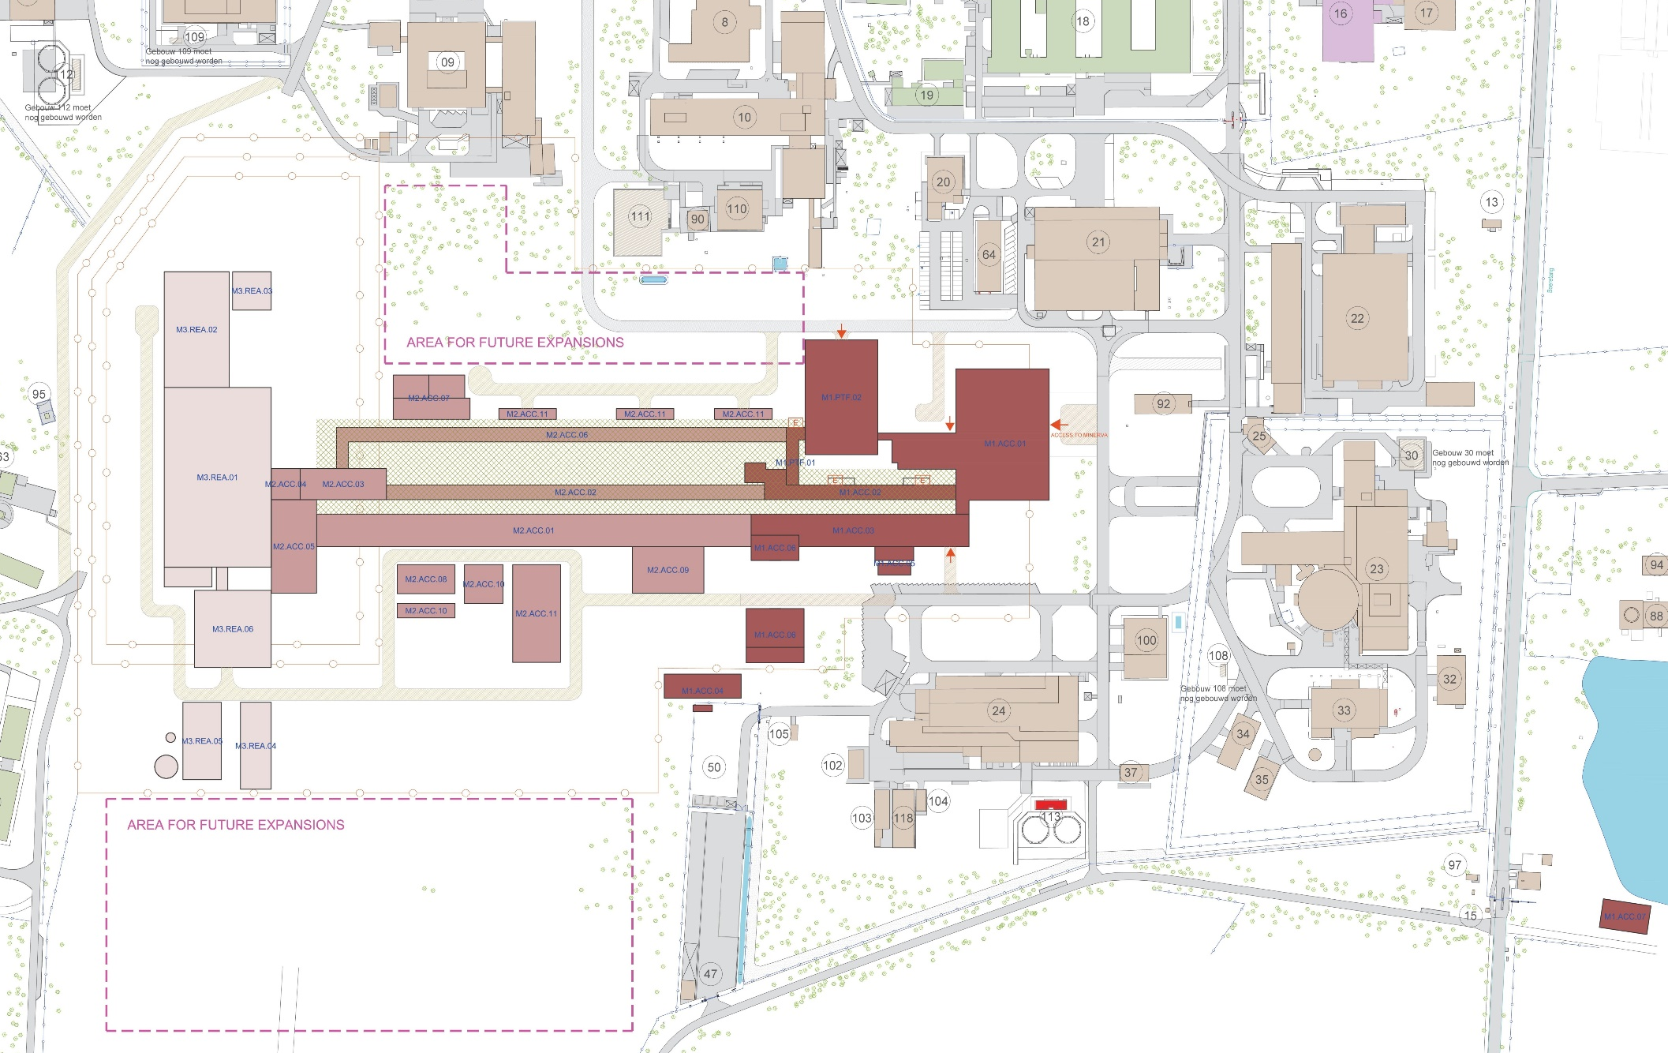
Project Masterplan at SCK•CEN site

Slide 20
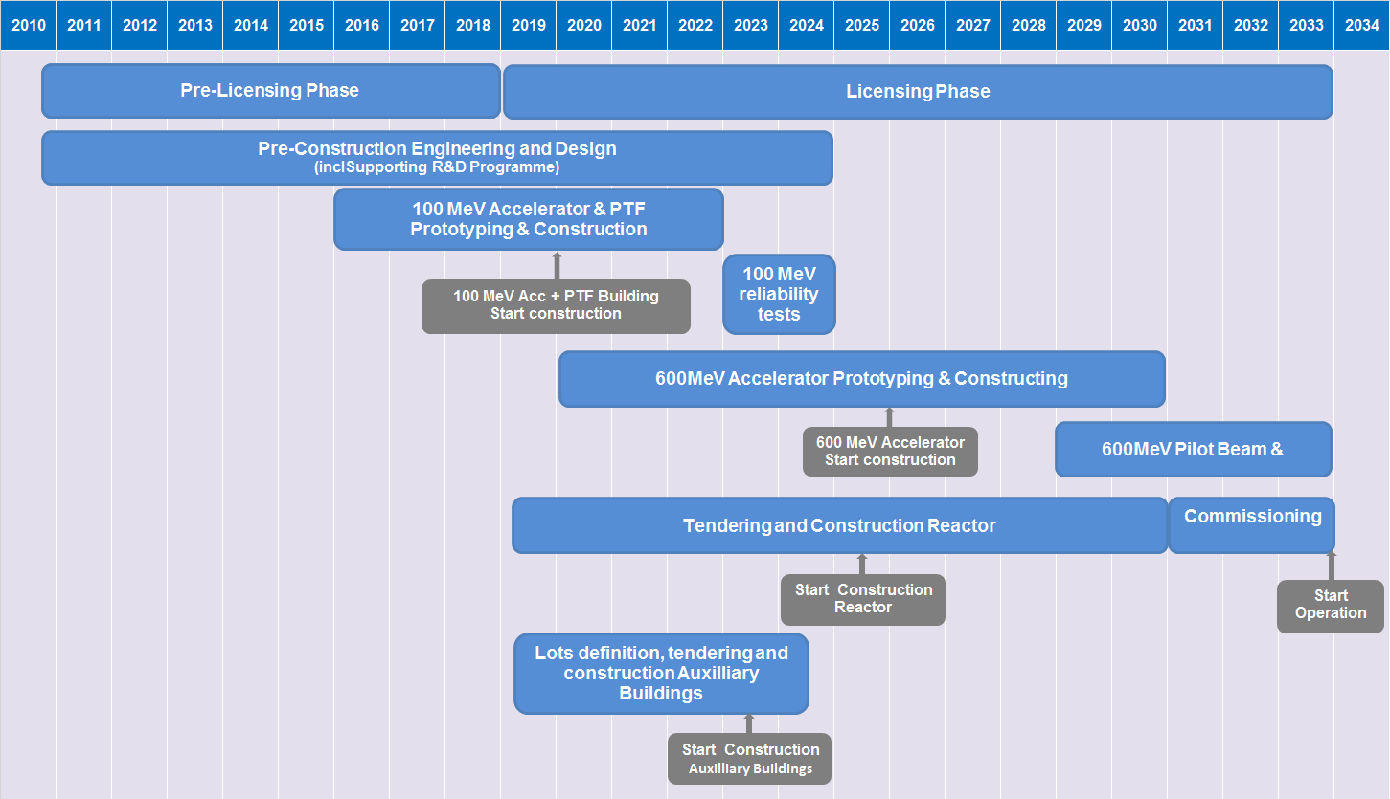
MYRRHA High-level Global Planning (2016-2030)

Slide 21
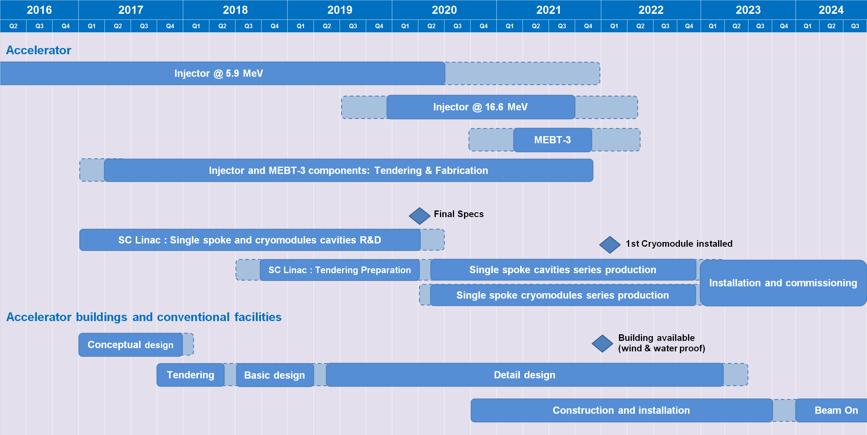
100 MeV Accelerator Planning

Slide 22
MINERVA in MYRRHA Phase 1 –
Selected Project Management Aspects
Project Organisation defined
Overall planning & main milestones defined
Resources defined
Hiring of key roles strengthened and on-going
Calls for Tender of accelerator and ISOL off-line components on-going
Preparing for industrialisation phase for cryomodules
Design Engineer call launched, companies selected, preparing granting phase
Dialogue with Belgian Safety Authorities on-going, PSAR preparation

Slide 23
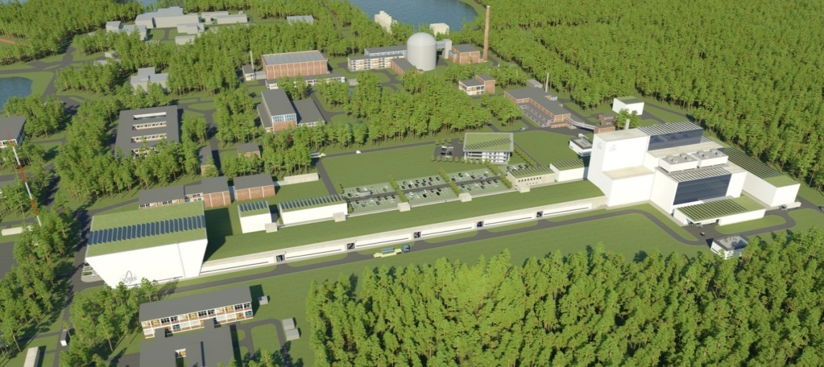
Innovation in Belgium for Europe
For sustainable & innovative nuclear energy and applications

Slide 24
Copyright © 2018 - SCK•CEN
PLEASE NOTE!
This presentation contains data, information and formats for dedicated use ONLY and may not be copied, distributed or cited without the explicit permission of the SCK•CEN. If this has been obtained, please reference it as a “personal communication. By courtesy of SCK•CEN”.
SCK•CEN
Studiecentrum voor Kernenergie
Centre d'Etude de l'Energie Nucléaire
Belgian Nuclear Research Centre
Stichting van Openbaar Nut
Fondation d'Utilité Publique
Foundation of Public Utility
Registered Office: Avenue Herrmann-Debrouxlaan 40 – BE-1160 BRUSSELS
Operational Office: Boeretang 200 – BE-2400 MOL

