Slide 1

Status of the ESS Test Stands
How difficult can it be to buy some concrete blocks ?
Wolfgang Hees, WP leader Test Stands
2018-06-12, SLHiPP, Uppsala

Slide 2
Contents
scope
collaboration
progress
schedule

Slide 3
TS2 CM testing scope
install, commission and operate Test Stand 2:
provide the facilities for the SAT of the elliptical cavity cryomodules and for the preparation of CMs for tunnel installation
perform the SAT of the elliptical cavity cryomodules
prepare the CMs for tunnel installation
final evaluation of test results & prepare decision about acceptance of a specific cryomodule
provide a physical ‘home’ for SRF know-how at ESS

Slide 4
TS2 – secondary goal
to act as a test bed for some of our equipment: klystrons, modulator, PSS, etc …
to test integration of our equipment with the building and utilities (more difficult than you might think)
to give our colleagues the chance to get their hands dirty - early on

Slide 5
TS2 Collaboration:
WP10 staff: organise testing and operate TS2, support for controls issues
WP10 IKC partner (IFJ PAN): specialists for CM handling, preparation, connection, testing (experience from XFEL)
WP5 staff / SRF section: SRF expertise and leading role for testing
WP5 IKC partners (CEA & IPNO, France): training, transfer of know-how, advice and support
WP8 & 17/ RF group: support for operation of RF equipment during tests (modulator, klystrons, LLRF, interlocks, RFDS)
WP11: cryoplant operation, support during CM cooldown
WP12: clean room operation, connection of pumps, support
WP15 & WP16: utilities operation

Slide 6
TS2 team
WP10: Wolfgang Hees, Emilio Asensi, Weiming Yue (IMP)
IFJ PAN (In-Kind): Michal Sienkiewicz, Tadeusz Ostrowicz, Wawrzyniec Gaj, Karol Kasprzak
WP05: Paolo Pierini, Christine Darve, Cecilia Maiano, Felix Schlander, Nuno Elias
WP08: Morten Jensen, Stevo Calic, Walther Borg, Staffan Ekström
WP17: Carlos Martins, Göran Göransson, Dana McKenzie
Area supervisor: Dennis Schön
miscellaneous personnel from WP15 & WP16 (Frithiof, Lia, Owen, Steven, Fredrik, Anton)

Slide 7
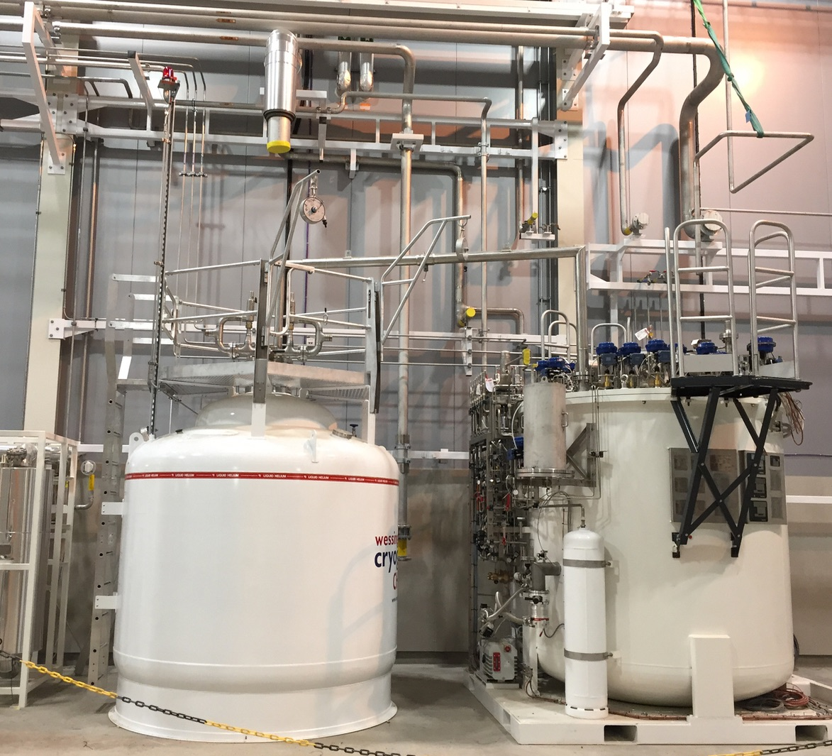
https://confluence.esss.lu.se/display/ATS/Accelerator+Cryomodule+Test+Stand+2

Slide 8
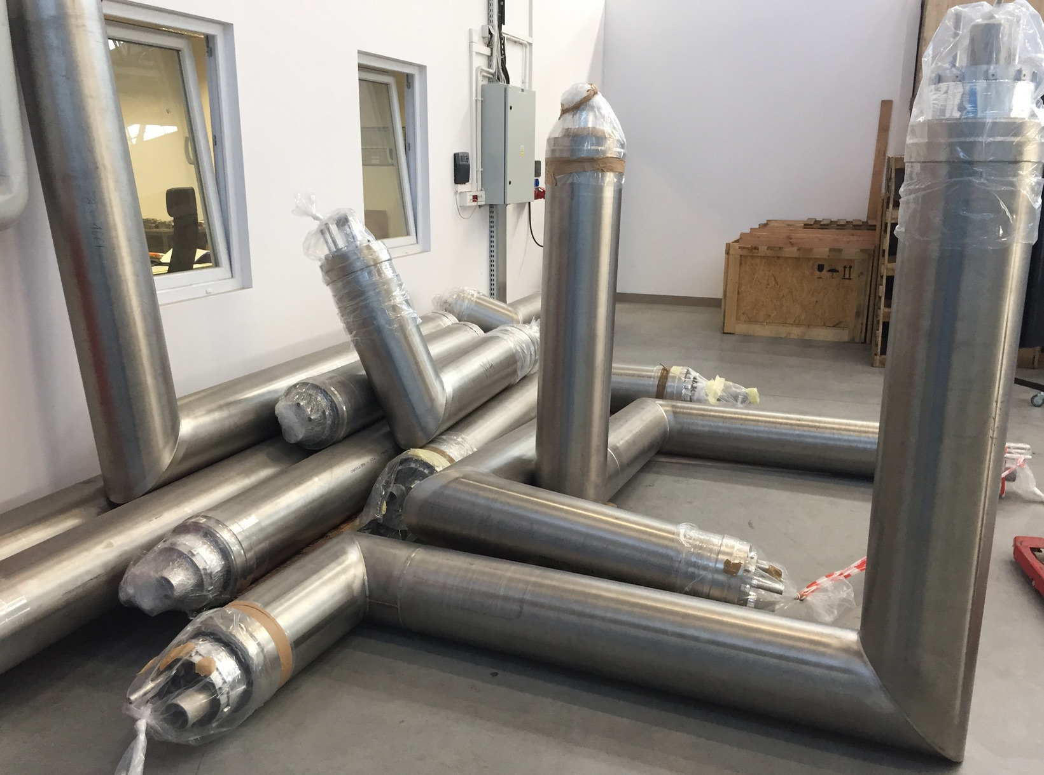
https://confluence.esss.lu.se/display/ATS/Accelerator+Cryomodule+Test+Stand+2

Slide 9
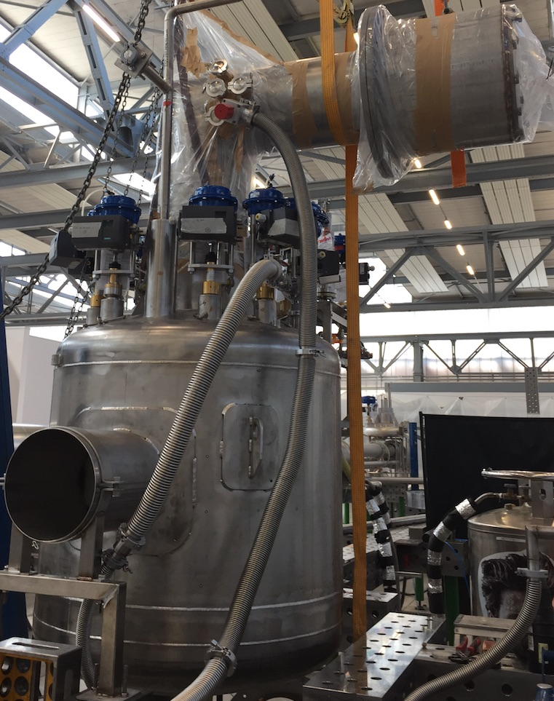
https://confluence.esss.lu.se/display/ATS/Accelerator+Cryomodule+Test+Stand+2

Slide 10
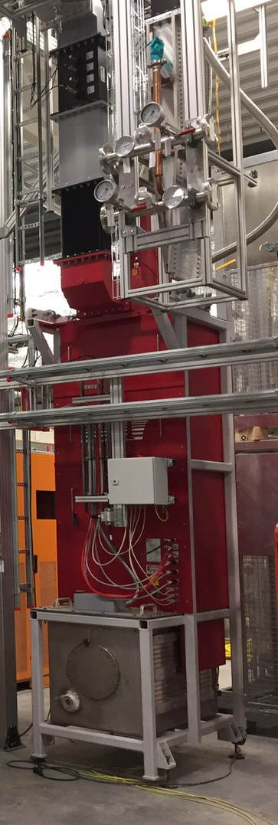
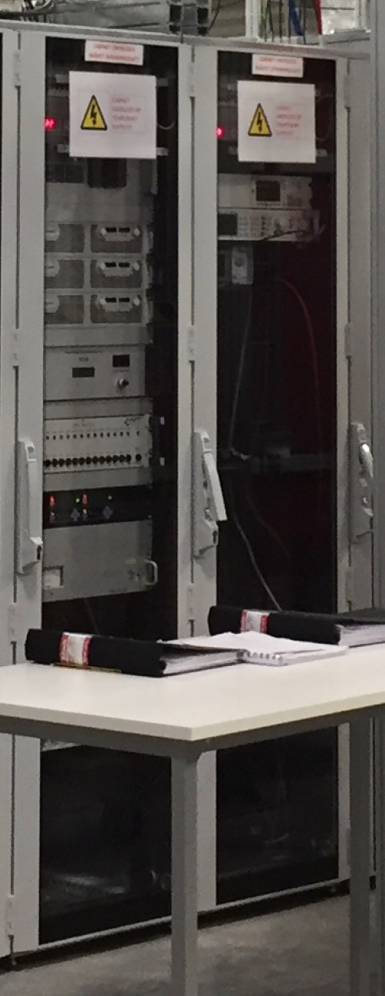
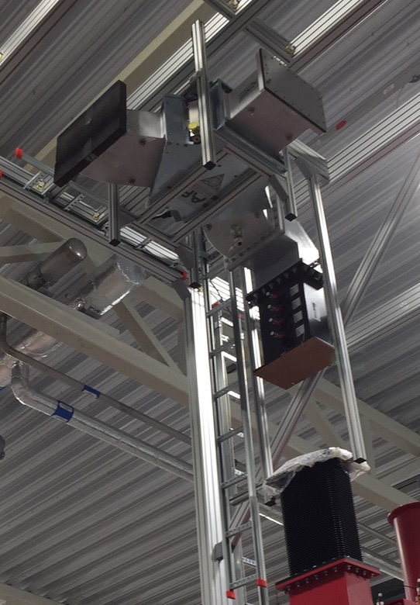
https://confluence.esss.lu.se/display/ATS/Accelerator+Cryomodule+Test+Stand+2

Slide 11
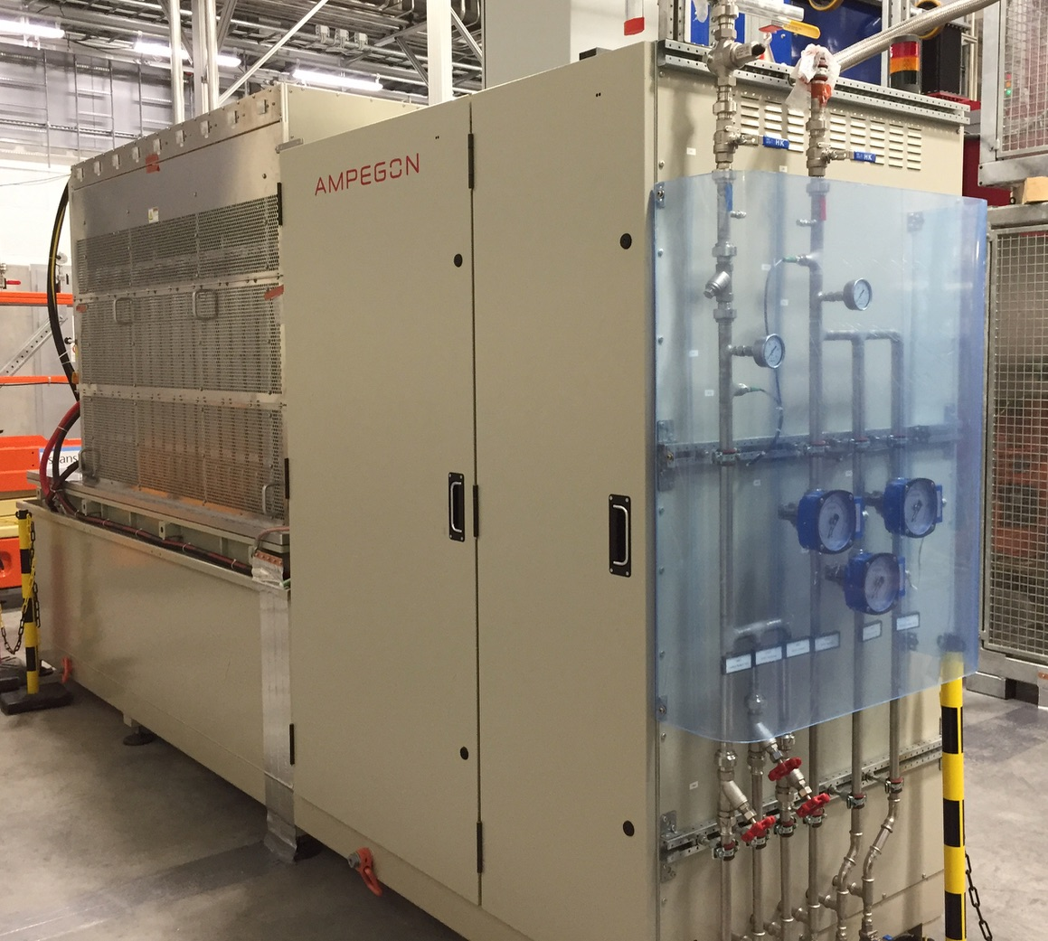
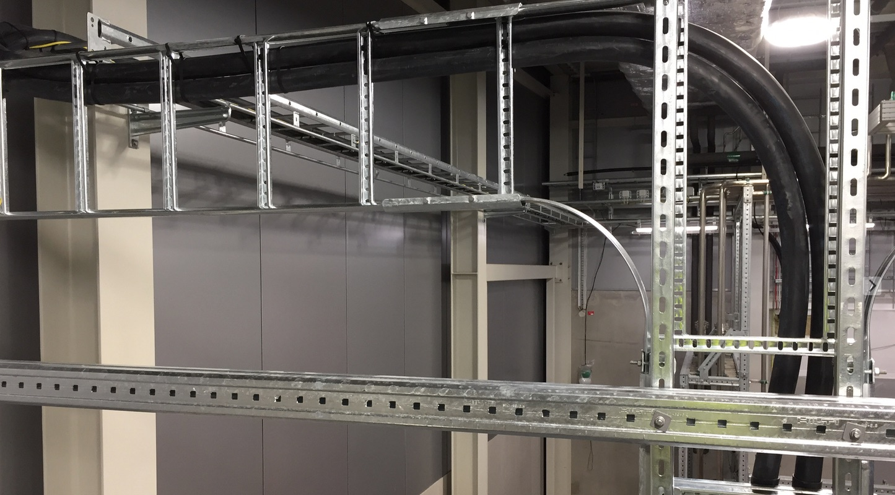
https://confluence.esss.lu.se/display/ATS/Accelerator+Cryomodule+Test+Stand+2

Slide 12
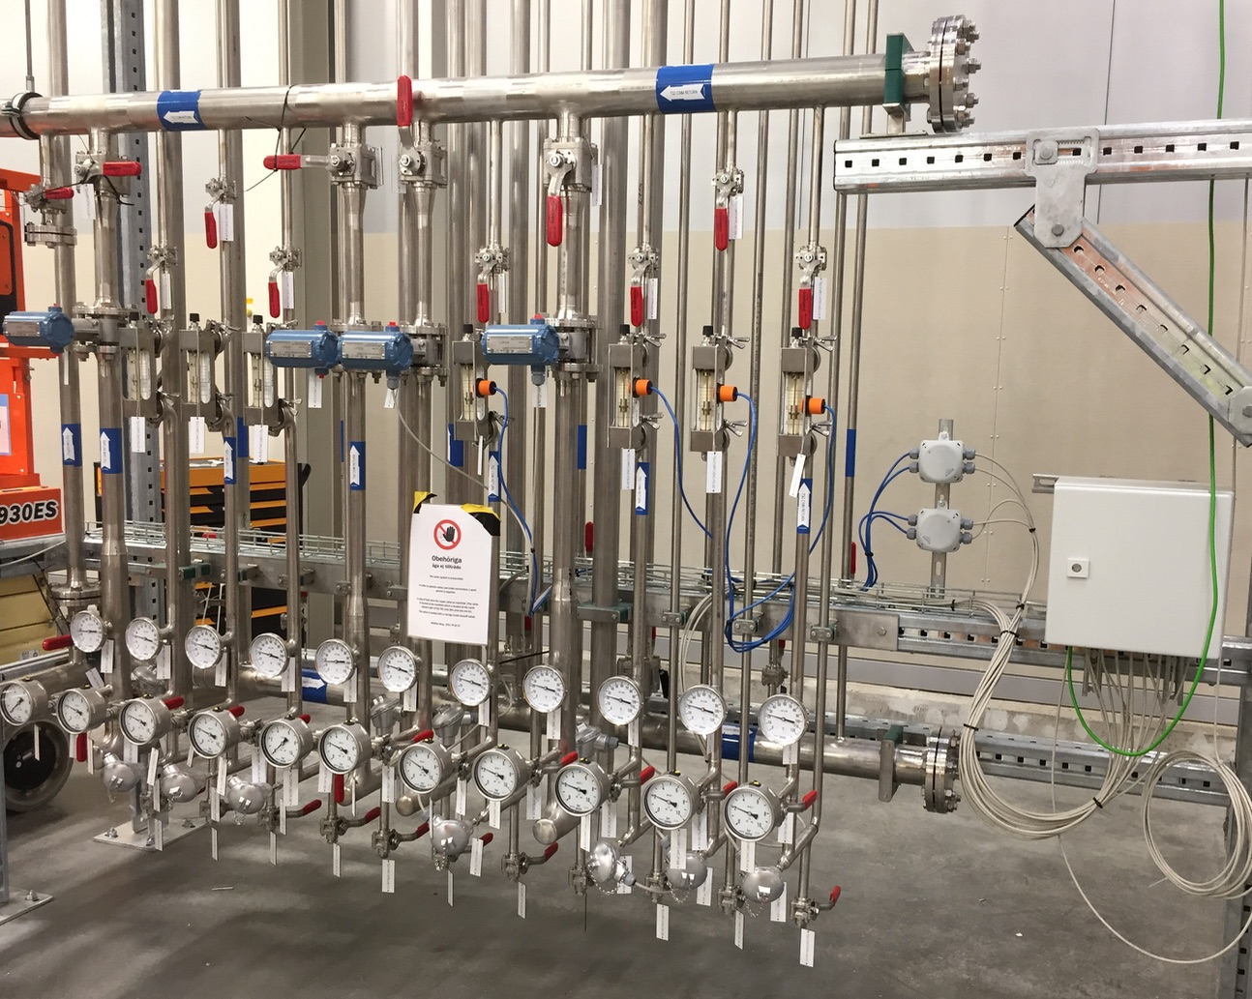
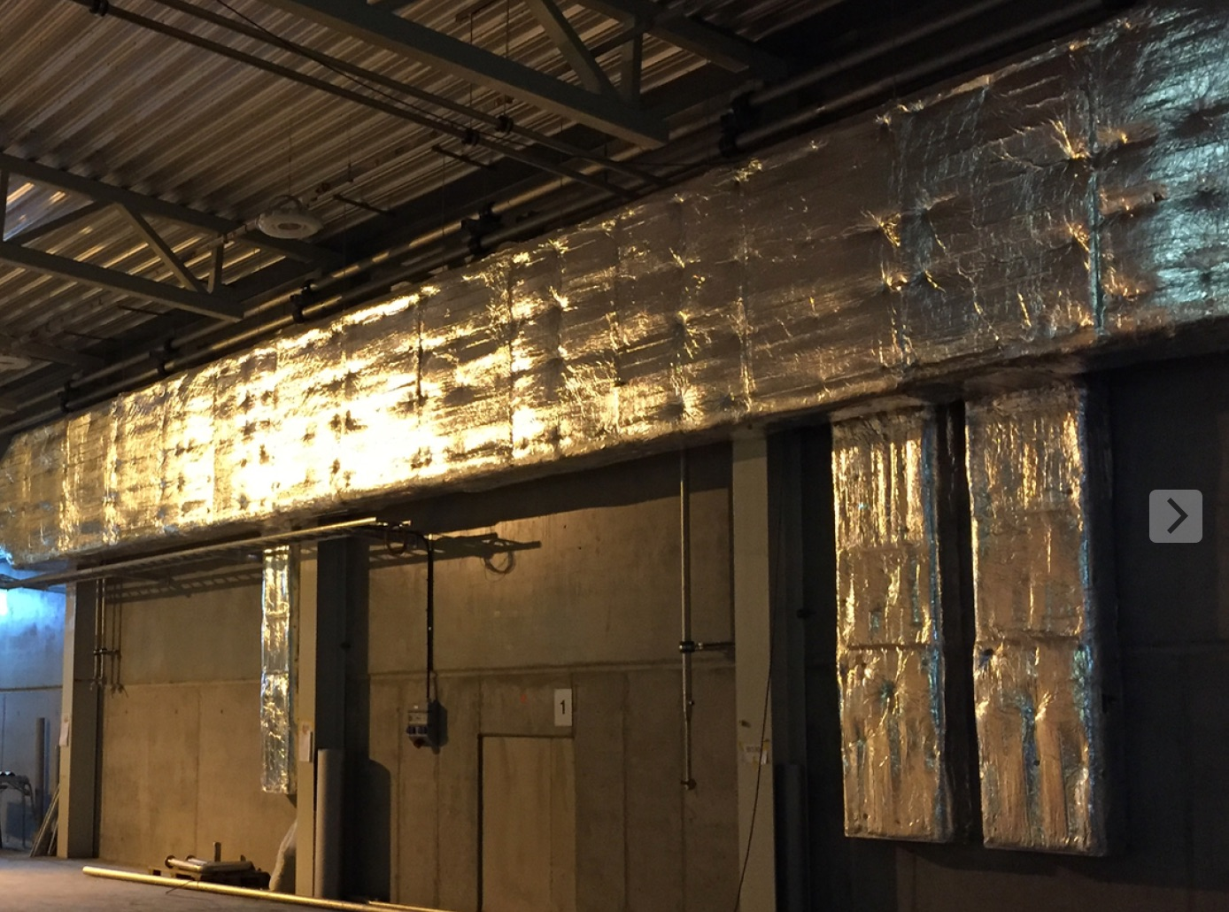
https://confluence.esss.lu.se/display/ATS/Accelerator+Cryomodule+Test+Stand+2

Slide 13
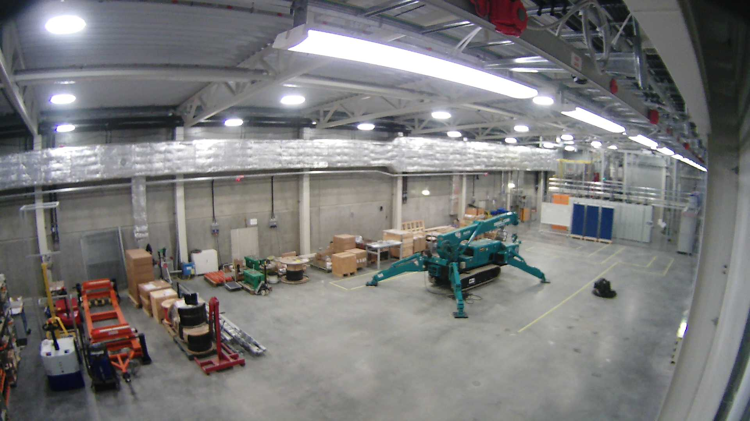
https://confluence.esss.lu.se/display/ATS/Accelerator+Cryomodule+Test+Stand+2

Slide 14
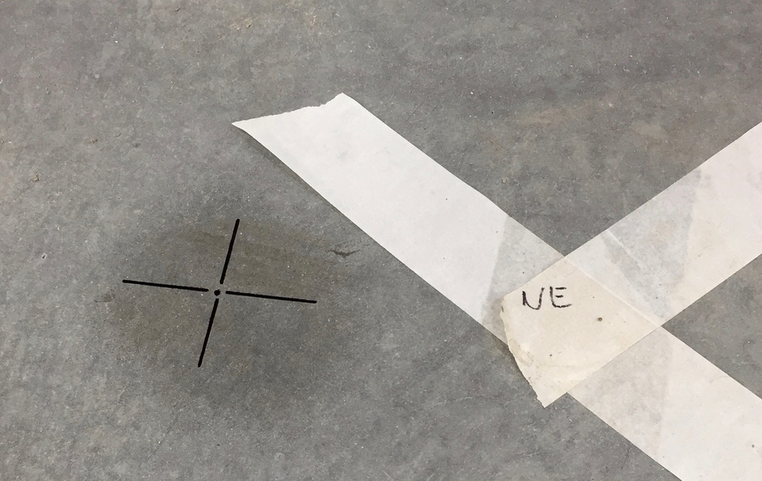
https://confluence.esss.lu.se/display/ATS/Accelerator+Cryomodule+Test+Stand+2

Slide 15
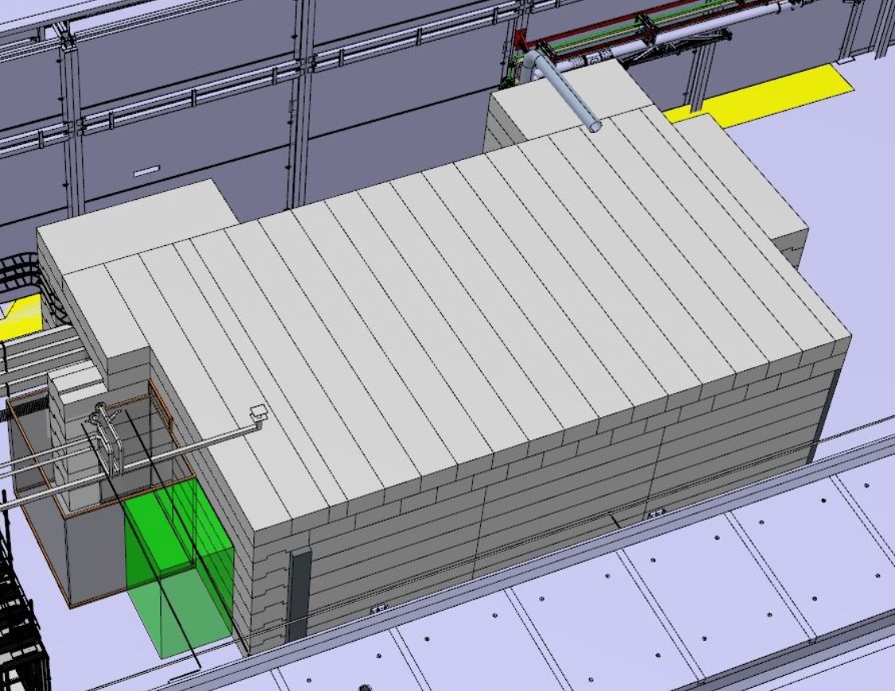
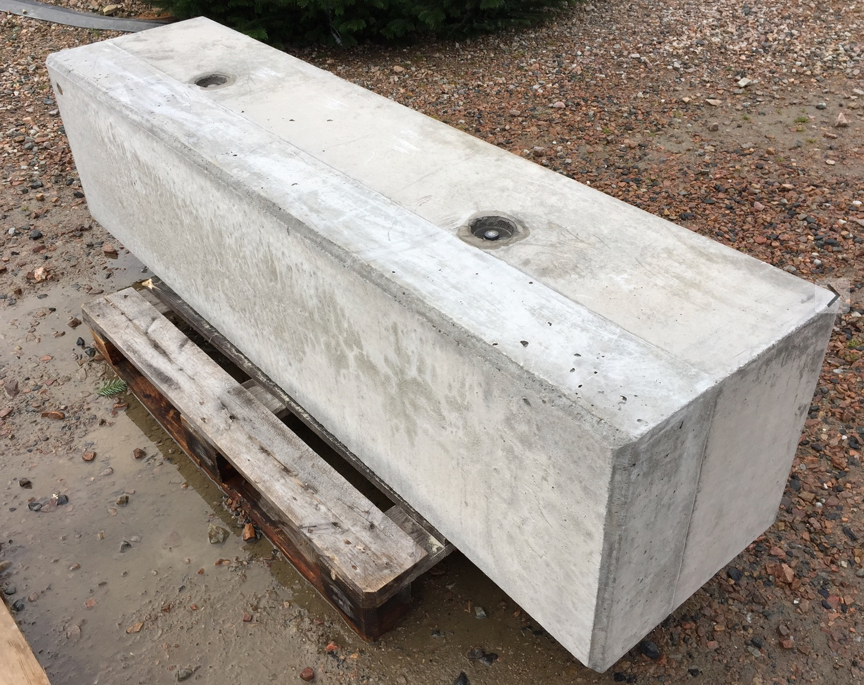
https://confluence.esss.lu.se/display/ATS/Accelerator+Cryomodule+Test+Stand+2

Slide 16
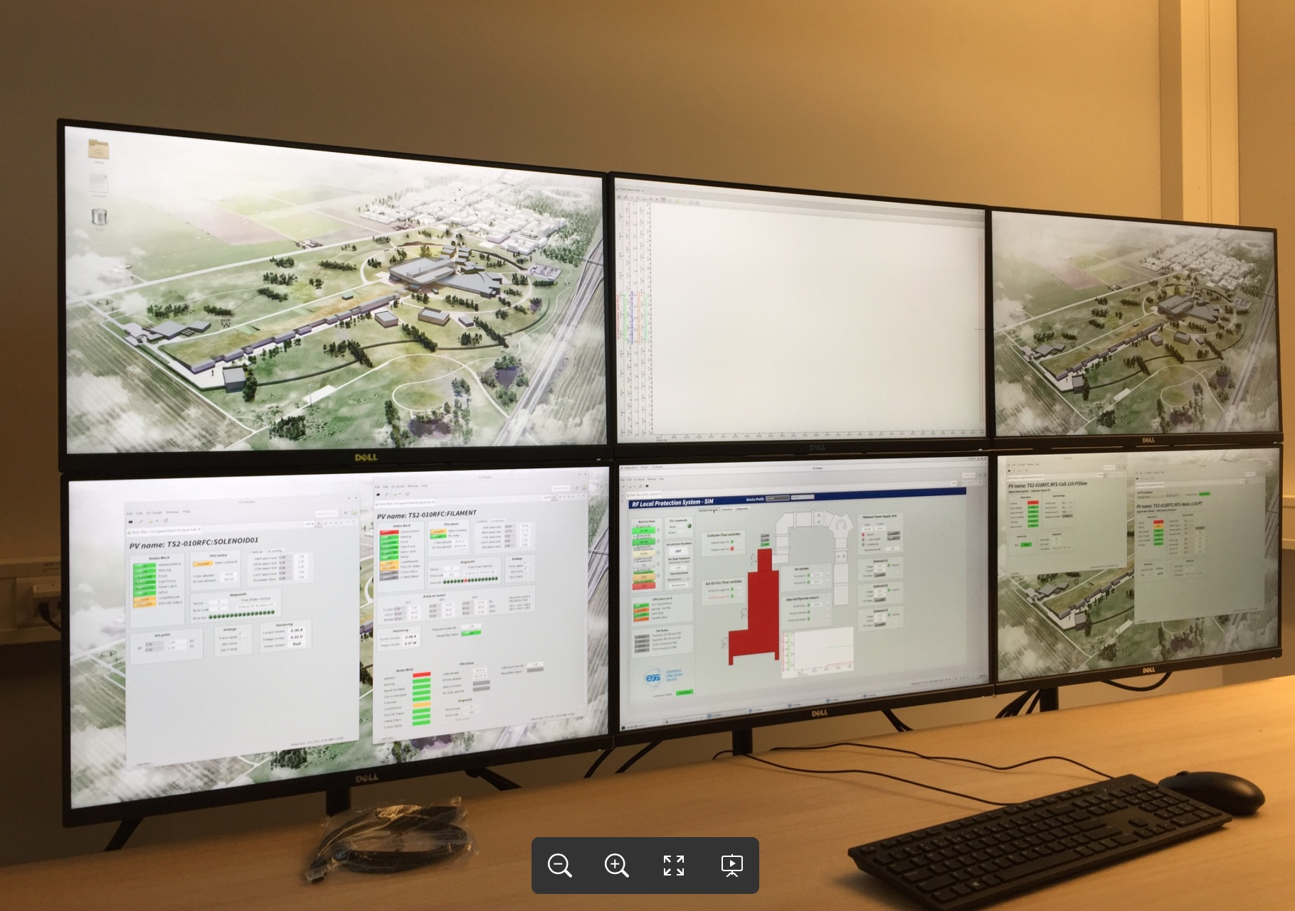
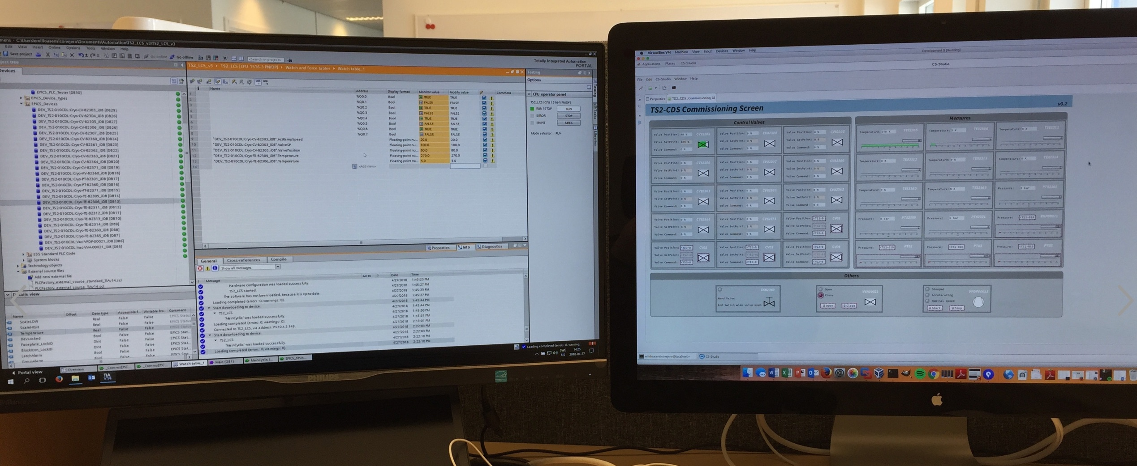
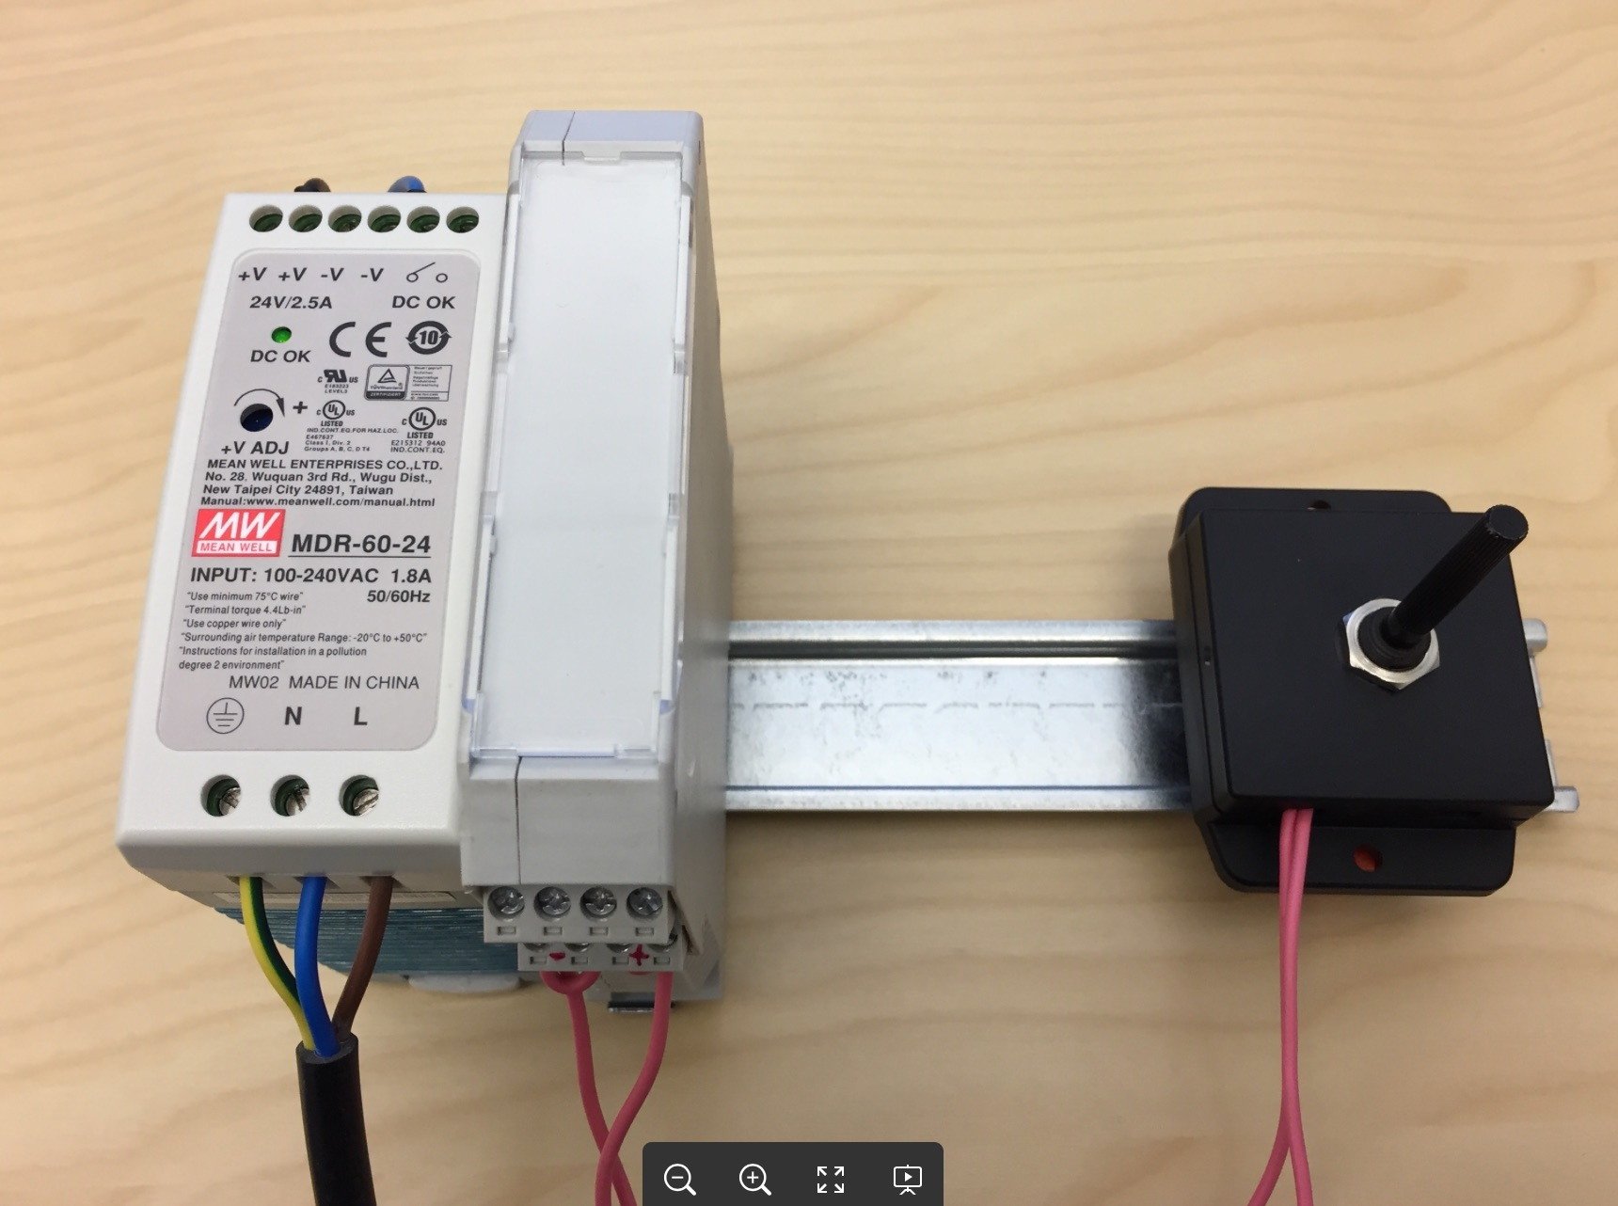
https://confluence.esss.lu.se/display/ATS/Accelerator+Cryomodule+Test+Stand+2

Slide 17
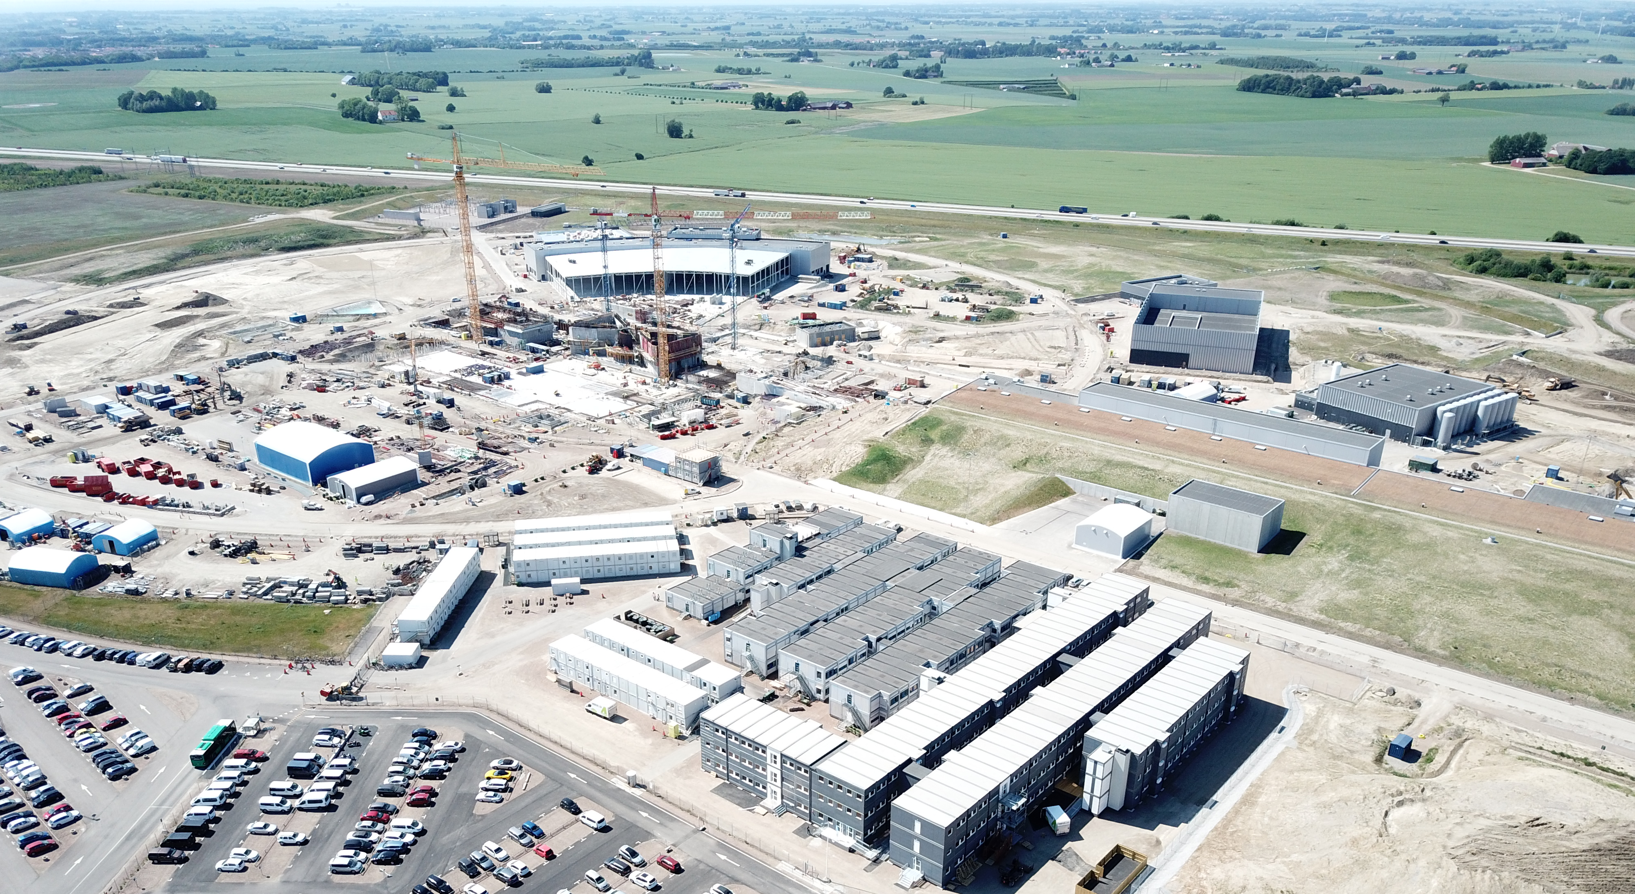
Location

Slide 18
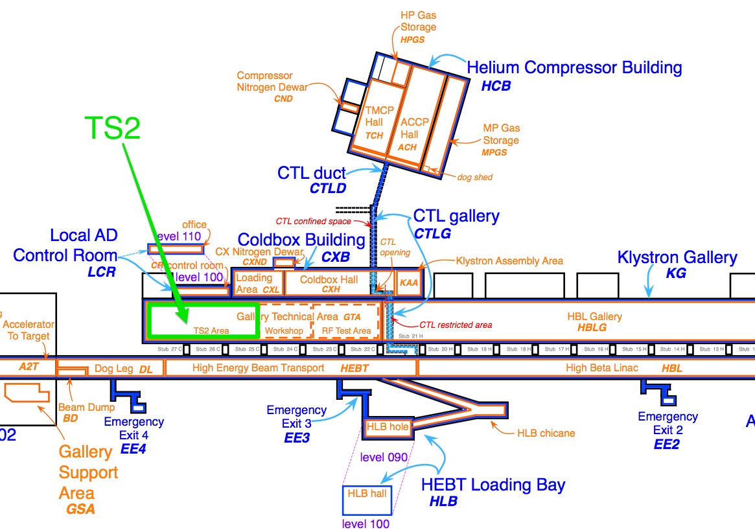
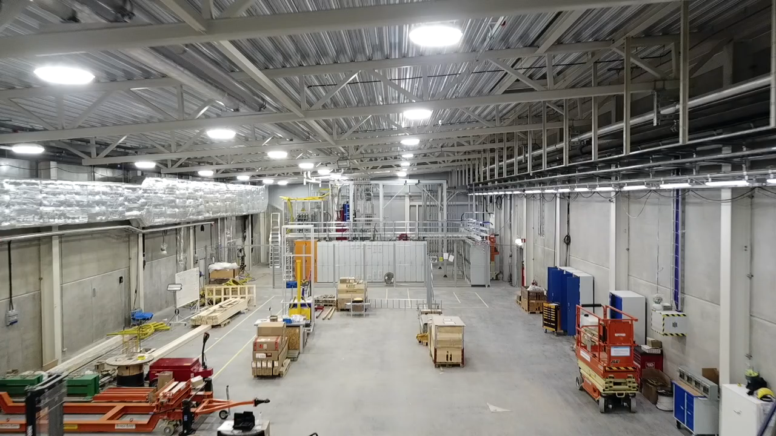
Layout (general)

Slide 19
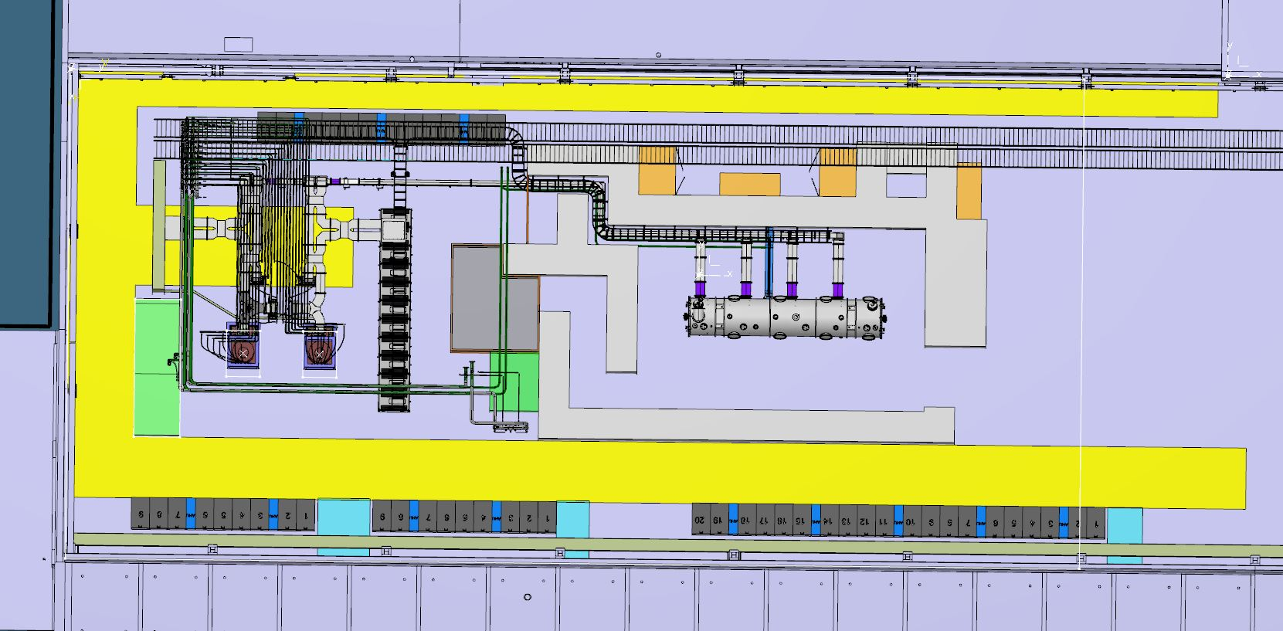
Layout (bunker and RF area)

Slide 20
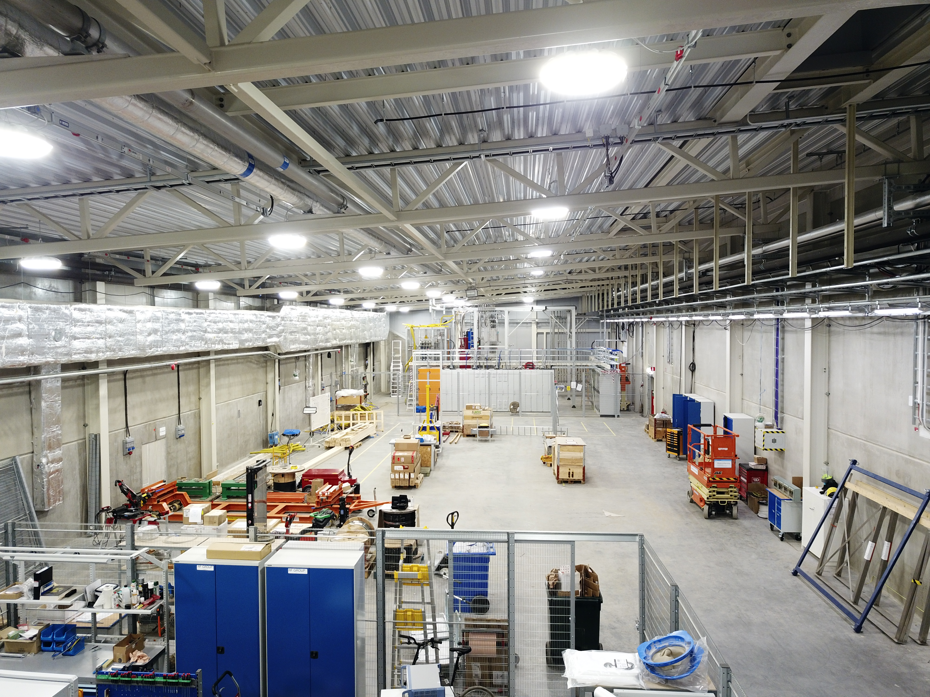
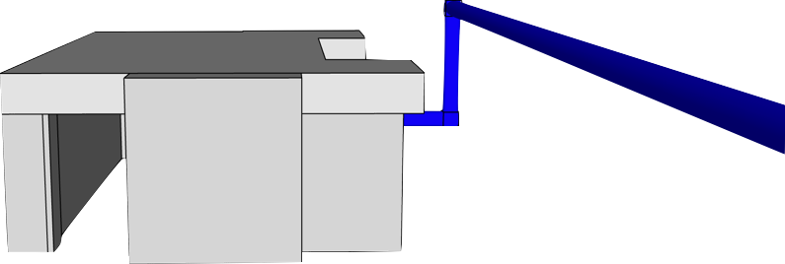
TS2 area in the Klystron Gallery

Slide 21
TS2 Installation Schedule
CF: TS2 partial access
CF: LCR partial access
CF: TS2 full access
& utilities (partly)
June 2018
WP5: TD available in Lund
WP10: bunker accessible
WP5: 1st MB CM available in Lund
2017-02-27
2017-03-31
2017-05-02
Dec. 2018
May 2019
July 2018
partial access
full access
utilities partly available
LCR partial access
LCR full access
bunker manuf.
bunker manuf.
WTF ?
bunker inst.
bunker inst.
Why That Försening ?
TD available
cold comm
1st MB CM
RF installation & commissioning outside bunker
RF inst. inside
MB CM testing
cabling
rack installation
rack inst.
cabling outside
cabling inside
TD inst
MB CM inst
TICP inst & comm
CTL inst. & comm.
CM controls design
inst. & comm.
PSS inst. & comm

Slide 22
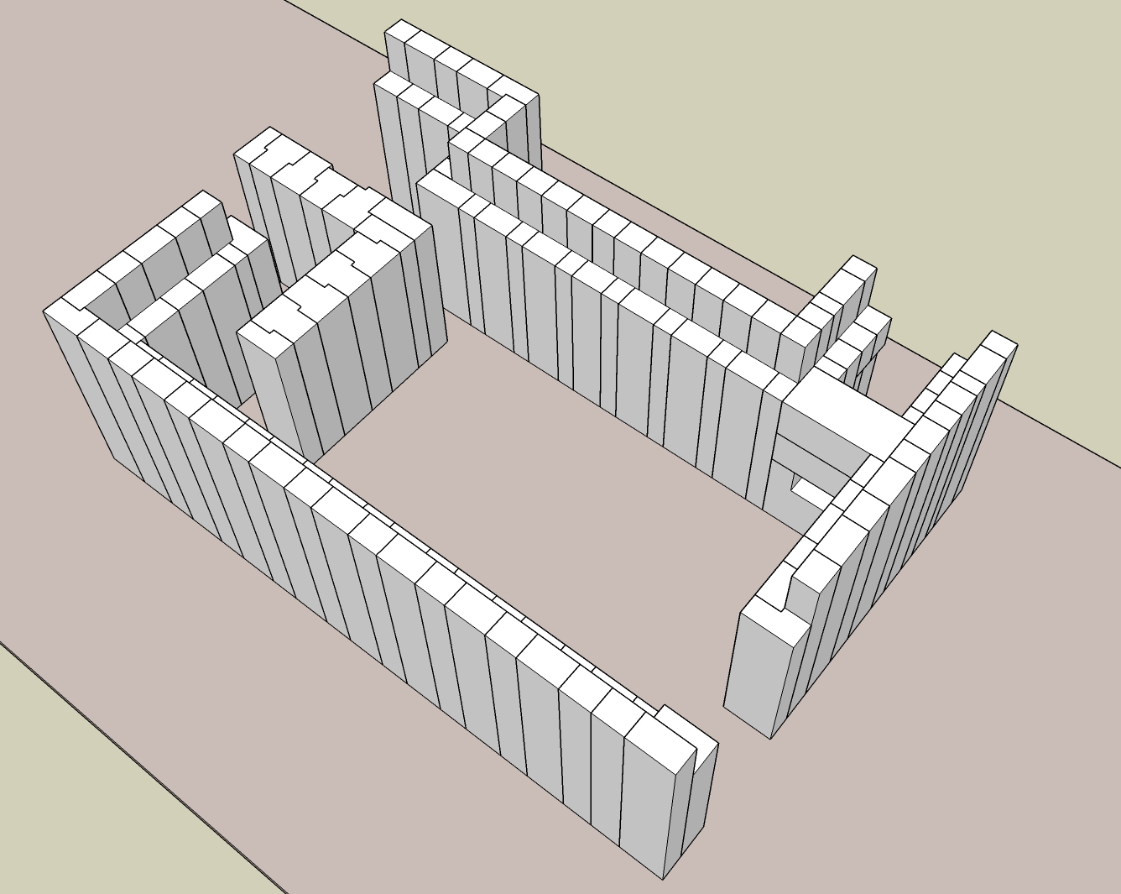

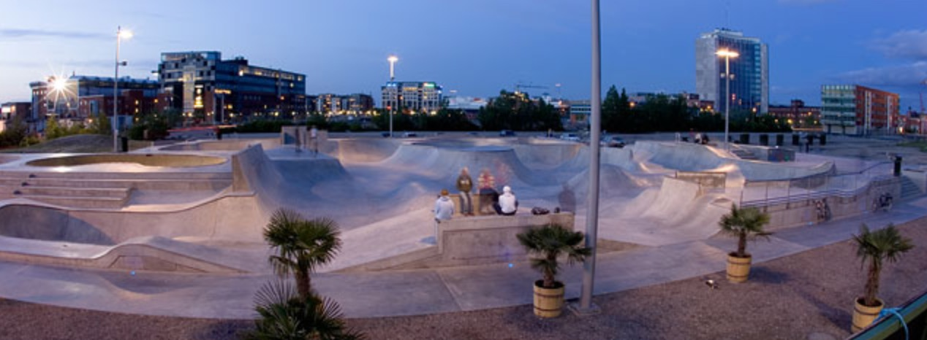

Concrete Problems
First bunker block design (by concrete experts):
complicated shapes, complicated spec
Procurement
in early 2017
1 offer (from a builder of skate parks…)

Slide 23
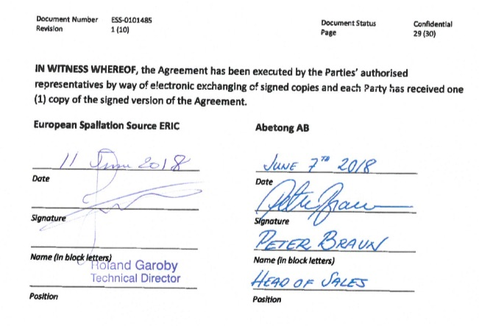
Concrete Problems
Second and third block design (by myself):
still too complex
Fourth block design:
simple shapes, almost all cuboids, reduced requirements and simpler spec
- procurement as negotiated procedure with two invited bidders
1 offer

Slide 24
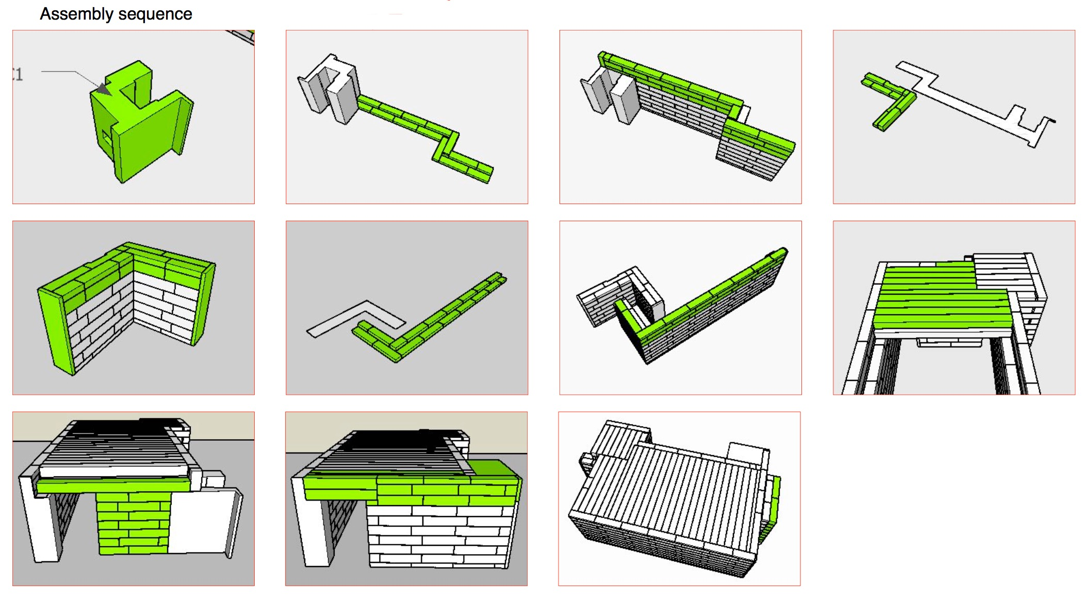
Concrete Solutions

Slide 25
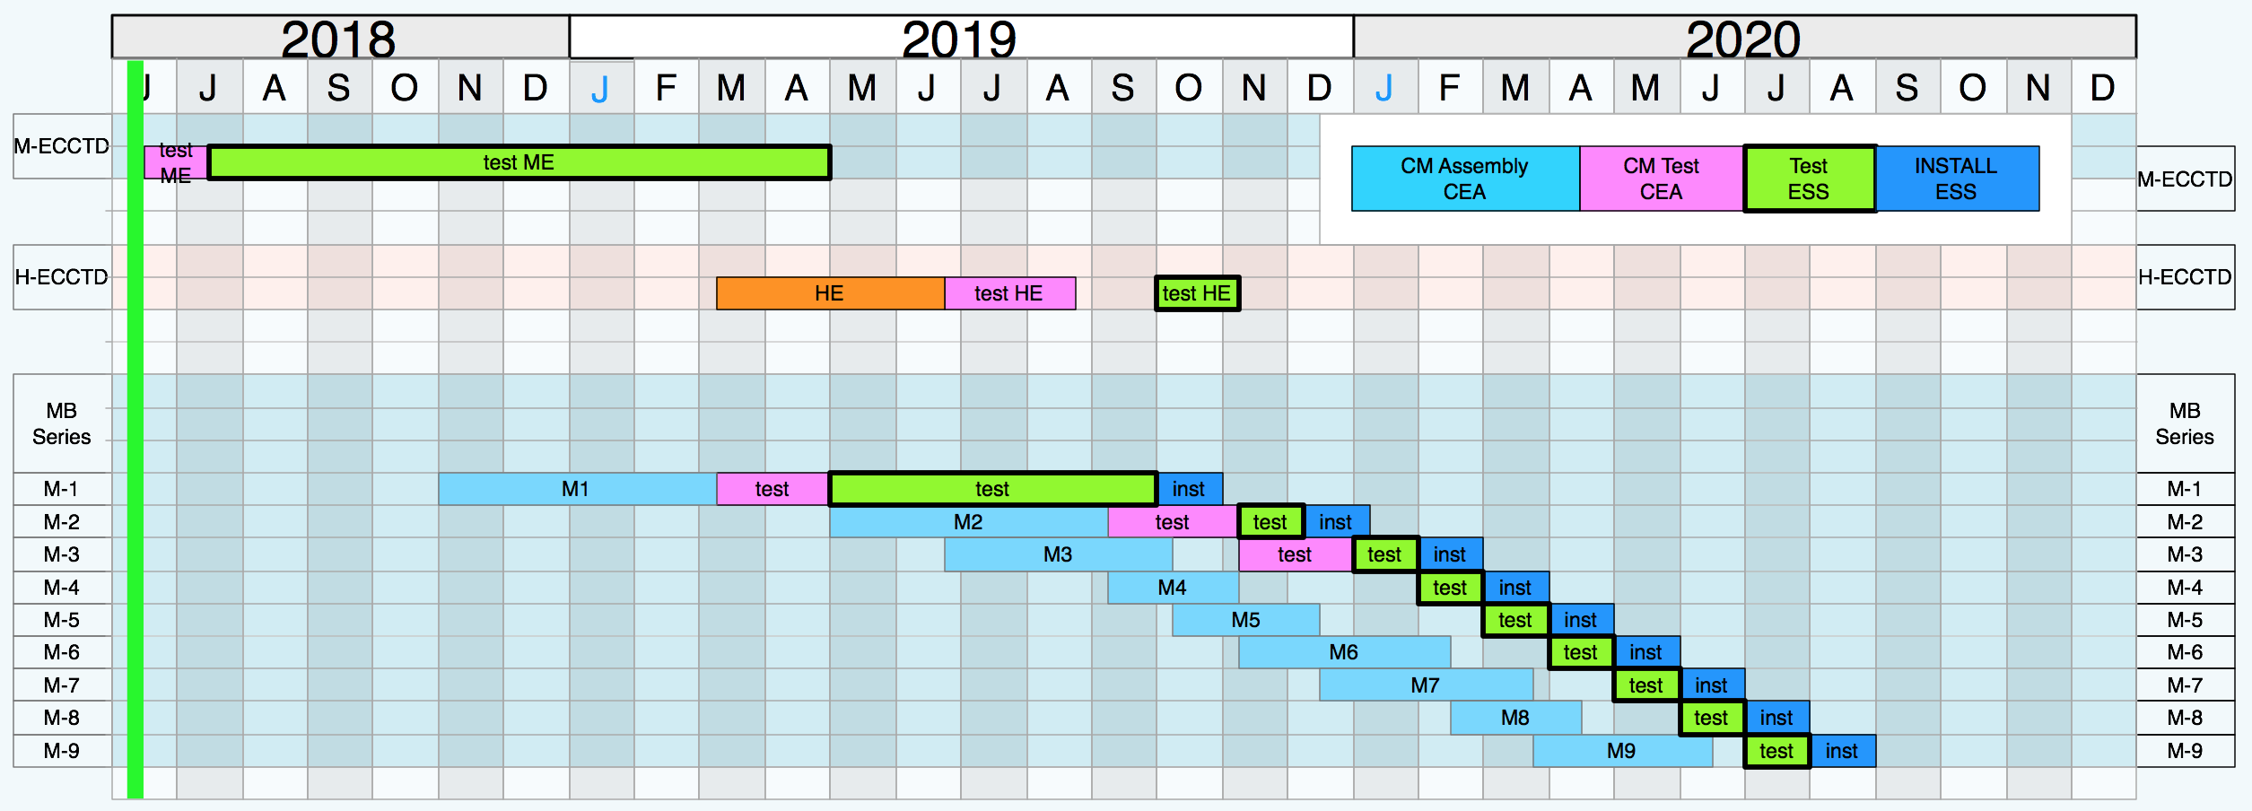
Schedule (from WP5, Nuno Elias)

