Slide 1
League of Advanced European Neutron Sources
Helmut Schober

Slide 2
The rationale behind LENS
Our societies are enjoying an exceptional standard of living.
This achievement is the fruit of technical progress.
Preserving this standard of living and sharing it with the rest of the globe is one of the great challenges of our times.
Responding to this challenge will require even better technology.
The technology of the future will be based on the materials developed today.
Materials research requires optimum analytical tools for their investigation.

Slide 3
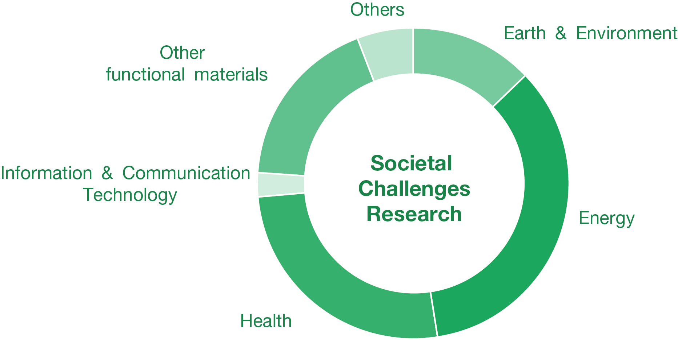
The rationale behind LENS
Neutron probes are uniquely suited to tackle many of these scientific and societal challenges:
advantageous magnetic properties
Sensitivity to light elements
possibility to investigate also big samples …..

Slide 4
Mission
Europe has achieved global leadership in the field of neutron science
Strong cooperation within the network of European facilities will help affirming this leadership
With LENS, the European neutron facilities declare their intention to set up this strong cooperation
LENS is a strategic Consortium, in order to create an even more effective eco-system of collaborating neutron sources.

Slide 5
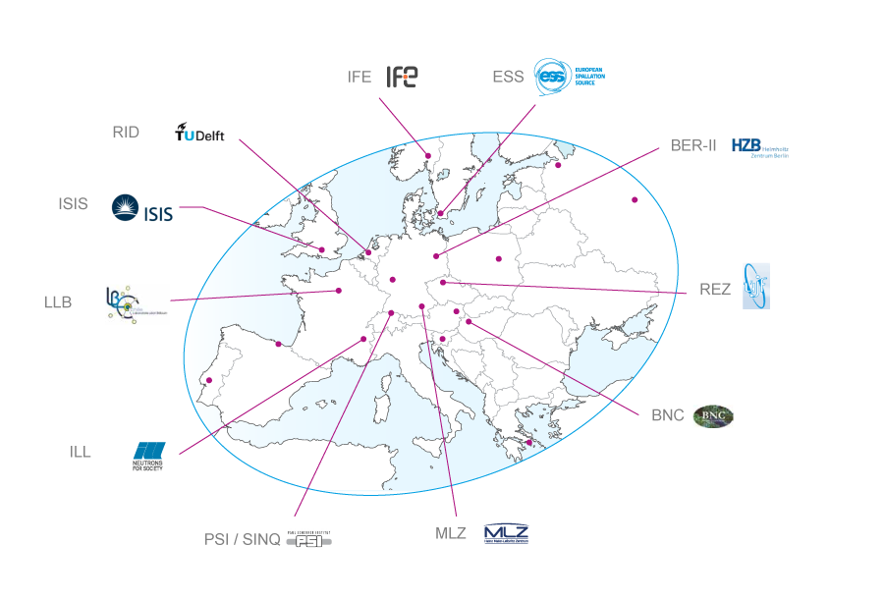
(prospective) Partners in LENS
LENS will be open to any neutron provider in Europe running an open international user programme for the majority of the beamtime provided and adhering to LENS’ principles.

Slide 6
Principles
LENS is building on the European lead in neutron science
Continuous improvement and adaptation of services to the needs of the user community by
optimization of resources
close alignment of policies among the facilities
Common representation and impact promotion
> Forming a functioning ecosystem of cooperating international and national sources
Such a coordination is a declared priority of the European Research Area and as well demanded by national funding agencies as well as user organizations

Slide 7
Specific Targets
Promotion
Outline the scientific and socio-economic impact
Coordinate the exchange with national and European organizations and stakeholders
Development strategies
Technologies
Achieve greater coherence in the development of data management along FAIR principles and the promotion of Open Science
Coordinate training activities and enhance staff qualification
Users
Join efforts in expanding existing and supporting new user communities
Coordinate access policies
Facilitate industrial access and collaboration

Slide 8
Governance
LENS is represented by its General Assembly. Statutes and rules of procedure determine the details (to be established in 1st meeting).
The General Assembly meets at least twice a year and elects by simple majority a chair and vice chair among the delegates for the period of one year.
The Chair may represent LENS with respect to third parties.
The General Assembly agrees on actions and has recourse to standing or ad-hoc working groups (composed by members of staff of LENS) for their execution.

Slide 9
Proposed working groups
WGs with overarching thematic orientation
Promotion & education (enlargement of user community, workshops)
Policy compliance (charter of access, FAIR data, open data etc.)
Synergies in technological development and operation
Industry (access schemes, cooperation models etc.)
Best management practices (efficiency increase, exchange on administrative procedures, tools etc., assessment based on key performance indicators etc.)

Slide 10
Way forward
Work in progress
Communication
website, email, printed information material, press release, logo, …
Organise signature event (agree on date, ICRI2018/Vienna?)
Set up core team to prepare statutes and rules of procedure
Discuss open questions, e.g. involvement of user organisations and other stakeholders
First meeting of general assembly
Elect chair
Establish full working governance (decide on working groups)
Decide on next actions to be pursued
Discuss financial support by facilities/EU-COM (install “secretariat”)?
Possible first outcomes/actions, e.g.
Paper on “coordinating neutron science in Europe” (goals, measures, …)
Recommendations for a sustainable landscape of neutron research

Slide 11
Thank you for your attention

