Slide 1
PLCs integration into the ICS
François Bellorini
ICS – HW&I Group
www.europeanspallationsource.se
2018-02-15

Slide 2
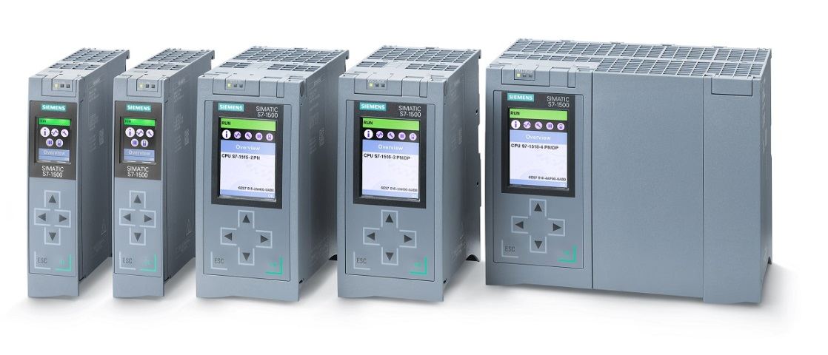
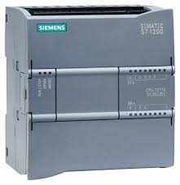
ESS standard PLC equipment
Hardware (Siemens):
Advanced controller: S7-1500
Basic controller: S7-1200.
Development Software:
SIMATIC STEP 7 Prof. V14 (SIEMENS TIA Portal).

Slide 3
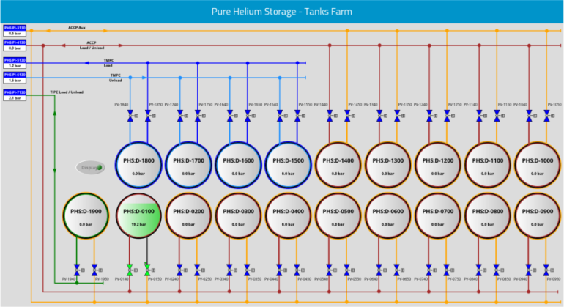
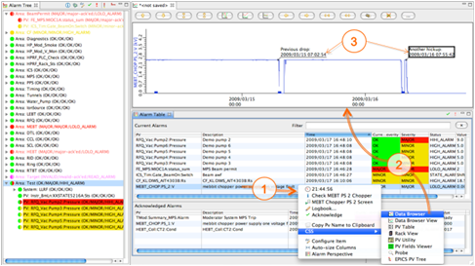
SCADA (supervisory control and data acquisition )
EPICS:
EPICS is chosen as the standard SCADA implementation for PLCs at ESS. The following EPICS components are involved
Control system studio [link]
For developing/implementing HMI
EPICS Archiver Appliance [link]
For archiving/historian functionality
BEAST [link]
For alarm handling

Slide 4
Hardware
PLC System:
Digital Inputs / Outputs
Analog Input / Outputs
Pneumatic valve panel
Freq. Converter (Drive)
…
(see ESS-0101132)
Virtualized PC
Industrial PC
EPICS for integration of PLC systems into the ICS will run on PC-class machines
Many of these EPICS instances will be run on virtual machines in the ICS control system data center
Field Devices
(Sensors & Actuators)

Slide 5
Software
PLC-project_1.ap14
EPICS IOC
HMI
Alarms
PLC-project_2.ap14
EPICS IOC
The EPICS implementation is a highly distributed control system. Many (hundreds) of EPICS IOC (Input/Output Controller) will be running to control different subsystems in the facility
The archiving function will be centralized
HMI
Alarms
Archive

Slide 6
Data Exchange
PLCproject.ap14
IOC
Data exchange depends on:
The EPICS driver (s7plc, Modbus TCP, s7nodave).
The communication supported by the PLC.
Standard ICS configuration:
Modbus TCP: from IOC to PLC (EPICtoPLC.db).
s7plc: from PLC to IOC (PLCtoEPICS.db).

Slide 7
PLC Integration workflow
Name
CCDB
IOC Factory
The PLC integration workflow is automated to some degree
The workflow relies on ICS software components
Naming service
Controls Configuration Database
IOC Factory

Slide 8
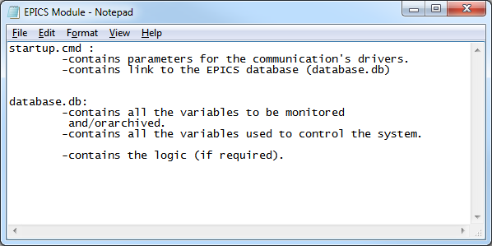
PLC Integration workflow
Configuration from CCDB
IOC Factory
IOC Factory automatically creates a startup script from information in the CCDB for the EPICS IOC containing variables to interact with the PLC
PLC variables are accessed via the IOC for control, display and archiving (SCADA)

Slide 9
PLC Factory
ICS is using the PLC Factory tool [link]
What is PLC Factory?
PLC Factory is a python script that consumes pre-defined properties of devices registered in CCDB to generate files according to templates.
PLC Factory is always used together with CCDB.
What does ICS do with PLC Factory?
The main purpose of PLC Factory is to provide matching variables between PLC and EPICS database (using templates and a small PLC code library) from a single definition file.
It generates matching files used by the IOC and by the PLC software.
[See also G. Ulm ICALEPCS2017: ttp://icalepcs2017.vrws.de/papers/tupha046.pdf]

Slide 10
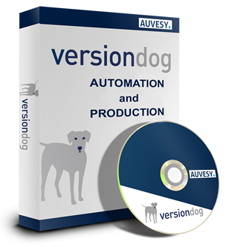
Data management
Versioning and configuration management of PLC projects is managed with versiondog
versiondog is a commercial software package deployed and managed by ICS
Versioning of EPICS modules is managed with Bitbucket and IOC Factory.

Slide 11
Thank you for your attention.

